Slide 1
Statistics and Data Analysis
Professor William Greene
Stern School of Business
IOMS Department
Department of Economics

Slide 2
Statistics and Data Analysis
Part 9 – The Normal
Distribution

Slide 3
The Normal Distribution
Continuous Distributions are models
  Application – The Exponential Model
  Computing Probabilities for Continuous Variables
Normal Distribution Model
  Normal Probabilities
  Reading the Normal Table and Computing Probabilities
Applications

Slide 4
The Normal Distribution
The most useful distribution in all branches of statistics and econometrics.
Strikingly accurate model for elements of human behavior and interaction
Strikingly accurate model for any random outcome that comes about as a sum of small influences.

Slide 5
Applications
Biological measurements of all sorts (not just human mental and physical)
Accumulated errors in experiments
Numbers of events accumulated in time
  Amount of rainfall per interval
  Number of stock orders per (longer) interval. (We used the Poisson for short intervals)
  Economic aggregates of small terms.
And on and on…..

Slide 6
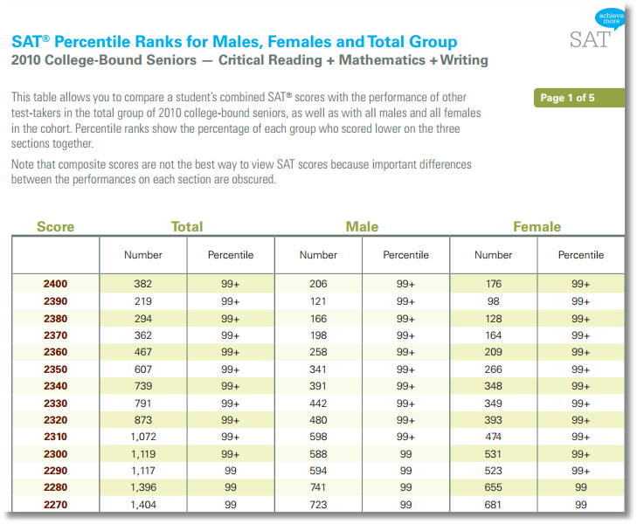
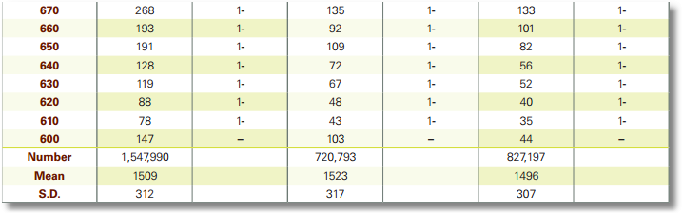
This is a frequency count of the 1,547,990 scores for students who took the SAT test in 2010.
• • •

Slide 7
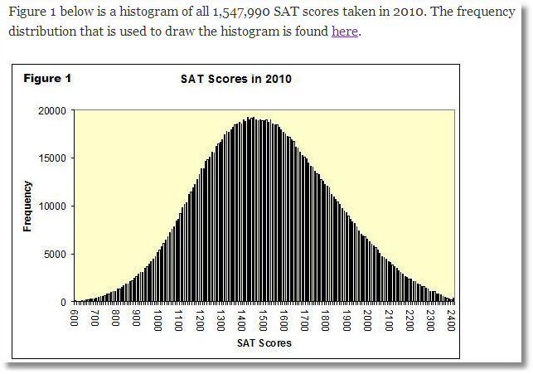
The histogram has 181 bars. SAT scores are 600, 610, …, 2390, 2400.

Slide 8
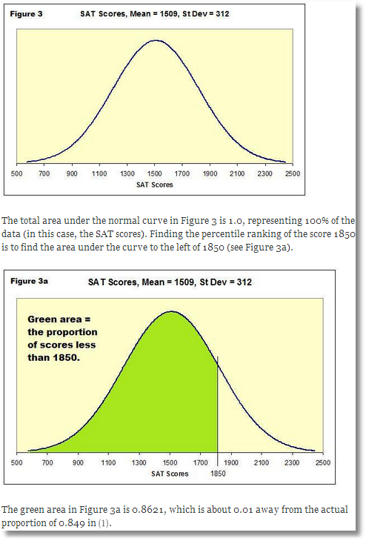

Slide 9
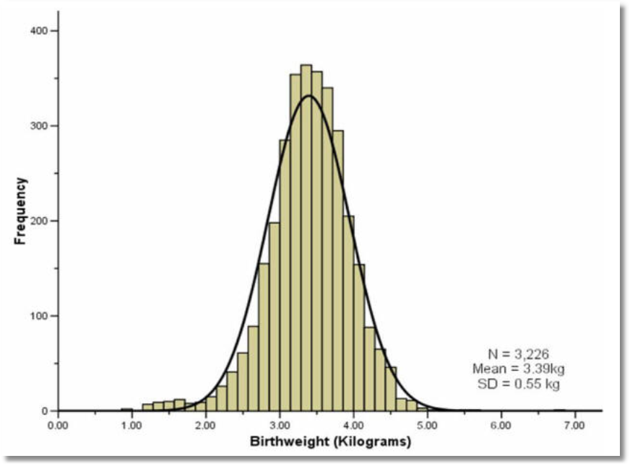
Distribution of 3,226 Birthweights
Mean = 3.39kg, Std.Dev.=0.55kg

Slide 10
Continuous Distributions
Continuous distributions are models for probabilities of events associated with measurements rather than counts.
Continuous distributions do not occur in nature the way that discrete counting rules (e.g., binomial) do.
The random variable is a measurement, X
The device is a probability density function, f(x).
Probabilities are computed using calculus (and computers)

Slide 11
Application: Light Bulb Lifetimes
A box of light bulbs states
“Average life is 1500 hours”
P[Fails at exactly 1500 hours] is 0.0. Note, this is exactly 1500.000000000…, not 1500.0000000001, …
P[Fails in an interval (1000 to 2000)] is provided by the model (as we now develop).
The model being used is called the exponential model

Slide 12
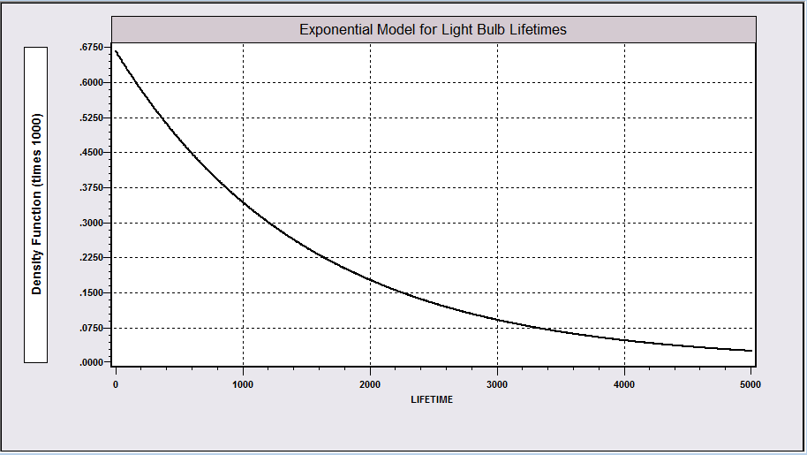
Model for Light Bulb Lifetimes
This is the exponential model for lifetimes.
The function is the exponential density.

Slide 13
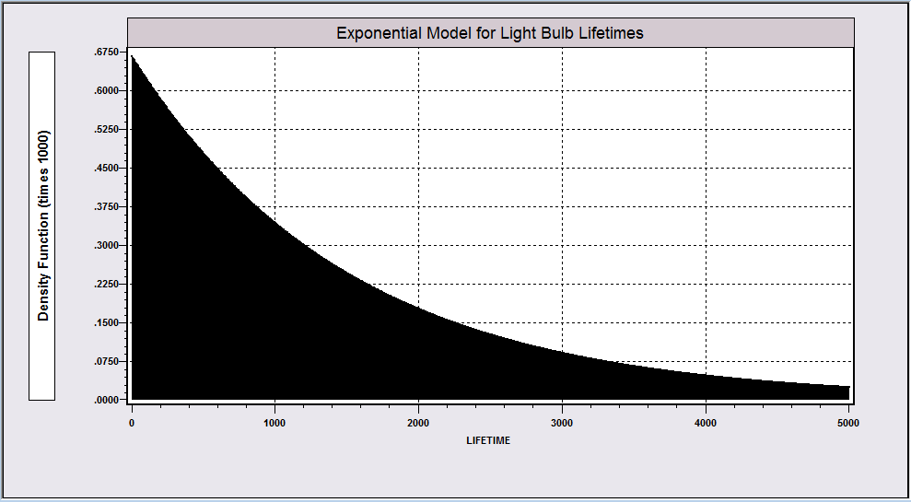
Using the Model for Light Bulb Lifetimes
The area under the entire curve is 1.0.

Slide 14
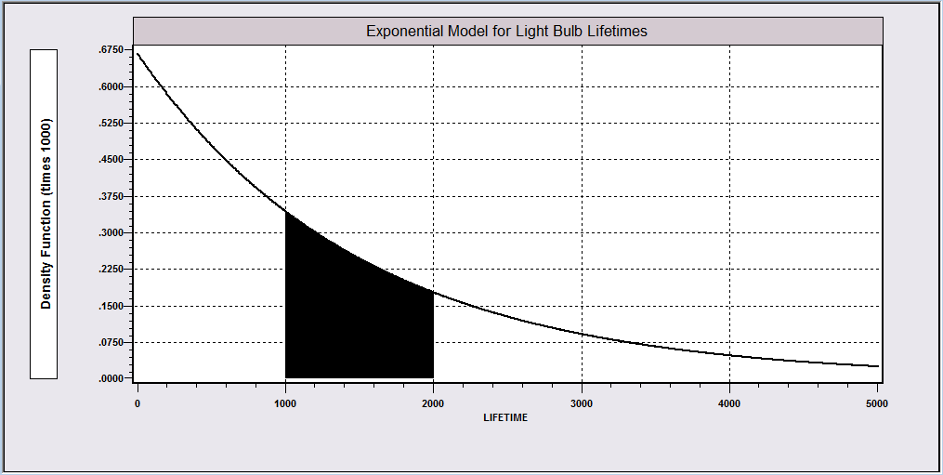
A Continuous Distribution
The probability associated with an interval such as 1000 < LIFETIME < 2000 equals
the area under the curve from the lower limit to the upper. Requires calculus.
A partial area will be between 0.0 and 1.0, and will produce a probability. (here, 0.2498)

Slide 15
The Probability of a Single Value Is Zero
The probability associated with a single point, such as LIFETIME=2000, equals 0.0.

Slide 16
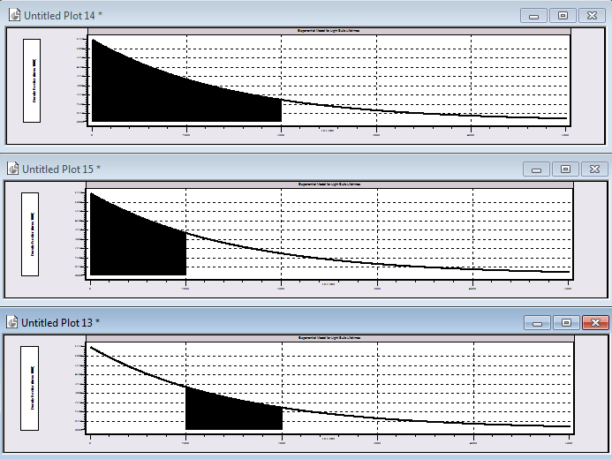
Probability for a Range of Values
Prob(Life < 2000) (.7364)
Minus
Prob(Life < 1000) (.4866)
Equals
Prob(1000 < Life < 2000) (.2498)
The probability associated with an interval such as 1000 < LIFETIME < 2000 is obtained by computing the
entire area to the left of the upper point (2000) and subtracting the area to the left of the lower point (1000).

Slide 17
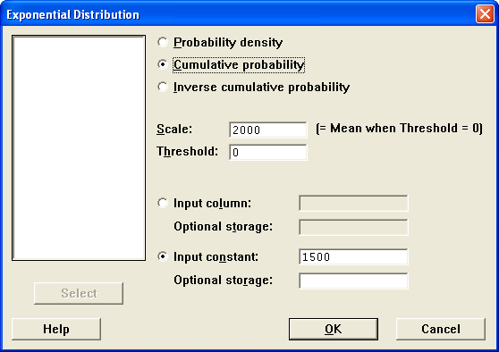
Computing a Probability with Minitab
Minitab cannot compute the probability in a range, only from zero to a value.

Slide 18
Applications of the Exponential Model
  Time between signals arriving at a switch (telephone, message center, email server, paging switch…) (This is called the “interarrival time.”)
  Length of survival of transplant patients. (Survival time)
  Lengths of spells of unemployment
  Time until failure of electronic components
  Time until consumers use a product warranty
  Lifetimes of light bulbs

Slide 19

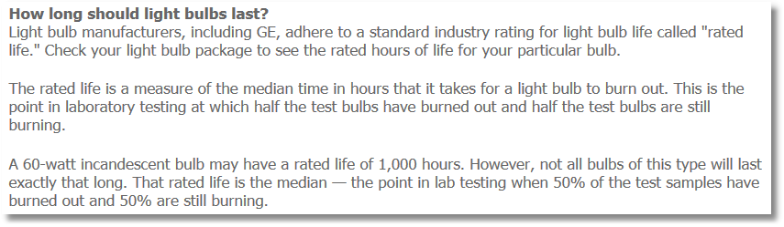
Lightbulb Lifetimes
http://www.gelighting.com...

Slide 20
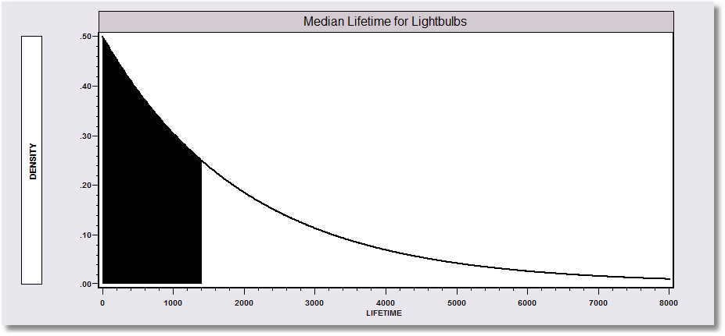
Median Lifetime
Prob(Lifetime < Median) = 0.5

Slide 21
The Normal Distribution
Normal Distribution Model
Normal Probabilities
Reading the Normal Table
Computing Normal Probabilities
Applications

Slide 22
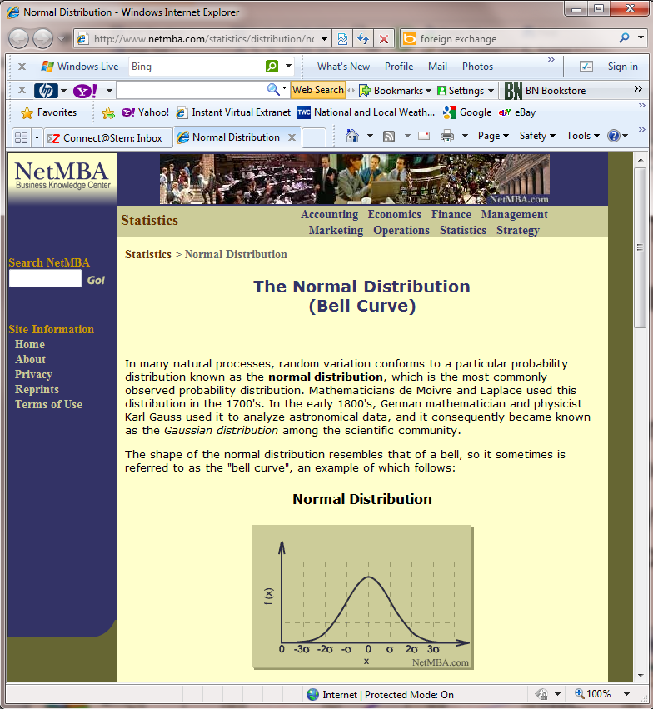
Try a visit to http://www.netmba.com/statistics/distribution/normal/

Slide 23
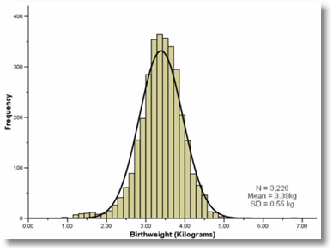
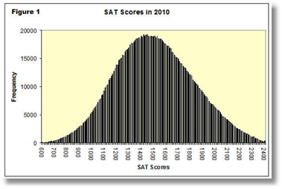
Shape and Placement Depend on the Application

Slide 24
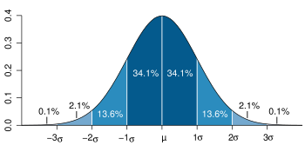
The Empirical Rule and the Normal Distribution
Dark blue is less than one standard deviation from the mean. For the normal distribution, this accounts for about 68% of the set (dark blue) while two standard deviations from the mean (medium and dark blue) account for about 95% and three standard deviations (light, medium, and dark blue) account for about 99.7%.

Slide 25
Computing Probabilities
P[X = a specific value] = 0. (Always)
P[a < X < b] = P[X < b] – P[X < a]
(Note, for continuous distributions,
< and < are the same because of the first point above.)

Slide 26
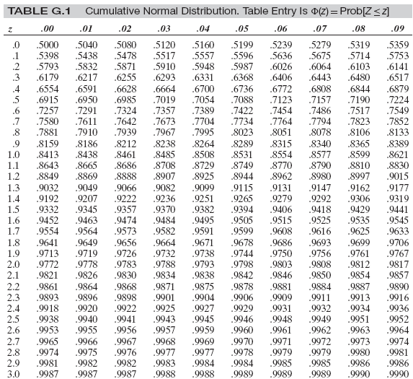
Textbooks Provide Tables of Areas for the Standard Normal
Econometric Analysis, WHG, 2012, Appendix G
Note that values are only given for z ranging from 0.00 to 3.99. No values are given for negative z.
There is no simple formula for computing areas under the normal density (curve) as there is for the exponential. It is done using computers and approximations.

Slide 27
Computing Probabilities
Standard Normal Tables give probabilities when μ = 0 and σ = 1.
For other cases, do we need another table?
Probabilities for other cases are obtained by “standardizing.”
  Standardized variable is Z = (X – μ)/ σ
  Z has mean 0 and standard deviation 1

Slide 28
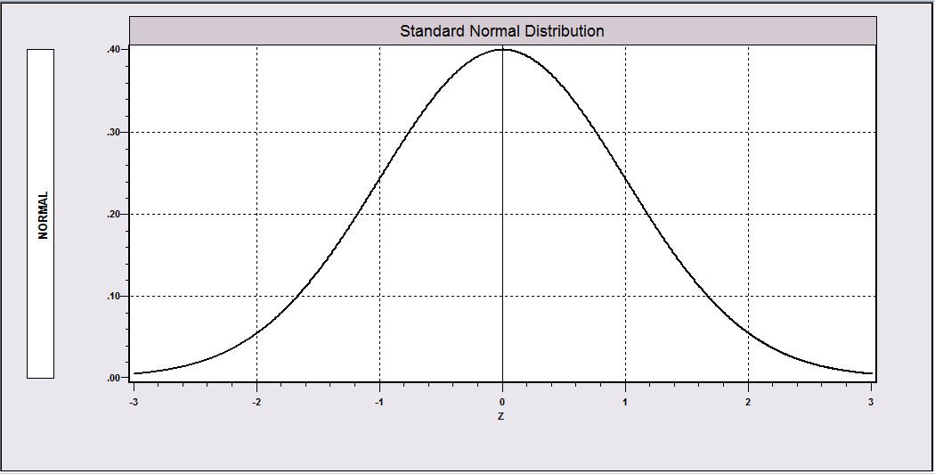
Standard Normal Density

Slide 29
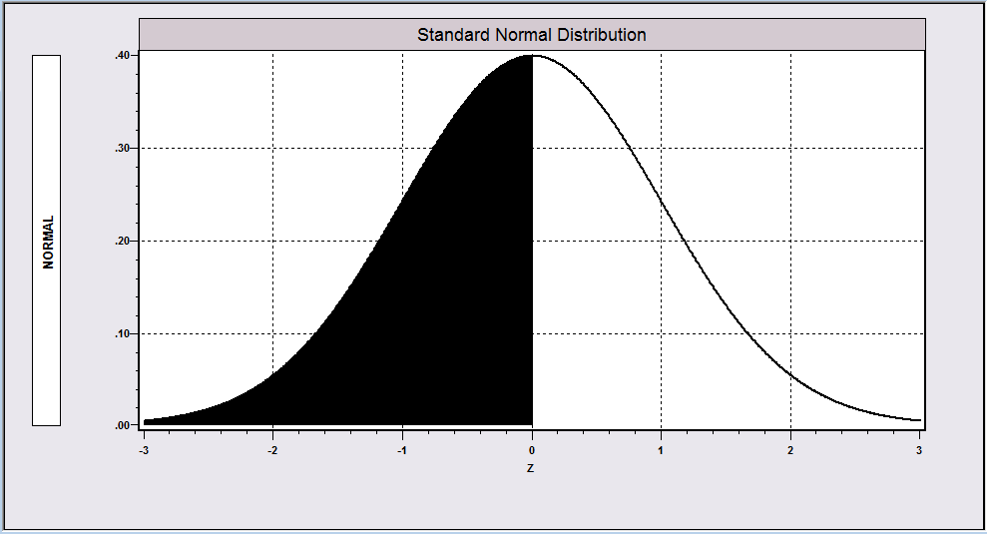
Only Half of the Table Is Needed
The area to left of 0.0 is exactly 0.5.

Slide 30
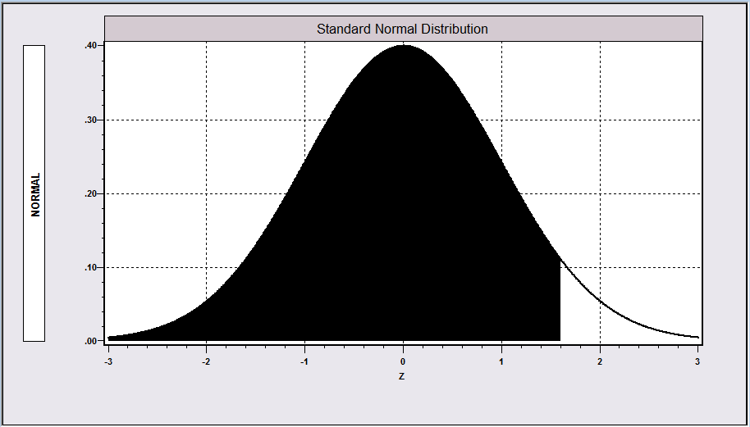
Only Half of the Table Is Needed
The area left of 1.60 is exactly 0.5 plus the area between 0.0 and 1.60.

Slide 31
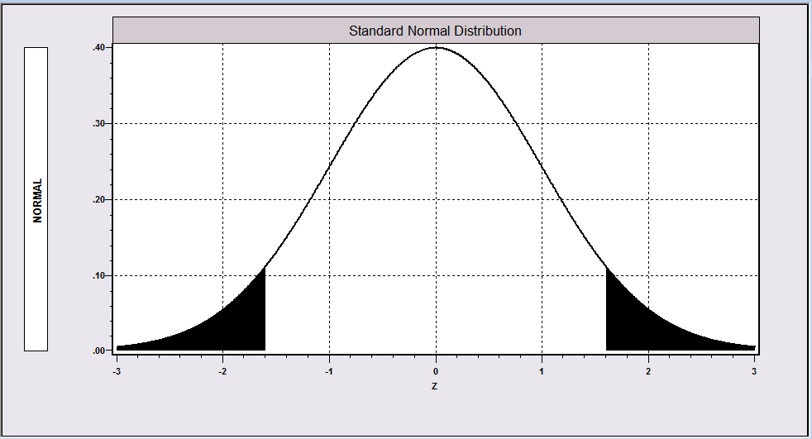
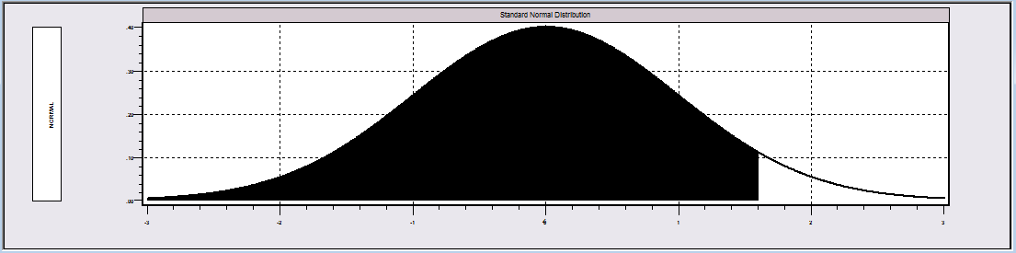
Areas Left of Negative Z
Area left of -1.6 equals area right of +1.6.
Area right of +1.6 equals 1 – area to the left of +1.6.

Slide 32
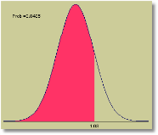
Prob(Z < 1.03) = .8485

Slide 33
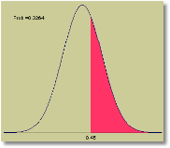
Prob(Z > 0.45) = 1 - .6736

Slide 34
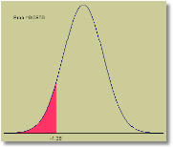
Prob(Z < -1.36) = Prob(Z > +1.36)
= 1 - .9131
= .0869

Slide 35
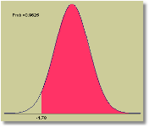
Prob(Z > -1.78) = Prob(Z < + 1.78)
= .9625

Slide 36
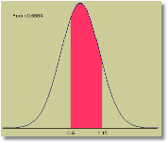
Prob(-.5 < Z < 1.15) = Prob(Z < 1.15)
- Prob(Z < -.5)
= .8749 – (1 - .6915) = .5664

Slide 37
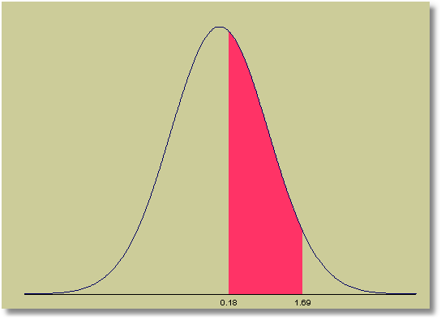
Prob(.18 < Z < 1.67) = Prob(Z< 1.67)
- Prob(Z < 0.18)
= .9525 –5714 = .3811

Slide 38
Normal Distributions
The scale and location (on the horizontal axis) depend on μ and σ. The shape of the distribution is always the same. (Bell curve)

Slide 39
Computing Normal Probabilities when μ is not 0 and σ is not 1

Slide 40
Some Benchmark Values
(You should remember these.)
Prob(Z > 1.96) = .025
Prob(|Z| > 1.96) = .05
Prob(|Z| > 2) ~ .05
Prob(Z < 1) = .8413
Prob(Z > 1) = .1587

Slide 41
Computing Probabilities by Standardizing: Example

Slide 42
Computing Normal Probabilities
If SAT scores were scaled to have a normal distribution with mean 1500 and standard deviation of 300, what proportion of students would be expected to score between 1350 and 1800?

Slide 43
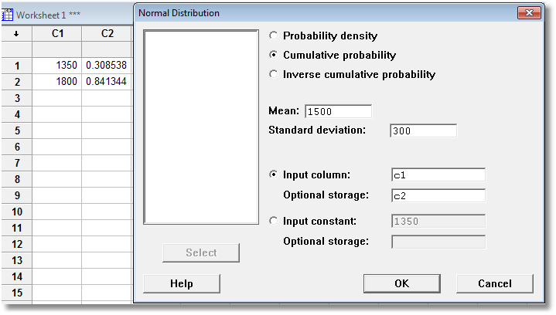
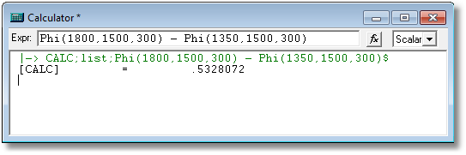
Modern Computer Programs Make the Tables Unnecessary
Now calculate
0.841344 – 0.308538 = 0.532806
Not Minitab

Slide 44
Application of
Normal Probabilities
Suppose that an automobile muffler is designed so that its lifetime (in months) is approximately normally distributed with mean 26.4 months and standard deviation 3.8 months. The manufacturer has decided to use a marketing strategy in which the muffler is covered by warranty for 18 months. Approximately what proportion of the mufflers will fail the warranty?
Note the correspondence between the probability that a single muffler will die before 18 months and the proportion of the whole population of mufflers that will die before 18 months. We treat these two notions as equivalent. Then, letting X denote the random lifetime of a muffler,
P[ X < 18 ] = p[(X-26.4)/3.8 < (18-26.4)/3.8]
≈ P[ Z < -2.21 ]
= P[ Z > +2.21 ]
= 1 - P[ Z ≤ 2.21 ]
= 1 - 0.9864
= 0.0136 (You could get here directly using Minitab.)
From the manufacturer’s point of view, there is not much risk in this warranty.

Slide 45
A Normal Probability Problem
The amount of cash demanded in a bank each day is normally distributed with mean $10M (million) and standard deviation $3.5M. If they keep $15M on hand, what is the probability that they will run out of money for the customers? Let $X = the demand. The question asks for the Probability that $X will exceed $15M.

Slide 46
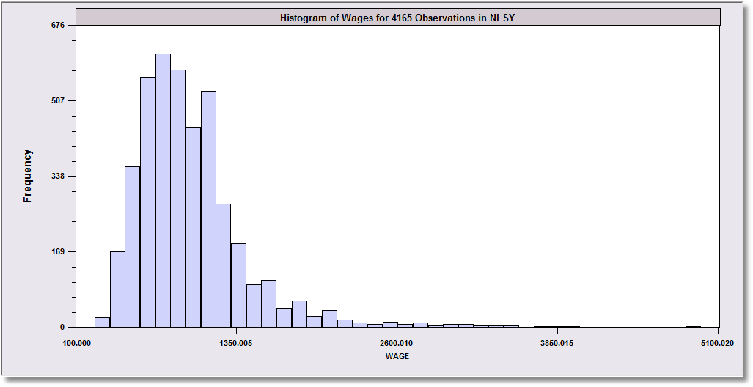
‘Nonnormality’ comes in two forms in observed data
Skewness: Size variables such as Assets or Sales of businesses, or income/wealth of individuals.
Kurtosis: Essentially ‘thick tails.’ Seemingly outlying observations are more common than would be expected from a normal distribution. Financial data such as exchange rates sometimes behave this way.

Slide 47
Summary
Continuous Distributions
  Models of reality
  The density function
  Computing probabilities as differences of cumulative probabilities
  Application to light bulb lifetimes
Normal Distribution
  Background
  Density function depends on μ and σ
  The empirical rule
  Standard normal distribution
  Computing normal probabilities with tables and tools

