Slide 1
Statistics and Data Analysis
Professor William Greene
Stern School of Business
IOMS Department
Department of Economics

Slide 2
Statistics and Data Analysis
Part 8 – The Poisson
Distribution

Slide 3
The Poisson Model
The Poisson distribution
  Distribution for counts of occurrences such as accidents, incidence of disease, arrivals of ‘events’
  Model – useful description of probabilities, not an exact statement of them.

Slide 4
Models
Settings in which the probabilities can only be approximated
  Counting events such as gambling admit exact statements of probabilities
  Processes in nature, such as how many people per 1000 observed have a disease, can only be modeled with some accuracy.
Models “describe” reality but don’t match it exactly
  Assumptions are descriptive

Slide 5
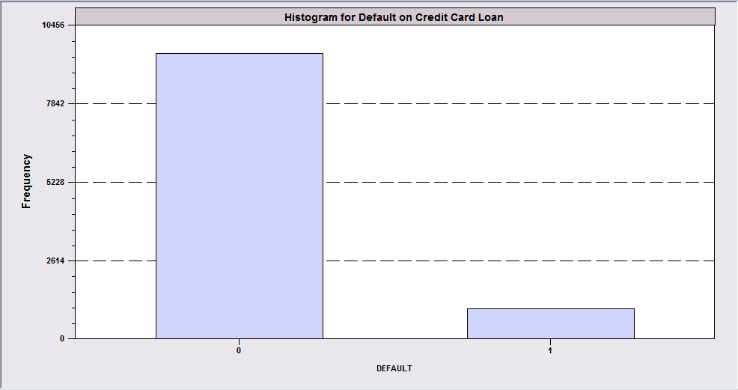
Start with a Bernoulli Random Variable
X = 0 or 1
Probabilities: P(X = 1) = θ
P(X = 0) = 1 – θ
(X = 0 or 1 corresponds to an event occurring or not occurring)

Slide 6
Counting Rules
If trials are independent, with constant success probability θ, then Bernoulli and binomial distributions give the exact probabilities of the outcomes.
  They are counting rules.
  The “assumptions” are met in reality.

Slide 7
Counting Events in Time and Space
Many common settings isolated in space or time
Events happen within fixed intervals or fixed spaces, one at a time.
  E.g., in one second intervals, email or phone messages arrive at a switch
  E.g., in square kilometers or groups of specific sizes, individuals have a particular disease.
Examples
  Phone calls that arrive at a switch per second.
  Customers that arrive at a service point per minute
  Number of accidents per month at a given location
  Number of buy orders per minute for a certain stock
  Number of individuals who have a disease in a large population
  Number of plants of a given species per square kilometer
  Number of derogatory reports in a credit history
In principle, X, the number of occurrences, could be huge (essentially unlimited)

Slide 8
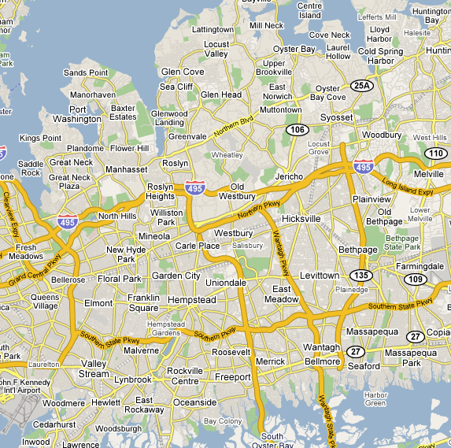
Disease Incidence
How many people per 1,000 in Nassau County have diabetes? The rate is about 7 per 1,000. If tracts have 1,000 people in them, then the expected number of occurrences per tract is 7 cases. The distribution of the number of cases in a given tract should be Poisson with λ = 7.0.

Slide 9
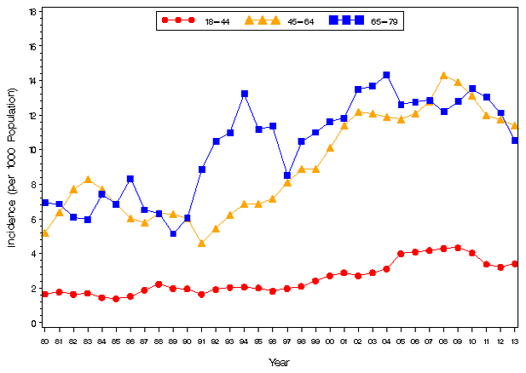
Diabetes Incidence Per 1000
http://www.cdc.gov/diabetes/statistics/incidence/fig3.htm

Slide 10
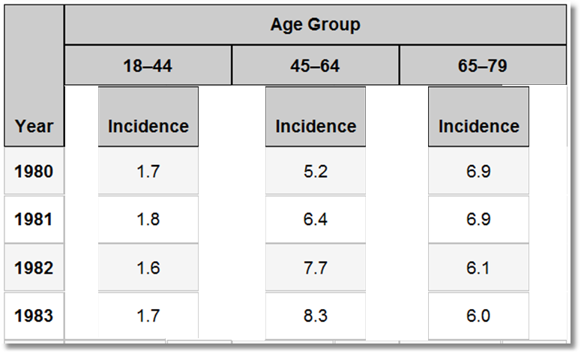
A Poisson ‘Regression:’ The mean depends on age and year.
E[Cases(per 1000) | Age,Year] = a function of Age and Year.

Slide 11

Doctor visits in the last year by people in a sample of 27,326: A Poisson Process
Notes:
11

Slide 12
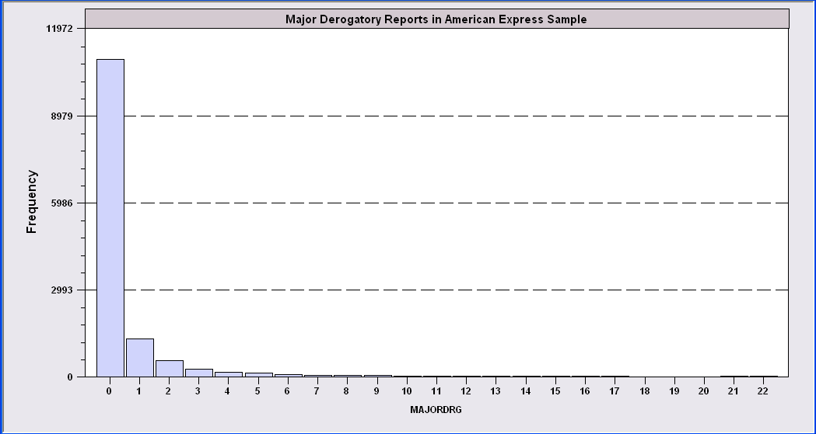
Application: Major Derogatory Reports in Credit Application Files
AmEx Credit Card Holders
N = 13,777
Number of major derogatory reports in 1 year
Notes:
12

Slide 13

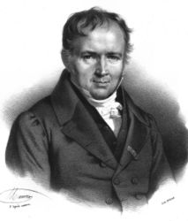
Poisson Model for Counts of Events
poisson
Poisson
(Siméon Denis, Fr. 1781-1840 )

Slide 14
Poisson Model
The Poisson distribution is a model that fits situations such as these very well.
e is the base of the natural logarithms, approximately equal to 2.7183.
e^{something} is often written as the exponential function, exp(something)

Slide 15
Poisson Variable
X is the random variable
λ is the mean of x
is the standard deviation
The figure shows P[X=x] for a Poisson variable with λ = 4.

Slide 16
Poisson Distribution of Disease: Cases in 1000 Draws with Mean 7

Slide 17
Doctor visits by people in a sample of 27,326. Mean Equals About 0.7
Notes:
17

Slide 18
V2 Rocket Hits
16/28
Adapted from Richard Isaac, The Pleasures of Probability, Springer Verlag, 1995, pp. 99-101.
576 0.25Km² areas of South London in a grid (24 by 24)
535 rockets were fired randomly into the grid = n
P(a rocket hits a particular grid area) = 1/576 = 0.001736 = θ
Expected number of rocket hits in a particular area = 535/576 = 0.92882
How many rockets will hit any particular area? 0,1,2,… could be anything up to 535.
The 0.9288 is the λ for the Poisson distribution:

Slide 19
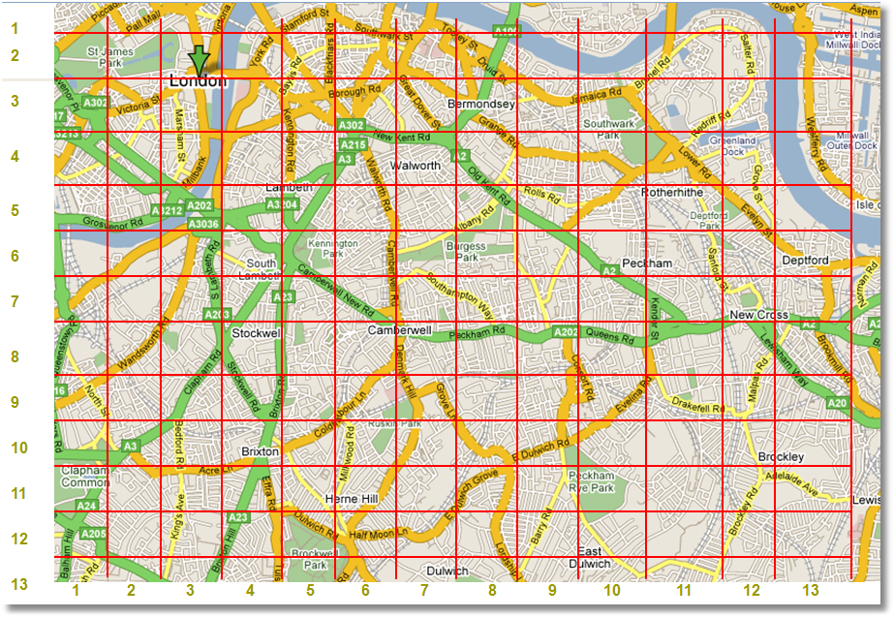

Slide 20
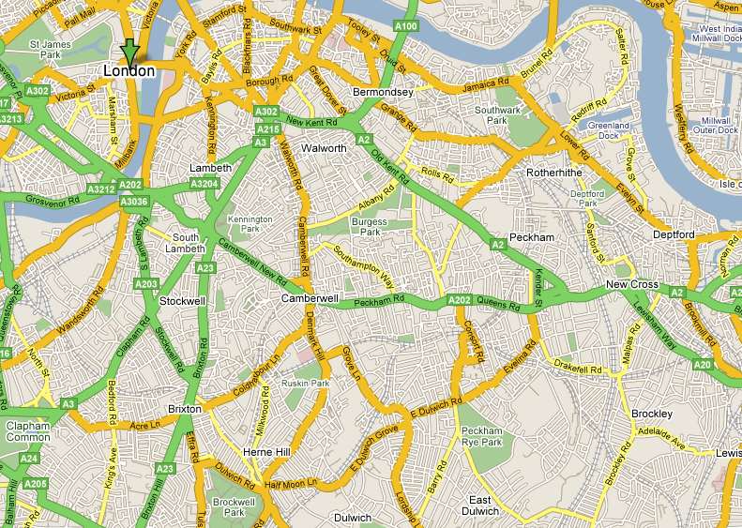
1
2
3
4
5
6
7
8
9
10
11
12
13
1 2 3 4 5 6 7 8 9 10 11 12 13

Slide 21
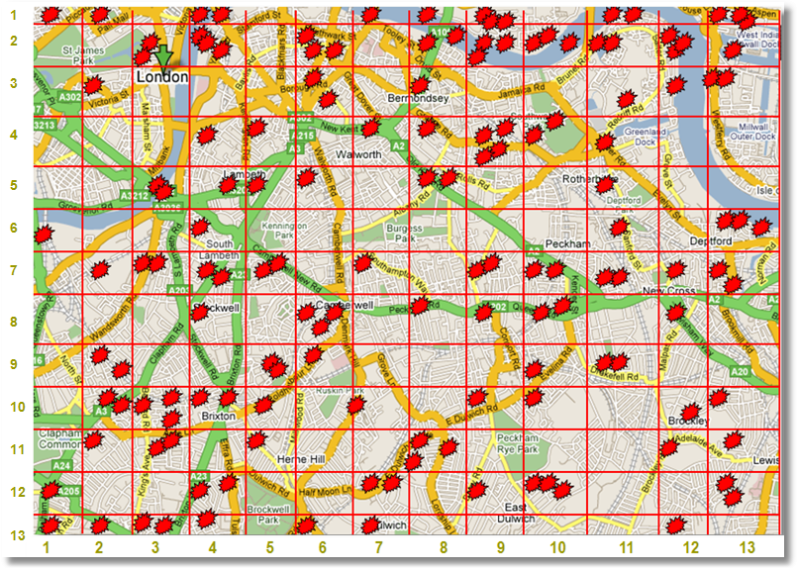

Slide 22
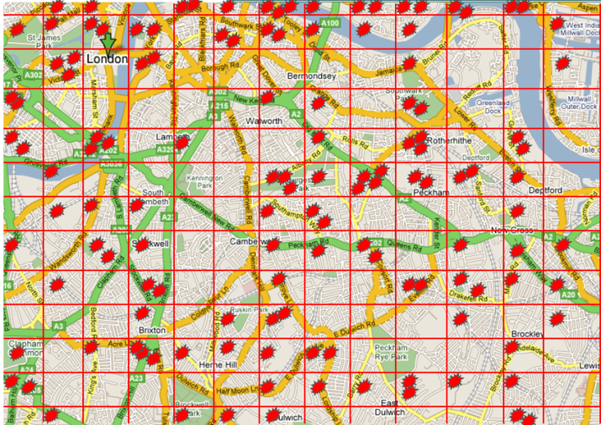
Poisson Process
θ = 1/169
N = 133
λ = 133 * 1/169 = 0.787
Theoretical Probabilities:
  P(X=0) = .4552
  P(X=1) = .3582
  P(X=2) = .1410
  P(X=3) = .0370
  P(X=4) = .0073
  P(X>4) = .0013

Slide 23
Interpreting The Process
λ = 0.787
Probabilities:
  P(X=0) = .4552
  P(X=1) = .3582
  P(X=2) = .1410
  P(X=3) = .0370
  P(X=4) = .0073
  P(X>4) = .0013
There are 169 squares
There are 133 “trials”
Expect .4552*169 = 76.6 to have 0 hits/square
Expect .3582*169 = 60.5 to have 1 hit/square
Etc.
Expect the average number of hits/square to = .787.

Slide 24
Does the Theory Work?
 | Theoretical Outcomes |  | Sample Outcomes
Outcome | Probability | Number of Cells | Sample Proportion | Number of cells
0 | .4552 | 77 | .4733 | 80
1 | .3582 | 60.5 | .2781 | 47
2 | 1410 | 23.8 | .1420 | 24
3 | 0370 | 6.3 | .0592 | 10
4 | 0073 | 1.2 | .0118 | 2
> 4 | 0013 | 0.2 | .0000 | 0
 | n*λ = .787 |  | 0(80)+1(47)+2(24)+...]/169=.787

Slide 25
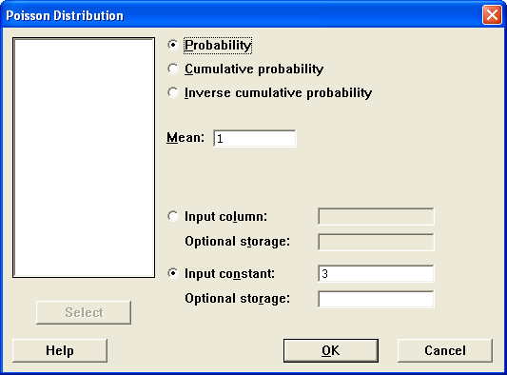
Calc->Probability Distributions->Poisson
Probability
Poisson with mean = 1
x P( X = x )
3 0.0613132

Slide 26
Application
-----------------------------------------------
Probability =
Exp(-3.2) 3.2^{customers} / customers!
-----------------------------------------------
Customers Probability
0 0.0407622
1 0.130439
2 0.208702
3 0.222616
4 0.178093
5 0.113979
6 0.060789
7 0.0277893
8 0.0111157
9 0.00395225
10 0.00126472
The arrival rate of customers at a bank is 3.2 per hour.
What is the probability of 6 customers in a particular hour?

Slide 27
Application: Deadbeats
In the derogatory reports application, the data follow a Poisson process with mean λ = 0.6.
The least attractive applicant had 14 major derogatory reports. How unattractive is this applicant?
The standard deviation of the Poisson process is sqr(.6) = 0.77.
14 MDRs is (14 - 0.6)/0.77 = 17.3 standard deviations above the mean.
This individual is an outlier by any construction. Their application was not accepted.
The probability of observing an individual with 14 or more MDRs when the mean is 0.6 is less than 0.5 x 10⁻¹⁵. This individual is unique (and uniquely unattractive to the credit card vendor).

Slide 28
Scaling
The mean can be scaled up to the appropriate time unit or area
Ex. Arrival rate at a Starbucks counter is 3.2/hour. What is the probability of 9 customers in 2 hours? The arrival rate will be 6.4 customers per 2 hours, so we use
Prob[X=9|λ=6.4] = exp(-6.4)6.4⁹/9! = 0.0824844.

Slide 29
Application: Hospital Beds
Cardiac care unit handles heart attack victims on the day of the incident.
In the population served, heart attacks are Poisson with mean 4.1 per day
If there are 5 beds in the unit, what is the probability of an overload?

Slide 30
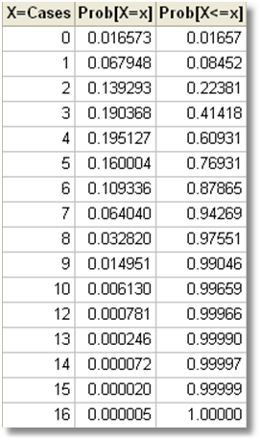
Application – Poisson Arrivals
With 5 beds, the probability that they will be overloaded is P[X > 6] = 1 – P[X < 5]
= 1 - .76931 = 0.23069.
What is the smallest number of beds that they can install to reduce the overload probability to less than 10%? If they have 7 beds, P[Overload] = 1 - .94269 = .05731. For less than 7 beds, it exceeds 10%. (If they have 6 beds, the probability is 1 - .87865 = .12135 which is too high.)

Slide 31
Application: Peak Loading and Excess Capacity
(Peak Loading Problem) If they have 7 beds, the expected vacancy rate is 7 - 4.1 = 2.9 beds, or 2.9/7 = 42% of capacity. This is costly. (This principle applies to any similar operation with random demand, such as an electric utility.)
They must plan capacity for the peak demand, and have excess capacity most of the time. A business tradeoff found throughout the economy. (Power systems, urban mass transit, telephone system, etc.)

Slide 32
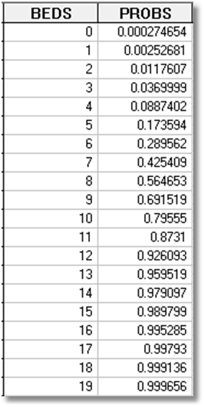
An Economy of Scale
Suppose the arrival rate doubles to 8.2.
The same computations show that the hospital does not need to double the size of the unit to achieve the same 90% adequacy. Now they need 12 beds, not 14.
The vacancy rate is now
(12-8.2)/8.2 = 32%. Better.
The hospital that serves the larger demand has a cost advantage over the smaller one.

Slide 33
Summary
Basic building blocks
  Uniform (equally probable outcomes)
  Set of independent Bernoulli trials
Poisson Model
  Poisson processes
  The Poisson distribution for counts of events
  The model demonstrate one source of economies of scale.

