Slide 1
Statistics and Data Analysis
Professor William Greene
Stern School of Business
IOMS Department
Department of Economics

Slide 2
Statistics and Data Analysis
Part 7 – Discrete Distributions:
Bernoulli and Binomial

Slide 3
Probability Distributions
Convenient formulas for summarizing probabilities
We use these to build descriptions of random events
  Discrete events: Usually whether or not, or how many times
  Continuous ‘events:’ Usually a measurement
Two specific types:
  Whether or not something (random) happens: Bernoulli
  How many times something (random) happens: Binomial

Slide 4
Elemental Experiment
Experiment consists of a “trial”
Event either occurs or it does not
P(Event occurs) = θ, 0 < θ < 1
P(Event does not occur) = 1 - θ

Slide 5
Applications
Randomly chosen individual is left handed: About .085 (higher in men than women)
Light bulb fails in first 1400 hours. 0.5 (according to manufacturers)
Card drawn is an ace. Exactly 1/13
Child born is male. Slightly > 0.5
Borrower defaults on a loan. Modeled.
Manufactured part has a defect. P(D).

Slide 6
Binary Random Variable
Event occurs ⬄ X = 1
Event does not occur ⬄ X = 0
Probabilities: P(X = 1) = θ
P(X = 0) = 1 - θ

Slide 7
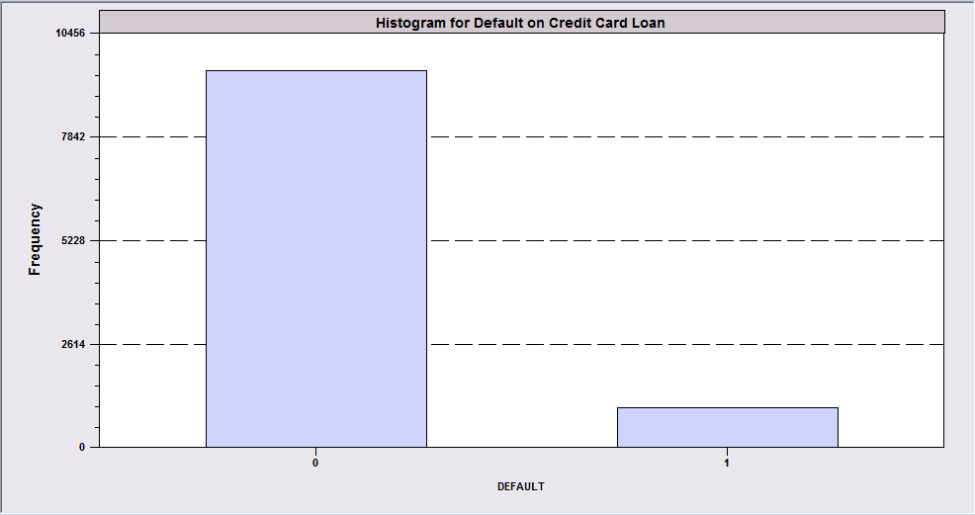
The Random Variable Lenders Are Really Interested In Is Default
DEFAULT RATE
Of 10,499 people whose application was accepted, 996 (9.49%) defaulted on their credit account (loan). We let X denote the behavior of a credit card recipient.
X = 0 if no default
X = 1 if default
This is a crucial variable for a lender. They spend endless resources trying to learn more about it.

Slide 8
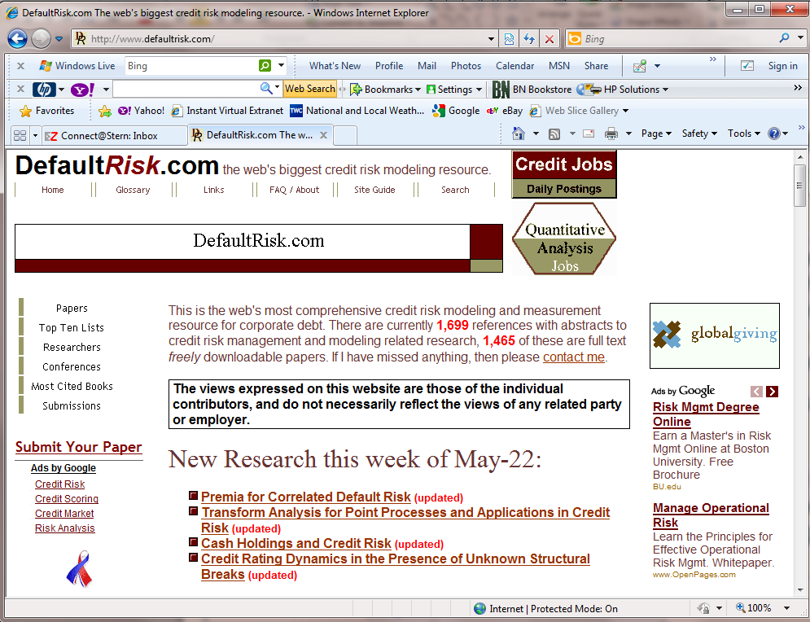

Slide 9
Bernoulli Random Variable
X = 0 or 1
Probabilities: P(X = 1) = θ
P(X = 0) = 1 – θ
(X = 0 or 1 corresponds to an event)

Slide 10


What is the ‘breach rate’ in a pool of tens of thousands of mortgages? (‘Breach’ = improperly underwritten or serviced or otherwise faulty mortgage.)
Each mortgage is a Bernoulli trial. The breach rate is θ, the probability that the mortgage is in breach.

Slide 11
Discrete Probability Distribution
Events A₁ A₂ … A_{M}
Probabilities P₁ P₂ … P_{M}
Distribution = the set of probabilities associated with the set of outcomes.
  Each is > 0 and they sum to 1.0
  Each outcome has exactly one probability.
  A list of the outcomes and the probabilities. All of our previous examples.

Slide 12
Probability Function
Define the probabilities as a function of X
Bernoulli random variable
  Probabilities: P(X = 1) = θ
  P(X = 0) = 1 – θ
Function: P(X=x) = θ^{x} (1- θ)^{1-x}, x=0,1

Slide 13
Mean and Variance
E[X] = 0(1- θ) + 1(θ) = θ
Variance = [0²(1- θ) + 1² θ] – θ²
= θ – θ²
= θ(1 – θ)
Application: If X is the number of male children in a family with 1 child, what is E[X]? θ = .5, so this is the expected number of male children in families with one child.

Slide 14
Probabilities
Probability that X = x is written as a function of x. Synonyms:
  Probability function
  Probability density function
  PDF
  Density
The Bernoulli distribution is the building block for most of the probability distributions we (or anyone else) will study.

Slide 15
Independent Trials
X₁ X₂ X₃ … X_{R} are all Bernoulli random variables (outcomes)
All have the same distribution
  Events X = 0 or 1
  Success probability is the same, θ
All are independent: P(X_{i}=x|X_{j}=x) = P(X_{i}=x).
  May be a sequence of trials across time
  May be a set of trials across space

Slide 16
Bernoulli Trials:
(Time) Wins in successive plays of a game at a casino.
(Time) Sexes of children in families.
(A sequence of trials – each child is a ‘trial’)
(Space) Incidence of disease in a population
(A sequence of observations)
(Space) Servers that are “down” at a point in time in a server “farm”
(Space? Time?) Wins at roulette (poker, craps, baccarat,…) Many kinds of applications in gambling (of course).
(Space) Political polls: Each trial is the opinion of a surveyed individual.

Slide 17
R Independent Trials
If events are independent, the probability of them all happening is the product.
Application: Prob(at least one defective part made on an assembly line in a given minute) = .02. What is the probability of 5 consecutive zero defect minutes?
.98×.98×.98×.98×.98 = .904
This assumes observations are independent from minute to minute.

Slide 18
Sum of Bernoulli Trials
“Trial” X = 0,1.
Denote X=1 as “success” and X=0 as “failure”
R independent trials, X₁, X₂, …, X_{R}, each with success probability θ.
The number of successes is r = Σ_{i}x_{i}.
r is a random variable

Slide 19
Number of Successes in R Trials
r successes in R trials
A hypothetical example: 4 employees
(E, A, J, and L). On any day, each has probability .2 of not showing up for work.
Random variable: X_{i} = 0 absent ⬇ (.2)
X_{i} = 1 present ⬆ (.8)

Slide 20
Probabilities
P(Everyone shows up for work)
  = P(⬆, ⬆, ⬆, ⬆)
  = .8×.8×.8×.8 = .8⁴ = .4096
P(exactly 3 people show up for work) = P(1 absent)
  E A J L
  P(⬇,⬆,⬆,⬆)= .2×.8×.8×.8=.1024
  P(⬆,⬇,⬆,⬆)= .8×.2×.8×.8=.1024
  P(⬆,⬆,⬇,⬆)= .8×.8×.2×.8=.1024
  P(⬆,⬆,⬆,⬇)= .8×.8×.8×.2=.1024
  All 4 are the same event (1 absent), so
  P(exactly 1 absent) = .1024+…+.1024
  = 4(.1024)
  = .4096

Slide 21
Binomial Probability
P(r successes in R trials) = number of ways r successes can occur in R independent trials times the probability of r successes times the probability of (R-r) failures
P(r successes in R trials) =

Slide 22
Binomial Probabilities
Probability of r successes in R independent trials:
In our fictitious firm with 4 employees, what is the probability that exactly 2 call in sick? Success here is defined by calling in sick, so for this question, θ = .2
  E A J L
  P(⬇,⬇,⬆,⬆)= .2×.2×.8×.8=.0256
  P(⬆,⬇,⬇,⬆)= .8×.2×.2×.8=.0256
  P(⬆,⬆,⬇,⬇)= .8×.8×.2×.2=.0256
  P(⬇,⬆,⬇,⬆)= .2×.8×.2×.8=.0256
  P(⬆,⬇,⬆,⬇)= .8×.2×.8×.2=.0256
  P(⬇,⬆,⬆,⬇)= .2×.8×.8×.2=.0256

Slide 23
Application
20 coin tosses, exactly 9 heads

Slide 24
Factorials are clumsy to compute. Software generally provides a tool to do this for you. In Excel, = BINOMDIST(9,20,50%,FALSE). (False means probability.)
R,θ
r
Probability Density Function
Binomial with R = 20 and p = 0.5
x P( X = x )
9 0.160179

Slide 25
Cumulative Probabilities
Cumulative probability for number of successes x is
Prob[X < x] = probability of x or fewer.
Obtain by addition.
Example: 10 bets on #1 at roulette. Success = “win” (ball stops in #1). What is P(X < 2)? θ =1/38 = 0.026316.
  P(0) = .7659
  P(1) = .2070
  P(2) = .0252
  P(3) = .0018
  P(more than 3) = .0001
Cumulative probabilities always use <.
For P[X < x] use P[X < x-1]
P(X < 2) = .0251 + .2070 + .7659 = .9981.

Slide 26
Complementary Probability
Sometimes, when seeking the probability that an event occurs, it is easier to find the probability that it does not occur, and then subtract that from 1.
Ex. A certain weapon system is badly prone to failure. On a given day, suppose the probability of breakdown is θ = 0.15. If there are 20 systems used, what is the probability that at least 2 will break down.
  This is P(X=2) + P(X=3) + … + P(X=20) [19 terms]
  The complement is P(X=0) + P(X=1) = 0.0387595+0.136798
  The result is P[X > 2] = 1 – Prob(X<2)
  = 1 – (Prob(X=0) + Prob(X=1))
  = 1 – (0.0387595 + 0.136798)
  = 0.8244425.

Slide 27
Application: Fraudulent Claims
Historically, 5% of all claims filed with the Beta Insurance Company are fraudulent. The manager of the Claims Division at Beta has reason to believe that the percentage of fraudulent claims may have risen recently. To test his theory, a random sample of 15 recently filed claims was selected. After extensive, careful investigation of each of these 15 claims, it is discovered that 4 are fraudulent. Is there sufficient evidence in this outcome to conclude that the percentage of fraudulent claims has actually risen at Beta Insurance Company?
If the fraud rate were really 5%, it is extremely unlikely that we would observe 4 frauds in 15 claims, 26.6%. The probability of observing this many fraudulent claims in a sample of 15 is only about 0.0055.
Note the strategy
  Assume the false claims rate is still 5%
  Under the assumption, the observed fact seems very unlikely. This casts doubt on the assumption.

Slide 28
Expected Number of Succeses

Slide 29
Variance of Number of Successes

Slide 30
Using The Empirical Rule
Daily absenteeism at a given plant with 450 employees is binomial with θ = .06. On a given day, 60 people call in sick. Is this “unusual?”
The expected number of absences is 450×.06 = 27. The standard deviation is sqr(450×.06×.94) = 5.04. So, 60 is
(60-27)/5.04 = 6.55 standard deviations above the mean. Remember, 99.5% of a distribution will be within ± 3 standard deviations of the mean. 6.55 is way out of the ordinary.
What do you conclude?

Slide 31
Application: Fraudulent Claims (Cont.)
Historically, 5% of all claims filed with the Beta Insurance Company are fraudulent. The manager of the Claims Division at Beta has reason to believe that the percentage of fraudulent claims may have risen recently. To test his theory, a random sample of 15 recently filed claims was selected. After extensive, careful investigation of each of these 15 claims, it is discovered that 4 are fraudulent. Is there sufficient evidence in this outcome to conclude that the percentage of fraudulent claims has actually risen at Beta Insurance Company?
Assuming that the fraud rate is still 0.05, the expected number of frauds in 15 claims is 15*.05 = .75. The standard deviation is sqr(15*.05*.95)=.844. 4 fraudulent claims is (4 - .75)/.844 = 3.85 standard deviations above the expected value. Based on our empirical rule, this seems rather unlikely.

Slide 32
Summary
Bernoulli random variables
Probability function
Independent trials (summing the trials)
Binomial distribution of number of successes in R trials
  Probabilities
  Cumulative probabilities
  Complementary probability

