Slide 1
Statistics and Data Analysis
Professor William Greene
Stern School of Business
IOMS Department
Department of Economics

Slide 2
Statistics and Data Analysis
Part 6 – Correlation

Slide 3
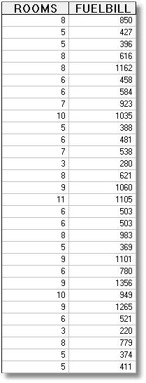
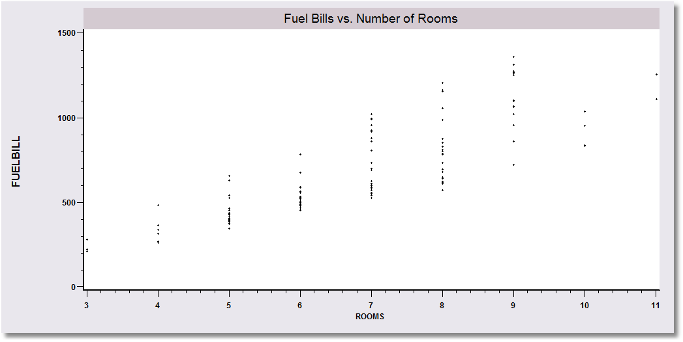
Correlated Variables

Slide 4
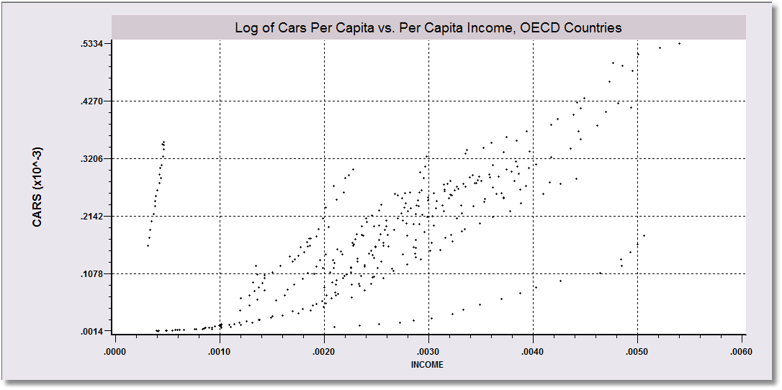
Correlated Variables

Slide 5
Correlation Agenda
Two ‘Related’ Random Variables
  Dependence and Independence
  Conditional Distributions
We’re interested in correlation
  We have to look at covariance first
  Regression is correlation
Correlated Asset Returns

Slide 6
Probabilities for Two Events, A,B
Marginal Probability = The probability of an event not considering any other events. P(A)
Joint Probability = The probability that two events happen at the same time. P(A,B)
Conditional Probability = The probability that one event happens given that another event has happened. P(A|B)

Slide 7
Probabilities: Inherited Color Blindness*
Inherited color blindness has different incidence rates in men and women. Women usually carry the defective gene and men usually inherit it.
Experiment: pick an individual at random from the population.
CB = has inherited color blindness
MALE = gender, Not-Male = FEMALE
Marginal: P(CB) = 2.75%
P(MALE) = 50.0%
Joint: P(CB and MALE) = 2.5%
P(CB and FEMALE) = 0.25%
Conditional: P(CB|MALE) = 5.0% (1 in 20 men)
P(CB|FEMALE) = 0.5% (1 in 200 women)
* There are several types of color blindness and large variation in the incidence across different demographic groups. These are broad averages that are roughly in the neighborhood of the true incidence for particular groups.

Slide 8
Dependent Events
Random variables X and Y are dependent if P_{XY}(X,Y) ≠ P_{X}(X)P_{Y}(Y).
 | Color Blind
Gender | No | Yes | Total
Male | .475 | .025 | 0.50
Female | .4975 | .0025 | 0.50
Total | .97255 | .0275 | 1.00
P(Color blind, Male) = .0250
P(Male) = .5000
P(Color blind) = .0275
P(Color blind) x P(Male)
= .0275 x .500 = .01375
.01375 is not equal to .025
Gender and color blindness are not independent.

Slide 9
Equivalent Definition of Independence
Random variables X and Y are independent if P_{XY}(X,Y) = P_{X}(X)P_{Y}(Y).
“The joint probability equals the product of the marginal probabilities.”

Slide 10
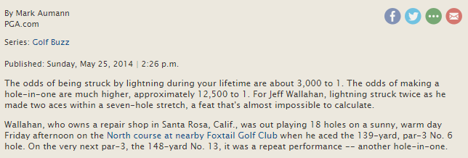
Getting hit by lightning and hitting a hole-in-one are independent Events
If these probabilities are correct,
P(hit by lightning) = 1/3,000 and P(hole in one) = 1/12,500,
then the probability of (Struck by lightning in your lifetime and hole-in-one)
= 1/3,000 * 1/12500 = .00000003 or one in 37,500,500.
Has it ever happened?

Slide 11
Dependent Random Variables
Random variables are dependent if the occurrence of one affects the probability distribution of the other.
If P(Y|X) changes when X changes, then the variables are dependent.
If P(Y|X) does not change when X changes, then the variables are independent.

Slide 12
Two Important Math Results
For two random variables,
P(X,Y) = P(X|Y) P(Y)
P(Color blind, Male) = P(Color blind|Male)P(Male)
= .05 x .5 = .025
For two independent random variables,
P(X,Y) = P(X) P(Y)
P(Ace,Heart) = P(Ace) x P(Heart).
(This does not work if they are not independent.)

Slide 13
Conditional Probability
Prob(A | B) = P(A,B) / P(B)
Prob(Color Blind | Male)
= Prob(Color Blind,Male)
P(Male)
= .025 / .50
= .05
 | Color Blind
Gender | No | Yes | Total
Male | .475 | .025 | 0.500
Female | .4975 | .0025 | 0.50
Total | .97255 | .0275 | 1.00
What is P(Male | Color Blind)?
A Theorem: For two random variables, P(X,Y) = P(X|Y) P(Y)
P(Color blind, Male) = P(Color blind|Male)P(Male)
= .05 x .5 = .025

Slide 14
Conditional Distributions
Marginal Distribution of Color Blindness
Color Blind Not Color Blind
.0275 .9725
Distribution Among Men (Conditioned on Male)
Color Blind|Male Not Color Blind|Male
.05 .95
Distribution Among Women (Conditioned on Female)
Color Blind|Female Not Color Blind|Female
.005 .995
The distributions for the two genders are different. The
variables are dependent.

Slide 15
Independent Random Variables
One card is drawn randomly from a deck of 52 cards
P(Ace|Heart) = 1/13
P(Ace|Not-Heart) = 3/39 = 1/13
P(Ace) = 4/52 = 1/13
P(Ace) does not depend on whether the card is a heart or not.
 | Ace
Heart | Yes=1 | No=0 | Total
Yes=1 | 1/52 | 12/52 | 13/52
No=0 | 3/52 | 36/52 | 39/52
Total | 4/52 | 48/52 | 52/52
P(Heart|Ace) = 1/4
P(Heart|Not-Ace) = 12/48 = 1/4
P(Heart) = 13/52 = 1/4
P(Heart) does not depend on whether the card is an ace or not.
A Theorem: For two independent random variables, P(X,Y) = P(X) P(Y)
P(Ace, Heart) = P(Ace)P(Heart) = 1/13 x 1/4 = 1/52

Slide 16
Covariation and Expected Value
Pick 10,325 people at random from the population. Predict how many will be color blind: 10,325 x .0275 = 284
Pick 10,325 MEN at random from the population. Predict how many will be color blind: 10,325 x .05 = 516
Pick 10,325 WOMEN at random from the population. Predict how many will be color blind: 10,325 x .005 = 52
The expected number of color blind people, given gender, depends on gender.
Color Blindness covaries with Gender

Slide 17
Positive Covariation: The distribution of one variable depends on another variable.
Distribution of fuel bills changes (moves upward) as the number of rooms changes (increases).
The per capita number of cars varies (positively) with per capita income. The relationship varies by country as well.

Slide 18
Application – Legal Case Mix: Two kinds of cases show up each month, real estate (R=0,1,2) and financial (F=0,1) (sometimes together, usually separately).
Joint Distribution
R = Real estate cases
F = Financial cases
Joint probabilities are
Prob(F=f and R=r)
Real Estate
Finance 0 1 2 Total
0 .15 .10 .05 .30
1 .30 .20 .20 .70
Total .45 .30 .25 1.00
Marginal
Distribution for Financial Cases
Marginal Distribution for Real Estate Cases
Note that marginal probabilities are obtained by summing across or down.

Slide 19
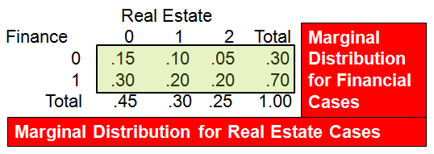
Legal Services Case Mix
Probabilities for R given the value of F
Distribution of R|F=0 Distribution of R|F=1
P(R=0|F=0)=.15/.30=.50 P(R=0|F=1)=.30/.70=.43
P(R=1|F=0)=.10/.30=.33 P(R=1|F=1)=.20/.70=.285
P(R=2|F=0)=.05/.30=.17 P(R=2|F=1)=.20/.70=.285
The probability distribution of Real estate cases (R) given Financial cases (F) varies with the number of Financial cases (0 or 1).
The probability that (R=2)|F goes up as F increases from 0 to 1.
This means that the variables are not independent.

Slide 20
(Linear) Regression of Bills on Rooms

Slide 21
Measuring How Variables Move Together: Covariance
Covariance can be positive or negative
The measure will be positive if it is likely that Y is above its mean when X is above its mean.
It is usually denoted σ_{XY}.

Slide 22
Conditional Distributions
Overall Distribution
Color Blind Not Color Blind
.0275 .9725
Distribution Among Men (Conditioned on Male)
Color Blind|Male Not Color Blind|Male
.05 .95
Distribution Among Women (Conditioned on Female)
Color Blind|Female Not Color Blind|Female
.005 .995
The distribution changes given gender.

Slide 23
Covariation
Pick 10,325 people at random from the population. Predict how many will be color blind: 10,325 x .0275 = 284
Pick 10,325 MEN at random from the population. Predict how many will be color blind: 10,325 x .05 = 516
Pick 10,325 WOMEN at random from the population. Predict how many will be color blind: 10,325 x .005 = 52
The expected number of color blind people, given gender, depends on gender.
Color Blindness covaries with Gender

Slide 24
Covariation in legal services
How many real estated cases should the office expect if it knows (or predicts) the number of financial cases?
E[R|F=0] = 0(.50) + 1(.33) + 2(.17) = 0.670
E[R|F=1] = 0(.43) + 1(.285) + 2(.285) = 0.855
This is how R and F covary.
Distribution of R|F=0 Distribution of R|F=1
P(R=0|F=0)=.15/.30=.50 P(R=0|F=1)=.30/.70=.43
P(R=1|F=0)=.10/.30=.33 P(R=1|F=1)=.20/.70=.285
P(R=2|F=0)=.05/.30=.17 P(R=2|F=1)=.20/.70=.285

Slide 25
Covariation and Regression
Expected Number of Real Estate Cases
Given Number of Financial Cases
1.0–
0.8–
0.6–
0.4–
0.2 -
0.0 -
The “regression of R on F”
0 1
Financial Cases

Slide 26
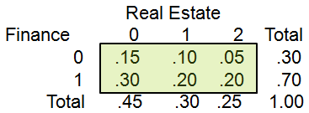
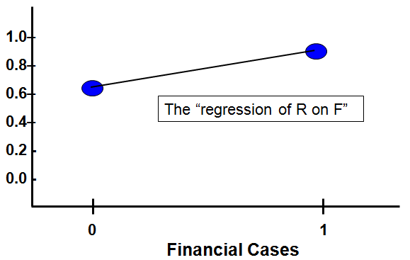
Legal Services Case Mix Covariance
Compute the Covariance
Σ_{F}Σ_{R} (F-.7)(R-.8)P(F,R)=
(0-.7)(0-.8).15 =+.084
(0-.7)(1-.8).10= -.014
(0-.7)(2-.8).05= -.042
(1-.7)(0-.8).30= -.072
(1-.7)(1-.8).20= +.012
(1-.7)(2-.8).20= +.072
Sum = +0.04 = Cov(R,F)
The two means are
μ_{R} = 0(.45)+1(.30)+2(.25) = 0.8
μ_{F} = 0(.00)+1(.70) = 0.7
I knew the covariance would be positive because the regression slopes upward. (We will see this again later in the course.)

Slide 27
Covariance and Scaling
Compute the Covariance
Cov(R,F) = +0.04
What does the covariance mean?
Suppose each real estate case requires 2 lawyers and each financial case requires 3 lawyers. Then the number of lawyers is N_{R} = 2R and N_{F} = 3F. The covariance of N_{R} and N_{F} will be 3(2)(.04) = 0.24.
But, the “relationship” is the same.

Slide 28
Independent Random Variables Have Zero Covariance
One card drawn randomly from a deck of 52 cards
E[H] = 1(13/52)+0(49/52) = 1/4
E[A] = 1(4/52)+0(48/52) = 1/13
Covariance = Σ_{H}Σ_{A}P(H,A) (H – μ_{H})(A – μ_{A})
1/52 (1 – 1/4)(1 – 1/13) = +36/52²
3/52 (0 – 1/4)(1 – 1/13) = – 36/52²
12/52 (1 – 1/4)(0 – 1/13) = – 36/52²
36/52 (0 – 1/4)(0 – 1/13) = +36/52²
SUM = 0 !!
 | A=Ace
H=Heart | Yes=1 | No=0 | Total
Yes=1 | 1/52 | 12/52 | 13/52
No=0 | 3/52 | 36/52 | 39/52
Total | 4/52 | 48/52 | 52/52

Slide 29
Covariance and Units of Measurement
Covariance takes the units of
(units of X) times (units of Y)
Consider Cov($Price of X,$Price of Y).
  Now, measure both prices in GBP, roughly $1.60 per £.
  The prices are divided by 1.60, and the covariance is divided by 1.60².
This is an unattractive result.

Slide 30
Correlation is Units Free

Slide 31
Correlation
μ_{R} = .8 μ_{F} = .7
Var(F) = 0²(.3)+1²(.7) - .7² = .21
Standard deviation = ..46
Var(R) = 0²(.45)+1²(.30)+2²(.25) – .8²
= .66
Standard deviation = 0.81
Covariance = +0.04

Slide 32
Uncorrelated Variables
Independence implies zero correlation. If the variables are independent, then the numerator of the correlation coefficient is zero.

Slide 33
Sums of Two Random Variables
Example 1: Total number of cases = F+R
Example 2: Personnel needed = 3F+2R
Find for Sums
  Expected Value
  Variance and Standard Deviation
Application from Finance: Portfolio

Slide 34
Math Facts 1 – Mean of a Sum
Mean of a sum. The
Mean of X+Y = E[X+Y] = E[X]+E[Y]
Mean of a weighted sum
Mean of aX + bY = E[aX] + E[bY]
= aE[X] + bE[Y]

Slide 35
Mean of a Sum
μ_{R} = .8
μ_{F} = .7
What is the mean (expected) number of cases each
month, R+F? E[R + F] = E[R] + E[F] = .8 + .7 = 1.5

Slide 36
Mean of a Weighted Sum
Suppose each Real Estate case requires 2 lawyers and each Financial case requires 3 lawyers. Then
N_{R} = 2R and N_{F} = 3F.
μ_{R} = .8
μ_{F} = .7
If N_{R} = 2R and N_{F} = 3F, then the mean number of lawyers is the mean of 2R+3F. E[2R + 3F] = 2E[R] + 3E[F] = 2(.8) + 3(.7) = 3.7 lawyers required.

Slide 37
Math Facts 2 – Variance of a Sum
Variance of a Sum
Var[x+y] = Var[x] + Var[y] +2Cov(x,y)
Variance of a sum equals the sum of the variances only if the variables are uncorrelated.
Standard deviation of a sum
The standard deviation of x+y is not equal to the sum of the standard deviations.

Slide 38
Variance of a Sum
μ_{R} = .8, σ_{R}² = .66, σ_{R} = .81
μ_{F} = .7, σ_{F}² = .21, σ_{F} = .46
σ_{RF} = 0.04
What is the variance of the total number of cases that occur each month? This is the variance of F+R = .21 + .66 + 2(.04) = .95.
The standard deviation is .975.

Slide 39
Math Facts 3 – Variance of a Weighted Sum
Var[ax+by] = Var[ax] + Var[by] +2Cov(ax,by)
= a²Var[x] + b²Var[y] + 2ab Cov(x,y).
Also, Cov(x,y) is the numerator in ρ_{xy}, so
Cov(x,y) = ρ_{xy} σ_{x} σ_{y}.

Slide 40
Variance of a Weighted Sum
μ_{R} = .8, σ_{R}² = .66, σ_{R} = .81
μ_{F} = .7, σ_{F}² = .21, σ_{F} = .46
σ_{RF} = 0.04, , ρ_{RF} = .107
Suppose each real estate case requires 2 lawyers and each financial case requires 3 lawyers. Then N_{R} = 2R and N_{F} = 3F.
What is the variance of the total number of lawyers needed each month? What is the standard deviation? This is the variance of 2R+3F
= 2²(.66) + 3²(.21) + 2(2)(3)(.107)(.81)(.46) = 5.008
The standard deviation is the square root, 2.238

Slide 41
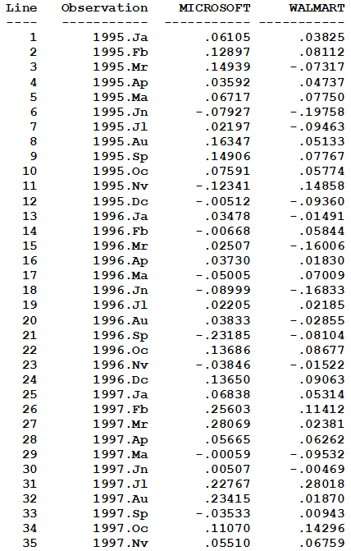
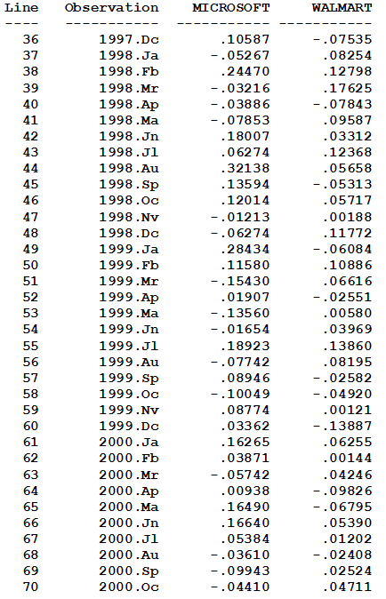
Correlated Variables: Returns on Two Stocks*
* Averaged yearly return

Slide 42
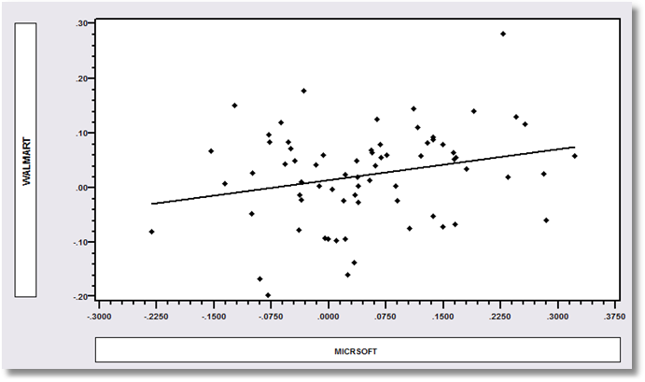
The two returns are positively correlated.

Slide 43
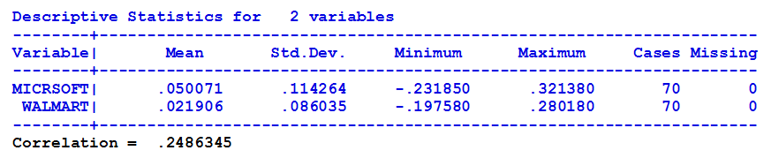

Slide 44
Application - Portfolio
You have $1000 to allocate between assets A and B. The yearly returns on the two assets are random variables r_{A} and r_{B}.
The means of the two returns are
E[r_{A}] = μ_{A} and E[r_{B}] = μ_{B}
The standard deviations (risks) of the returns are σ_{A} and σ_{B}.
The correlation of the two returns is ρ_{AB}

Slide 45
Portfolio
You have $1000 to allocate to A and B.
You will allocate proportions w of your $1000 to A and (1-w) to B.

Slide 46
Return and Risk
Your expected return on each dollar is
E[wr_{A} + (1-w)r_{B}] = wμ_{A} + (1-w)μ_{B}
The variance your return on each dollar is
Var[wr_{A} + (1-w)r_{B}]
= w² σ_{A}² + (1-w)²σ_{B}² + 2w(1-w)ρ_{AB}σ_{A}σ_{B}
The standard deviation is the square root.

Slide 47
Risk and Return: Example
Suppose you know μ_{A}, μ_{B}, ρ_{AB}, σ_{A}, and σ_{B} (You have watched these stocks for over 6 years.)
The mean and standard deviation are then just functions of w.
I will then compute the mean and standard deviation for different values of w.
For our Microsoft and Walmart example,
μ_{A} = .050071, μ_{B}, = .021906
σ_{A} = .114264, σ_{B},= .086035, ρ_{AB} = .248634
E[return] = w(.050071) + (1-w)(.021906)
= .021906 + .028156w
SD[return] = sqr[w²(.114²)+ (1-w)²(.086²) +
2w(1-w)(.249)(.114)(.086)]
= sqr[.013w² + .0074(1-w)² + .000244w(1-w)]

Slide 48
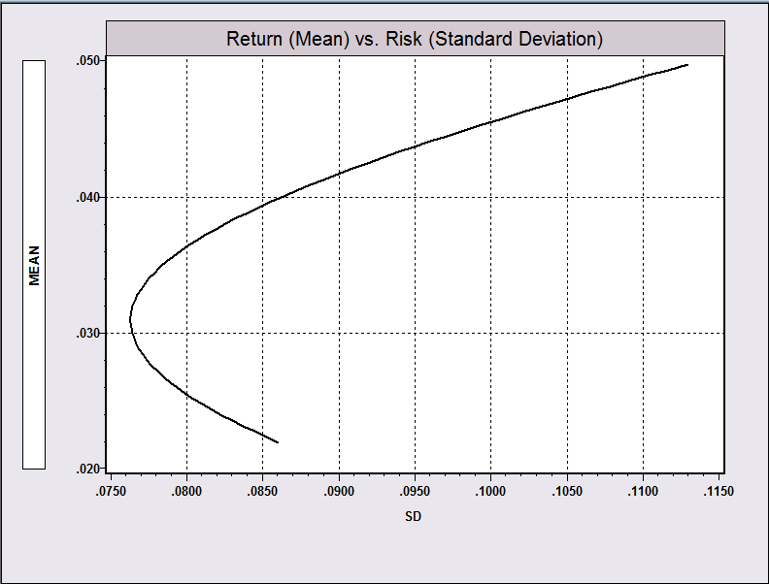
W=1
W=0
For different values of w,
risk = sqr[.013w² + .0074(1-w)² + .00244w(1-w)] is on the horizontal axis
return = .02196 + .028156w is on the vertical axis.

Slide 49
Summary
Random Variables – Dependent and Independent
Conditional probabilities change with the values of dependent variables.
Covariation and the covariance as a measure. (The regression)
Correlation as a units free measure of covariation
Math results
  Mean of a weighted sum
  Variance of a weighted sum
  Application to a portfolio problem.

