Slide 1
Statistics and Data Analysis
Professor William Greene
Stern School of Business
IOMS Department
Department of Economics

Slide 2
Statistics and Data Analysis
Part 5 – Random Variables

Slide 3
Random Variable
Using random variables to organize the information about a random occurrence.
Random Variable: A variable that will take a value assigned to it by the outcome of a random experiment.
Realization of a random variable: The outcome of the experiment after it occurs. The value that is assigned to the random variable is the realization.
X = the variable, x = the outcome

Slide 4
Types of Random Variables
Discrete: Takes integer values
  Binary: Will an individual default (X=1) or not (X=0)?
  How many messages arrive at a switch (customers at a service point) per unit of time?
  Finite: How many female children in families with 4 children; values = 0,1,2,3,4?
  Infinite: How many people will catch a certain disease per year in a given population? Values = 0,1,2,3,… (How can the number be infinite? It is a model.)
Continuous: A measurement.
  How long will a light bulb last? Values X = 0 to ∞
  Performance of financial assets over time
  How do we describe the distribution of biological measurements?
  Measures of intellectual performance

Slide 5
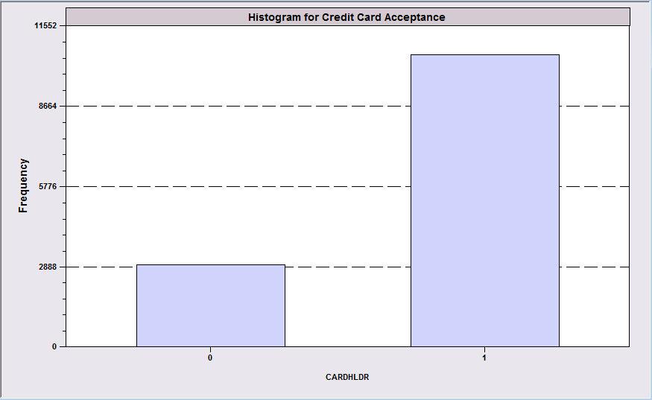
Modeling Fair Isaacs:
A Binary Random Variable
(Real) Sample of Applicants for a Credit Card
Experiment = One randomly picked application.
Let X = 0 if Rejected
Let X = 1 if Accepted
X is DISCRETE (Binary). This is called a Bernoulli random variable.
Rejected
Approved
The outcome is random from the credit card vendor’s point of view.
Fair Isaacs uses a formula. Given the information on the application, the outcome is not random to Fair Isaacs. It is random to the vendor because they do not know the formula.

Slide 6
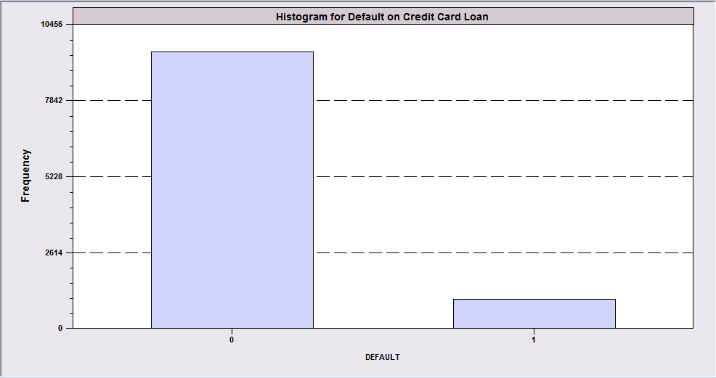
The Random Variable Lenders Are Really Interested In Is Default
Of 10,499 people whose application was accepted, 996 (9.49%) defaulted on their credit account (loan). We let X denote the behavior of a credit card recipient.
X = 0 if no default
X = 1 if default
This is a crucial variable for a lender. They spend endless resources trying to learn more about it.

Slide 7
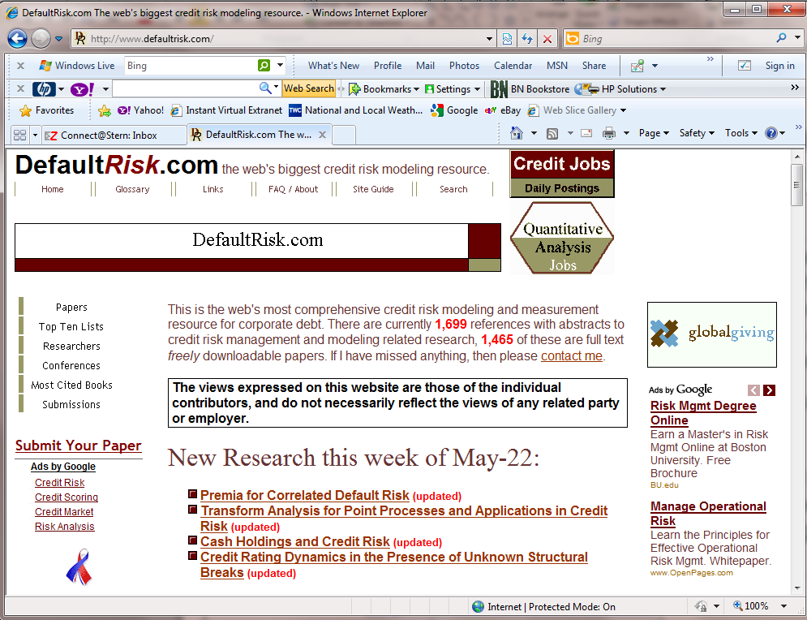

Slide 8
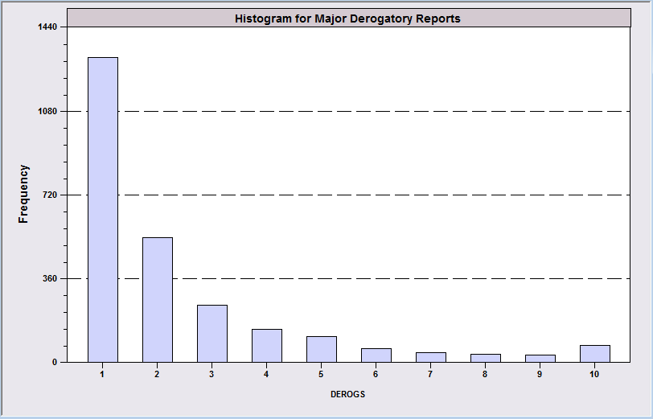
Distribution Over a Count
Of 13,444 Applications, 2,561 had at least one ‘derogatory report’ in the previous 12 months.
Let X = the number of reports for individuals who have at least 1.
X = 1,2,…,>10. X is a discrete random variable. (There are also about 9,500 individuals in this data set who had X=0.)

Slide 9
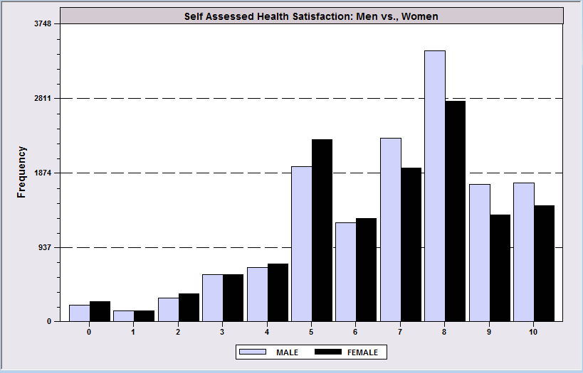
Discrete Qualitative Random Variable
Response (0 to 10) to the question: How satisfied are you with your health right now?
Experiment = the response of an individual drawn at random.
Let X = their response to the question. X = 0,1,…,10
This is a DISCRETE random variable, but it is not a count.
Do women answer systematically differently from men?

Slide 10
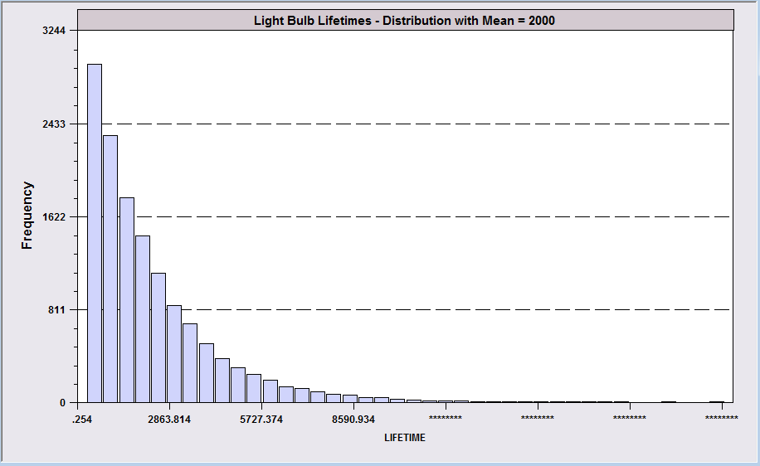
Continuous Variable – Light Bulb Lifetimes
Probability for a specific value is 0.
Probabilities are defined over intervals, such as
P(1000 < Lifetime < 2500). Needs calculus.

Slide 11

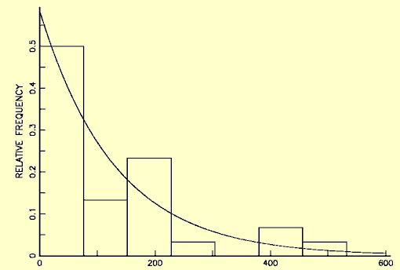
Lightbulb Lifetimes
Distribution of T = the lifetime of the bulb.
10,000 Hours?
Philips DuraMax Long Life “Lasts 1 Year” … “Life 1000 Hours.” Exactly?
Probability for a specific value is 0.
Probabilities are defined over intervals, such as
P(200 < Lifetime < 250). Needs calculus.

Slide 12
Probability Distribution
Range of the random variable = the set of values it can take
  Discrete: A set of integers. May be finite or infinite
  Continuous: A range of values
Probability distribution: Probabilities associated with values in the range.

Slide 13
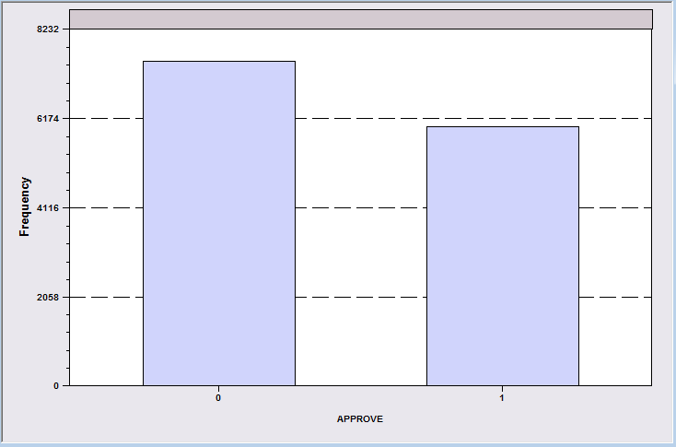
Bernoulli Random Variable
Probability Distribution
P(X=0) P(X=1)
0.5556 0.4444
Experiment = A randomly picked application.
Let X = 0 if Rejected
Let X = 1 if Accepted
The range of X is [0,1]
Reject
Approve

Slide 14
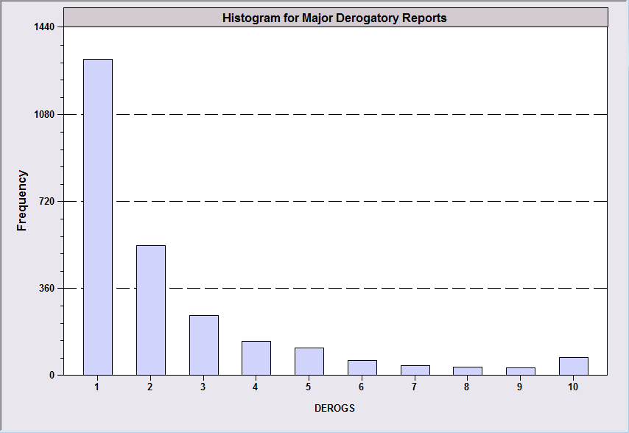
Probability Distribution Over Derogatory Reports
Derogatory
Reports
X P(X=x)
1 .5100
2 .2085
3 .0953
4 .0547
5 .0430
6 .0226
7 .0148
8 .0125
9 .0109
10 .0277

Slide 15
Notation
Probability distribution = probabilities assigned to outcomes.
P(X=x) or P(Y=y) is common.
Probability function = P_{X}(x). Sometimes called the density function
Cumulative probability is
Prob(X < x) for the specific x.

Slide 16
Cumulative Probability
Derogatory Reports
X P(X=x) P(X<x)
1 .5100 .5100
2 .2085 .7185
3 .0953 .8138
4 .0547 .8685
5 .0430 .9115
6 .0226 .9341
7 .0148 .9489
8 .0125 .9614
9 .0109 .9723
10 .0277 1.0000

Slide 17
Rules for Probabilities
1. 0 < P(x) < 1 (Valid probabilities)
2.
3. For different values of x, say A and
B, Prob(X=A or X=B) = P(A) + P(B)

Slide 18
Probabilities
Derogatory Reports
X P(X=x) P(X<x)
1 .5100 .5100
2 .2085 .7185
3 .0953 .8138
4 .0547 .8685
5 .0430 .9115
6 .0226 .9341
7 .0148 .9489
8 .0125 .9614
9 .0109 .9723
10 .0277 1.0000
P(a < x < b) = P(a)+P(a+1)+…+P(b)
E.g., P(5 < Derogs < 8) = .0430 + .0226 + .0148 + .0125
= .0929
P(a < x < b) = P(x < b) – P(x < a-1)
E.g., P(5 < Derogs < 8) = P(Derogs < 8) – P(Derogs < 4)
= .9614 - .8685
= .0929

Slide 19
Mean of a Random Variable
Average outcome; outcomes weighted by probabilities (likelihood)
Typical value
Usually not equal to a value that the random variable actually takes.
  E.g., the average family size in the U.S. is 1.4 children.
Usually denoted E[X] = μ (mu)

Slide 20
Expected Value
X = Derogs
x P(X=x)
1 .5100
2 .2085
3 .0953
4 .0547
5 .0430
6 .0226
7 .0148
8 .0125
9 .0109
10 .0277
μ=2.361
E[X] = 1(.5100) + 2(.2085) + 3(.0953) + … + 10(.0277) = 2.3610

Slide 21
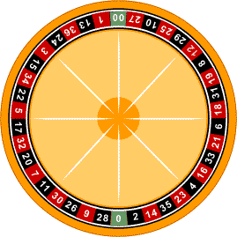
Expected Payoffs are Expected Values of Random Variables
Bet $1 on a number
If it comes up, win $35. If not, lose the $1
The amount won is the random variable:
Win = -1 P(-1) = 37/38
+35 P(+35) = 1/38
E[Win] = (-1)(37/38) + (+35)(1/38)
= -0.053
= -5.3 cents (familiar).
18 Red numbers 18 Black numbers 2 Green numbers (0,00)

Slide 22

Buy a Product Warranty?
Should you buy a $20 replacement warranty on a $47.99 appliance?
What are the considerations?
Probability of product failure = P (?)
Expected value of the insurance = -$20 + P*$47.99 < 0 if P < 20/47.99.
Expected value of the warranty is negative if P < 0.42.

Slide 23
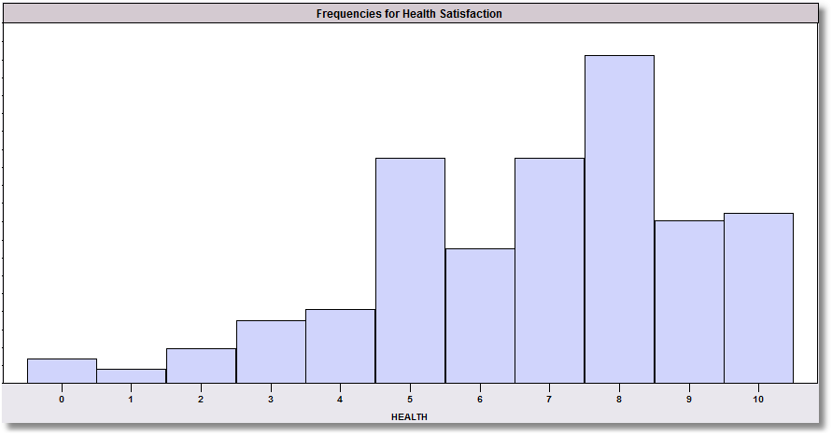
Median of a Random Variable
The median of X is the value x such that Prob(X < x) = .5.
For a continuous variable, we will find this using calculus.
For a discrete value, Prob(X < M+1) > .5 and Prob(X < M-1) < .5
X Prob(X=x) Prob(X < x)
0 .0164 .0164
1 .0093 .0257
2 .0235 .0492
3 .0429 .0921
4 .0509 .1430
5 .1549 .2979
6 .0926 .3905
7 .1548 .5453
8 .2259 .7712
9 .1120 .8832
10 .1168 1.0000
Mean (6.8)
Median (7)
Health Satisfaction Sample Proportions.

Slide 24
Measuring the “Spread” of the Random Outcomes
Derogatory
Reports
X P(X=x)
1 .5100
2 .2085
3 .0953
4 .0547
5 .0430
6 .0226
7 .0148
8 .0125
9 .0109
10 .0277
The range is 1 to 10, but values outside 1 to 5 are rather unlikely.
μ=2.361

Slide 25
Variance
Variance = E[X – μ]² = σ² (sigma²)
Compute
The square root is usually more useful.
  Standard deviation = σ
  Compute

Slide 26
Variance Computation
X = Derogatory Reports. μ = 2.361
x P(X=x) x-μ (x- μ)² P(X=x)(x-μ)²
1 .5100 -1.361 1.85232 0.94468
2 .2085 -0.361 0.13032 0.02717
3 .0953 0.639 0.40832 0.03891
4 .0547 1.639 2.28632 0.14694
5 .0430 2.639 6.96432 0.29947
6 .0226 3.639 13.24232 0.29928
7 .0148 4.639 21.53032 0.31850
8 .0125 5.639 31.79832 0.39748
9 .0109 6.639 44.07632 0.48043
10 .0277 7.639 58.35432 1.61641
SUM 4.56928
σ² = 4.56928
σ = 2.13759

Slide 27
Common Results for Random Variables
Concentration of Probability
  For almost any random variable, 2/3 of the probability lies within μ ± 1σ
  For almost any random variable, 95% of the probability lies within μ ± 2σ
  For almost any random variable, more than 99.5% of the probability lies within μ ± 3σ
What it means: For any random outcome,
  An (observed) outcome more than one σ away from μ is somewhat unusual.
  One that is more than 2σ away is very unusual.
  One that is more than 3σ away from the mean is so unusual that it might be an outlier (a freak outcome).

Slide 28
Outlier?
In the larger credit card data set, there was an individual who had 14 major derogatory reports in the year of observation. Is this “within the expected range” by the measure of the distribution?
The person’s deviation is (14 – 2.361)/2.138 = 5.4 standard deviations above the mean. This person is very far outside the norm.

Slide 29
Application: Sharpe Ratio

Slide 30
Reliable Rules of Thumb
Recall from day 2 of class
Almost always, 66% of the observations in a sample will lie in the range
[mean+1 s.d. and mean – 1 s.d.]
Almost always, 95% of the observations in a sample will lie in the range
[mean+2 s.d. and mean – 2 s.d.]
Almost always, 99.5% of the observations in a sample will lie in the range
[mean+3 s.d. and mean – 3 s.d.]

Slide 31
A Possibly Useful “Shortcut”
E[X – μ]² = E[X²] – μ²
=

Slide 32
Application

Slide 33
Important Algebra
Linear Translation: For the random variable X with mean E[X] = μ,
if Y = a+bX, then E[Y] = a + bμ
Scaling: For the random variable X with standard deviation σ_{X},
if Y = a+bX, then σ_{Y} = |b| σ_{X}

Slide 34
Example: Repair Costs
The number of repair orders per day at a body shop is distributed by:
Repairs 0 1 2 3 4
Probability .1 .2 .35 .2 .15
Opening the shop costs $500 for any repairs. Two people each cost $100/repair to do the work.
What are the mean and standard deviation of the number of repair orders?
μ = 0(.1) + 1(.2) + 2(.35) + 3(.2) + 4(.15) = 2.10
σ² = 0²(.1) + 1²(.2) + 2²(.35) + 3²(.2) + 4²(.15) – 2.1² = 1.39
σ = 1.179
What are the mean and standard deviation of the cost per day to run the shop?
Cost = $500 + $100*(2)*(Number of Repairs)
Mean = $500 + $100*(2)*(2.1) = $920/day
Standard deviation = $100*(2)*(1.179) = $235.80/day

Slide 35
Summary
Random variables and random outcomes
  Outcome or sample space = range of the random variable
  Types of variables: discrete vs. continuous
Probability distributions
  Probabilities
  Cumulative probabilities
  Rules for probabilities
Moments
  Mean of a random variable
  Standard deviation of a random variable

Slide 36
Application: Expected Profits and Risk
You must decide how many copies of your self published novel to print . Based on market research, you believe the following distribution describes X, your likely sales (demand).
x P(X=x)
25 .10 (Note: Sales are in thousands. Convert your final result to
40 .30 dollars after all computations are done by multiplying your
55 .45 final results by $1,000.)
70 .15
Printing costs are $1.25 per book. (It’s a small book.) The selling price will be $3.25. Any unsold books that you print must be discarded (at a loss of $2.00/copy). You must decide how many copies of the book to print, 25, 40, 55 or 70. (You are committed to one of these four – 0 is not an option.)
A. What is the expected number of copies demanded.
B. What is the standard deviation of the number of copies demanded.
C. Which of the four print runs shown maximizes your expected profit? Compute all four.
D. Which of the four print runs is least risky – i.e., minimizes the standard deviation of the
profit (given the number printed). Compute all four.
E. Based on C. and D., which of the four print runs seems best for you?

Slide 40
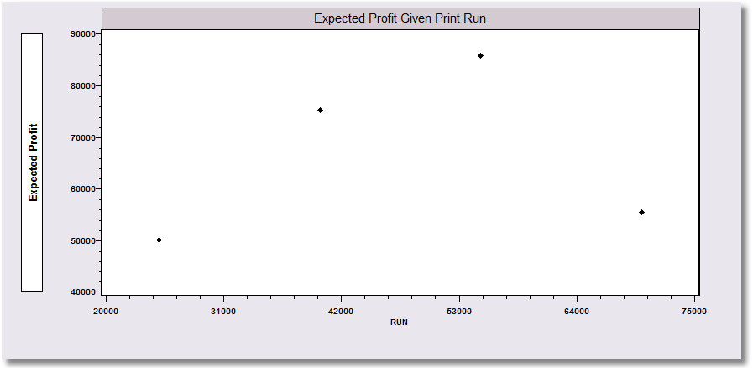
Expected Profit Given Print Run

Slide 42
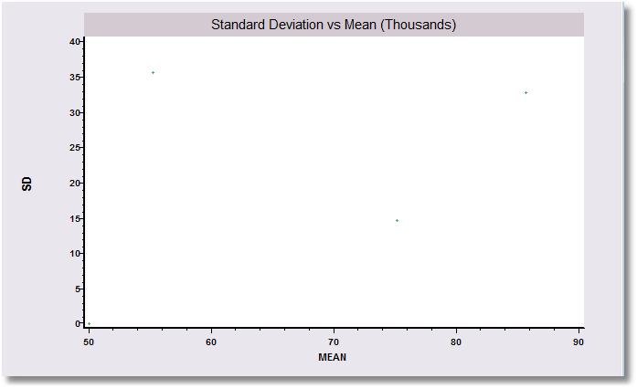
Run=70,000
Run=55,000
Run=40,000
Run=25,000

Slide 43
Run=70,000
Run=55,000
70,000 is inferior to 40,000
Run=40,000
Run=25,000

Slide 44
Which of these choices
would you prefer?
Run=55,000
25,000 is safe, but an
extremely risk averse choice
and has far lower expected payoff than 40 or 55.
Run=40,000
Run=25,000

