Slide 1
Statistics and Data Analysis
Professor William Greene
Stern School of Business
IOMS Department
Department of Economics

Slide 2
Statistics and Data Analysis
Part 3 – Probability

Slide 3
Probability: Probable Agenda
Randomness and decision making
Quantifying randomness with probability
  Types of probability: Objective and Subjective
  Rules of probability
Probabilities of events
  Compound events
  Computation of probabilities
  Independence
  Joint events and conditional probabilities
  Drug testing and Bayes Theorem

Slide 4
What is Randomness?
A lack of information?
Can it be made to go away with
enough information?
Can it be ‘reduced’ with more
information?
Consider the process of ‘underwriting’ a loan. The lender accepts a probability of default. Through research, they hope to reduce that probability. But, it does not go to zero.

Slide 5
Decision Making Under Uncertainty:
Why you want to understand probability
Use probability to understand expected value and risk
Applications
  Financial transactions at future dates
  Travel mode (or time)
  Product purchase
  Insurance and warranties – health and product
  Enter a market
  Any others?
… Life is full of uncertainty

Slide 6
Probability
Quantifying randomness
The context: An “experiment” that admits several possible outcomes
  Some outcome will occur
  The observer is uncertain which (or what) before the experiment takes place
Event space = the set of possible outcomes. (Also called the “sample space.”)
Probability = a measure of “likelihood” attached to the events in the event space.
(Try to define probability without using a word that means probability.)

Slide 7
Types of Probabilities
Objective long run frequencies (the law of large numbers). E.g., Prob(heads) in a coin toss.
Subjective probabilities, e.g., sports betting, belief of the risk of flying. Assessments based on personal information.
Aggregation of subjective frequencies (parimutuel, sports betting lines, insurance, casinos, racetrack)
Mathematical models: weather, options pricing

Slide 8
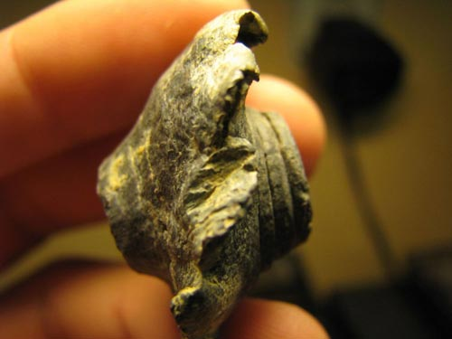
Assigning Probabilities to ‘Rare’ Events
Colliding Bullets at Gettysburg
There is no meaningful way to define the ‘sample space,’ so no meaningful way to assign probabilities to these events. (The experiment cannot be repeated.)

Slide 9

Assign a Meaningful Probability? Yes, but very small.
For all the criticism BP executives may deserve, they are far from the only people to struggle with such low-probability, high-cost events. Nearly everyone does. “These are precisely the kinds of events that are hard for us as humans to get our hands around and react to rationally,”
On the other hand, when an unlikely event is all too easy to imagine, we often go in the opposite direction and overestimate the odds. After the 9/11 attacks, Americans canceled plane trips and took to the road.
Quotes from Spillonomics: Underestimating Risk
By DAVID LEONHARDT, New York Times Magazine, Sunday, June 6, 2010, pp. 13-14.

Slide 10
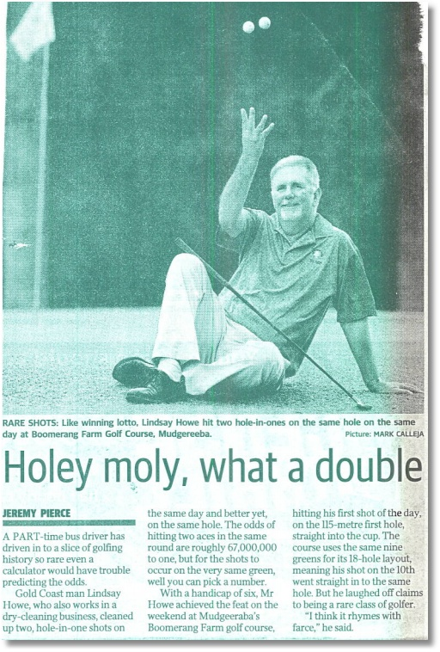
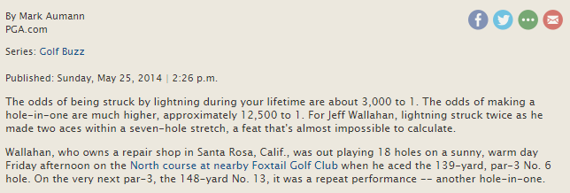
Two holes in one on the same day on the same hole.
Meaningful probability?
Sample space can be defined.
67,000,000 to one? Where did this come from? Since there have been more than 67,000,000 rounds of golf played, does this calculation suggest this has been done before?

Slide 11

210 Travelers between Sydney and Melbourne. One is picked at random:
P(Car) = 59/210
P(Ground) = (63+30+59) / 210
58
63
30
59
The connection between ‘data’ and probability. Assuming random sampling, based on the data above, if a random traveler is selected from the whole population (not just this sample), the probability that they would be a driver is (believed to be) 59/210 = 0.281.
Based on only 210 observations. Seems optimistic. If based on 210,000 observations, more realistic. That is the implication of the law of large numbers. We will study this later.

Slide 12
Rules of Probability
An “event” E will occur or not occur.
P(E) is a number that equals the probability that E will occur.
By convention, 0 < P(E) < 1.
Not-E = the event that E does not occur
P(Not-E) = the probability that E does not occur.

Slide 13
Essential Results for Probability
If P(E) = 0, then E cannot (will not) occur
If P(E) = 1, then E must (will) occur
E and Not-E are exhaustive – one of E or Not-E will occur. The event ‘E or Not-E’ must occur.
Something will occur, P(E) + P(Not-E) = 1
Only one thing can occur. If E occurs, then Not-E will not occur – E and Not-E are exclusive.
P(E and Not-E) = 0. They can’t both happen.

Slide 14
Compound Outcomes (Events)
Define an event set of more than two possible equally likely elementary events.
Compound event: An event that consists of a set of elementary events.
The compound event occurs if any of the elementary events occurs.

Slide 15
Counting Rule for Probabilities
Probabilities for compounds of atomistic equally likely events are obtained by counting.
P(Compound Event) =

Slide 16


Compound Events: Randomly pick a BMW*
E = A Random consumer’s random choice of exactly one model
E = X Series = X1 or X3 or X5 or X6
P(X Series) = P(X1) + P(X3) + P(X5) + P(X6) = 1/10 + 1/10 + 1/10 + 1/10 = 4/10
P(Hot Sports Coupe) = P(i8) + P(Z4) = 1/10 + 1/10 = 2/10
Etc.
*This is not the entire line.

Slide 17
Counting the Number of Elements
A set contains R items
The number of different subsets with r items is the number of combinations of r items chosen from R
(Derivations, see the Appendix)

Slide 18
How Many Poker Hands?
How many 5 card hands are there from a deck of 52? R=52, r=5.
There are 52*51*50*49*48)/(5*4*3*2*1) 2,598,960 possible hands.

Slide 19
Probability of 4 Aces in a
5 Card Poker Hand

Slide 20
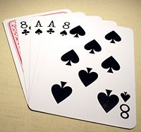
The Dead Man’s Hand
The dead man’s hand is 5 cards, 2 aces, 2 8’s and some other 5th card (Wild Bill Hickok was holding this hand when he was shot in the back and killed in 1876.) The number of hands with two aces and two 8’s is 44 = 1,584
The rest of the story claims that Hickok held all black cards (the bullets). The probability for this hand falls to only 22/2598960. (The four cards in the picture and one of the remaining 22.)
Some claims have been made about the 5th card, but no one is sure – there is no record.
http://en.wikipedia.org/wiki/Dead_man's_hand

Slide 21
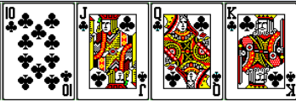






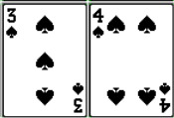



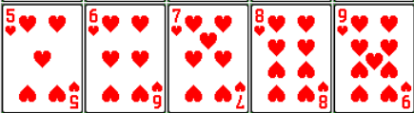






Some Poker Hands
Royal Flush – Top 5 cards in a suit
Full House – 3 of one kind, 2 of another. (Also called a “boat.”)
Straight Flush – 5 sequential cards in the same suit suit
Flush – 5 cards in a suit, not sequential
Straight – 5 cards in a numerical row, not the same suit
4 of a kind – plus any other card

Slide 22
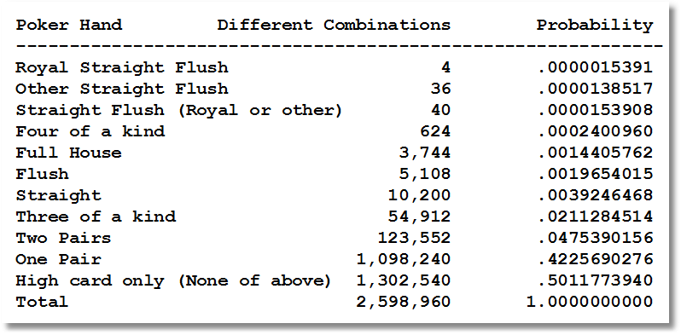
Probabilities of 5 Card Poker Hands
http://www.durangobill.com/Poker.html

Slide 23
Odds (Ratios)

Slide 24
Odds vs. 5 Card Poker Hands
Poker Hand Combinations Probability Odds Against
--------------------------------------------------------------------------
Royal Straight Flush 4 .0000015391 649,729:1
Other Straight Flush 36 .0000138517 72,193:1
Straight Flush (Royal or other) 40 .0000153908 64,973:1
Four of a kind 624 .0002400960 4,164:1
Full House 3,744 .0014405762 693:1
Flush 5,108 .0019654015 508:1
Straight 10,200 .0039246468 254:1
Three of a kind 54,912 .0211284514 46:1
Two Pairs 123,552 .0475390156 20:1
One Pair 1,098,240 .4225690276 1.4:1
High card only (None of above) 1,302,540 .5011773940 1:1
Total 2,598,960 1.0000000000
http://www.durangobill.com/Poker.html

Slide 25
Joint Events
Two events: A and B
One or the other occurs is denoted A or B ≡ A ∪ B
Both events occur is denoted A and B ≡ A ∩ B
Neither event occurs is Not-A and Not-B.
Independent events: Occurrence of A does not affect the probability of B
An addition rule: P(A ∪ B) = P(A)+P(B)-P(A ∩ B)
The product rule for independent events:
P(A ∩ B) = P(A)P(B)

Slide 26
Joint Events: Pick a Card, Any Card
Event A = Diamond: P(Diamond) = 13/52
2♦ 3♦ 4♦ 5♦ 6♦ 7♦ 8♦ 9♦ 10♦ J♦ Q♦ K♦ A♦
Event B = Ace: P(Ace) = 4/52
A♦ A♥ A♣ A♠
Addition Rule: Event A or B = Diamond or Ace
P(Diamond or Ace)
= P(Diamond) + P(Ace) – P(Diamond and Ace)
= 13/52 + 4/52 – 1/52 = 16/52

Slide 27
Application: Orders
Orders arrive from 3 sources, Catalog, Repeat Sales, Phone and in 4 sizes, Small, Medium, Large, Huge. The last 4,000 orders produced this table:
Small Medium Large Huge Total
Catalog 1021 216 109 14 1360
Repeat 86 371 308 49 814
Phone 1497 230 86 13 1826
Total 2604 817 503 76 4000
• Catalog and Repeat sales must go through an entry step. What is the probability that a randomly chosen order goes through this step (i.e., is a Catalog or Repeat Sale order)?
P(Catalog or Repeat) = 1360/4000 + 814/4000 = .3400 + .2035 = .5435
• Huge orders and phone orders are held for credit verification. What is the probability that a randomly chosen order is held for credit verification?
P(Huge or Phone) = P(Huge) + P(Phone) - P(Huge and Phone)
= 76/4000 + 1826/4000 – 13/4000
= .01900 + .45650 + -.00325 = .47225

Slide 28
Application of Joint Probabilities
Survey of 27326 German Individuals. * Frequency in black, sample proportion in red. E.g., .04186 = 1144/27326, .52123 = 14243/27326
 | Female | Male | Total
Uninsured | 1144 | 1979 | 3123
Insured | 11939 | 12264 | 24203
Total | 13083 | 14243 | 27326
 | Female | Male | Total
Uninsured | .04186 | .07242 | .11429
Insured | .43691 | .44880 | .88571
Total | .47877 | .52123 | 1.00000
* In the German system, ‘uninsured’ as above means does not purchase the ‘public’ insurance. Everyone has
health insurance. Individuals may choose to buy a ‘private’ insurance policy instead of the public insurance.

Slide 29
The Addition Rule - Application
 | Female | Male | Total
Uninsured | .04186 | .07242 | .11429
Insured | .43691 | .44880 | .88571
Total | .47877 | .52123 | 1.00000
An individual is drawn randomly from the pool of 27,326 observations.
P(Female or Insured) = P(Female) + P(Insured) – P(Female and Insured)
= .47877 + .88571 – .43691
= .92757

Slide 30
Product Rule for Independent Events
Events A and B both occur.
Probability = P(A ∩ B)
If A and B are independent, P(A ∩ B) = P(A)P(B)

Slide 31
Independent Events
If these probabilities are correct,
P(hit by lightning) = 1/3,000 and P(hole in one) = 1/12,500,
then the probability of (Struck by lightning in your lifetime and hole-in-one)
= 1/3,000 * 1/12500 = .00000003 or one in 37,500,500.
Has it ever happened?

Slide 32
Product Rule for Independent Events
Example:
I will fly to Washington (and back) for a meeting on Monday.
I will use the train on Tuesday.
Late or on time for the two days are independent.
P(Late | I fly) = .6. P(Not-Late|fly) = 1 - .6 = .4
P(Late | I take the train) = .2. P(Not Late|Train) = 1 - .2 = .8
What is the probability that I will miss at least one meeting?
Monday Tuesday
  P(Late, Not late) = (.6)(1-.2) = .48
  P(Not late, Late ) = (1-.6)(.2) = .08
  P(Late, Late) = (.6)(.2) = .12
  P(Late at least once) = .48+.08+.12 = .68

Slide 33
Joint Events and Joint Probabilities
Marginal probability = Probability for each event, without considering the other.
Joint probability = Probability that two events happen at the same time

Slide 34
Marginal and Joint Probabilities
Survey of 27326 German Individuals
Consider drawing an individual at random from the sample.
 | Female | Male | Total
Uninsured | .04186 | .07242 | .11429
Insured | .43691 | .44880 | .88571
Total | .47877 | .52123 | 1.00000
Marginal Probabilities; P(Male)=.52123, P(Insured) = .88571
Joint Probabilities; P(Male and Insured) = .44880

Slide 35
Conditional Probability
“Conditional event” = occurrence of an event given that some other event has occurred.
Conditional probability = Probability of an event given that some other event is certain to occur. Denoted P(A|B) = Probability that A will occur given B occurs.
  Prob(A|B) = Prob(A and B) / Prob(B)

Slide 36
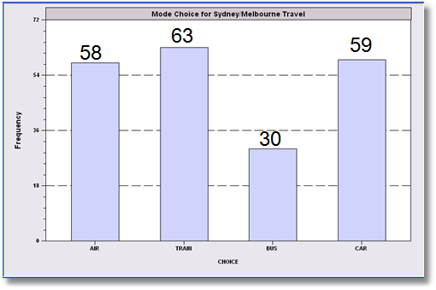
Conditional Probability
210 Travelers between Sydney and Melbourne. One of the ground travelers is picked at random. What is the probability they are a car driver?
P(Ground) = (63+30+59) / 210 = .7238
P(Car) = 59/210 = .2810
P(Car|Ground) = 59/(63+30+59) = .3882

Slide 37
Buying a BMW*
A random buyer of one of these models (conditioning on these 10 models) is chosen.
(1) What is the probability that they buy an X5? 1/10
(2) Given that they will buy an X series, what is the probability that they buy an X5? Prob(X5|Xseries) = Prob(X5 and Xseries)/P(Xseries)
= (1/10) / (4/10)
= 1/4
(Individual probabilities are surely not all 1/10. Market shares of these models differ)
*This is not the entire line.

Slide 38
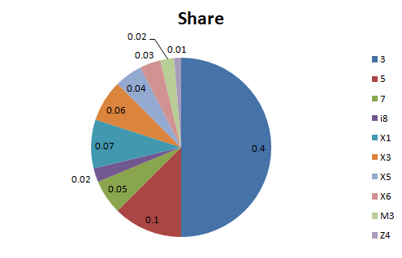
.40
.10
.05
.02
.07
.06
.04
.03
.02
.01
BMW has a 10% total market share in the car market.*
The 10 models shown are 80% of BMW’s sales
P(random car buyer buys a BMW)
P(random car buyer buys one of these 10 models)
P(random BMW buyer buys one of these 10 models)
P(random car buyer buys an X series BMW)
P(random BMW buyer buys an X series BMW)
P(random car buyer buys a BMW not one of these 10 models)
All of the numbers in this example are completely fictitious.

Slide 39
Conditional Probabilities
Company ESI sells two types of software, Basic and Advanced, to two markets, Government and Academic.
Orders arrive with the following probabilities:
Academic Government Total
Basic .4 .2 .6
Advanced .3 .1 .4
Total .7 .3 1.0
P(Basic) = .60
P(Basic | Academic) = .4 / .7 = .571
P(Government) = .30
P(Government | Advanced) = .1 / .4 = .25

Slide 40
Conditional Probabilities
Do women take up public health insurance more than men?
 | Female | Male | Total
Uninsured | .04186 | .07242 | .11429
Insured | .43691 | .44880 | .88571
Total | .47877 | .52123 | 1.00000
P(Insured|Female)
=P(Insured and Female)/P(Female)
=.43691/.47877 = .91257
P(Insured|Male)
= P(Insured and Male)/P(Male)
= .44880/.52123 = .86104
Yes, they do. Notice that the joint probabilities might suggest otherwise, but they are the wrong probabilities to look at.

Slide 41
The Product Rule for Conditional Probabilities
For events A and B, P(A ∩ B) = P(A|B)P(B)
Example: You draw a card from a well shuffled deck of cards, then a second one without replacing the first one. What is the probability that the two cards will be a pair?
  There are 13 cards.
  Let A be the card on the first draw and B be the second one. Then, P(A ∩ B) = P(A)P(B|A).
  For a pair of kings, P(K₁) = 1/13. P(K₂|K₁) = 3/51.
  P(K₁ ∩ K₂) = (1/13)(3/51) = 1/(13x17).
  There are 13 possible pairs, so P(Pair) = 13(1/13)(3/51) = 1/17.

Slide 42
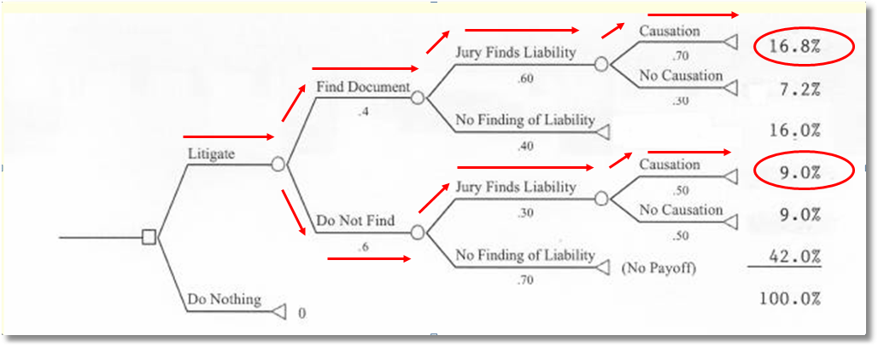
Litigation Risk Analysis: Using Probabilities to Determine a Strategy
P(Upper path) = P(Causation|Liability,Document)P(Liability|Document)P(Document)
= P(Causation,Liability|Document)P(Document)
= P(Causation,Liability,Document)
= .7(.6)(.4)=.168. (Similarly for lower path, probability = .5(.3)(.6) = .09.)
Two paths to a favorable outcome. Probability =
(upper) .7(.6)(.4) + (lower) .5(.3)(.6) = .168 + .09 = .258.
How can I use this to decide whether to litigate or not?

Slide 43
Independent Events
Events are independent if the occurrence of one does not affect probabilities related to the other.
Events A and B are independent if and only if P(A|B) = P(A). I.e., conditioning on B does not affect the probability of A.

Slide 44
Independent Events?
Pick a Card, Any Card
P(Red card drawn) = 26/52 = 1/2
P(Ace drawn) = 4/52 = 1/13.
P(Ace|Red) = (2/52) / (26/52) = 1/13
P(Ace) = P(Ace|Red) so “Red Card” and “Ace” are independent.

Slide 45
Independent Events?
Company ESI sells two types of software, Basic and Advanced, to two markets, Government and Academic.
Sales occur randomly with the following probabilities:
Academic Government Total
Basic .4 .2 .6
Advanced .3 .1 .4
Total .7 .3 1.0
P(Basic | Academic) = .4 / .7 = .571 not equal to P(Basic)=.6
P(Government | Advanced) = .1 / .4 = .25 not equal to P(Govt) =.3
The probability for Advanced|Academic is different from the probability for Advanced|Government. They are not independent.

Slide 46
Using Conditional Probabilities: Bayes Theorem
Typical application: We know P(B|A), we want P(A|B)
In drug testing:
We know P(find evidence of drug use | usage) < 1.
We need P(usage | find evidence of drug use).
The problem is false positives.
P(find evidence drug of use | Not usage) > 0
This implies that
P(usage | find evidence of drug use) ≠ 1

Slide 47
Bayes Theorem

Slide 48
Disease Testing
Notation
  + = test indicates disease, – = test indicates no disease
  D = presence of disease, N = absence of disease
Known Data
  P(Disease) = P(D) = .005 (Fairly rare) (Incidence)
  P(Test correctly indicates disease) = P(+|D) = .98 (Sensitivity)
  (Correct detection of the disease)
  P(Test correctly indicates absence) = P(-|N) = . 95 (Specificity)
  (Correct failure to detect the disease)
Objectives: Deduce these probabilities
  P(D|+) (Probability disease really is present | test positive)
  P(N|–) (Probability disease really is absent | test negative)
  Note, P(D|+) = the probability that a patient actually has the disease
  when the test says they do.

Slide 49
More Information
Deduce: Since P(+|D)=.98, we know P(–|D)=.02
because P(-|D)+P(+|D)=1
[P(–|D) is the P(False negative).
Deduce: Since P(–|N)=.95, we know P(+|N)=.05
because P(-|N)+P(+|N)=1
[P(+|N) is the P(False positive).
Deduce: Since P(D)=.005, we know P(N)=.995
because P(D)+P(N)=1.

Slide 50
Now, Use Bayes Theorem

Slide 51
Summary
Randomness and decision making
Probability
  Sources
  Basic mathematics
Simple and compound events and constructing probabilities
Joint events
  Independence
  Addition and product rules for probabilities
Conditional probabilities and Bayes theorem

Slide 52
Appendix – Counting Rules

Slide 53
Counting the Number of Events:
Permutations and Combinations
Permutations = Number of possible arrangements of a set of R items:
E.g., 4 kids, Allison, Julie, Betsy, Lesley. How many different lines that contain 3 of them?
  AJB, ABJ, AJL, ALJ, ABL, ALB, all with Allison first:
  JAB, JBA, JAL, JLA, JBL, JLB, all with Julie first.
  And so on… 24 different lines in total.

Slide 54
Counting Permutations
What’s the rule?
  R items in total
  Choose sets of r items
  Order matters
R possible first choices, then R-1 second, then R-2 third, and so on.
R × (R-1) × (R-2) × … ×(R-r+1)
4 kids, 3 in line, 4×3×2 = 24 ways.

Slide 55
Permutations

Slide 56
Permutations
The number of ways to put R objects in order is R×(R-1)…(1) = R! E.g., AJEL, ALEJ, AEJL, and so on. 24 possibilities
The number of ways to order r objects chosen out of R is

Slide 57
Permutations and Combinations
E.g., 8 Republican presidential candidates; How many ways can one order 2 of them? There are 8 possibilities for the first and 7 for the second, so
8(7)=56 = 8!/(8-2)! = 8!/6!

Slide 58
Combinations and Permutations
What if order doesn’t matter?
E.g., out of A,J,E,L, 12 permutations of 2 are AJ AE AL JE JL EL LE LJ EJ LA EA JA. Here order matters
But suppose AJ and JA are the same event (order doesn’t matter)? The list double counts.
The number of repetitions is the number of permutations of the r items, which is r!.

Slide 59
Combinations and Permutations
The number of “combinations” is the number of permutations when order does not matter.

Slide 60
Combinations and Permutations
The number of “combinations” is the number of permutations when order does not matter.

Slide 61
Some Useful Results

Slide 62
Counting the Dead Man’s Cards
The Aces 6: There are 6 possible pairs out of [A♠ A♣ A♥ A♦]
(♠ ♣) (♠♥) (♠♦) (♣♥) (♣♦) (♥♦)
The 8’s: There are also 6 possible pairs out of [8♠ 8♣ 8♥ 8♦]
(♠ ♣) (♠♥) (♠♦) (♣♥) (♣♦) (♥♦)
There are 44 remaining cards in the deck that are not aces and not 8’s.
The total number of possible different hands is therefore 6(6)(44) = 1,584. If he held the bullets (black cards), then there are only (1)(1)(44) = 44 combinations.
There is a claim that the 5th card was a diamond. This reduces the number of
possible combinations to (1)(1)(11).

Slide 63
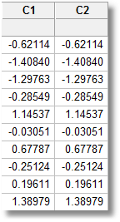
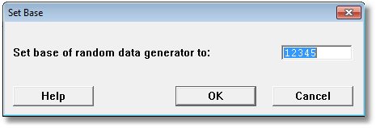
Types of Probabilities
Physical events – mechanical. “Random number generators,” e.g., coins, cards, computers, horse races, dog races.
Random number generators are not random. By setting the ‘seed,’ a set of values can be repeated.
(They are called ‘pseudo-random number generators.)

