Slide 1

Statistics and Data Analysis
Professor William Greene
Stern School of Business
IOMS Department
Department of Economics

Slide 2
Statistics and Data Analysis
Part 25 – Qualitative
Data

Slide 3
Modeling Qualitative Data
A Binary Outcome
Yes or No – Bernoulli
Survey Responses: Preference Scales
Multiple Choices Such as Brand Choice

Slide 4
Binary Outcomes
Did the advertising campaign “work?”
Will an application be accepted?
Will a borrower default?
Will a voter support candidate H?
Will travelers ride the new train?

Slide 5
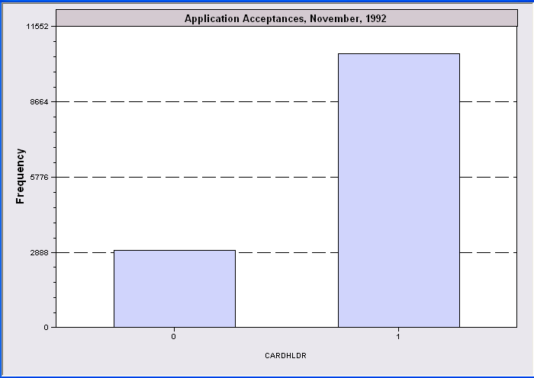
Modeling Fair Isaacs
13,444 Applicants for a Credit Card (November, 1992)
Experiment = A randomly picked application.
Let X = 0 if Rejected
Let X = 1 if Accepted
Rejected
Approved

Slide 6
Modelling The Probability
Prob[Accept Application] = θ
Prob[Reject Application ] = 1 – θ
Is that all there is?
  Individual 1: Income = $100,000, lived at the same address for 10 years, owns the home, no derogatory reports, age 35.
  Individual 2: Income = $15,000, just moved to the rental apartment, 10 major derogatory reports, age 22.
  Same value of θ?? Not likely.

Slide 7
Bernoulli Regression
Prob[Accept] = θ = a function of
  Age
  Income
  Derogatory reports
  Length at address
  Own their home
Looks like regression
Is closely related to regression
A way of handling outcomes (dependent variables) that are Yes/No, 0/1, etc.

Slide 8
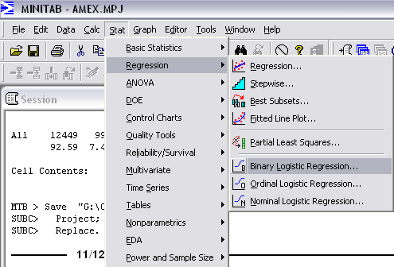
Binary Logistic Regression

Slide 9
How To?
It’s not a linear regression model.
It’s not estimated using least squares.
How? See more advanced course in statistics and econometrics
Why do it here? Recognize this very common application when you see it.

Slide 10
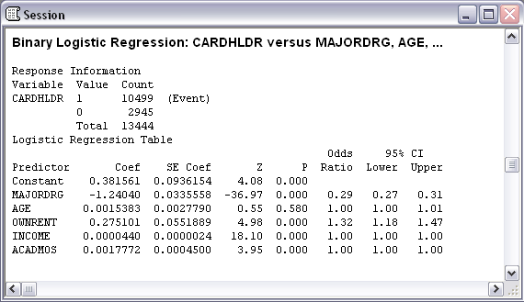
Logistic Regression

Slide 11
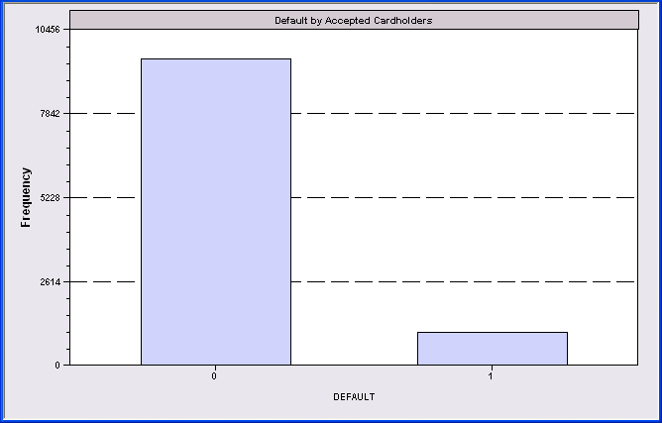
The Question They Are Really Interested In
Of 10,499 people whose application was accepted, 996 (9.49%) defaulted on their credit account (loan). We let X denote the behavior of a credit card recipient.
X = 0 if no default
X = 1 if default
This is a crucial variable for a lender. They spend endless resources trying to learn more about it.
No Default
Default

Slide 12
A Statistical Model for Credit Scoring
E[Profit per customer] = PD*E[Loss]
+ (1-PD)*E[spending]*Merchant Fees etc
E[Spending] = f(Income, Age, …, PD)
Riskier customers spend more on average
E[Loss|Default] = Spending
- Recovery (about half)
PD = F(Income, Age, Ownrent, …, Acceptance)

Slide 13
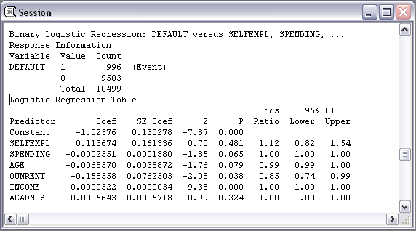
Default Model
Why didn’t mortgage lenders use this technique in 2000-2007? They didn’t care!

Slide 14
Application
How to determine if an advertising campaign worked?
A model based on survey data:
Explained variable: Did you buy (or recognize) the product – Yes/No, 0/1.
Independent variables: (1) Price, (2) Location, (3)…, (4) Did you see the advertisement? (Yes/No) is 0,1.
The question is then whether effect (4) is “significant.”
This is a candidate for “Binary Logistic Regression”

Slide 15
Multiple Choices
Multiple possible outcomes
  Travel mode
  Brand choice
  Choice among more than two candidates
  Television station
  Location choice (shopping, living, business)
No natural ordering

Slide 16
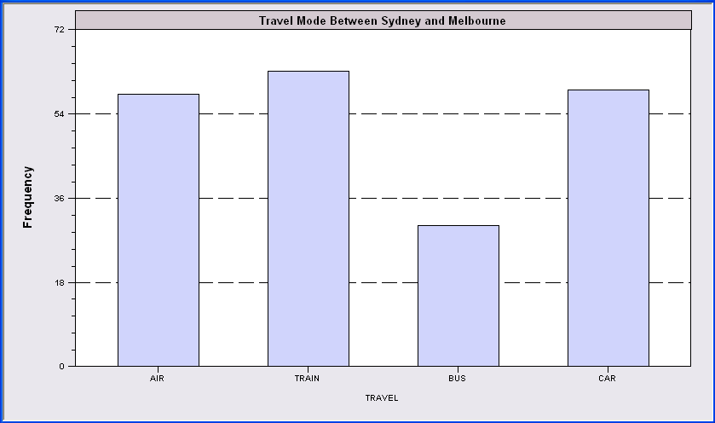
210 Sydney/Melbourne Travelers
Choice depends on trip cost, trip time, income, etc. How?

Slide 17
Modeling Multiple Choices
How to combine the information in a model
The model must recognize that making a specific choice means not making the other choices. (Probabilities sum to 1.0.)
Application: Willingness to pay for a new mode of transport or improvements in an old mode.
Application: Modeling brand choice.
Econometrics II, Spring semester.

Slide 18
Ordered Nonquantitative Outcomes
Health satisfaction
Taste test
Strength of preferences about
  Legislation
  Movie
  Fashion
Severity of Injury
Bond ratings

Slide 19
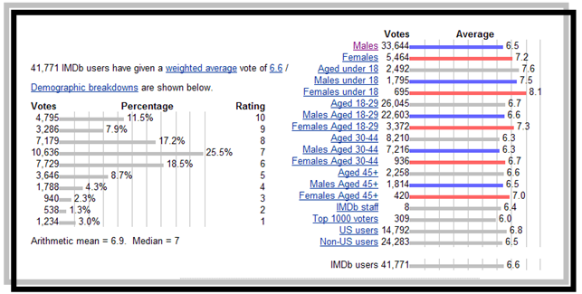
Movie Ratings at IMDb.com

Slide 20
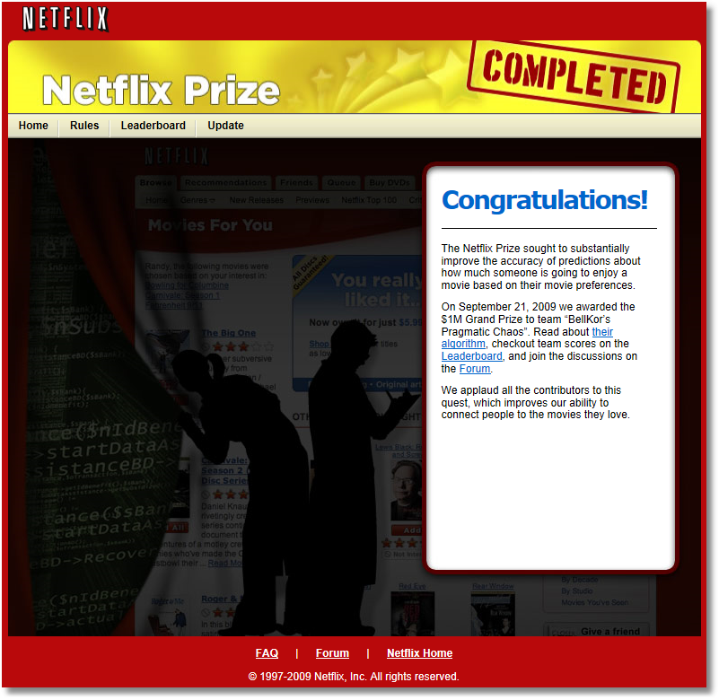

Slide 21
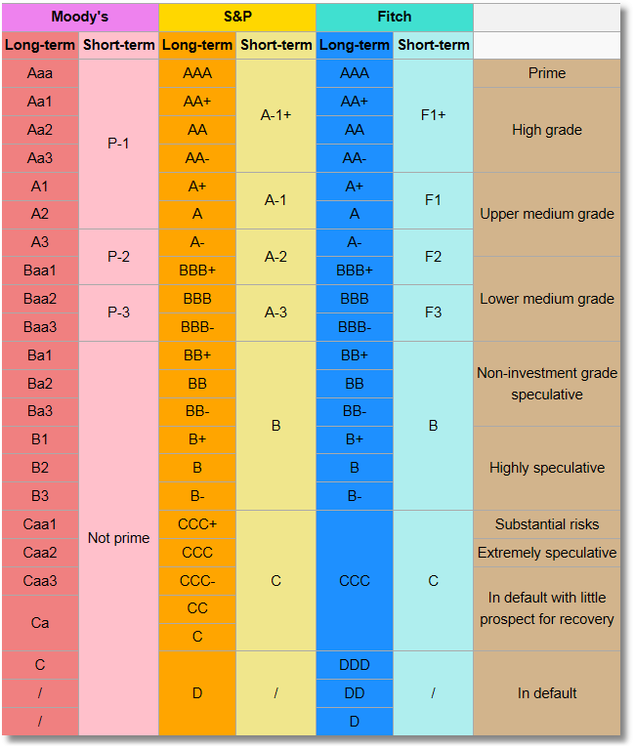
Bond Ratings

Slide 22

Health Satisfaction (HSAT)
Self administered survey: Health Care Satisfaction? (0 – 10)
Continuous Preference Scale
http://w4.stern.nyu.edu/economics/research.cfm?doc_id=7936
Working Paper EC-08: William Greene:Modeling Ordered Choices
Notes:
22

Slide 23




What did we learn this semester?
Descriptive statistics: How to display statistical information
  Mean, median, standard deviation, boxplot, scatter
  plot, pie chart, histogram,
Understanding randomness in our environment
  Random Variables: Bernoulli, Poisson, normal
  Expected values, product warranty, margin of error,
  law of large numbers, biases
Estimating features of our environment
  Point estimate
  Confidence intervals, margin of error
Multiple regression model: Modeling our world
  Holding things constant.
  Estimating effect of one variable on another
  Correlation
Testing hypotheses about our world

Slide 24

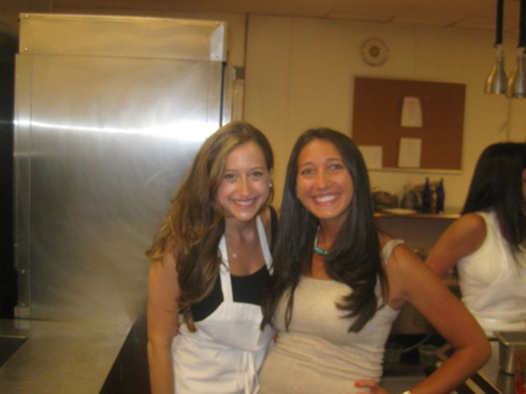
Cupcake Warriors
Think,
Statistically !
μ=200,σ=20
μ=1000,σ=50

