Slide 1

Statistics and Data Analysis
Professor William Greene
Stern School of Business
IOMS Department
Department of Economics

Slide 2
Statistics and Data Analysis
Part 24 – Multiple
Regression: 4

Slide 3
Hypothesis Tests in Multiple Regression
Simple regression: Test β = 0
Testing about individual coefficients in a multiple regression
R² as the fit measure in a multiple regression
  Testing R² = 0
  Testing about sets of coefficients
  Testing whether two groups have the same model

Slide 4
Regression Analysis
Investigate: Is the coefficient in a regression model really nonzero?
Testing procedure:
  Model: y = α + βx + ε
  Hypothesis: H₀: β = 0.
  Rejection region: Least squares coefficient is far from zero.
Test:
  α level for the test = 0.05 as usual
  Compute t = b/StandardError
  Reject H₀ if t is above the critical value
    1.96 if large sample
    Value from t table if small sample.
  Reject H₀ if reported P value is less than α level
Degrees of Freedom for the t statistic is N-2

Slide 5
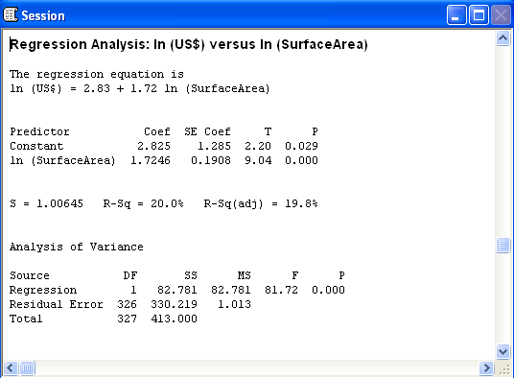

Application: Monet Paintings
Does the size of the painting really explain the sale prices of Monet’s paintings?
Investigate: Compute the regression
Hypothesis: The slope is actually zero.
Rejection region: Slope estimates that are very far from zero.
The hypothesis that β = 0 is rejected

Slide 6
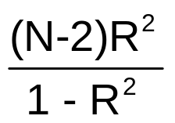
An Equivalent Test
Is there a relationship?
H₀: No correlation
Rejection region: Large R².
Test: F=
Reject H₀ if F > 4
Math result: F = t².
Degrees of Freedom for the F statistic are 1 and N-2

Slide 7
Partial Effects in a Multiple Regression
Hypothesis: If we include the signature effect, size does not explain the sale prices of Monet paintings.
Test: Compute the multiple regression; then H₀: β₁ = 0.
α level for the test = 0.05 as usual
Rejection Region: Large value of b₁ (coefficient)
Test based on t = b₁/StandardError
Degrees of Freedom for the t statistic is N-3 = N-number of
predictors – 1.
Regression Analysis: ln (US$) versus ln (SurfaceArea), Signed
The regression equation is
ln (US$) = 4.12 + 1.35 ln (SurfaceArea) + 1.26 Signed
Predictor Coef SE Coef T P
Constant 4.1222 0.5585 7.38 0.000
ln (SurfaceArea) 1.3458 0.08151 16.51 0.000
Signed 1.2618 0.1249 10.11 0.000
S = 0.992509 R-Sq = 46.2% R-Sq(adj) = 46.0%
Reject H₀.

Slide 8
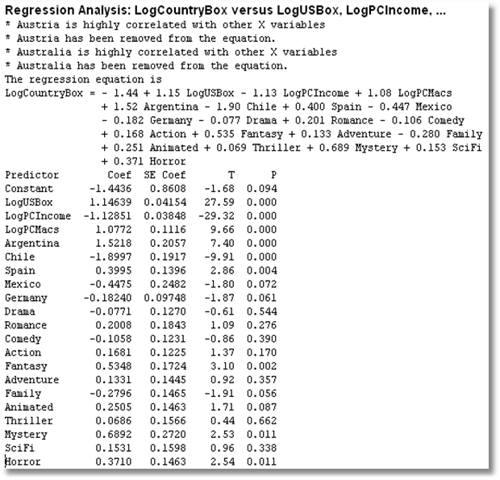
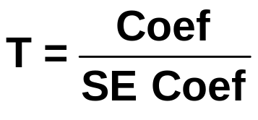
Use individual “T” statistics.
T > +2 or T < -2 suggests the variable is “significant.”
T for LogPCMacs
= +9.66.
This is large.

Slide 9
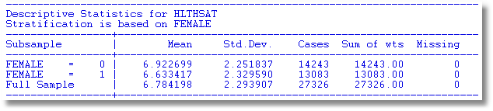
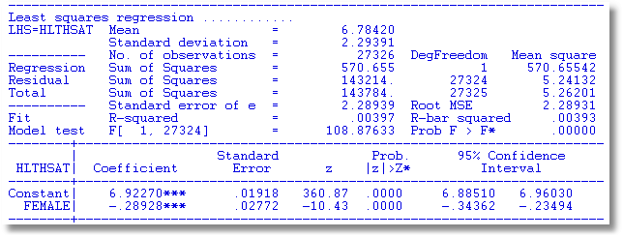
Women appear to assess health satisfaction differently from men.

Slide 10
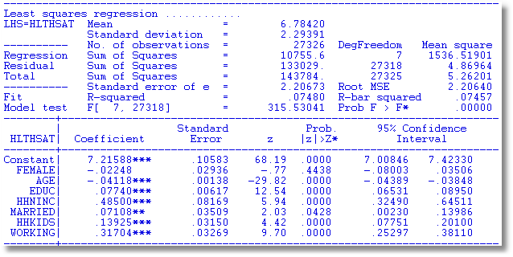
Or do they? Not when other things are held constant

Slide 11
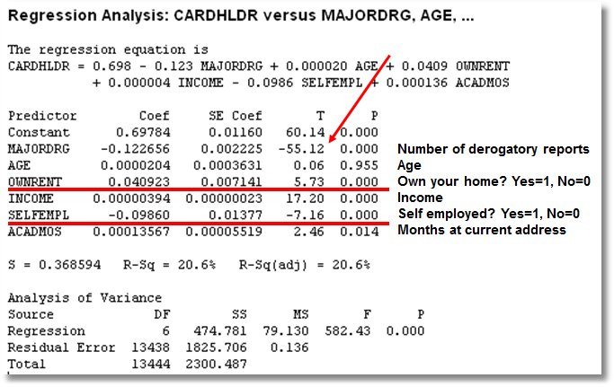

Slide 12
Confidence Interval for
Regression Coefficient
Coefficient on OwnRent
  Estimate = +0.040923
  Standard error = 0.007141
  Confidence interval
  0.040923 ± 1.96 X 0.007141 (large sample)
  = 0.040923 ± 0.013996
  = 0.02693 to 0.05492
Form a confidence interval for the coefficient on SelfEmpl. (Left for the reader)

Slide 13
Model Fit
How well does the model fit the data?
R² measures fit – the larger the better
  Time series: expect .9 or better
  Cross sections: it depends
    Social science data: .1 is good
    Industry or market data: .5 is routine
Use R² to compare models and find the right model

Slide 14

Dear Prof William
I hope you are doing great.
I have got one of your presentations on Statistics and Data Analysis, particularly on regression modeling. There you said that R squared value could come around .2 and not bad for large scale survey data. Currently, I am working on a large scale survey data set data (1975 samples) and r squared value came as .30 which is low. So, I need to justify this. I thought to consider your presentation in this case. However, do you have any reference book which I can refer while justifying low r squared value of my findings? The purpose is scientific article.

Slide 15
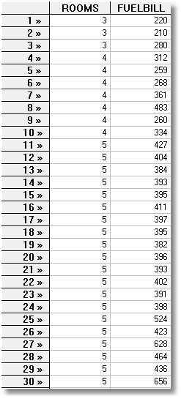
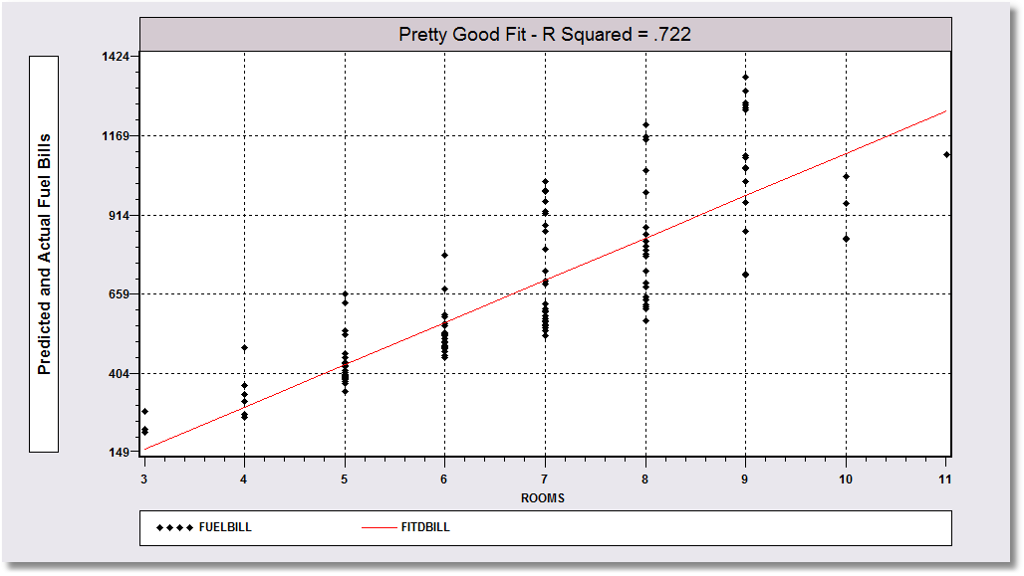
Pretty Good Fit: R² = .722
Regression of Fuel Bill on Number of Rooms

Slide 16
A Huge Theorem
R² always goes up when you add variables to your model.
Always.

Slide 17
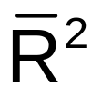
The Adjusted R Squared
Adjusted R² penalizes your model for obtaining its fit with lots of variables. Adjusted R²
= 1 – [(N-1)/(N-K-1)]*(1 – R²)
Adjusted R² is denoted
Adjusted R² is not the mean of anything and it is not a square. This is just a name.

Slide 18
The Adjusted R Squared
S = 0.952237 R-Sq = 57.0% R-Sq(adj) = 56.6%
Analysis of Variance
Source DF SS MS F P
Regression 20 2617.58 130.88 144.34 0.000
Residual Error 2177 1974.01 0.91
Total 2197 4591.58
If N is very large, R² and Adjusted R² will not differ by very much.
2198 is quite large for this purpose.

Slide 19
Success Measure
Hypothesis: There is no regression.
Equivalent Hypothesis: R² = 0.
How to test: For now, rough rule.
Look for F > 2 for multiple regression
(Critical F was 4 for simple regression)
F = 144.34 for Movie Madness

Slide 20
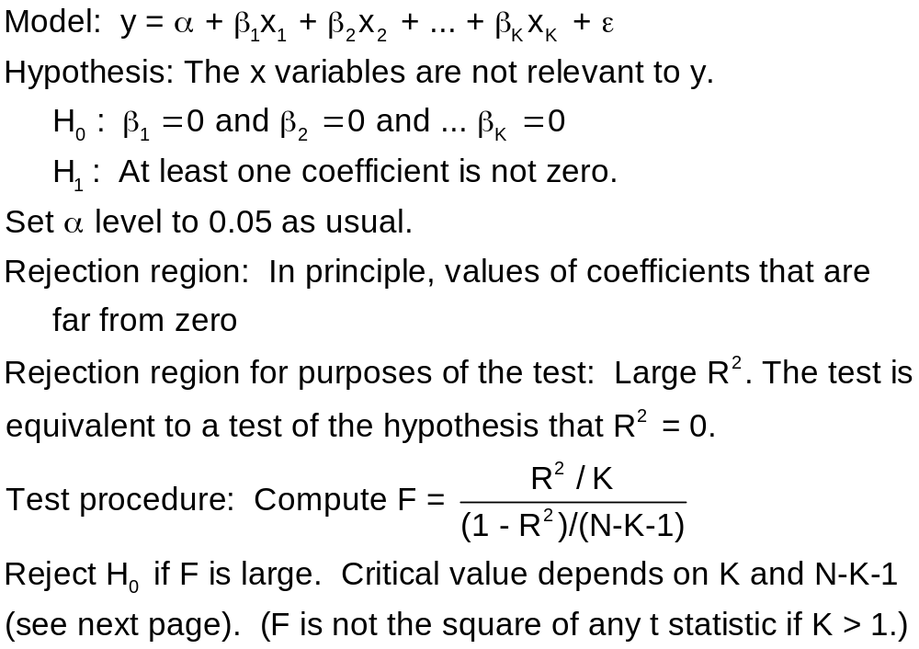
Testing “The Regression”
Degrees of Freedom for the F statistic are K and
N-K-1

Slide 21
The F Test for the Model
Determine the appropriate “critical” value from the table.
Is the F from the computed model larger than the theoretical F from the table?
  Yes: Conclude the relationship is significant
  No: Conclude R²= 0.

Slide 22
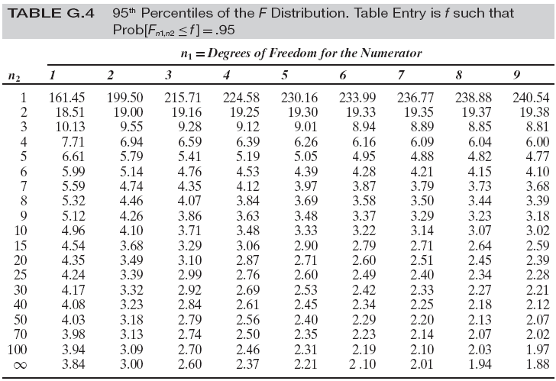
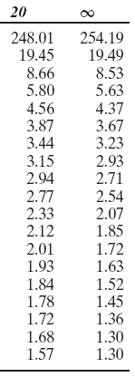
n₁ = Number of predictors
n₂ = Sample size – number of predictors – 1

Slide 23
Movie Madness Regression
S = 0.952237 R-Sq = 57.0% R-Sq(adj) = 56.6%
Analysis of Variance
Source DF SS MS F P
Regression 20 2617.58 130.88 144.34 0.000
Residual Error 2177 1974.01 0.91
Total 2197 4591.58

Slide 24
Compare Sample F to Critical F
F = 144.34 for Movie Madness
Critical value from the table is 1.57.
Reject the hypothesis of no relationship.

Slide 25
An Equivalent Approach
What is the “P Value?”
We observed an F of 144.34 (or, whatever it is).
If there really were no relationship, how likely is it that we would have observed an F this large (or larger)?
  Depends on N and K
  The probability is reported with the regression results as the P Value.

Slide 26
The F Test
S = 0.952237 R-Sq = 57.0% R-Sq(adj) = 56.6%
Analysis of Variance
Source DF SS MS F P
Regression 20 2617.58 130.88 144.34 0.000
Residual Error 2177 1974.01 0.91
Total 2197 4591.58

Slide 27
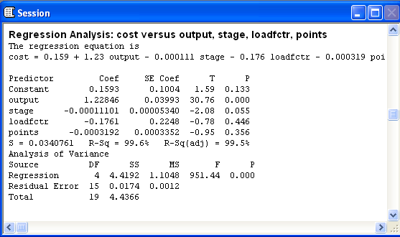
A Cost “Function” Regression
The regression is “significant.” F is huge. Which variables are significant? Which variables are not significant?

Slide 28
What About a
Group of Variables?
Is Genre significant in the movie model?
  There are 12 genre variables
  Some are “significant” (fantasy, mystery, horror) some are not.
  Can we conclude the group as a whole is?
Maybe. We need a test.

Slide 29
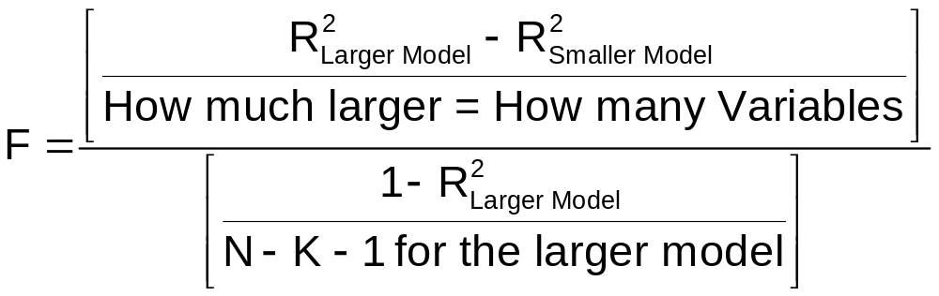
Theory for the Test
A larger model has a higher R² than a smaller one.
(Larger model means it has all the variables in the smaller one, plus some additional ones)
Compute this statistic with a calculator

Slide 30
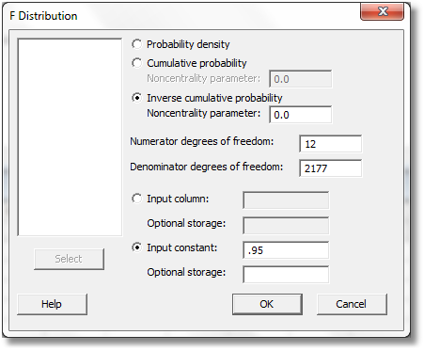
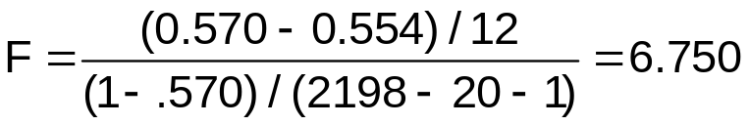
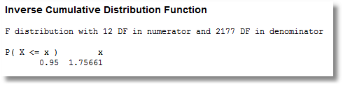
Is Genre Significant?
Calc -> Probability Distributions -> F…
The critical value shown by Minitab is 1.76
With the 12 Genre indicator variables:
R-Squared = 57.0%
Without the 12 Genre indicator variables:
R-Squared = 55.4%
The F statistic is 6.750.
F is greater than the critical value.
Reject the hypothesis that all the genre coefficients are zero.

Slide 31
Now What?
If the value that Minitab shows you is less than your F statistic, then your F statistic is large
I.e., conclude that the group of coefficients is “significant”
This means that at least one is nonzero, not that all necessarily are.

Slide 32
Application: Part of a Regression Model
Regression model includes variables x1, x2,… I am sure of these variables.
Maybe variables z1, z2,… I am not sure of these.
Model: y = α+β₁x1+β₂x2 + δ₁z1+δ₂z2 + ε
Hypothesis: δ₁=0 and δ₂=0.
Strategy: Start with model including x1 and x2. Compute R². Compute new model that also includes z1 and z2.
Rejection region: R² increases a lot.

Slide 33
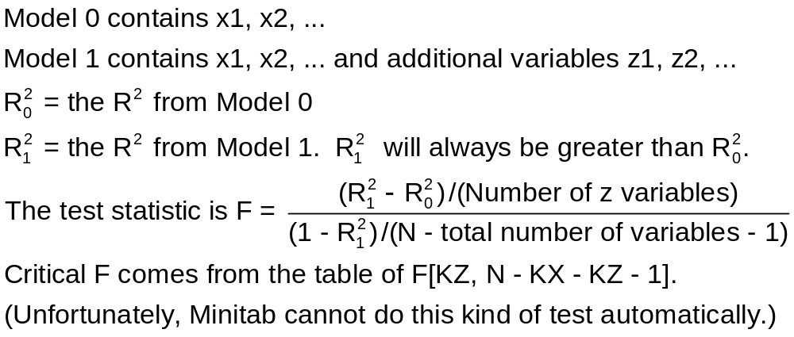
Test Statistic

Slide 34
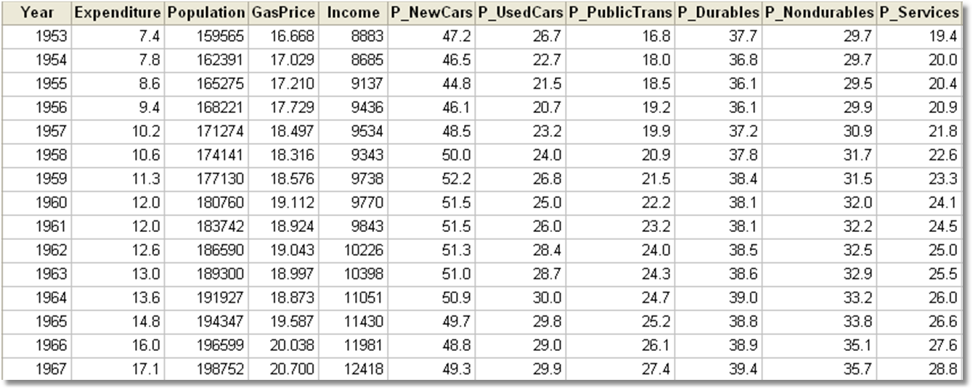
Gasoline Market

Slide 35
Gasoline Market
Regression Analysis: logG versus logIncome, logPG
The regression equation is
logG = - 0.468 + 0.966 logIncome - 0.169 logPG
Predictor Coef SE Coef T P
Constant -0.46772 0.08649 -5.41 0.000
logIncome 0.96595 0.07529 12.83 0.000
logPG -0.16949 0.03865 -4.38 0.000
S = 0.0614287 R-Sq = 93.6% R-Sq(adj) = 93.4%
Analysis of Variance
Source DF SS MS F P
Regression 2 2.7237 1.3618 360.90 0.000
Residual Error 49 0.1849 0.0038
Total 51 2.9086
R² = 2.7237/2.9086 = 0.93643

Slide 36
Gasoline Market
Regression Analysis: logG versus logIncome, logPG, ...
The regression equation is
logG = - 0.558 + 1.29 logIncome - 0.0280 logPG
- 0.156 logPNC + 0.029 logPUC - 0.183 logPPT
Predictor Coef SE Coef T P
Constant -0.5579 0.5808 -0.96 0.342
logIncome 1.2861 0.1457 8.83 0.000
logPG -0.02797 0.04338 -0.64 0.522
logPNC -0.1558 0.2100 -0.74 0.462
logPUC 0.0285 0.1020 0.28 0.781
logPPT -0.1828 0.1191 -1.54 0.132
S = 0.0499953 R-Sq = 96.0% R-Sq(adj) = 95.6%
Analysis of Variance
Source DF SS MS F P
Regression 5 2.79360 0.55872 223.53 0.000
Residual Error 46 0.11498 0.00250
Total 51 2.90858
Now, R² = 2.7936/2.90858 = 0.96047
Previously, R² = 2.7237/2.90858 = 0.93643

Slide 37
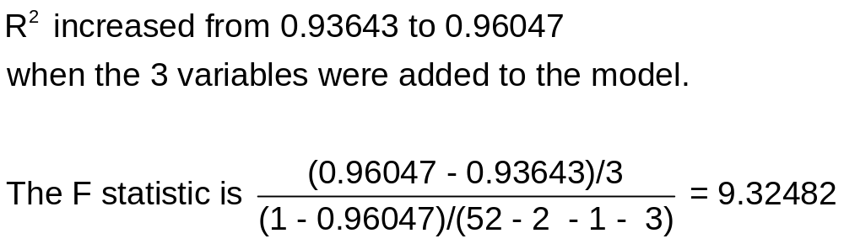

Slide 38
n₁ = Number of predictors
n₂ = Sample size – number of predictors – 1

Slide 39
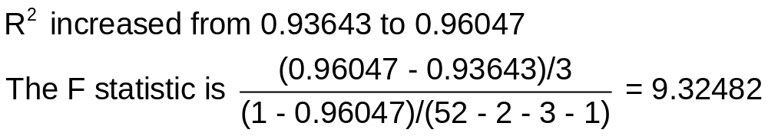
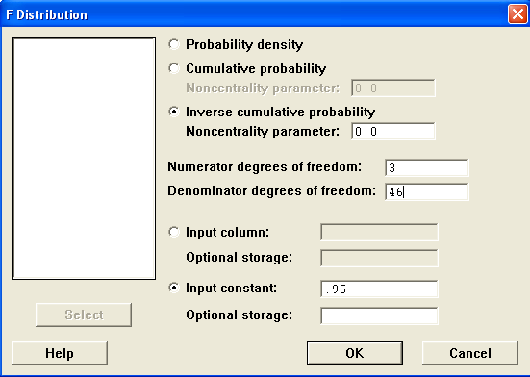
Improvement in R²
Inverse Cumulative Distribution Function
F distribution with 3 DF in numerator and 46 DF in denominator
P( X <= x ) = 0.95 x = 2.80684
The null hypothesis is rejected.
Notice that none of the three individual variables are “significant” but the three of them together are.

Slide 40
Application
Health satisfaction depends on many factors:
  Age, Income, Children, Education, Marital Status
  Do these factors figure differently in a model for women compared to one for men?
Investigation: Multiple regression
Null hypothesis: The regressions are the same.
Rejection Region: Estimated regressions that are very different.

Slide 41
Equal Regressions
Setting: Two groups of observations (men/women, countries, two different periods, firms, etc.)
Regression Model:
y = α+β₁x1+β₂x2 + … + ε
Hypothesis: The same model applies to both groups
Rejection region: Large values of F

Slide 42
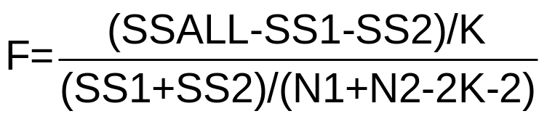
Procedure: Equal Regressions
There are N1 observations in Group 1 and N2 in Group 2.
There are K variables and the constant term in the model.
This test requires you to compute three regressions and retain the sum of squared residuals from each:
  SS1 = sum of squares from N1 observations in group 1
  SS2 = sum of squares from N2 observations in group 2
  SSALL = sum of squares from NALL=N1+N2 observations when the two groups
  are pooled.
The hypothesis of equal regressions is rejected if F is larger than the critical value from the F table (K numerator and NALL-2K-2 denominator degrees of freedom)

Slide 43
Health Satisfaction Models: Men vs. Women
+--------+--------------+----------------+--------+--------+----------+
|Variable| Coefficient | Standard Error | T |P value]| Mean of X|
+--------+--------------+----------------+--------+--------+----------+
Women===|=[NW = 13083]================================================
Constant| 7.05393353 .16608124 42.473 .0000 1.0000000
AGE | -.03902304 .00205786 -18.963 .0000 44.4759612
EDUC | .09171404 .01004869 9.127 .0000 10.8763811
HHNINC | .57391631 .11685639 4.911 .0000 .34449514
HHKIDS | .12048802 .04732176 2.546 .0109 .39157686
MARRIED | .09769266 .04961634 1.969 .0490 .75150959
Men=====|=[NM = 14243]================================================
Constant| 7.75524549 .12282189 63.142 .0000 1.0000000
AGE | -.04825978 .00186912 -25.820 .0000 42.6528119
EDUC | .07298478 .00785826 9.288 .0000 11.7286996
HHNINC | .73218094 .11046623 6.628 .0000 .35905406
HHKIDS | .14868970 .04313251 3.447 .0006 .41297479
MARRIED | .06171039 .05134870 1.202 .2294 .76514779
Both====|=[NALL = 27326]==============================================
Constant| 7.43623310 .09821909 75.711 .0000 1.0000000
AGE | -.04440130 .00134963 -32.899 .0000 43.5256898
EDUC | .08405505 .00609020 13.802 .0000 11.3206310
HHNINC | .64217661 .08004124 8.023 .0000 .35208362
HHKIDS | .12315329 .03153428 3.905 .0001 .40273000
MARRIED | .07220008 .03511670 2.056 .0398 .75861817
German survey data over 7 years, 1984 to 1991 (with a gap). 27,326 observations on Health Satisfaction and several covariates.

Slide 44
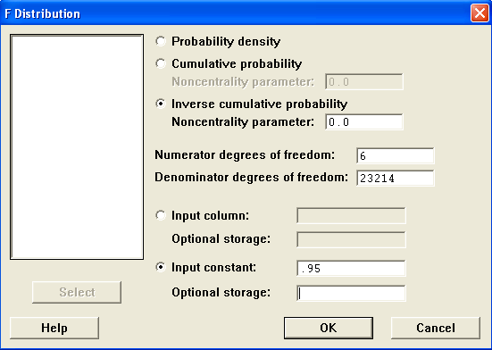
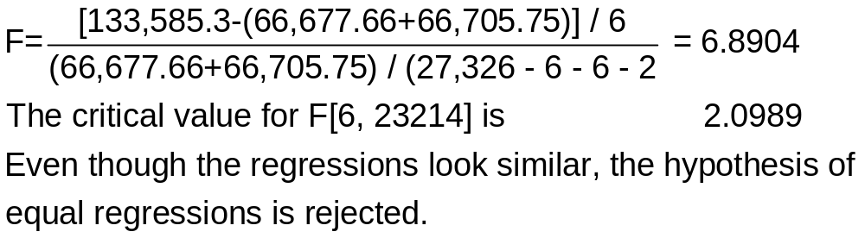
Computing the F Statistic
+--------------------------------------------------------------------------------+
| Women Men All |
| HEALTH Mean = 6.634172 6.924362 6.785662 |
| Standard deviation = 2.329513 2.251479 2.293725 |
| Number of observs. = 13083 14243 27326 |
| Model size Parameters = 6 6 6 |
| Degrees of freedom = 13077 14237 27320 |
| Residuals Sum of squares = 66677.66 66705.75 133585.3 |
| Standard error of e = 2.258063 2.164574 2.211256 |
| Fit R-squared = 0.060762 0.076033 .070786 |
| Model test F (P value) = 169.20(.000) 234.31(.000) 416.24 (.0000) |
+--------------------------------------------------------------------------------+

Slide 45
Summary
Simple regression: Test β = 0
Testing about individual coefficients in a multiple regression
R² as the fit measure in a multiple regression
  Testing R² = 0
  Testing about sets of coefficients
  Testing whether two groups have the same model

