Slide 1

Statistics and Data Analysis
Professor William Greene
Stern School of Business
IOMS Department of
Department of Economics

Slide 2
Statistics and Data Analysis
Part 23 – Multiple
Regression: 3

Slide 3
Regression Model Building
What are we looking for: Vaguely in order of importance
1. A model that makes sense – there is a reason for
the variables to be in the model.
  a. Appropriate variables
  b. Functional form. E.g., don’t mix logs and levels.
  Transformed variables are appropriate.
  Dummy variables are a valuable tool.
  Given we are comfortable with these:
2. Reasonable fit to the data is better than no fit.
Measured by R².
3. Statistical significance of the predictor variables.

Slide 4
Multiple Regression Modeling
Data Preparation
  Examining the Data
  Transformations – Using Logs
  Mini-seminar: Movie Madness and McDonalds
  Scaling
Residuals and Outliers
Variable Selection – Stepwise Regression
Multicollinearity

Slide 5
Data Preparation
Get rid of observations with missing values.
  Small numbers of missing values, delete observations
  Large numbers of missing values – may need to give up on certain variables
  There are theories and methods for filling missing values. (Advanced techniques. Usually not useful or appropriate for real world work.)
Be sure that “missingness” is not directly related to the values of the dependent variable. E.g., a regression that follows systematically removing “high” values of Y is likely to be biased if you then try to use the results to describe the entire population.

Slide 6
Using Logs
Generally, use logs for “size” variables
Use logs if you are seeking to estimate elasticities
Use logs if your data span a very large range of values and the independent variables do not (a modeling issue – some art mixed in with the science).
If the data contain 0s or negative values then logs will be inappropriate for the study – do not use ad hoc fixes like adding something to Y so it will be positive.

Slide 7
More on Using Logs
Generally only for continuous variables like income or variables that are essentially continuous.
Not for discrete categorical variables like binary variables or qualititative variables (e.g., stress level = 1,2,3,4,5)
Generally DO NOT take the log of “time” (t) in a model with a time trend. TIME is discrete and not a “measure.”

Slide 8

We used McDonald’s Per Capita

Slide 9
More Movie Madness
McDonald’s and Movies (Craig, Douglas, Greene: International Journal of Marketing)
Log Foreign Box Office(movie,country,year) =
α +
β₁* LogBox(movie,US,year) +
β₂* LogPCIncome +
β₄ * LogMacsPC +
GenreEffect +
CountryEffect +
ε.

Slide 10
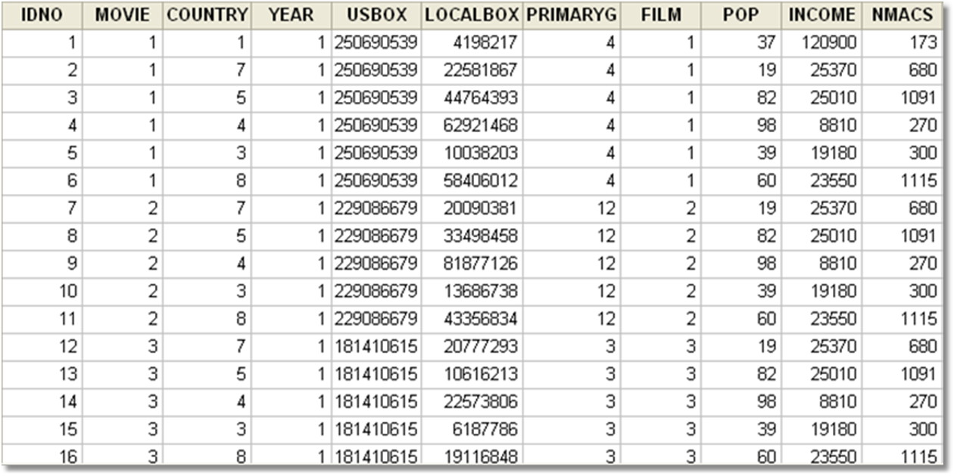
Movie Madness Data (n=2198)

Slide 11
Macs and Movies
Genres (MPAA)
1=Drama
2=Romance
3=Comedy
4=Action
5=Fantasy
6=Adventure
7=Family
8=Animated
9=Thriller
10=Mystery
11=Science Fiction
12=Horror
13=Crime
Countries and Some of the Data
Code Pop(mm) per cap # of Language
Income McDonalds
1 Argentina 37 12090 173 Spanish
2 Chile, 15 9110 70 Spanish
3 Spain 39 19180 300 Spanish
4 Mexico 98 8810 270 Spanish
5 Germany 82 25010 1152 German
6 Austria 8 26310 159 German
7 Australia 19 25370 680 English
8 UK 60 23550 1152 UK

Slide 12
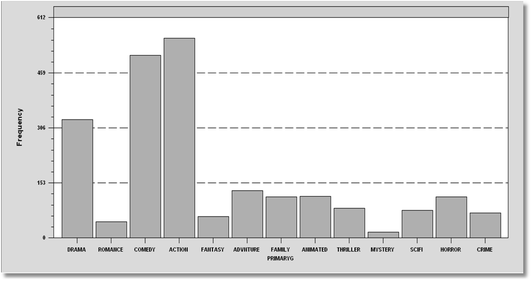
Movie Genres

Slide 13
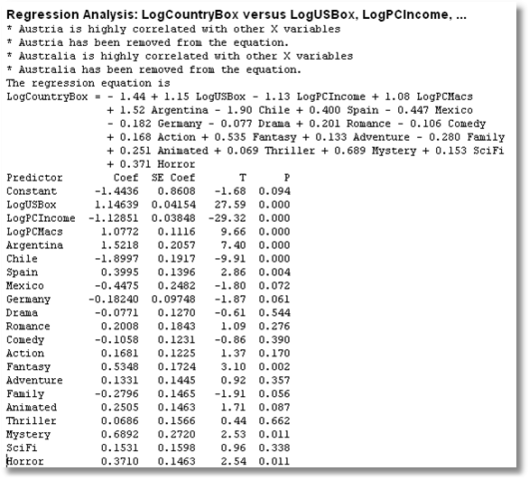
CRIME is the left out GENRE.
AUSTRIA is the left out country. Australia and UK were left out for other reasons (algebraic problem with only 8 countries).

Slide 14
Scaling the Data
Units of measurement and coefficients
Macro data and per capita figures
Micro data and normalizations

Slide 15
Units of Measurement
y = a + b₁x₁ + b₂x₂ + e
If you multiply every observation of variable x by the same constant, c, then the regression coefficient will be divided by c.
E.g., multiply X by .001 to change $ to thousands of $, then b is multiplied by 1000. b times x will be unchanged.

Slide 16
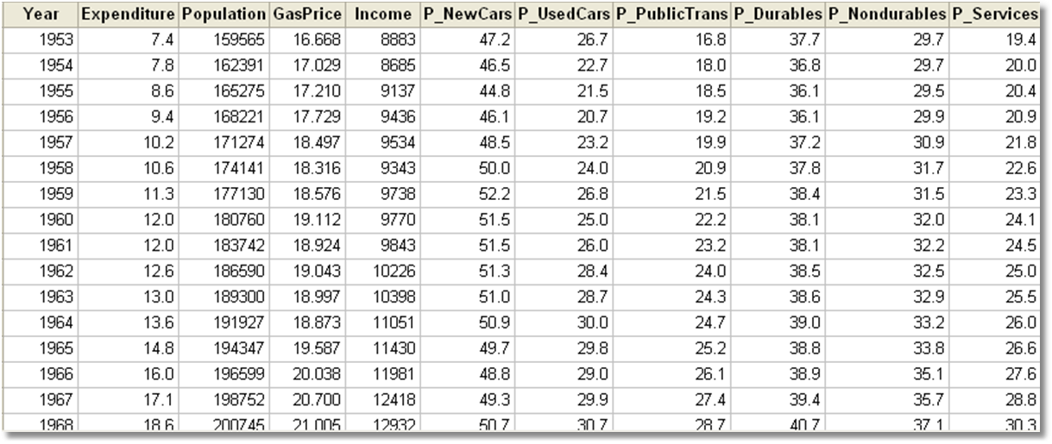
The Gasoline Market
Agregate consumption or expenditure data would not be interesting. Income data are already per capita.

Slide 17
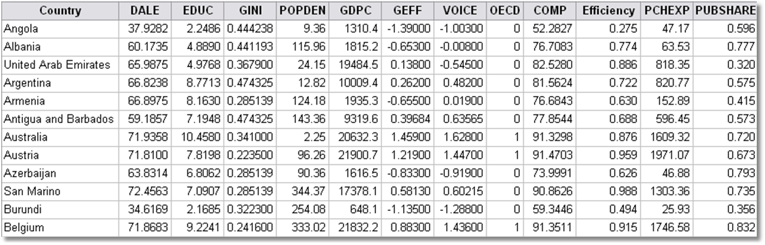
The WHO Data
Per Capita GDP and Per Capita Health Expenditure.
Aggregate values would make no sense.
Years

Slide 18
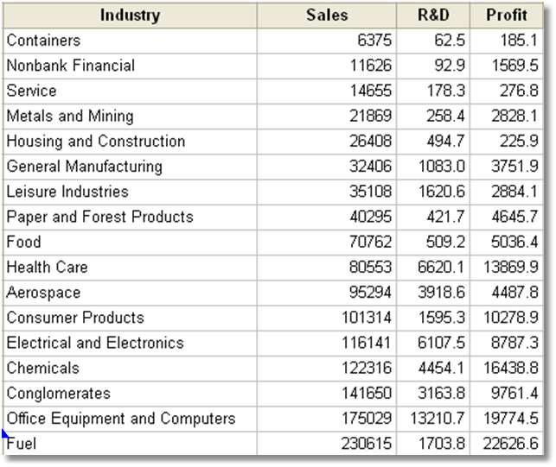
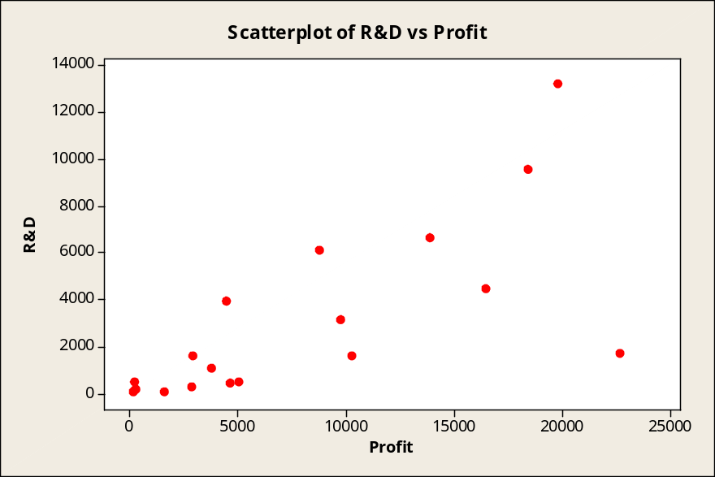
Profits and R&D by Industry
Is there a relationship between R&D and Profits?
This just shows that big industries have larger profits and R&D than small ones.
Gujarati, D. Basic Econometrics, McGraw Hill, 1995, p. 388.

Slide 19
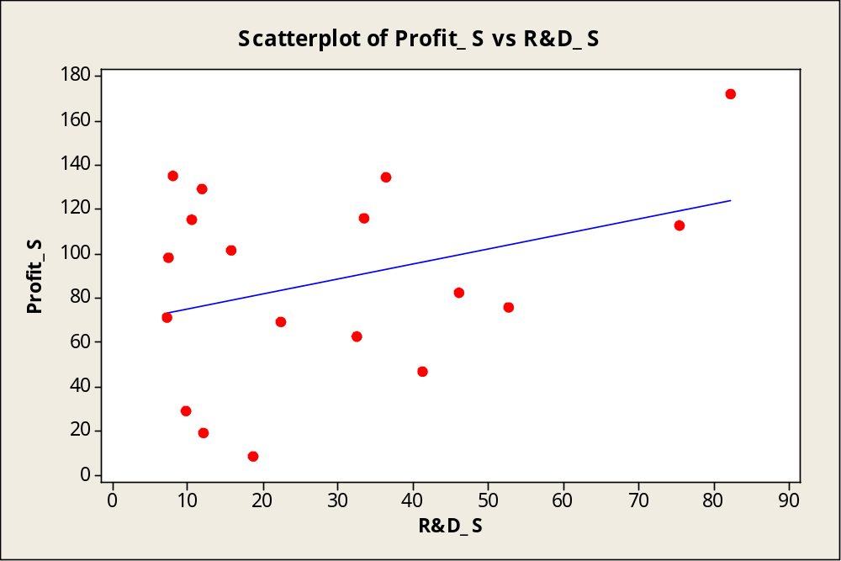
Normalized by Sales
Profits/Sales = α + β R&D/Sales + ε

Slide 20
Using Residuals to Locate Outliers
As indicators of “bad” data
As indicators of observations that deserve attention
As a diagnostic tool to evaluate the regression model

Slide 21
Residuals
Residual = the difference between the actual value of y and the value predicted by the regression.
E.g., Switzerland:
  Estimated equation is
  DALE = 36.900 + 2.9787*EDUC + .004601*PCHexp
  Swiss values are EDUC=9.418360, PCHexp=2646.442
  Regression prediction = 77.1307
  Actual Swiss DALE = 72.71622
  Residual = 72.71622 – 77.1307 = -4.41448
The regression overpredicts Switzerland

Slide 22
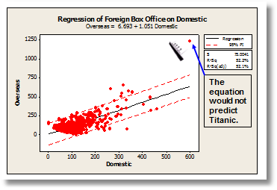
Outlier

Slide 23
When to Remove “Outliers”
Outliers have very large residuals
Only if it is ABSOLUTELY necessary
  The data are obviously miscoded
  There is something clearly wrong with the observation
Do not remove outliers just because Minitab flags them. This is not sufficient reason.

Slide 24



Slide 25
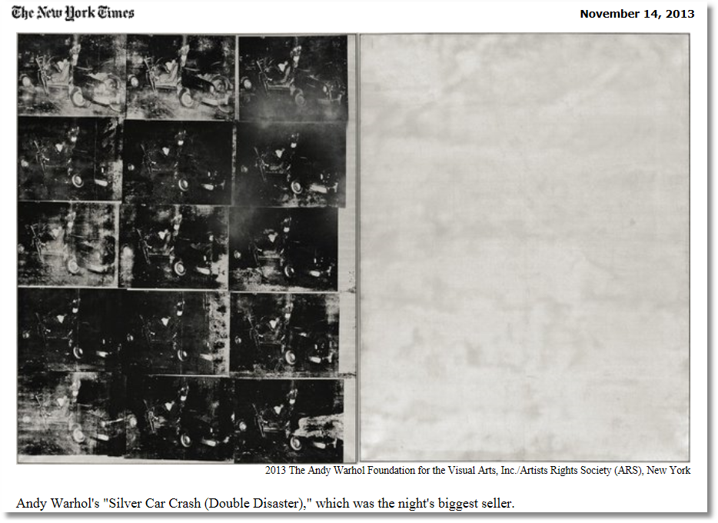

Slide 26
Final prices include the buyer’s premium: 25 percent of the first $100,000; 20 percent from $100,000 to $2 million; and 12 percent of the rest. Estimates do not reflect commissions.
(Also a 12% seller’s commission.)

Slide 27
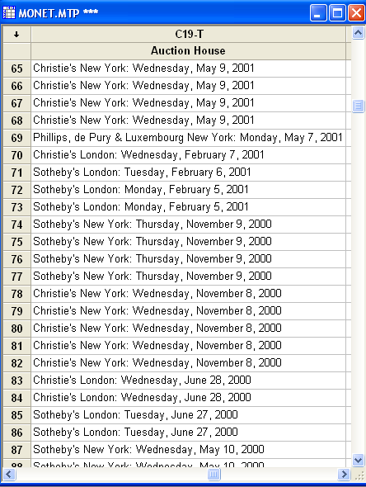
A Conspiracy Theory for Art Sales at Auction
Sotheby’s and Christies, 1995 to about 2000 conspired on commission rates.

Slide 28


Multicollinearity
Enhanced Monet Area Effect Model: Height and Width Effects
Log(Price) = α + β₁ log Area +
β₂ log Width +
β₃ log Height +
β₄ Signature +
ε
What’s wrong with this model?
Not a Monet; Sold 4/12/12, $120M.

Slide 29
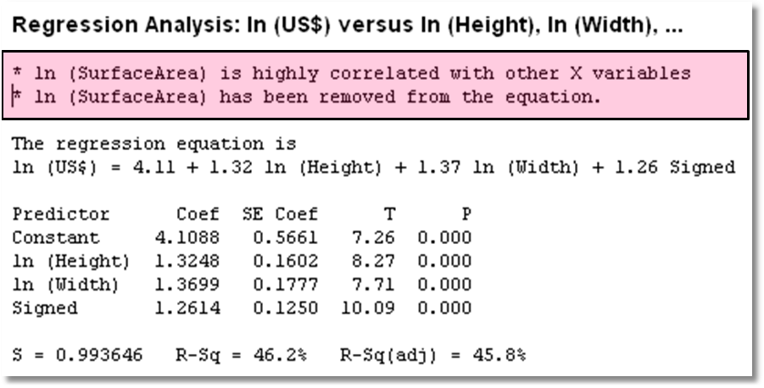
Minitab to the Rescue (?)

Slide 30
What’s Wrong with the Model?
Enhanced Monet Model: Height and Width Effects
Log(Price) = α + β₁ log Height +
β₂ log Width +
β₃ log Area +
β₄ Signature +
ε
β₃ = The effect on logPrice of a
change in logArea while holding
logHeight, logWidth and Signature
constant.
It is not possible to vary the area while holding Height and Width constant.
Area = Width * Height
For Area to change, one of the other variables must change. Regression requires for it to be possible for the variables to vary independently.

Slide 31
Symptoms of Multicollinearity
Imprecise estimates
Implausible estimates
Very low significance (possibly with very high R²)
Big changes in estimates when the sample changes even slightly

Slide 32
The Worst Case: Monet Data
Enhanced Monet Model: Height and Width Effects
Log(Price) = α + β₁ log Height +
β₂ log Width +
β₃ log Area +
β₄ Signature +
ε
What’s wrong with this model?
Once log Area and log Width are known, log Height contains zero additional information:
log Height = log Area – log Width
R² in model
log Height = a + b₁ log Area +
b₂ log Width +
b₃ Signed + e
will equal 1.0000000. A perfect fit.
a=0.0, b₁=1.0, b₂=-1.0, b₃=0.0.

Slide 33
Gasoline Market
Regression Analysis: logG versus logIncome, logPG
The regression equation is
logG = - 0.468 + 0.966 logIncome - 0.169 logPG
Predictor Coef SE Coef T P
Constant -0.46772 0.08649 -5.41 0.000
logIncome 0.96595 0.07529 12.83 0.000
logPG -0.16949 0.03865 -4.38 0.000
S = 0.0614287 R-Sq = 93.6% R-Sq(adj) = 93.4%
Analysis of Variance
Source DF SS MS F P
Regression 2 2.7237 1.3618 360.90 0.000
Residual Error 49 0.1849 0.0038
Total 51 2.9086
R² = 2.7237/2.9086 = 0.93643

Slide 34
Gasoline Market
Regression Analysis: logG versus logIncome, logPG, ...
The regression equation is
logG = - 0.558 + 1.29 logIncome - 0.0280 logPG
- 0.156 logPNC + 0.029 logPUC - 0.183 logPPT
Predictor Coef SE Coef T P
Constant -0.5579 0.5808 -0.96 0.342
logIncome 1.2861 0.1457 8.83 0.000
logPG -0.02797 0.04338 -0.64 0.522
logPNC -0.1558 0.2100 -0.74 0.462
logPUC 0.0285 0.1020 0.28 0.781
logPPT -0.1828 0.1191 -1.54 0.132
S = 0.0499953 R-Sq = 96.0% R-Sq(adj) = 95.6%
Analysis of Variance
Source DF SS MS F P
Regression 5 2.79360 0.55872 223.53 0.000
Residual Error 46 0.11498 0.00250
Total 51 2.90858
R² = 2.79360/2.90858 = 0.96047
logPG is no longer statistically significant when the other variables are added to the model.

Slide 35
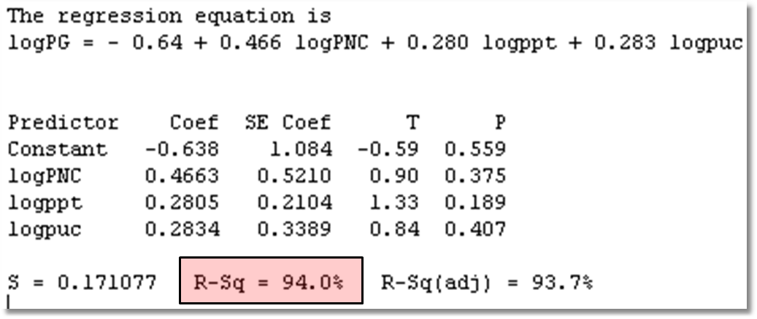
Evidence of Multicollinearity:
Regression of logPG on the other variables gives a very good fit.

Slide 36

Detecting Multicollinearity?
Not a “thing.” Not a yes or no condition.
More like “redness.”
Data sets are more or less collinear – it’s a shading of the data, a matter of degree.

Slide 37
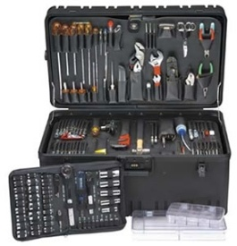
Diagnostic Tools
Look for incremental contributions to R² when additional predictors are added
Look for predictor variables not to be well explained by other predictors: (these are all the same)
Look for “information” and independent sources of information
Collinearity and influential observations can be related
  Removing influential observations can make it worse or better
  The relationship is far too complicated to say anything useful about how these two might interact.

Slide 38

Curing Collinearity?
There is no “cure.” (There is no disease)
There are strategies for making the best use of the data that one has.
  Choice of variables
  Building the appropriate model (analysis framework)

Slide 39
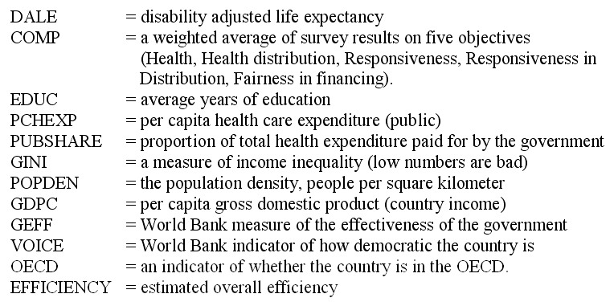
Choosing Among Variables for
WHO DALE Model
Dependent variable
Other dependent variable
Predictor variables
Created variable not used

Slide 40
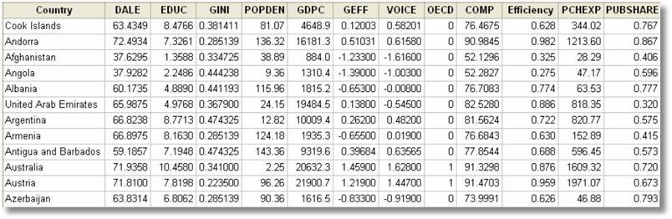
WHO Data

Slide 41
Choosing the Set of Variables
Ideally: Dictated by theory
Realistically
  Uncertainty as to which variables
  Too many to form a reasonable model using all of them
  Multicollinearity is a possible problem
Practically
  Obtain a good fit
  Moderate number of predictors
  Reasonable precision of estimates
  Significance agrees with theory

Slide 42
Stepwise Regression
Start with (a) no model, or (b) the specific variables that are designated to be forced to into whatever model ultimately chosen
(A: Forward) Add a variable: “Significant?” Include the most “significant variable” not already included.
(B: Backward) Are variables already included in the equation now adversely affected by collinearity? If any variables become “insignificant,” now remove the least significant variable.
Return to (A)
This can cycle back and forth for a while. Usually not.
Ultimately selects only variables that appear to be “significant”

Slide 43
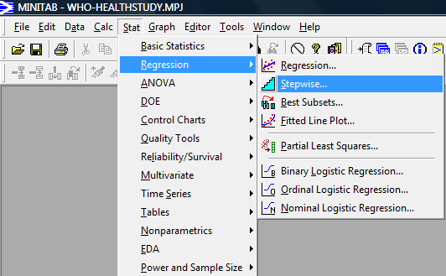
Stepwise Regression Feature

Slide 44
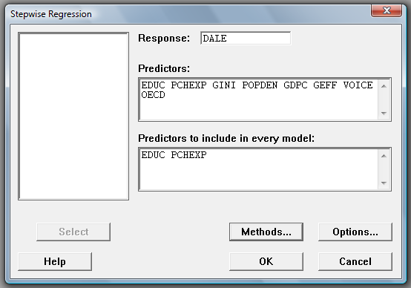
Specify Predictors
All predictors
Subset of predictors that must appear in the final model chosen (optional)
No need to change Methods or Options

Slide 45
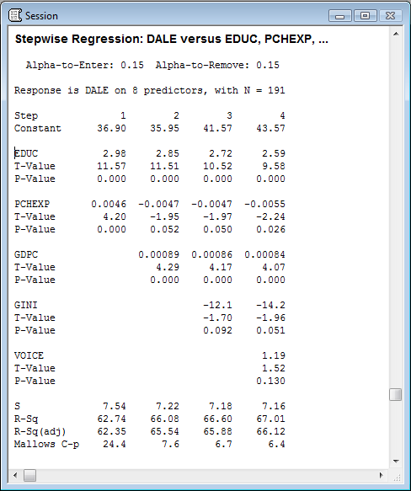
Stepwise Regression
Results
Used 0.15 as the cutoff “p-value” for inclusion or removal.

Slide 46
Stepwise Regression
What’s Right with It?
  Automatic – push button
  Simple to use. Not much thinking involved.
  Relates in some way to connection of the variables to each other – significance – not just R²
What’s Wrong with It?
  No reason to assume that the resulting model will make any sense
  Test statistics are completely invalid and cannot be used for statistical inference.

Slide 47
Summary
Data preparation: missing values
Residuals and outliers
Scaling the data
Finding outliers
Multicollinearity
Finding the best set of predictors using stepwise regression

