Slide 1

Statistics and Data Analysis
Professor William Greene
Stern School of Business
IOMS Department
Department of Economics

Slide 2
Statistics and Data Analysis
Part 21 – Multiple
Regression: 1

Slide 3


Slide 4


Slide 5


Slide 6
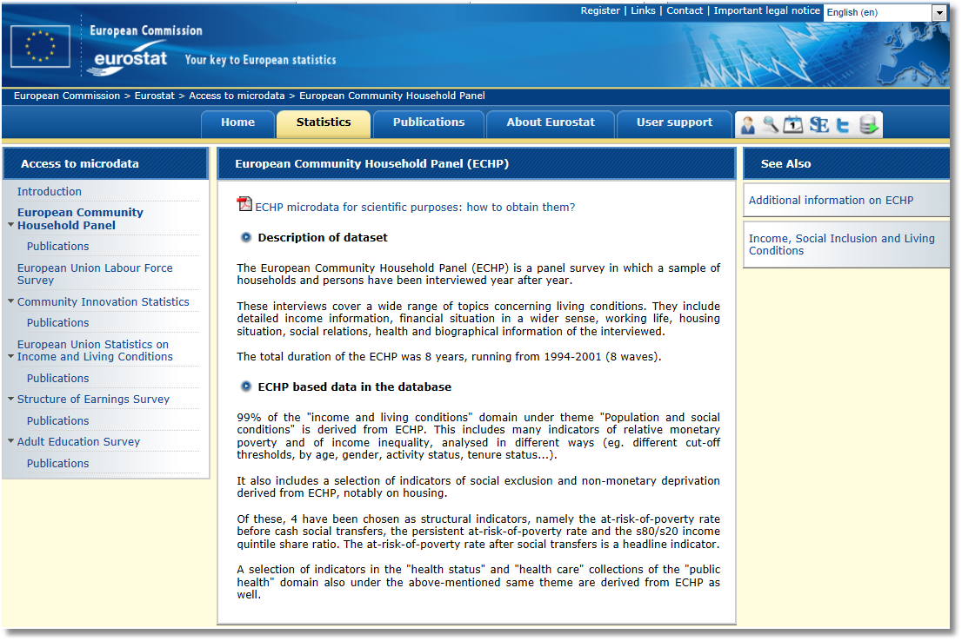

Slide 7


Slide 8
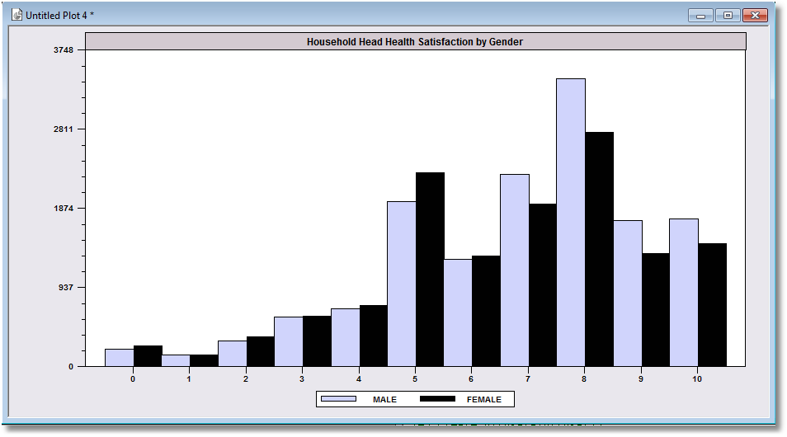

Slide 9
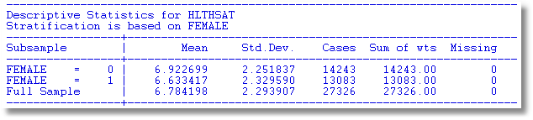
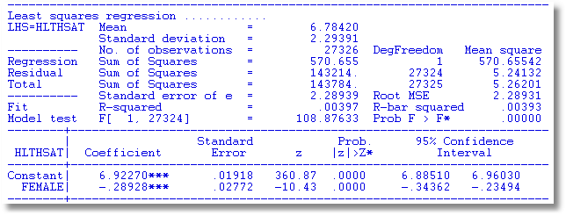
Women appear to assess health satisfaction differently from men.

Slide 10
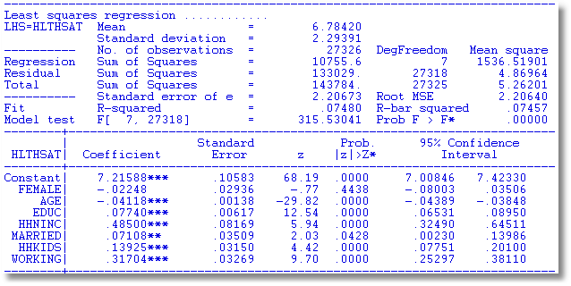
Or do they? Not when other things are held constant

Slide 11
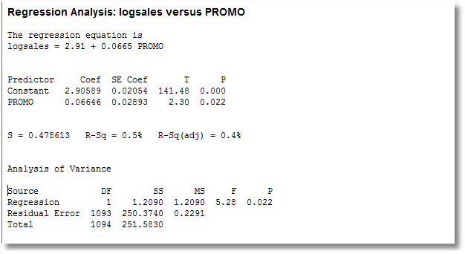

Slide 12
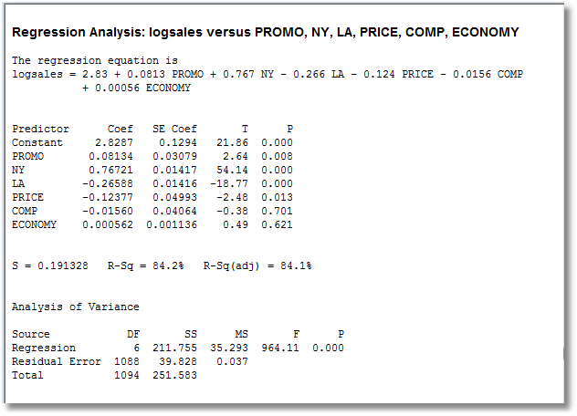

Slide 13
Multiple Regression Agenda
The concept of multiple regression
Computing the regression equation
Multiple regression “model”
Using the multiple regression model
Building the multiple regression model
Regression diagnostics and inference

Slide 14
Concept of Multiple Regression
Different conditional means
  Application: Monet’s signature
Holding things constant
  Application: Price and income effects
  Application: Age and education
  Sales promotion: Price and competitors
The general idea of multiple regression

Slide 15

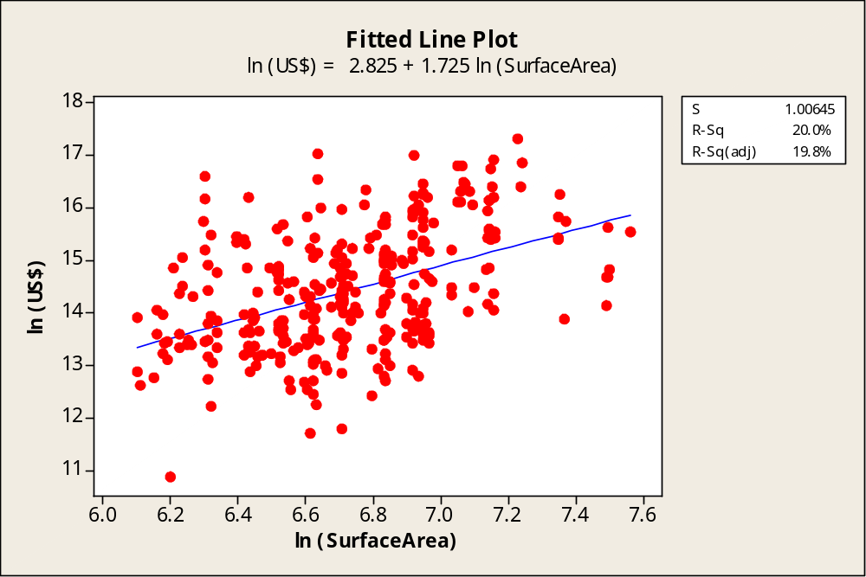
Monet in Large and Small
Logs of Sale prices of 328 signed Monet paintings
The residuals do not show any obvious patterns that seem inconsistent with the assumptions of the model.
Log of $price = a + b log surface area + e

Slide 16
How much for the signature?
The sample also contains 102 unsigned paintings
Average Sale Price
Signed $3,364,248
Not signed $1,832,712
Average price of a signed Monet is almost twice that of an unsigned one.

Slide 17
Can we separate the two effects?
Average Prices
Small Large
Unsigned 346,845 5,795,000
Signed 689,422 5,556,490
What do the data suggest?
(1) The size effect is huge
(2) The signature effect is confined to the
small paintings.

Slide 18
Thought experiments: Ceteris paribus
Monets of the same size, some signed and some not, and compare prices. This is the signature effect.
Consider signed Monets and compare large ones to small ones. Likewise for unsigned Monets. This is the size effect.

Slide 19
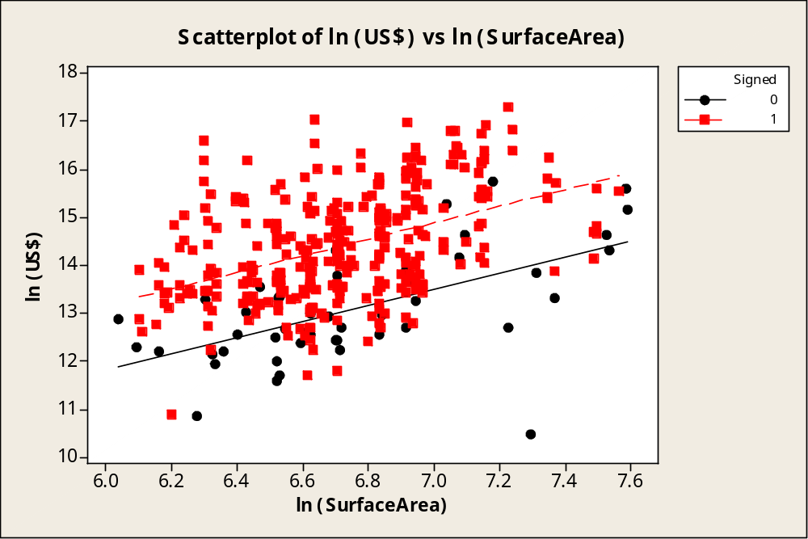
A Multiple Regression
b2
Ln Price = a + b1 ln Area + b2 (0 if unsigned, 1 if signed) + e

Slide 20
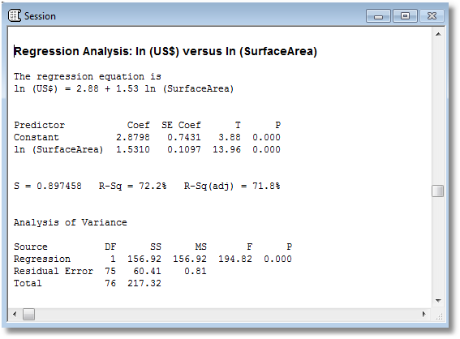

Slide 21
Monet Multiple Regression
Regression Analysis: ln (US$) versus ln (SurfaceArea), Signed
The regression equation is
ln (US$) = 4.12 + 1.35 ln (SurfaceArea) + 1.26 Signed
Predictor Coef SE Coef T P
Constant 4.1222 0.5585 7.38 0.000
ln (SurfaceArea) 1.3458 0.08151 16.51 0.000
Signed 1.2618 0.1249 10.11 0.000
S = 0.992509 R-Sq = 46.2% R-Sq(adj) = 46.0%
Interpretation (to be explored as we develop the topic):
(1) Elasticity of price with respect to surface area is 1.3458 – very large
(2) The signature multiplies the price by exp(1.2618) (about 3.5), for any
given size.

Slide 22
Ceteris Paribus in Theory
Demand for gasoline:
G = f(price,income)
Demand (price) elasticity:
e_{P} = %change in G given %change in P holding income constant.
How do you do that in the real world?
  The “percentage changes”
  How to change price and hold income constant?

Slide 23
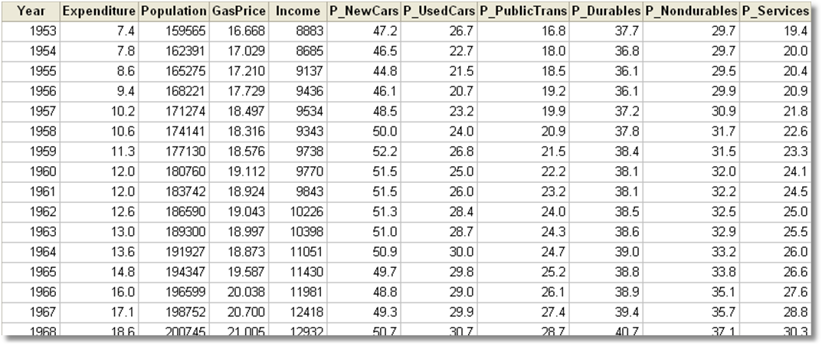
The Real World Data

Slide 24
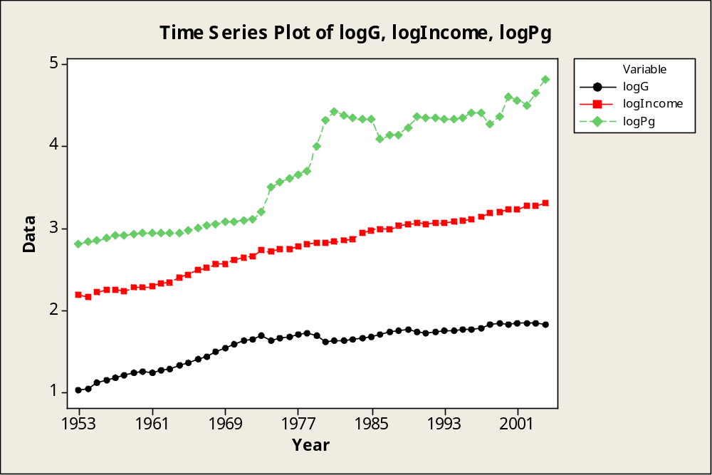
U.S. Gasoline Market, 1953-2004

Slide 25
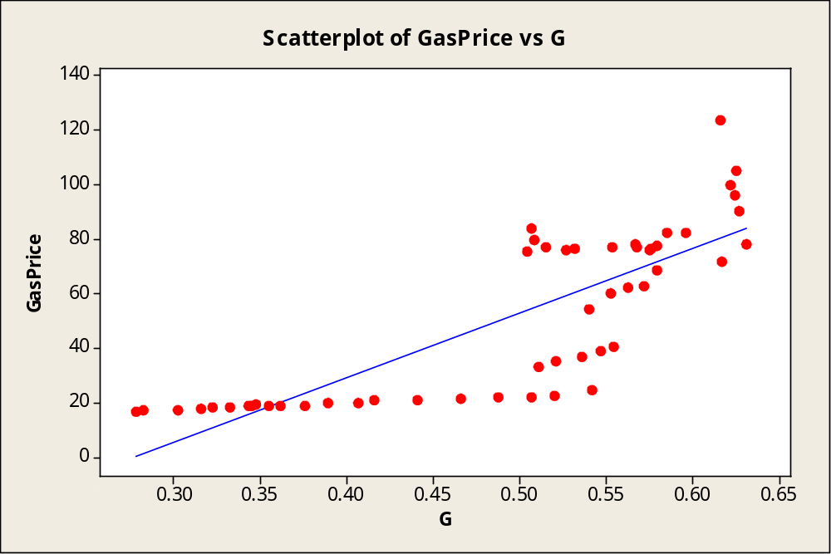
Shouldn’t Demand Curves Slope Downward?

Slide 26
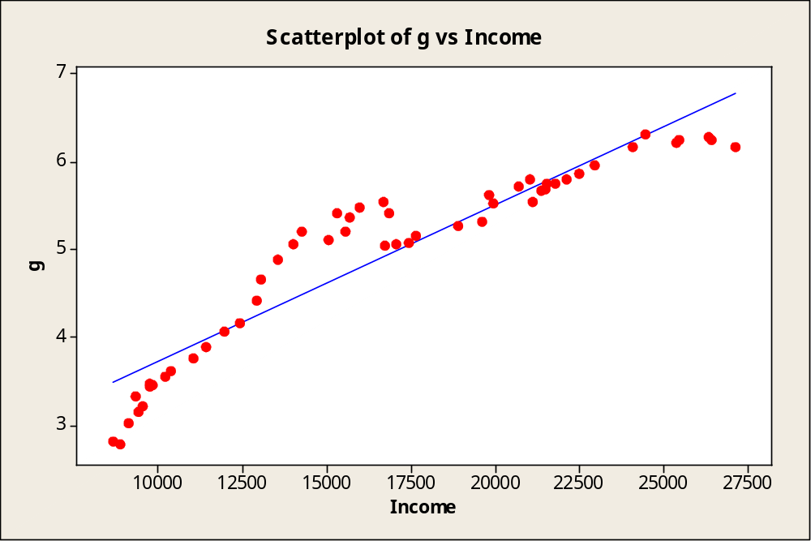
A Thought Experiment
The main driver of gasoline consumption is income not price
Income is growing over time.
We are not holding income constant when we change price!
How do we do that?

Slide 27
How to Hold Income Constant?
Multiple Regression Using Price and Income
Regression Analysis: G versus GasPrice, Income
The regression equation is
G = 0.134 - 0.00163 GasPrice + 0.000026 Income
Predictor Coef SE Coef T P
Constant 0.13449 0.02081 6.46 0.000
GasPrice -0.0016281 0.0004152 -3.92 0.000
Income 0.00002634 0.00000231 11.43 0.000
It looks like the theory works.

Slide 28
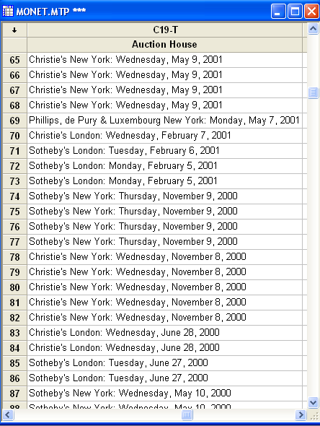
A Conspiracy Theory for Art Sales at Auction
Sotheby’s and Christies, 1995 to about 2000 conspired on commission rates.

Slide 29
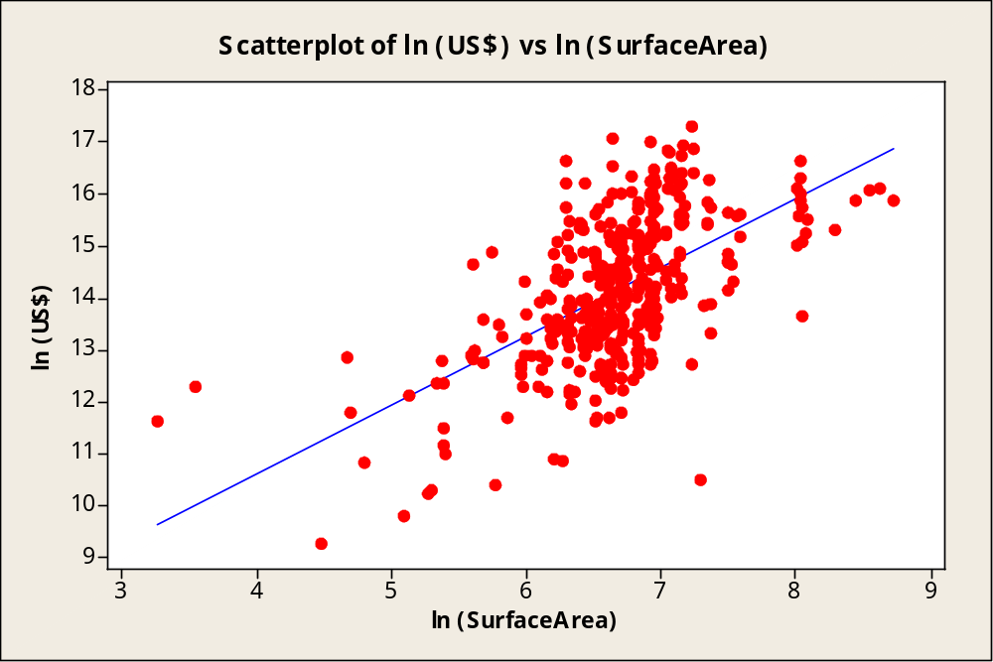
If the Theory is Correct…
Sold from 1995 to 2000
Sold before 1995 or after 2000

Slide 30
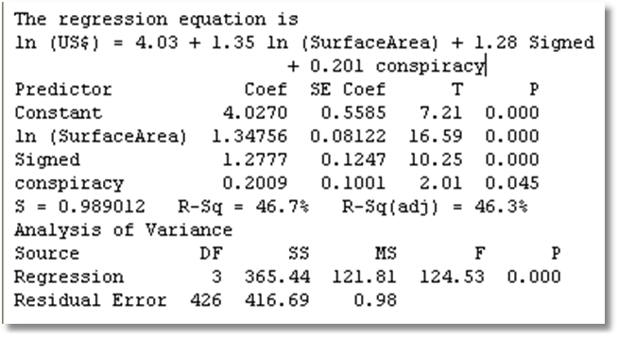
Evidence
The statistical evidence seems to be consistent with the theory.

Slide 31
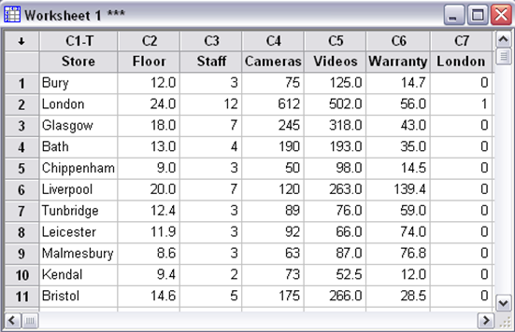
A Production Function Multiple Regression Model
Sales of (Cameras/Videos/Warranties) = f(Floor Space, Staff)

Slide 32
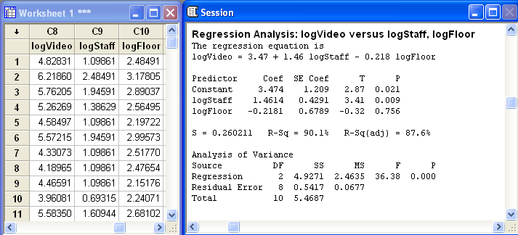
Production Function for Videos
How should I interpret the negative coefficient on logFloor?

Slide 33
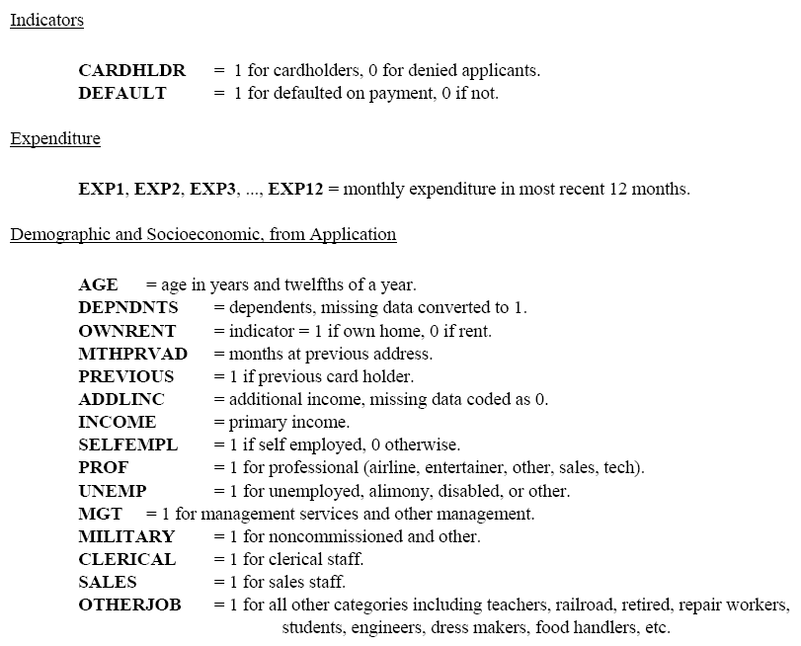
An Application to Credit Modeling

Slide 34
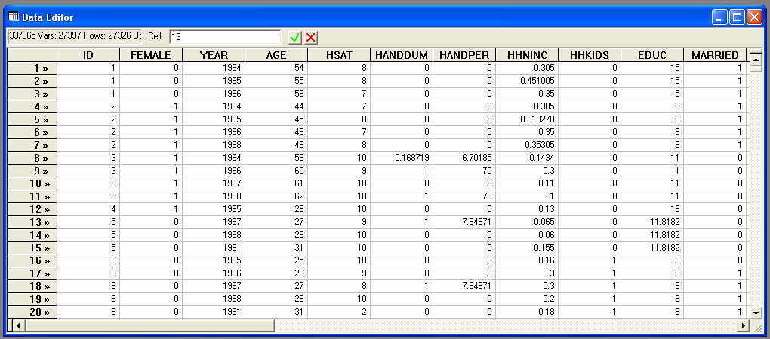
Age and Education Effects on Income

Slide 35
A Multiple Regression
+----------------------------------------------------+
| LHS=HHNINC Mean = .3520836 |
| Standard deviation = .1769083 |
| Model size Parameters = 3 |
| Degrees of freedom = 27323 |
| Residuals Sum of squares = 794.9667 |
| Standard error of e = .1705730 |
| Fit R-squared = .07040754 |
+----------------------------------------------------+
+--------+--------------+-----------+
|Variable| Coefficient | Mean of X|
+--------+--------------+-----------+
Constant| -.39266196
AGE | .02458140 43.5256898
EDUC | .01994416 11.3206310
+--------+--------------+-----------+

Slide 36
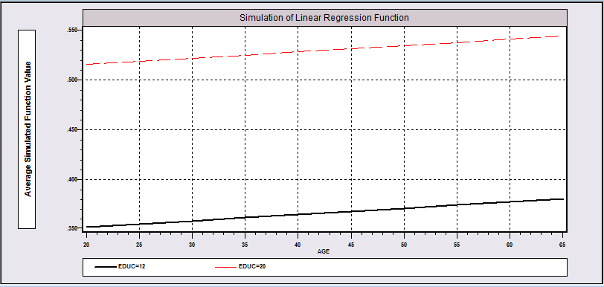
Education and Income Effects

Slide 37
Summary
Holding other things constant when examining a relationship
The multiple regression concept
Multiple regression model
Applications:
  Size and signature
  Model building for credit applications
  Quadratic relationship between income and education

