Slide 1

Statistics and Data Analysis
Professor William Greene
Stern School of Business
IOMS Department
Department of Economics

Slide 2
Statistics and Data Analysis
Part 20 – Aspects of
Regression

Slide 3
Regression Models
Using the regression model to predict the value of the dependent variable.
‘Cleaning’ the data to remove what look like extreme values.
  Trimming – removing values with extreme ‘x’
  Truncation – removing values with extreme ‘y’

Slide 4
Prediction
Use of the model for prediction
Use “x” to predict y based on y = α+βx+ε
Sources of uncertainty
  Predicting “x” first
  Using sample estimates of α and β (and, possibly, σ)
  Can’t predict noise, ε
  Predicting outside the range of experience – uncertainty about the reach of the regression model.

Slide 5
Base Case Prediction
Predict y with a given value of x*:
We would use the regression equation.
  True y = α + βx* + ε
  Since α and β must be estimated, the obvious estimate is y = a + bx
  We have no prediction for ε other than 0.
Sources of prediction error
  Can never predict ε at all
  The farther from the center of experience, the greater is the uncertainty.

Slide 6
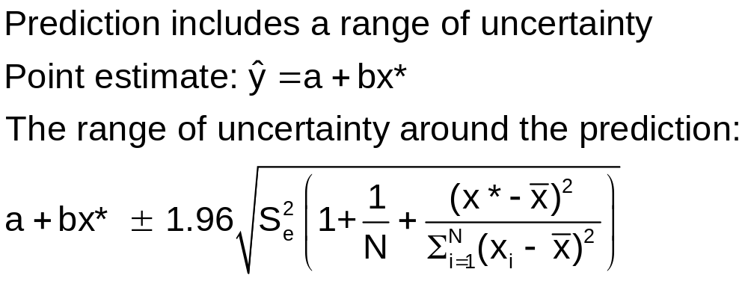
A Prediction Interval
The usual 95% Due to ε Due to estimating α and β with a and b
(Remember the empirical rule, 95% of the distribution will be within
two standard deviations.)

Slide 7
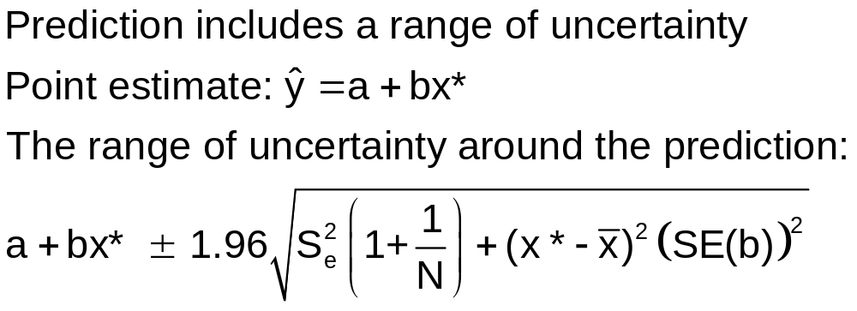
Slightly Simpler Formula for Prediction

Slide 8
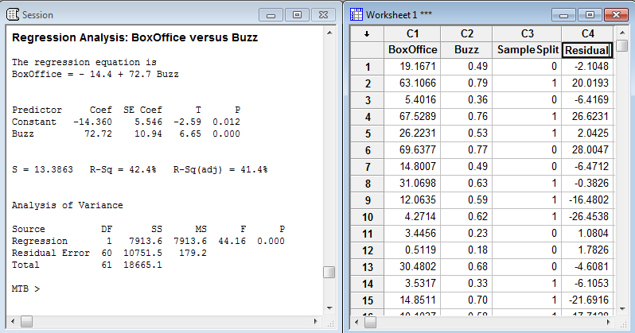
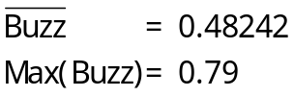
Prediction from Internet Buzz Regression

Slide 9
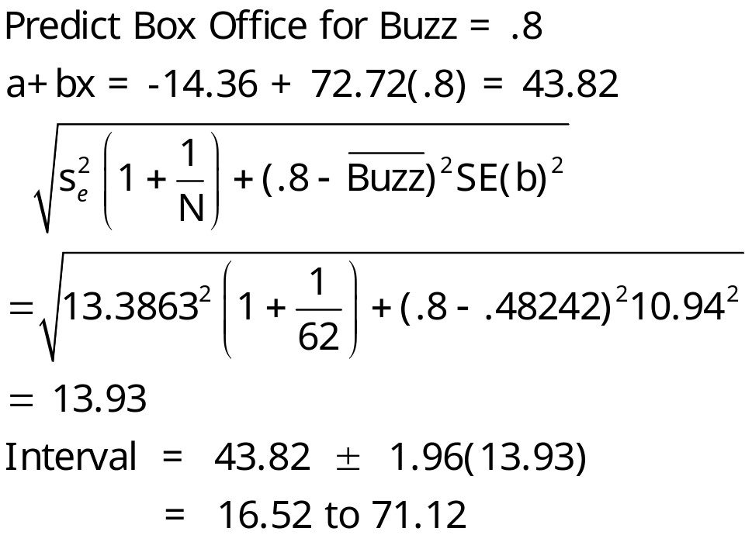
Prediction Interval for Buzz = .8

Slide 10
Predicting Using a Loglinear Equation
Predict the log first
  Prediction of the log
  Prediction interval – (Lower to Upper)
Prediction = exp(lower) to exp(upper)
This produces very wide intervals.

Slide 11
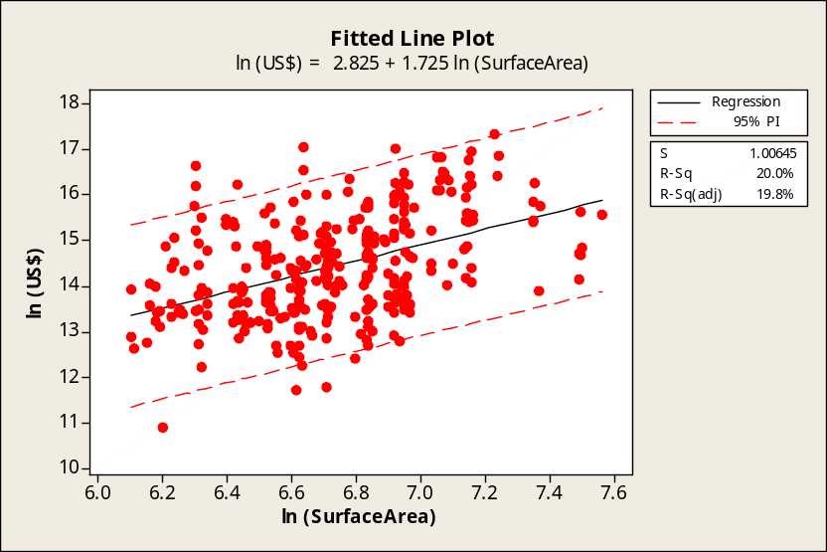
Interval Estimates for the Sample of Signed Monet Paintings
Regression Analysis: ln (US$) versus
ln (SurfaceArea)
The regression equation is
ln (US$) = 2.83 + 1.72 ln (SurfaceArea)
Predictor Coef SE Coef T P
Constant 2.825 1.285 2.20 0.029
ln (SurfaceArea) 1.7246 0.1908 9.04 0.000
S = 1.00645 R-Sq = 20.0% R-Sq(adj) = 19.8%
Mean of ln (SurfaceArea) = 6.72918

Slide 12

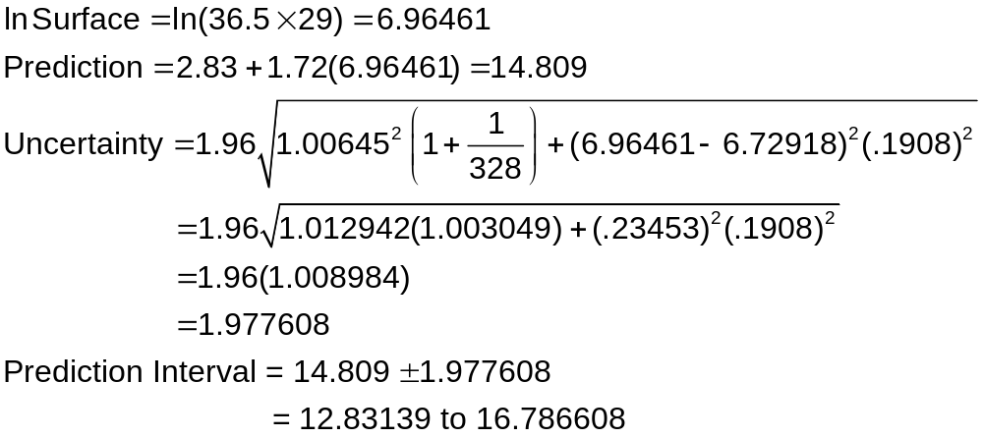
Prediction for An Out of Sample Monet
Claude Monet: Bridge Over a Pool of Water Lilies. 1899. Original, 36.5”x29.”

Slide 13
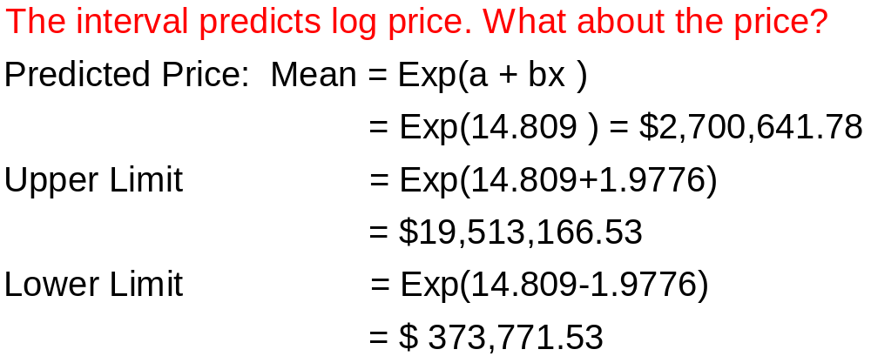
Predicting y when the Model Describes log y

Slide 14
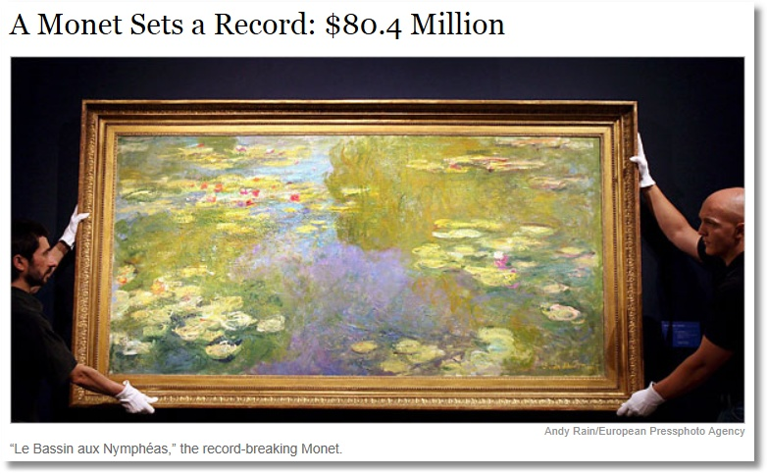
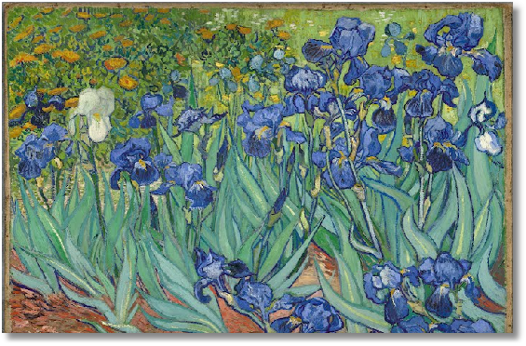
Van Gogh: Irises
39.5 x 39.125. Prediction by our model = $17.903M
Painting is in our data set. Sold for 16.81M on 5/6/04
Sold for 7.729M 2/5/01
Last sale in our data set was in May 2004
Record sale was 6/25/08. market peak, just before the crash.

Slide 15
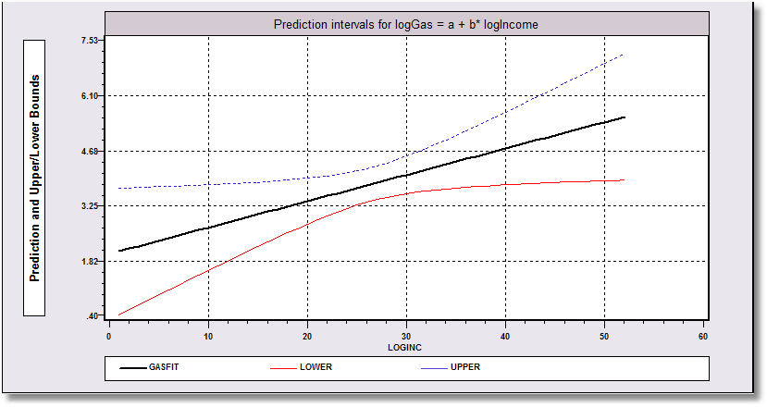

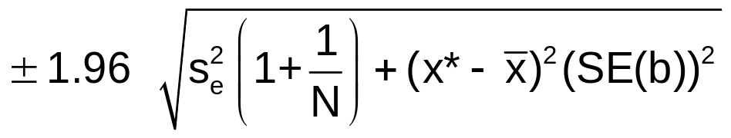
Uncertainty in Prediction
The interval is narrowest at x* = , the center of our experience.
The interval widens as we move away from the center of our experience to reflect the greater uncertainty.
(1) Uncertainty about the prediction of x
(2) Uncertainty that the linear
relationship will continue to exist as
we move farther from the center.

Slide 16

http://www.nytimes.com/2006/05/16/arts/design/16oran.html

Slide 17
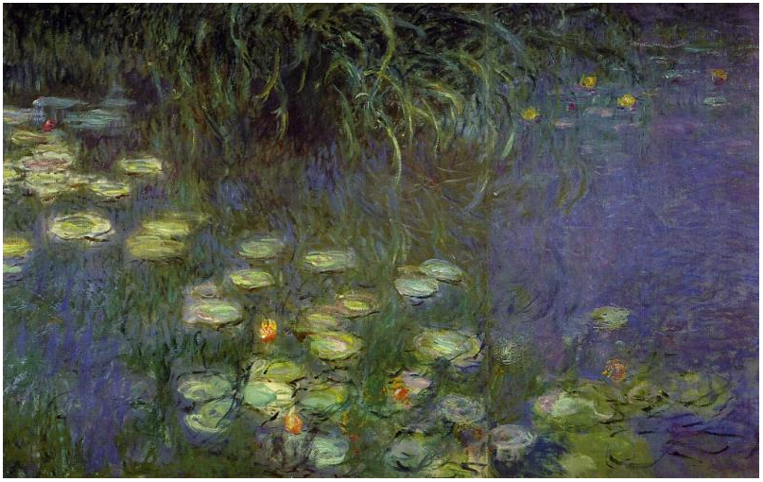
"Morning", Claude Monet 1920-1926, oil on canvas 200 x 425 cm, Musée de l Orangerie, Paris France. Left panel
167” (13 feet 11 inches)
78.74” (6 Feet 7 inch)
32.1” (2 feet 8 inches)
26.2” (2 feet 2.2”)

Slide 18
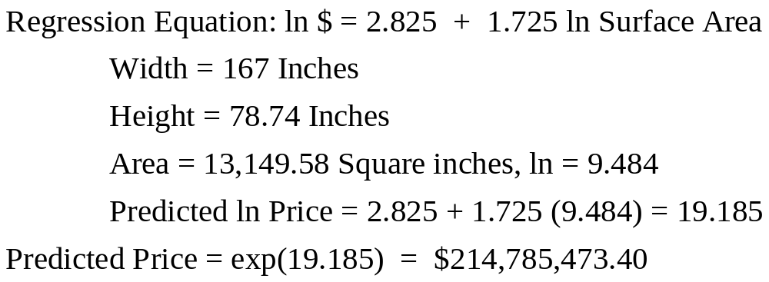
Predicted Price for a Huge Painting

Slide 19
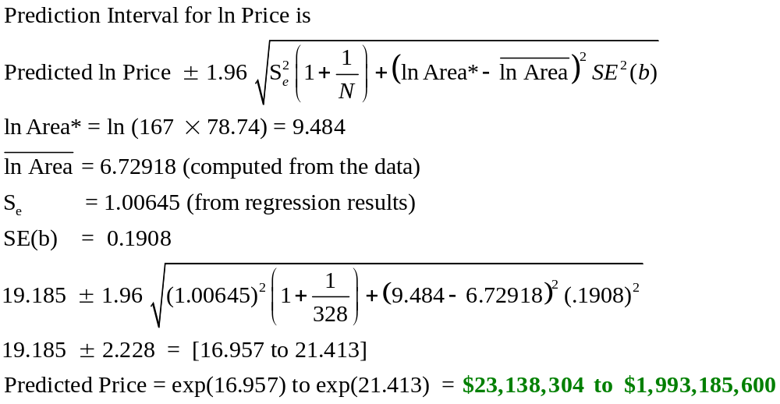
Prediction Interval for Price

Slide 20

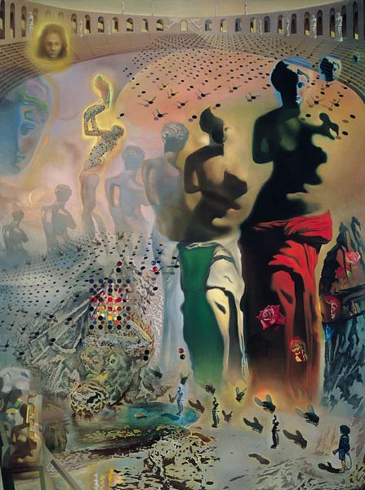
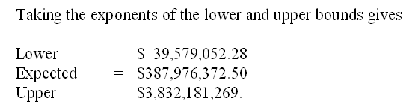
Use the Monet Model to Predict a Price for a Dali?
118” (9 feet 10 inches)
32.1” (2 feet 8 inches)
26.2” (2 feet 2.2”)
157” (13 Feet 1 inch)
Average Sized Monet
Hallucinogenic Toreador

Slide 22
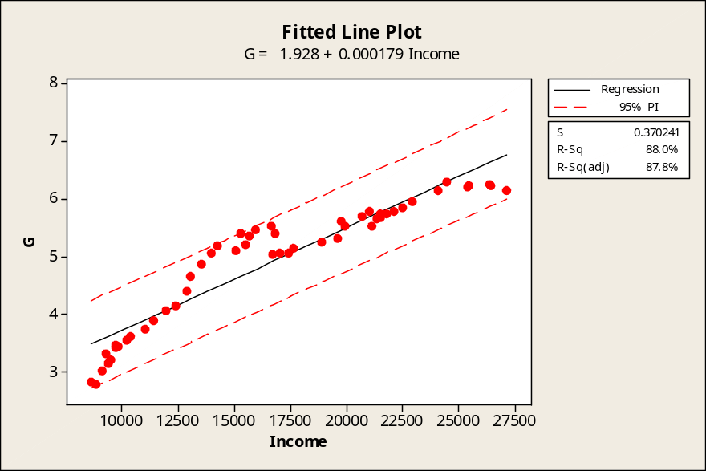
Forecasting Out of Sample
Regression Analysis: G versus Income
The regression equation is
G = 1.93 + 0.000179 Income
Predictor Coef SE Coef T P
Constant 1.9280 0.1651 11.68 0.000
Income 0.00017897 0.00000934 19.17 0.000
S = 0.370241 R-Sq = 88.0% R-Sq(adj) = 87.8%
How to predict G for 2017? You would need first to predict Income for 2017.
How should we do that?
Per Capita Gasoline Consumption vs. Per Capita Income, 1953-2004.

Slide 23
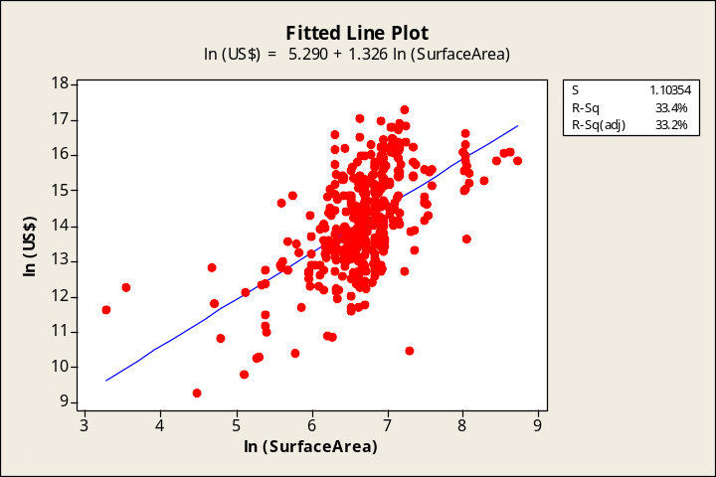

Data Trimming
Data→Subset Worksheet → Rows that match condition.
All 430 Sales:
4.290 + 1.326 log area
377 Sales of area 403.4 < area < 2981.0
(log > 6 and < 8)
3.068 + 1.662 log area
The sample is restricted to particular values of X – area between 403 and 2981. Trimming is generally benign, but the regression should be understood to apply to the specified range of x. The trimming is based on a variable not related to the underlying noise in Y.

Slide 24
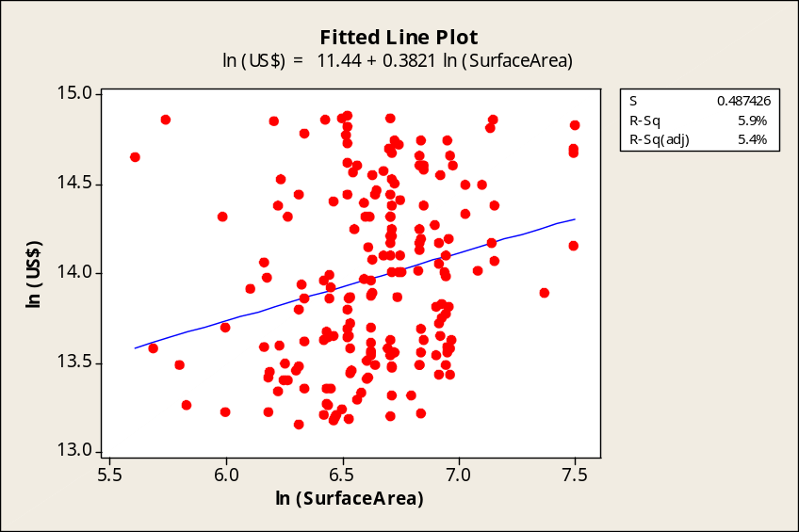
Truncation
Subsample: 500,000 < Price < 3,000,000
11.44 + 0.3821 log Area
Entire Sample: 5.290+1.326 log Area
Truncation based on the values of the dependent variable is VERY BAD. It reduces and sometimes destroys the relationship. This is one reason we resist removing “outliers” from the sample.

Slide 25
Where Have We Been?
Sample data – describing, display
Probability models
  Models for random experiments
  Models for random processes underlying sample data
Random variables
Models for covariation of random variables
Linear regression model for covariation of a pair of variables

Slide 26
Where Do We Go From Here?
Simple linear regression
  Thus far, mostly a descriptive device
  Use for prediction and forecasting
  Yet to consider: Statistical inference, testing the relationship
Multiple linear regression
  More than one variable to explain the variation of Y
  More elaborate model building

