Slide 1
Statistics and Data Analysis
Professor William Greene
Stern School of Business
IOMS Department
Department of Economics

Slide 2
Statistics and Data Analysis
Part 2 – Descriptive Statistics
Summarizing data with useful statistics

Slide 3
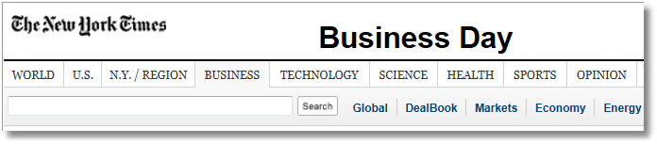

Use random samples and basic descriptive statistics.
What is the ‘breach rate’ in a pool of tens of thousands of mortgages? (‘Breach’ = improperly underwritten or serviced or otherwise faulty mortgage.)

Slide 4
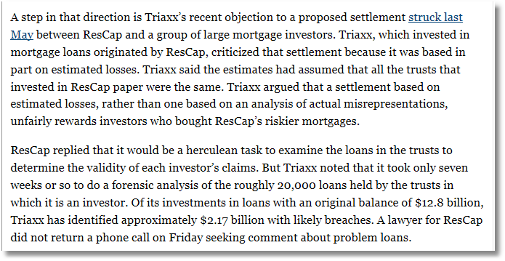
The forensic analysis was an examination of statistics from a random sample of 1,500 loans.

Slide 5
Descriptive Statistics
Agenda
Populations and Random Samples
Descriptive Statistics for a Variable
  Measures of location: Mean,median,mode
  Measure of dispersion: Standard deviation
Measuring Correlation of Two Variables
  Understanding correlation
  Measuring correlation
  Scatter plots and regression

Slide 6
Populations and Samples
Population: Collection of all possible observations (data points) on a variable
Sample: A subset of the data points in the population
Random sample: Defined by the way the sample data are obtained. All points in the population are equally likely to be drawn in any particular sample.
What is the purpose of obtaining a sample?
To describe or learn about the population.
  The sample is observed
  The population is assumed.
In order to learn confidently about the population from a sample, the sample must be ‘random.’

Slide 7
Random Sampling
A production process produces circuit boards. Boards are produced in each hour with an average of 2 defects per board when the process is in control. Each hour, the engineer examines a random sample of 100 circuit boards. The average number of defects per board in a particular 30 hour week is
Hour 1: Mean of 100 boards = 1.95,
Hour 2: “ 2.65,
Hour 3: “ 1.80, …
Hour 30: “ 2.35.
(These are estimates of the defect rate per board)
The objective of drawing the sample is to determine whether the process is in control or not. The process is under control if the defect rate is < 2.)
Method: Assuming the process is in control, would we expect to see this rate of defects?

Slide 8
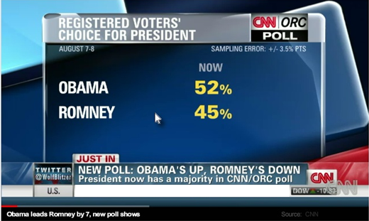
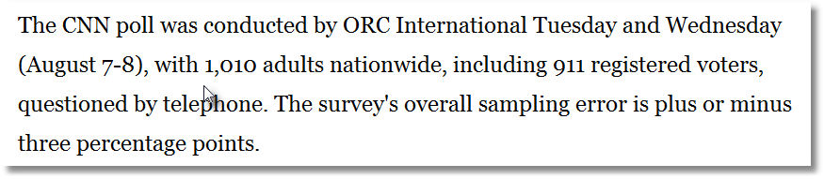
Random samples of behavior are difficult
to obtain, especially by telephone.

Slide 9
Nonrandom Samples
Nonrandom samples produce tainted, sometimes not believable results
  Biased with respect to the population
  May describe a not useful specific subset of the population.

Slide 10
(Non)Randomness of Samples
Sources of bias in samples (generally related)
  Bad sample design – e.g., home phone surveys conducted during working hours
  Survey (non)response bias – e.g., opinion surveys about service quality
  Participation bias – e.g., voluntary participation in a survey
  Self selection – volunteering for a trial or an opinion sample. (Shere Hite’s cultural revolution)
  Attrition bias from clinical trials - e.g., if the drug works, the subject does not come back.

Slide 11
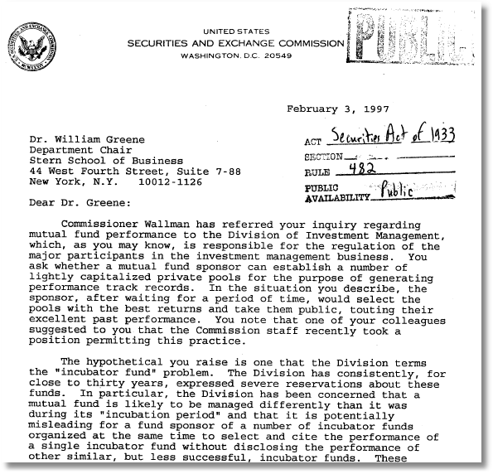
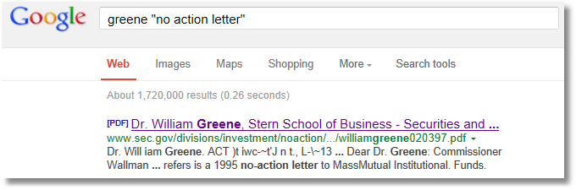
Nonrandom results in incubator funds.
The “NYU No Action Letter”

Slide 12

Nonscientific, Nonrandom “(non)Sampling”
A Cultural Revolution …
“3000 women, ages 14 to 78 describe in their own words …”

Slide 13

http://www.amazon.com/The-Hite-Report-National-Sexuality/dp/1583225692
A Cultural Revolution …
“3000 women, ages 14 to 78 describe in their own words …”

Slide 14
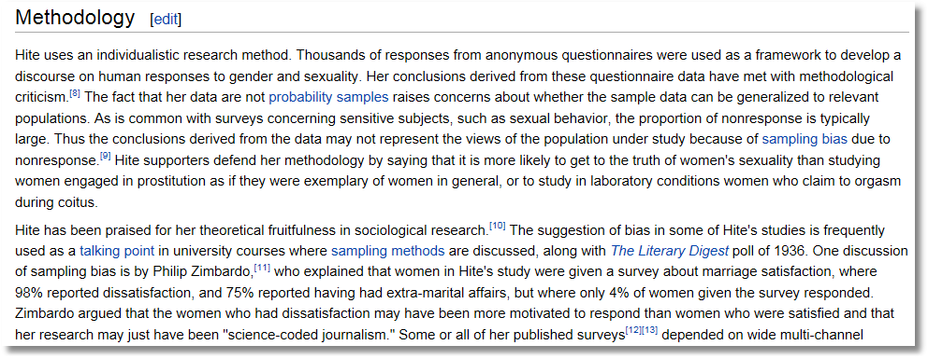
http://en.wikipedia.org/wiki/Shere_Hite

Slide 15
The Lesson…
Having a really big sample does not assure you of an accurate result. It may assure you of a really solid, really bad (inaccurate) result.

Slide 16

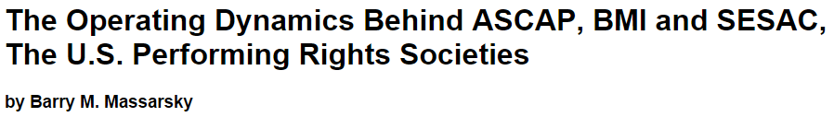
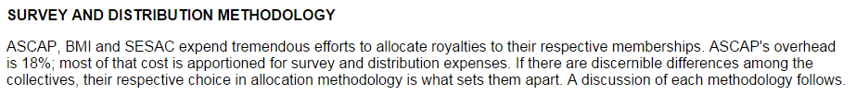
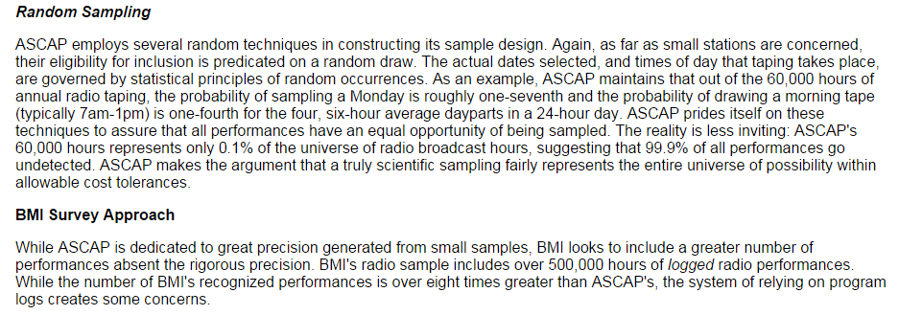
How do ASCAP, BMI and SESAC allocate the royalty pool to specific authors and publishers? The following relates to terrestrial radio, which, as a group, pays a lump sum into the pool, which is then allocated by the PRSs.
http://old.cni.org/docs/ima.ip-workshop/Massarsky.html

Slide 17
A Descriptive Statistic
Is … ?
Describes what?
  The sample data
  The population that the data came from

Slide 18
Measures of Location
These are 30 hours of average defect data on sets of circuit boards. Roughly what is the typical value?
1.45 1.65 1.50 2.25 1.65 1.60 2.30 2.20 2.70 1.70
2.35 1.70 1.90 1.45 1.40 2.60 2.05 1.70 1.05 2.35
1.90 1.55 1.95 1.60 2.05 2.05 1.70 2.30 1.30 2.35
Location and central tendency
  There exists a distribution of values
  We are interested in the “center” of the distribution
Two measures are the sample mean and the sample median
They look similar, and measure the same thing.
They differ systematically (and predictably) when the data are not ‘symmetric.’

Slide 19
The Sample Mean
These are 30 hours of average defect data on sets of circuit boards. Roughly what is the typical value?
1.45 1.65 1.50 2.25 1.65 1.60 2.30 2.20 2.70 1.70
2.35 1.70 1.90 1.45 1.40 2.60 2.05 1.70 1.05 2.35
1.90 1.55 1.95 1.60 2.05 2.05 1.70 2.30 1.30 2.35

Slide 20
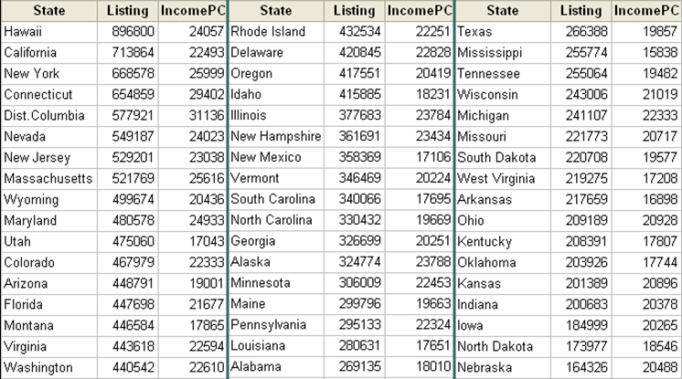
It may be necessary to ‘weight’ aggregate data.
Average Home Listings

Slide 21
Averaging Averages?
Hawaii’s average listing = $896,800
Hawaii’s population = 1,275,194
Illinois’ average listing = $377,683
Illinois’ population = 12,763,371
Illinois and Hawaii each get weight 1/51 = .019607 when the mean is computed.
Looks like Hawaii is getting too much influence.

Slide 22
A Properly Weighted Average
New average is 409,234 compared to 369,687 without weights, an error of 11%. Sometimes an unequal weighting of the observations is necessary.
State populations from http://www.factmonster.com/ipka/A0004986.html

Slide 23
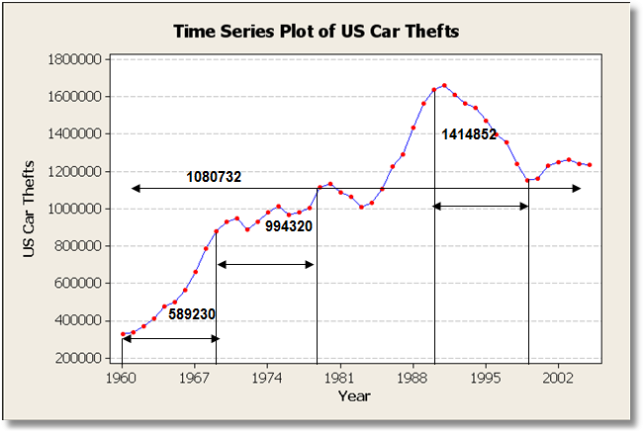
Averaging Trending Time Series
Observations Is Usually Not Informative
Note how the mean changes completely depending on what time interval is used to compute it.
Does the mean over the entire observation period mean anything? (Does it estimate anything meaningful?)

Slide 24
The Sample Median
Median = the middle observation after data are sorted.
Odd number: Central observation: Med[1,2,4,6,8,9,17] = 6
Even number: Midpoint between the two central observations Med[1,2,4,6,8,9,14,17] = (6+8)/2=7

Slide 25
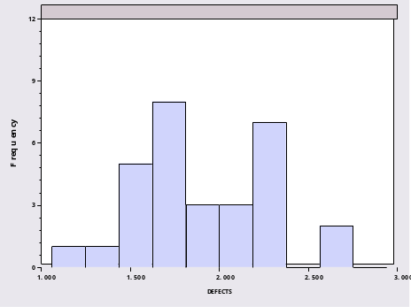
Sample Median of (Sorted) Defects Data
1.05 1.30 1.40 1.45 1.45 1.50
1.55 1.60 1.60 1.65 1.65 1.70
1.70 1.70 1.70 1.90 1.90 1.95
2.05 2.05 2.05 2.20 2.25 2.30
2.30 2.35 2.35 2.35 2.60 2.70
Median = 1.8000
Mean = 1.8767

Slide 26
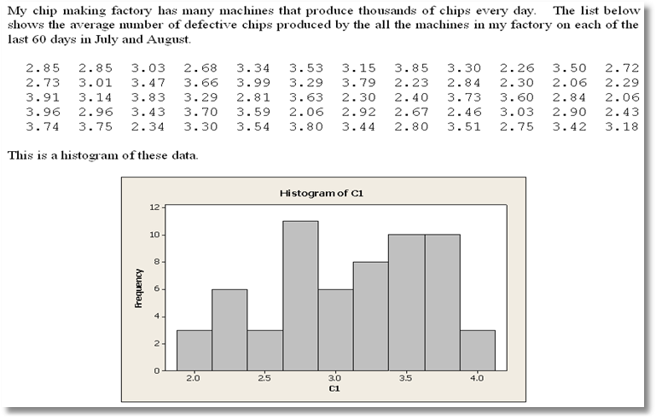
(Let’s deduce estimates of the mean and median from the histogram.)
Tomorrow I will compute the average number of defectives
for a 61st day. What is a good guess of the number I will find?

Slide 27
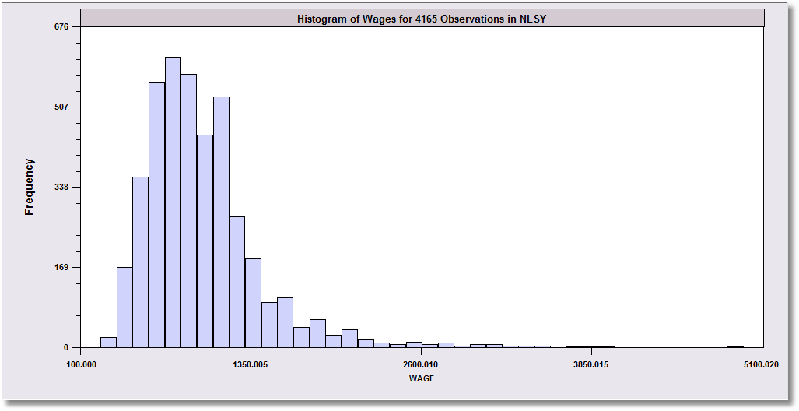
Skewed Earnings Distribution
Mean vs. Median in Skewed Data
Monthly Earnings
N = 595,
Median = 800
Mean = 883
These data are skewed to the right.
The mean will exceed the median when the distribution is skewed to the right. (The skewness is in the direction of the long tail.)

Slide 28
Extreme Observations Distort
Means but Not Medians
Outlying observations distort the mean
  Med [1,2,4,6,8,9,17] = 6
  Mean[1,2,4,6,8,9,17] = 6.714
  Med [1,2,4,6,8,9,17000] = 6 (still)
  Mean[1,2,4,6,8,9,17000] = 2432.8 (!)
This typically occurs when there are some outlying obervations, such as in cross sections of income or wealth and/or when the sample is not very large.

Slide 29

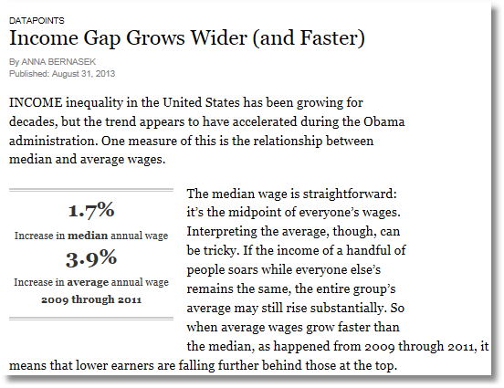
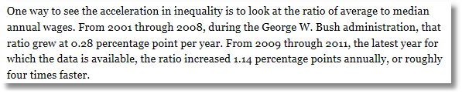

Slide 30

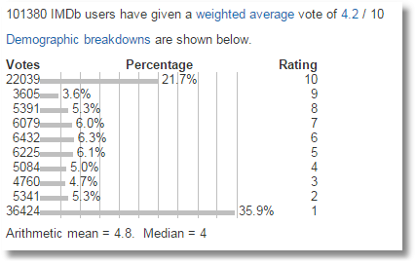
The mean does not give information about the shape of the distribution.
Two problems with the computations
(1) The data are ratings, not quantitative
(2) The mean does not suggest the
extreme nature of the data

Slide 31
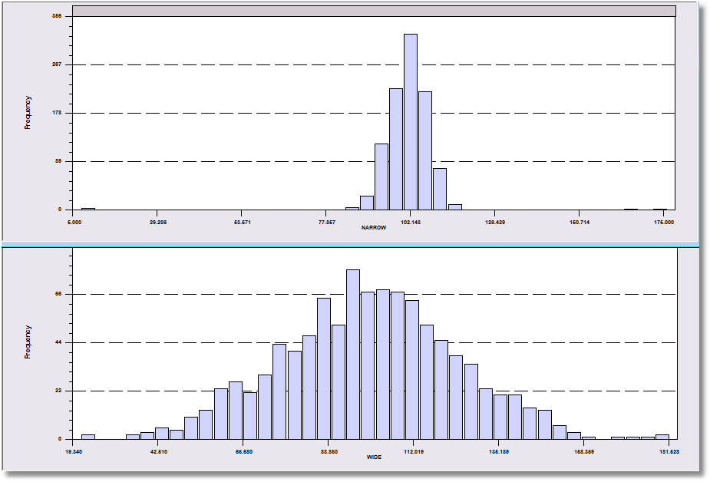
The problem with the mean or median as a description of a sample – more information is usually needed.
Both data sets have a mean of about 100.

Slide 32
Dispersion of the Observations
These are 30 hours of average defect data on sets of circuit boards.
1.45 1.65 1.50 2.25 1.65 1.60 2.30 2.20 2.70 1.70
2.35 1.70 1.90 1.45 1.40 2.60 2.05 1.70 1.05 2.35
1.90 1.55 1.95 1.60 2.05 2.05 1.70 2.30 1.30 2.35
We quantify the variation of the values around the mean. Note the range is from 1.05 to 2.70. This gives an idea where the data lie. The mean plus a measure of the variation do the same job.

Slide 33
The Problem with the Range as a Measure of Dispersion
These two data sets both have 1,000 observations
that range from about 10 to about 180

Slide 34
A Measure of Dispersion
The standard deviation is the interesting value. You need to compute the variance to get the standard deviation.
Variance = s_{y}² =
Standard deviation = s_{y} =
Note the units of measurement. The standard deviation has the same units as the mean. The standard deviation is the standard measure for the dispersion (spread) of a set of values (sample of observations).

Slide 35
The variance is the average squared deviation of the sample values from the mean. Why is N-1 in the denominator of s²?
  Everyone else does it
  Minitab does it
  I have totally no idea.
  Tendency of the variance to be too small when computed using 1/N when the sample size, N, is itself small.
  (When N is large, it won’t matter.)
See HOG, p. 37

Slide 36
Computing a Standard Deviation
Y Deviation Squared
From Mean Deviation
1 -2.1 4.41
4 0.9 0.81
6 2.9 8.41
0 -3.1 9.61
3 -0.1 0.01
2 -1.1 1.21
6 2.9 8.41
4 0.9 0.81
4 0.9 0.81
1 -2.1 4.41
SUM 0.0 38.90
Sum = 31
Mean = 31/10=3.1
Sum of squared deviations = 38.90
Variance = 38.90/(10-1) = 4.322
Standard Deviation = 2.079

Slide 37
Standard Deviation
These are 30 hours of average defect data on sets of circuit boards.
1.45 1.65 1.50 2.25 1.65 1.60 2.30 2.20 2.70 1.70
2.35 1.70 1.90 1.45 1.40 2.60 2.05 1.70 1.05 2.35
1.90 1.55 1.95 1.60 2.05 2.05 1.70 2.30 1.30 2.35

Slide 38
Distribution of Values

Slide 39
Reliable Rules of Thumb
Almost always, 66% of the observations in a sample will lie in the range
[mean - 1 s.d. to mean + 1 s.d.]
Almost always, 95% of the observations in a sample will lie in the range
[mean - 2 s.d. to mean + 2 s.d.]
Almost always, 99.5% of the observations in a sample will lie in the range
[mean - 3 s.d. to mean + 3 s.d.]
When these rules are not met, they will almost be met. Data nearly always act this way.

Slide 40
A Reliable Empirical Rule
Mean ± 2 s = 1.8767 ± 2(.4072)
= 1.06 to 2.69 includes 28/30 = 93%
Mean ± 1 s =(1.47 to 2.28) includes 18/30 = 60%
Minitab: Graph → Dotplot …

Slide 41
Rules For Transformations
Mean of a + bY = a + b
Standard deviation of a + bY = |b| s_{y}

Slide 42
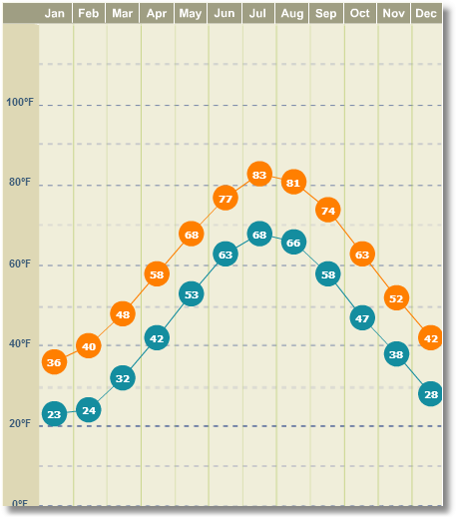
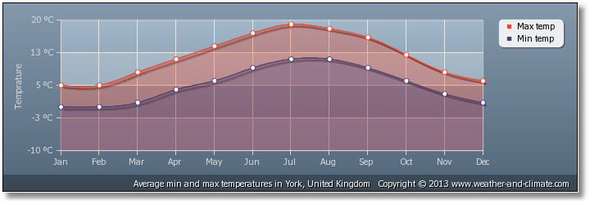
Which city is warmer, New York (USA) or Old York (England)? Which is more variable?
Average Temperatures (high + low)/2
Month NY (f) OY(c) Month NY(f) OY(c)
Jan 29.5 2.0 Jul 75.5 15.5
Feb 32.0 2.0 Aug 73.5 15.0
Mar 35.0 4.5 Sep 66.0 13.0
Apr 50.0 8.5 Oct 55.0 9.5
May 60.5 9.5 Nov 45.0 6.0
Jun 70.0 13.0 Dec 35.0 3.5
City Mean Std.Dev. Min Max
Old York 8.500 4.913 2.000 15.50
New York 52.25 16.93 29.50 75.50

Slide 43
Application – Cost of Defects
These are 30 observations of average defect data on sets of manufactured circuit boards.
1.45 1.65 1.50 2.25 1.65 1.60 2.30 2.20 2.70 1.70
2.35 1.70 1.90 1.45 1.40 2.60 2.05 1.70 1.05 2.35
1.90 1.55 1.95 1.60 2.05 2.05 1.70 2.30 1.30 2.35
Suppose the cost to repair defects is $25 + 10*Defects
I.e., a $25 setup cost plus $10 per defect.
Mean defects = 1.8767 Standard Deviation = 0.407205
Mean Cost = $25 + $10(1.8767) = $43.767
Standard Deviation Cost = $10(.407205) = $4.07205

Slide 44
Correlation
Variables Y and X vary together
Causality vs. correlation: Does movement in X “cause” movement in Y in some metaphysical sense?
Correlation
  Simultaneous movement through a statistical relationship
  Simultaneous variation “induced” by the variation of a common third effect

Slide 45
Samples of House Listings and
Per Capita Incomes at a Particular Time

Slide 46
Scatter Plot Suggests Positive Correlation

Slide 47
Regression Measures Correlation
Regression Line: Listing = a + b IncomePC

Slide 48
Correlation Is Not Causation
Price and Income seem to be “positively” related.
The U.S. Gasoline Market. Data are yearly from 1953 to 2004. Plot of per capita income vs. gasoline price index.

Slide 49
The Hidden (Spurious) Relationship
Not positively “related” to each other; both positively related to “time.”

Slide 50
Correlation is the interesting number.
We must compute covariance and the two standard deviations first.
-1 < r_{XY} < +1 Units free. A pure number.

Slide 51
Correlation
r_{Income,Listing} = +0.591

Slide 52
Correlations
r = 0.0
r = +1.0
r = +0.5

Slide 53
Sample Statistics and Population Parameters
Sample has a sample mean and standard deviation and s_{Y}.
Population has a mean, μ, and standard deviation, σ.
The sample “looks like” the population.
The sample statistics resemble the population features.
The bigger is the RANDOM sample, the closer will be the resemblance. We will study this later in the course.

Slide 54
Summary
Statistics to describe location (mean) and spread (standard deviation) of a sample of values.
  Interpretations
  Computations
  Complications
Statistics and graphical tools to describe bivariate (two variable) relationships
  Scatter plots
  Correlation

