Slide 1

Statistics and Data Analysis
Professor William Greene
Stern School of Business
IOMS Department
Department of Economics

Slide 2
Statistics and Data Analysis
Part 19 – Residuals, Outliers and Elasticities

Slide 3
Linear Regression Models
Analyzing residuals
  Violations of assumptions
  Unusual data points
  Hints for improving the model
Model building
  Linear models – cost functions
  Semilog models – growth models
  Logs and elasticities

Slide 4
Using the Residuals
How do you know the model is “good?”
The first place to look is at the residuals.

Slide 5
Residuals Can Signal a Flawed Model
Standard application: Cost function for output of a production process.
Compare linear equation to a quadratic model (in logs)
(123 American Electric Utilities)

Slide 6
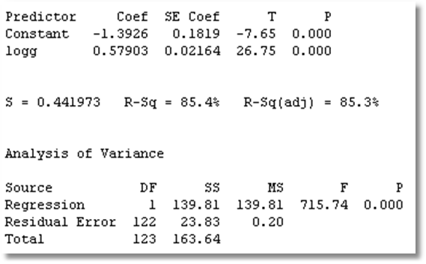
Electricity (log) Cost Function

Slide 7
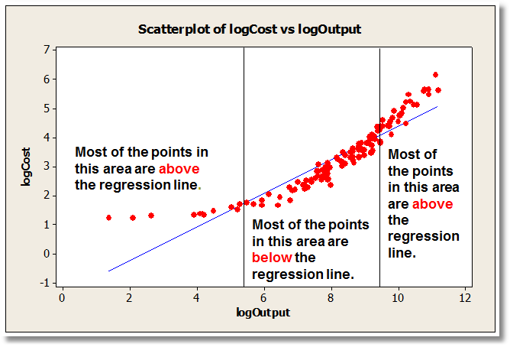
Candidate Model for Cost
Log c = a + b log q + e

Slide 8
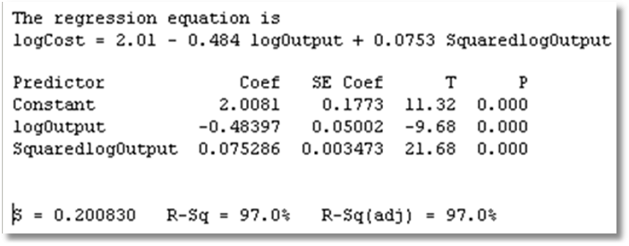
A Better Model?
Log Cost = α + β₁ logOutput + β₂ [logOutput]² + ε

Slide 9
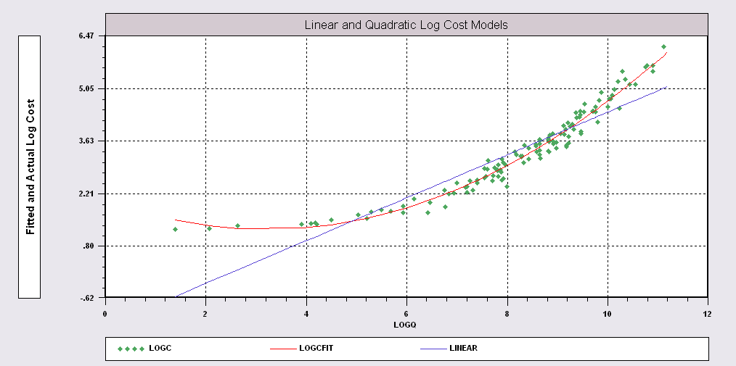
Candidate Models for Cost
The quadratic equation is the appropriate model.
Logc = a + b1 logq + b2 log²q + e

Slide 10
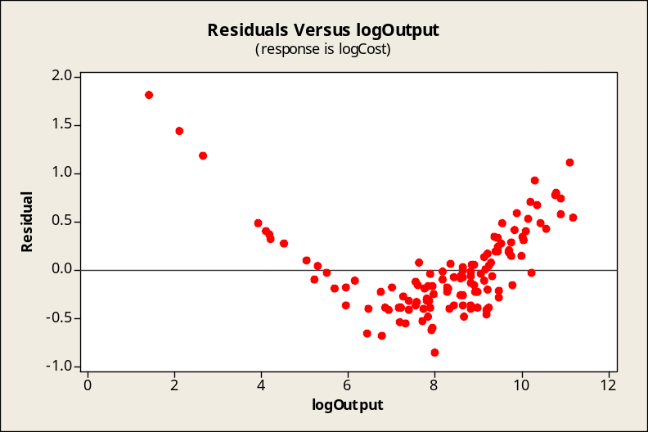
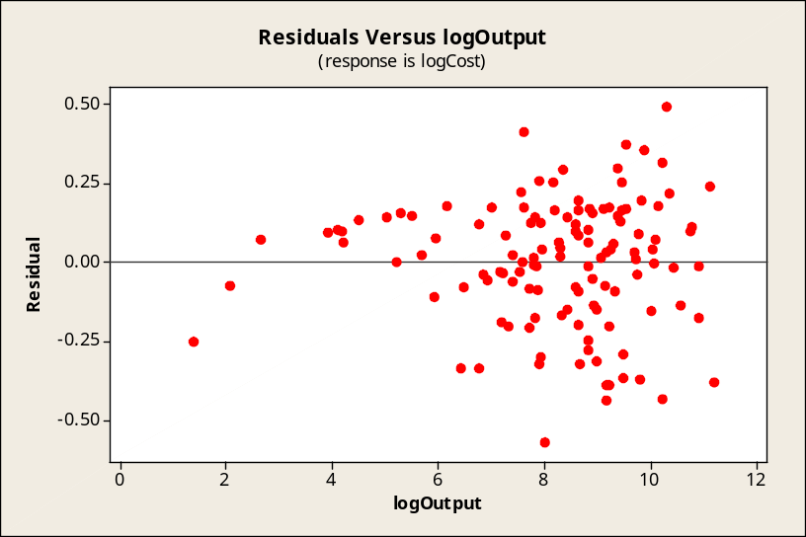
Missing Variable Included
Residuals from the quadratic cost model
Residuals from the linear cost model

Slide 11
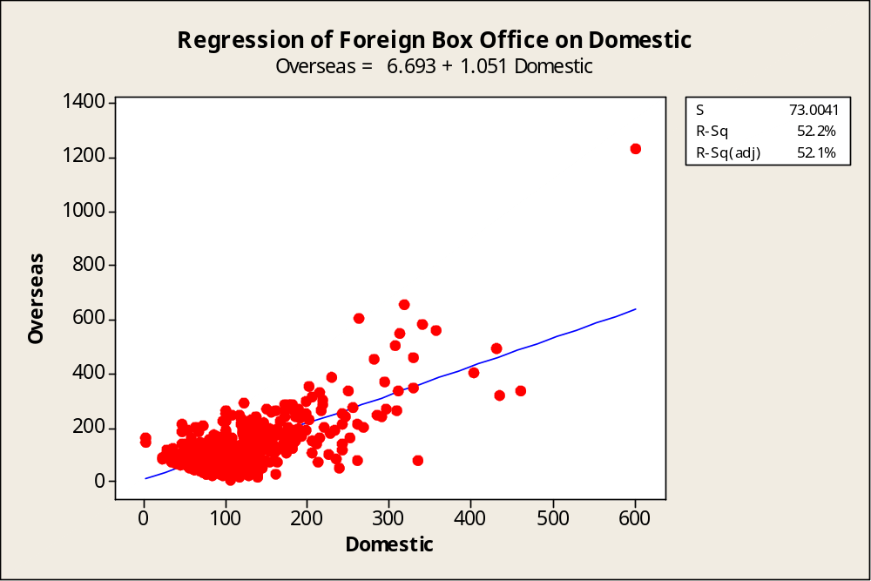

Unusual Data Points
Outliers have (what appear to be) very large disturbances, ε
The 500 most successful movies

Slide 12
Outliers
Remember the empirical rule, 99.5% of observations will lie within mean ± 3 standard deviations? We show (a+bx) ± 3s_{e} below.)
Titanic is 8.1 standard deviations from the regression!
Only 0.86% of the 466 observations lie outside the bounds. (We will refine this later.)
These points might deserve a closer look.

Slide 13
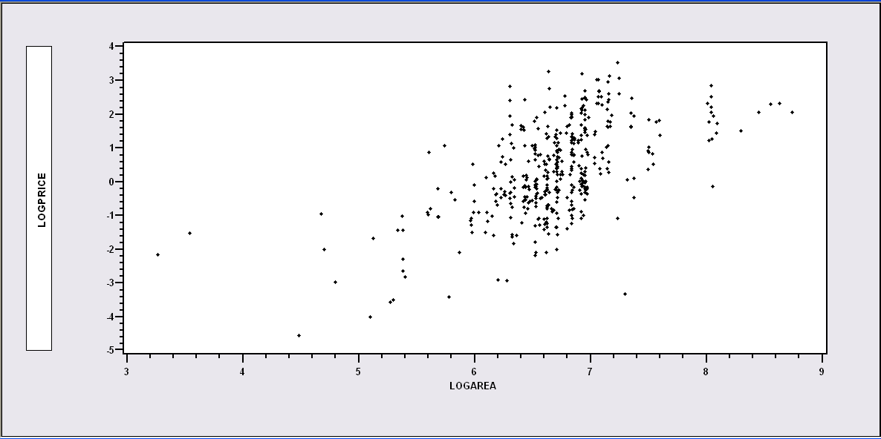

Prices paid at auction for Monet paintings vs. surface area (in logs)
logPrice = a + b logArea + e
Not an outlier: Monet chose to paint a small painting.
Possibly an outlier: Why was the price so low?

Slide 14
What to Do About Outliers
(1) Examine the data
(2) Are they due to mismeasurement error or obvious
“coding errors?” Delete the observations.
(3) Are they just unusual observations? Do nothing.
(4) Generally, resist the temptation to remove outliers.
Especially if the sample is large. (500 movies is
large.)
(5) Question why you think it is an outlier. Is it really?

Slide 15
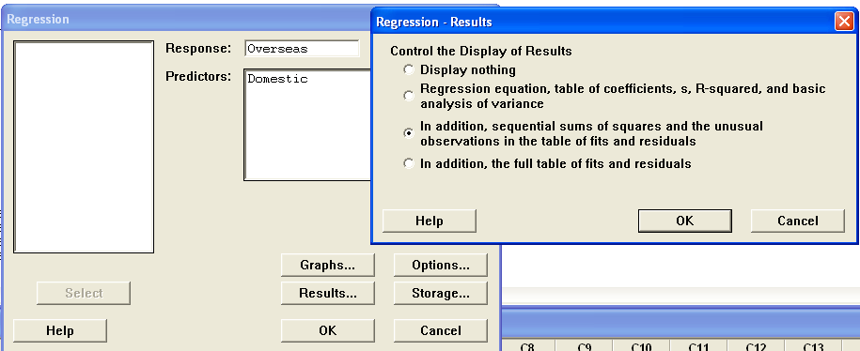
Regression Options

Slide 16
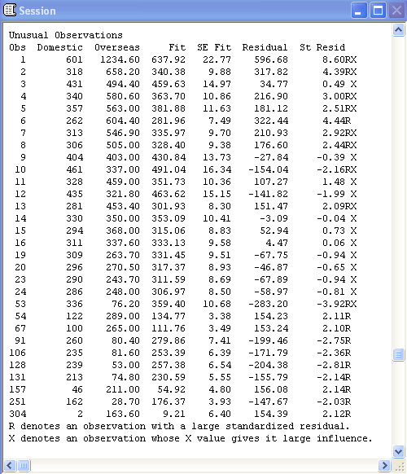
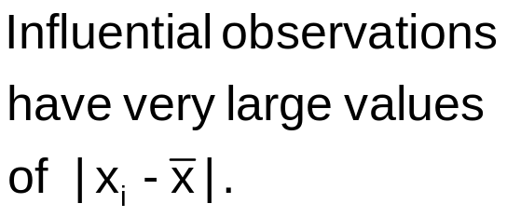
Minitab’s Opinions
Minitab uses ± 2S to flag “large” residuals.

Slide 17
On Removing Outliers
Be careful about singling out particular observations this way.
The resulting model might be a product of your opinions, not the real relationship in the data.
Removing outliers might create new outliers that were not outliers before.
Statistical inferences from the model will be incorrect.

Slide 18
Using and Interpreting the Model
Interpreting the linear model
Semilog and growth models
Log-log model and elasticities

Slide 19
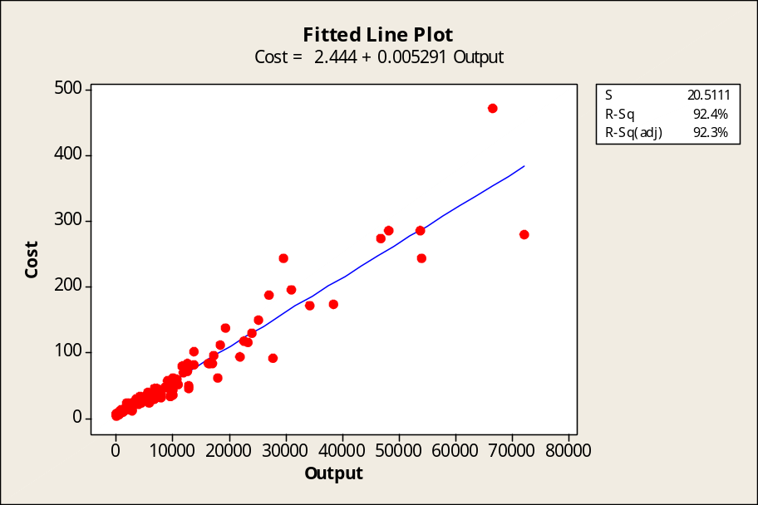
Statistical Cost Analysis
The units of the LHS and RHS must be the same.
$M cost = a + b MKWH
Y = $ cost
a = $ cost = 2.444 $M
b = $M /MKWH = 0.005291 $M/MKWH
So,…..
a = fixed cost = total cost if MKWH = 0
b = marginal cost = dCost/dMKWH
b * MKWH = variable cost
Generation cost ($M) and output (Millions of KWH) for 123 American electric utilities. (1970).

Slide 20
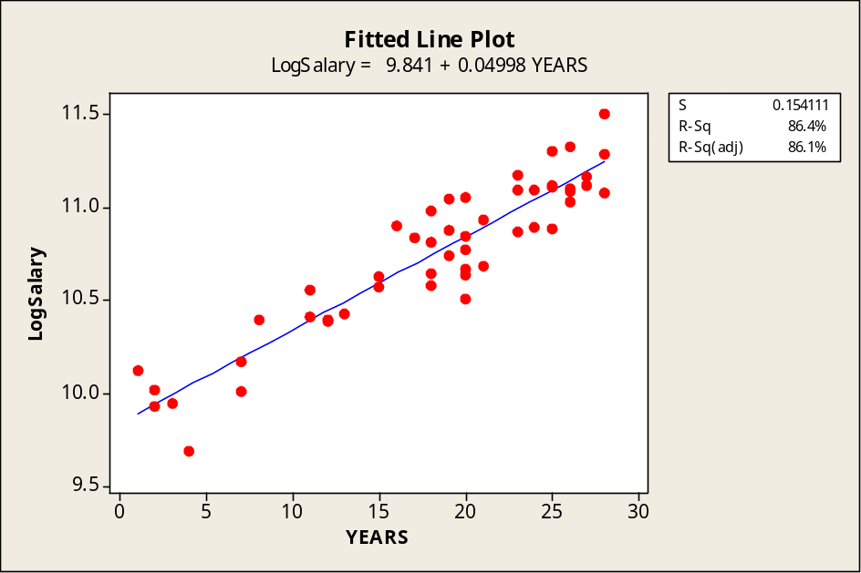

Semilog Models and Growth Rates
LogSalary = 9.84 + 0.05 Years + e

Slide 21
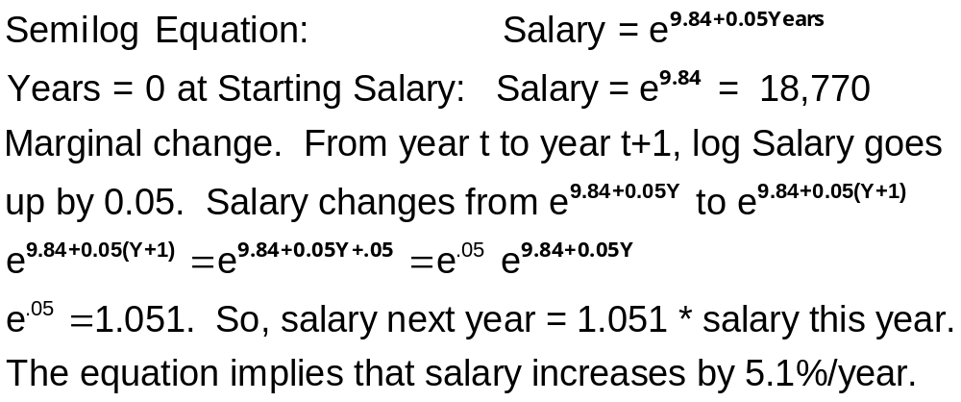
Growth Rate

Slide 22
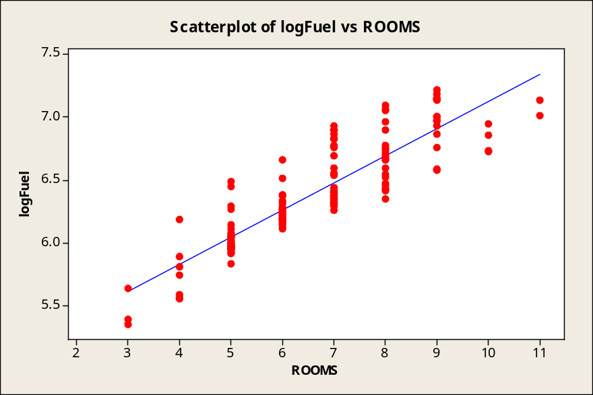
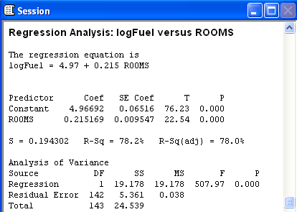
Semilog Model for Fuel Bills

Slide 23
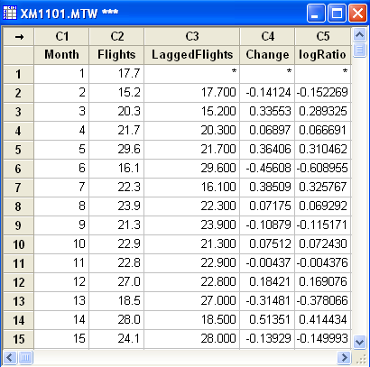
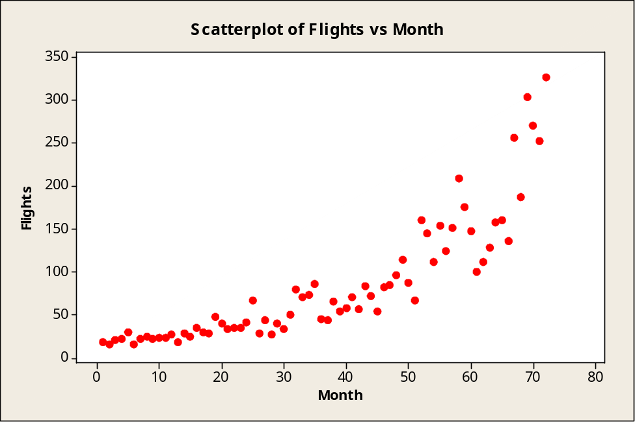
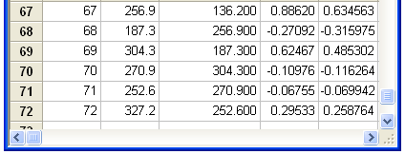
Using Semilog Models for Trends
Frequent Flyer Flights for 72 Months. (Text, Ex. 11.1, p. 508)

Slide 24
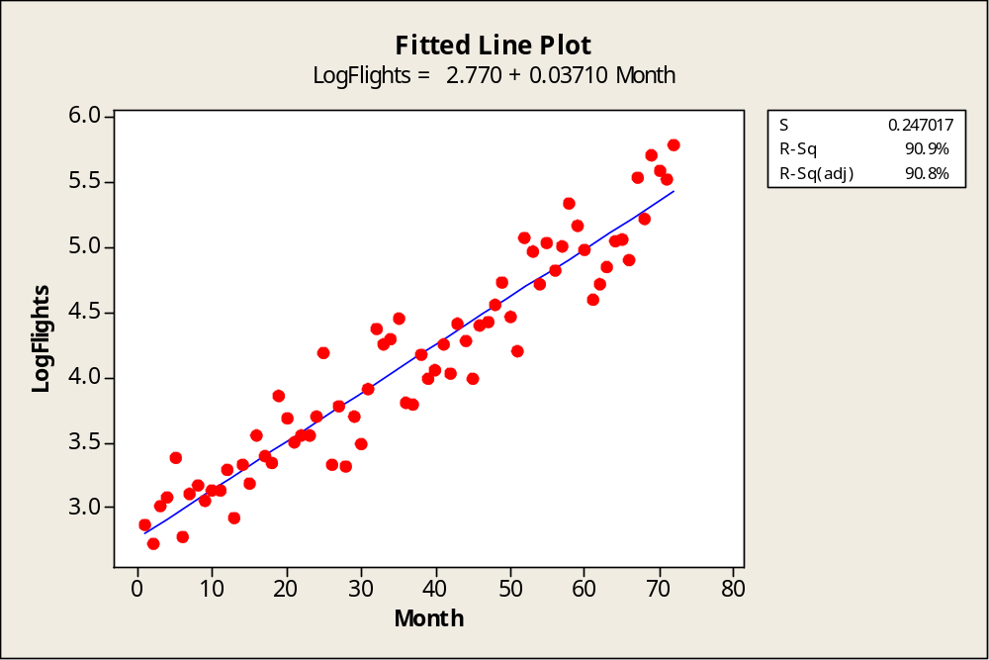
Regression Approach
logFlights = α + β Months + ε
a = 2.770, b = 0.03710, s = 0.06102

Slide 25
Elasticity and Loglinear Models
logY = α + βlogx + ε
The “responsiveness” of one variable to changes in another
E.g., in economics
demand elasticity = (%ΔQ) / (%ΔP)
Math: Ratio of percentage changes
  %ΔQ / %ΔP = {100%[(ΔQ )/Q] / {100%[(ΔP)/P]}
  Units of measurement and the 100% fall out of this eqn.
  Elasticity = (ΔQ/ΔP)*(P/Q)
  Elasticities are units free

Slide 26
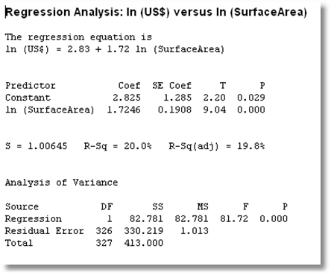
Monet Regression

Slide 27
Summary
Residual analysis
  Consistent with model assumptions?
  Suggest missing elements in the model
Building the regression model
  Interpreting the model – cost function
  Growth model – semilog
  Double log and estimating elasticities

