Slide 1

Statistics and Data Analysis
Professor William Greene
Stern School of Business
IOMS Department
Department of Economics

Slide 2
Statistics and Data Analysis
Part 17 – The Linear
Regression Model

Slide 3
Regression Modeling
Theory behind the regression model
Computing the regression statistics
Interpreting the results
Application: Statistical Cost Analysis

Slide 4
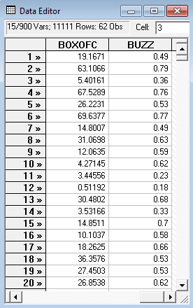
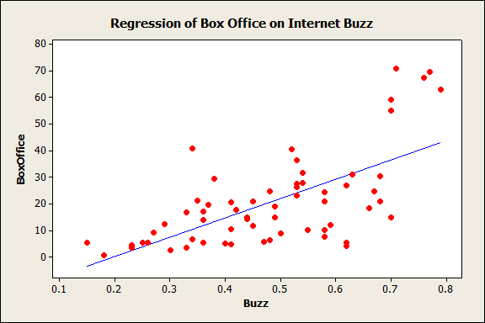
A Linear Regression
Predictor: Box Office = -14.36 + 72.72 Buzz

Slide 5
Data and Relationship
We suggested the relationship between box office sales and internet buzz is
Box Office = -14.36 + 72.72 Buzz
Box Office is not exactly equal to -14.36+72.72xBuzz
How do we reconcile the equation with the data?

Slide 6
Modeling the Underlying Process
A model that explains the process that produces the data that we observe:
  Observed outcome = the sum of two parts
  (1) Explained: The regression line
  (2) Unexplained (noise): The remainder.
  Internet Buzz is not the only thing that explains Box Office, but it is the only variable in the equation.
Regression model
  The “model” is the statement that part (1) is the same process from one observation to the next.

Slide 7
The Population Regression
THE model:
  (1) Explained:
  Explained Box Office = α + β Buzz
  (2) Unexplained: The rest is “noise, ε.”
  Random ε has certain characteristics
Model statement
  Box Office = α + β Buzz + ε
  Box Office is related to Buzz, but is not exactly equal to α + β Buzz

Slide 8
The Data Include the Noise

Slide 9
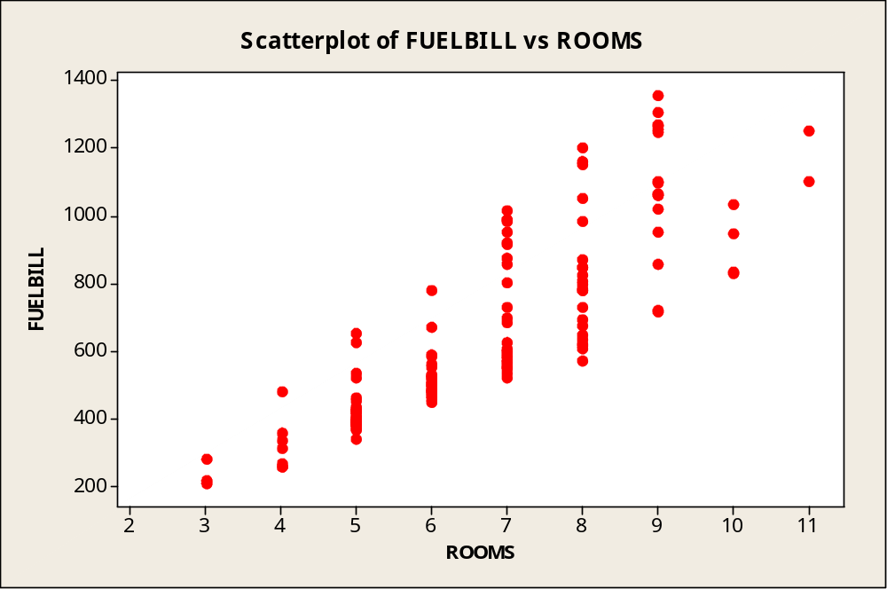
What explains the noise?
What explains the variation in fuel bills?

Slide 10
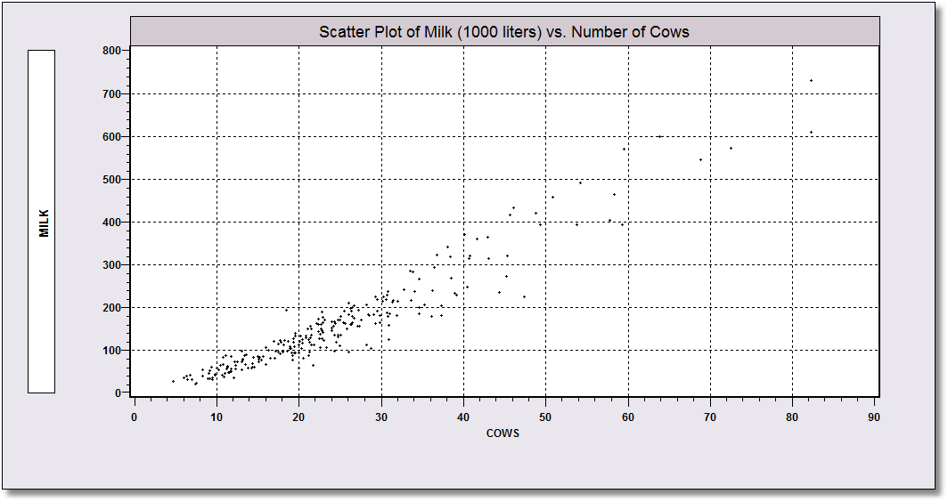
Noisy Data?
What explains the variation in milk production other than number of cows?

Slide 11
Assumptions
(Regression) The equation linking “Box Office” and “Buzz” is stable
E[Box Office | Buzz] = α + β Buzz
Another sample of movies, say 2012, would obey the same fundamental relationship.

Slide 12
Model Assumptions
y_{i} = α + β x_{i} + ε_{i}
  α + β x_{i} is the “regression function”
  ε_{i} is the “disturbance. It is the unobserved random component
The Disturbance is Random Noise
  Mean zero. The regression is the mean of y_{i}.
  ε_{i} is the deviation from the regression.
  Variance σ².

Slide 13

We will use the data to estimate α and β

Slide 14
We also want to estimate σ² =√E[ε_{i}²]
e=y-a-bBuzz

Slide 15
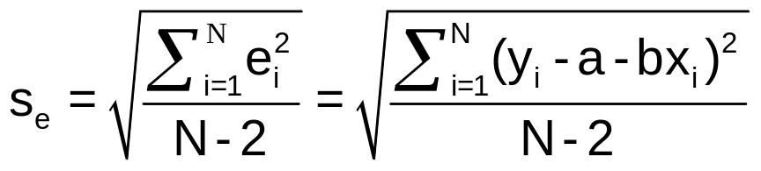
Standard Deviation of the Residuals
Standard deviation of ε_{i} = y_{i}-α-βx_{i} is σ
σ = √E[ε_{i}²] (Mean of ε_{i} is zero)
Sample a and b estimate α and β
Residual e_{i} = y_{i} – a – bx_{i} estimates ε_{i}
Use √(1/N-2)Σe_{i}² to estimate σ.
Why N-2? Relates to the fact that two parameters (α,β) were estimated. Same reason N-1 was used to compute a sample variance.

Slide 16
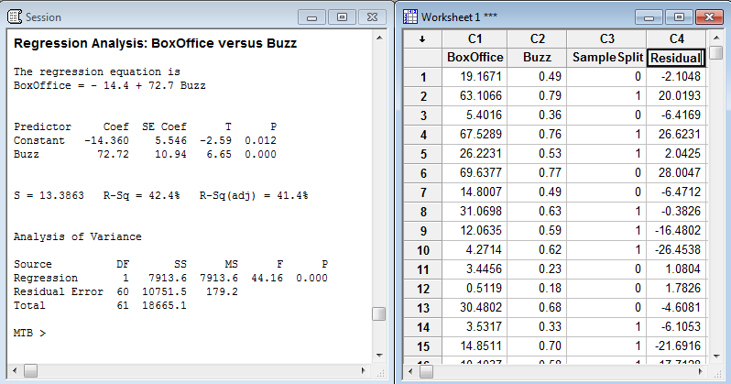
Residuals

Slide 17
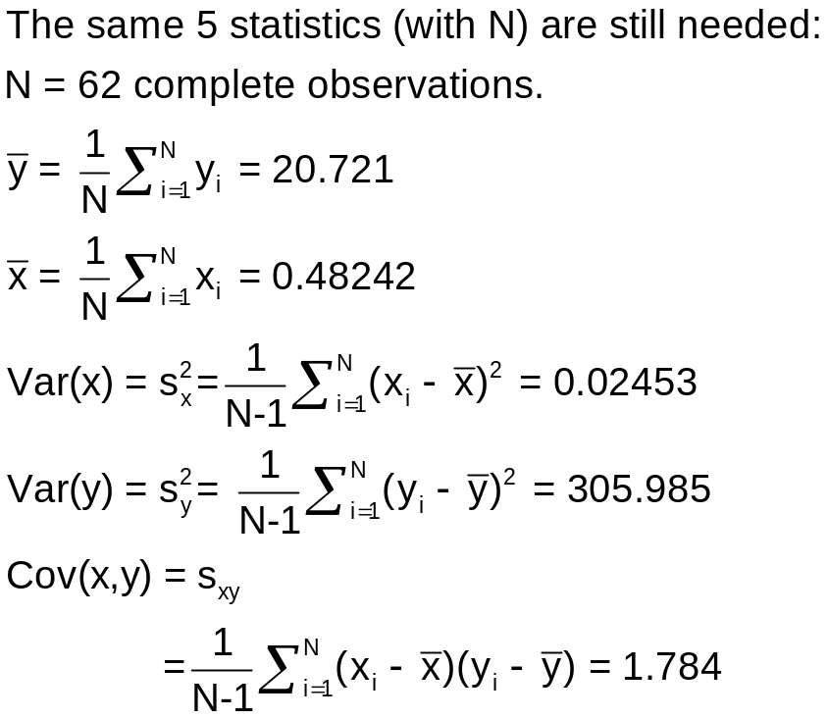
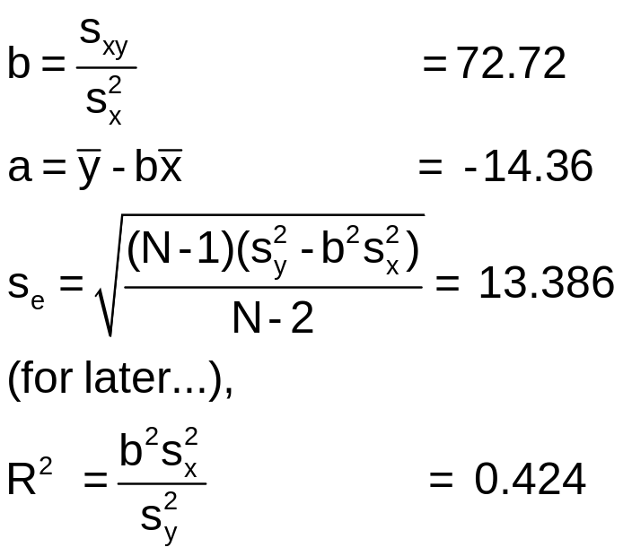
Summary: Regression Computations

Slide 18
Using s_{e} to identify outliers
Remember the empirical rule, 95% of observations will lie within mean ± 2 standard deviations? We show (a+bx) ± 2s_{e} below.)
This point is 2.2 standard deviations from the regression.
Only 3.2% of the 62 observations lie outside the bounds. (We will refine this later.)

Slide 19
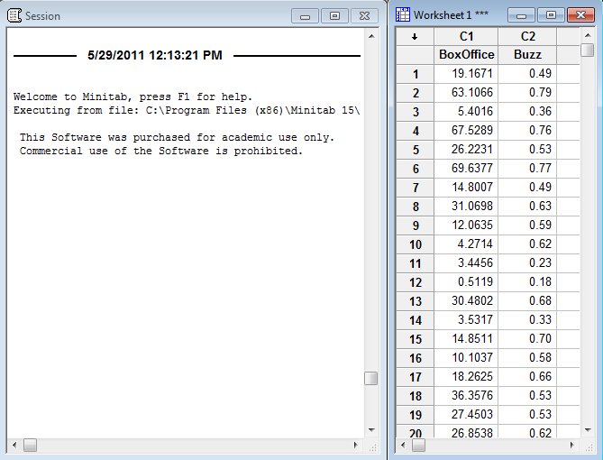

Slide 20
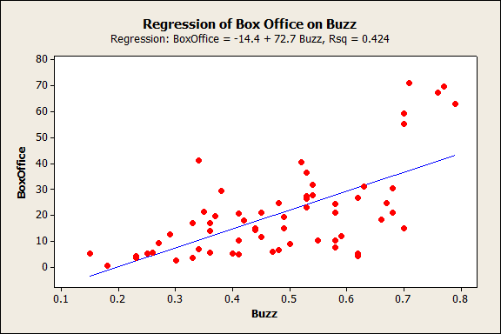
Linear Regression
Sample Regression Line

Slide 21
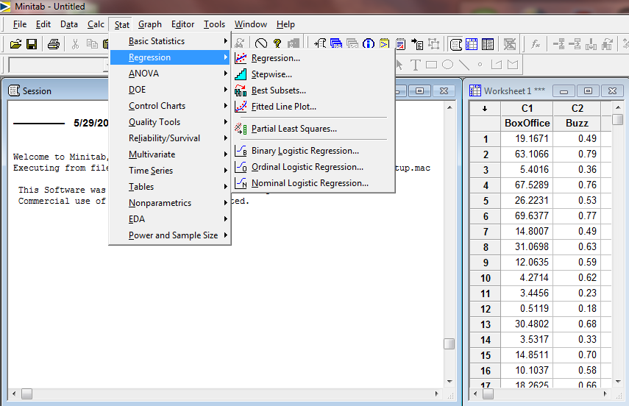

Slide 22
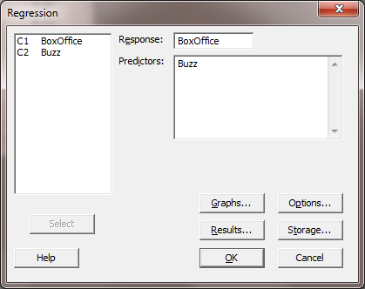

Slide 23
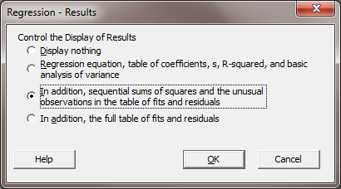
Results to Report

Slide 24
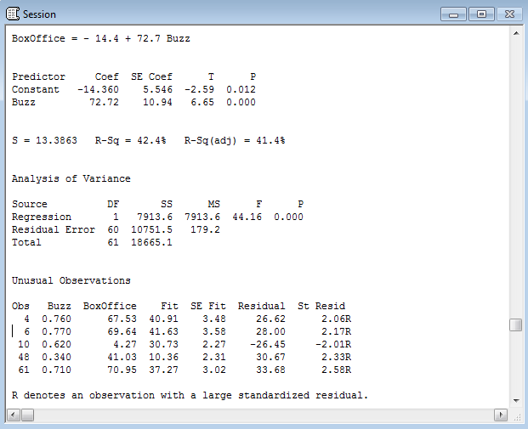
The Reported Results

Slide 25
Estimated equation

Slide 26
Estimated coefficients
a and b

Slide 27
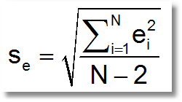
S = s_{e} = estimated std. deviation of ε

Slide 28
Square of the sample correlation between x and y

Slide 29
N-2 = degrees of freedom
N-1 = sample size minus 1

Slide 30
Sum of squared residuals, Σ_{i}e_{i}²

Slide 31
S² = s_{e}²

Slide 32
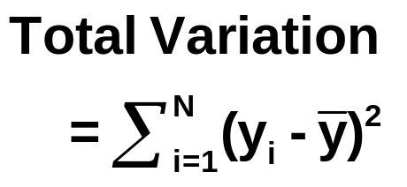

Slide 33
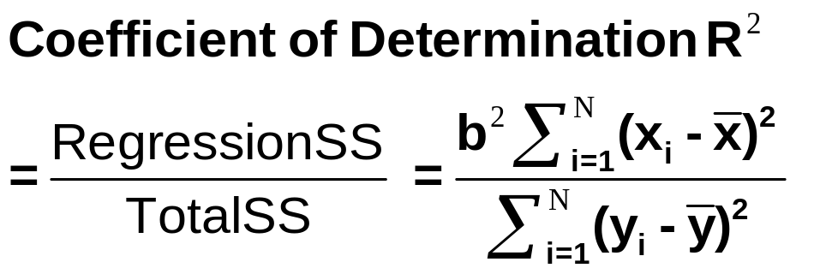

Slide 34
The Model
Constructed to provide a framework for interpreting the observed data
  What is the meaning of the observed relationship (assuming there is one)
How it’s used
  Prediction: What reason is there to assume that we can use sample observations to predict outcomes?
  Testing relationships

Slide 35
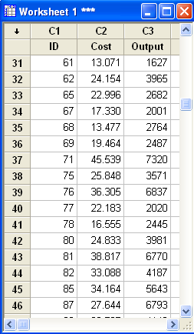
A Cost Model
Electricity.mpj
Total cost in $Million
Output in Million KWH
N = 123 American electric utilities
Model: Cost = α + βKWH + ε

Slide 36
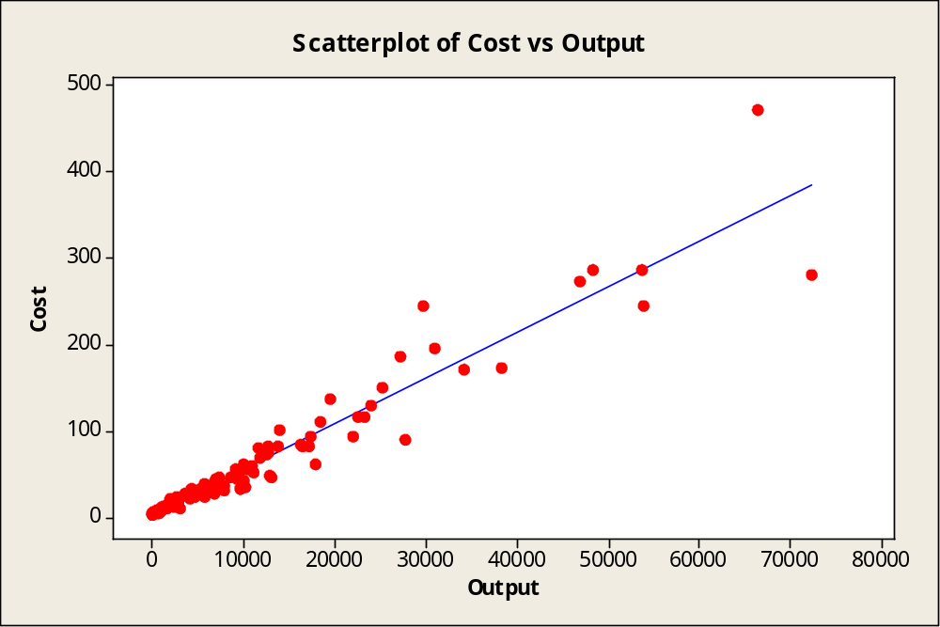
Cost Relationship

Slide 37
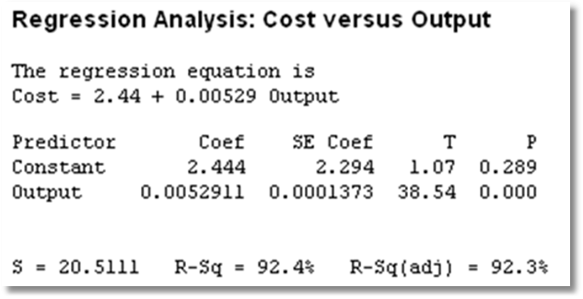
Sample Regression

Slide 38
Interpreting the Model
Cost = 2.44 + 0.00529 Output + e
Cost is $Million, Output is Million KWH.
Fixed Cost = Cost when output = 0
Fixed Cost = $2.44Million
Marginal cost
= Change in cost/change in output
= .00529 * $Million/Million KWH
= .00529 $/KWH = 0.529 cents/KWH.

Slide 39
Summary
Linear regression model
  Assumptions of the model
  Residuals and disturbances
Estimating the parameters of the model
  Regression parameters
  Disturbance standard deviation
Computation of the estimated model

