Slide 1

Statistics and Data Analysis
Professor William Greene
Stern School of Business
IOMS Department
Department of Economics

Slide 2
Statistics and Data Analysis
Part 16 – Regression

Slide 3


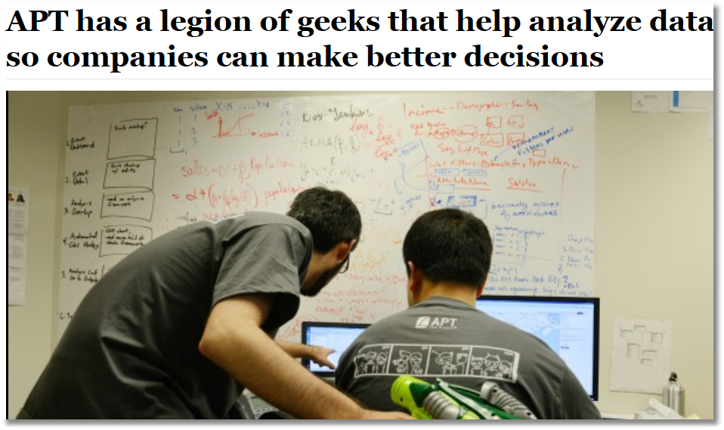

Slide 4

A Regression Analysis that People Really Cared About
The Year 2000 World Health Report by WHO
http://www.who.int/whr/2000/en

Slide 5
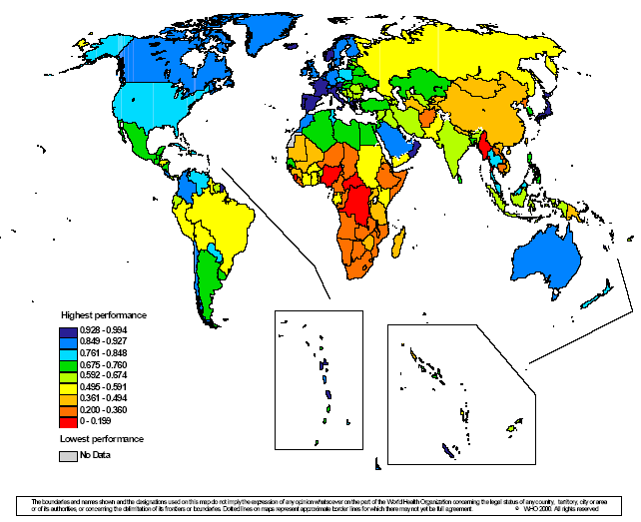
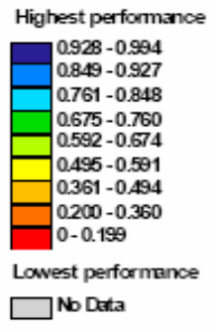
Health Care System Performance

Slide 6
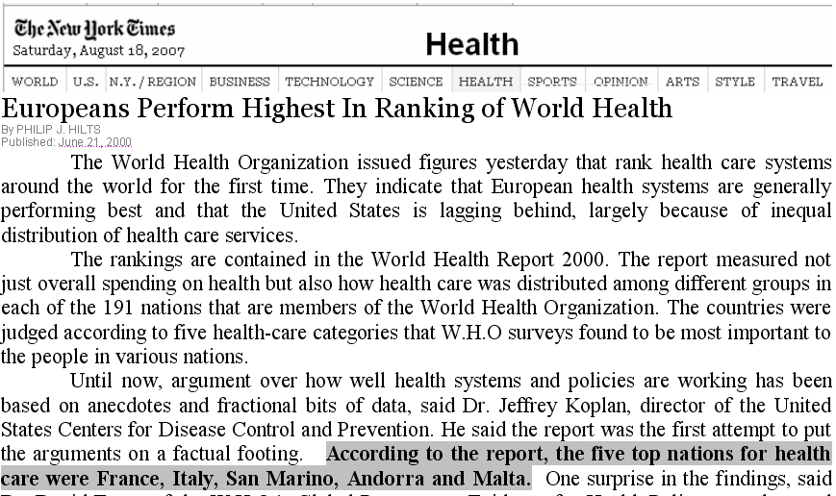
New York Times, Page 1, June 21, 2000

Slide 7
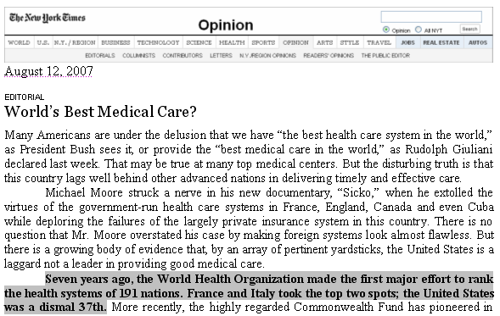

Slide 8
That Number 37 Ranking
What is the source?
What is it? Ranking of what?
And why are we looking at it in our class on Statistics and Data Analysis?
  Interesting
  It’s an application of regression analysis.

Slide 9
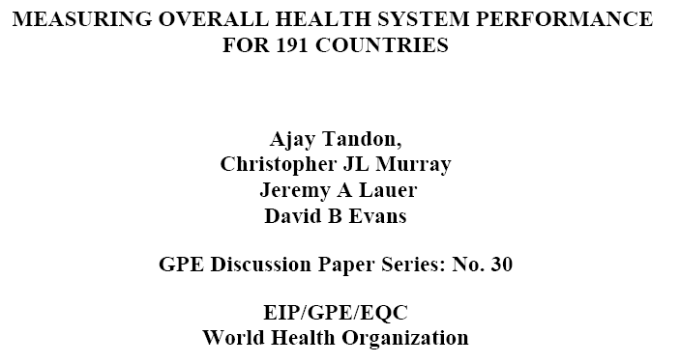
The Source Behind the News
http://www.who.int/entity/healthinfo/paper30.pdf

Slide 10

What Did They Study?

Slide 11
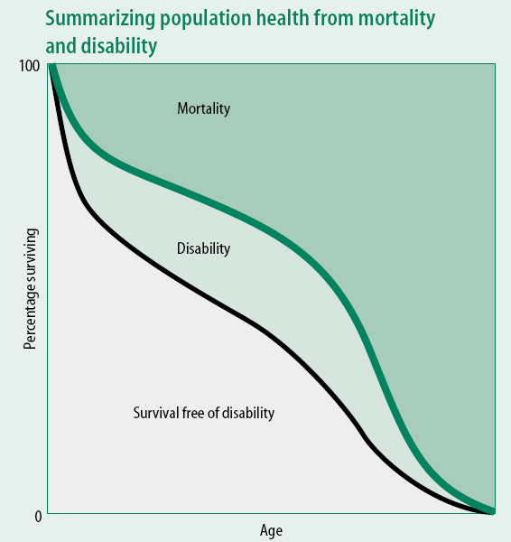
The standard measure of health care success is Disability Adjusted Life Expectancy,
DALE

Slide 12
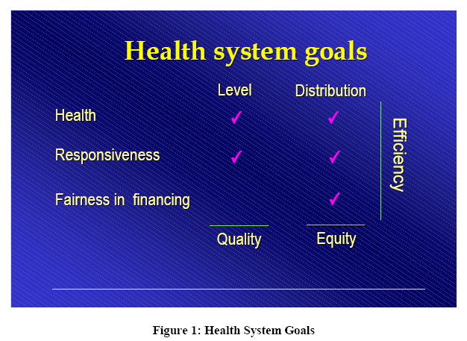
The WHO Researchers Were Interested in a Broader Measure
These are the items listed in the NYT editorial.

Slide 13
They Created a Measure
COMP = Composite Index
“In order to assess overall efficiency, the first step was to combine the individual
attainments on all five goals of the health system into a single number, which we call the composite index. The composite index is a weighted average of the five component goals specified above. First, country attainment on all five indicators (i.e., health, health inequality, responsiveness-level, responsiveness-distribution, and fair-financing) were rescaled restricting them to the [0,1] interval. Then the following weights were used to construct the overall composite measure: 25% for health (DALE), 25% for health inequality, 12.5% for the level of responsiveness, 12.5% for the distribution of responsiveness, and 25% for fairness in financing. These weights are based on a survey carried out by WHO to elicit stated preferences of individuals in their relative valuations of the goals of the health system.”
(From the WHO Technical Report)

Slide 14
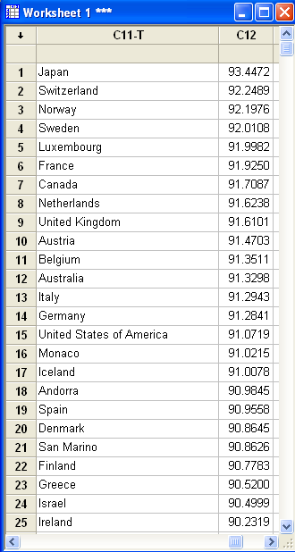
Did They Rank Countries by COMP? Yes, but that was not what produced the number 37 ranking!

Slide 15
So, What is Going On?
A Model:
Health Care Output = a function of Health Care Inputs
OUTPUT = COMP
INPUTS = Health Care Spending and Education of
the Population

Slide 16
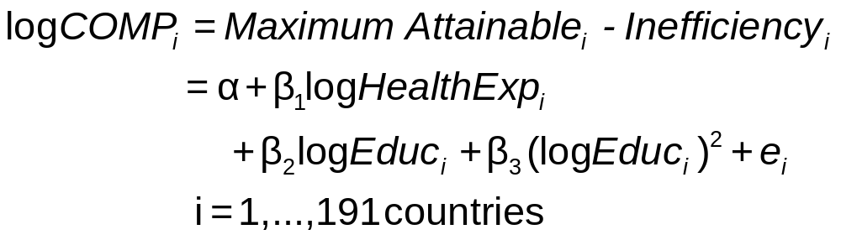
The WHO COMP Equation

Slide 17
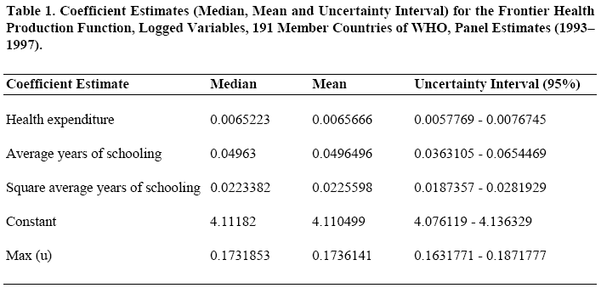
Estimated Model
β₁
β₂
β₃
α

Slide 18
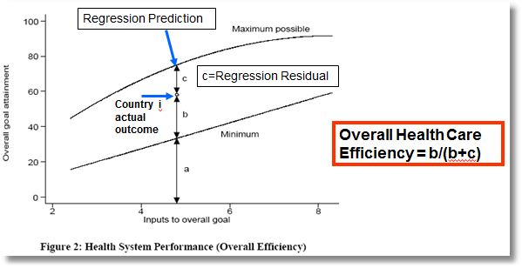
The Best a Country Could Do vs. What They Actually Do

Slide 20
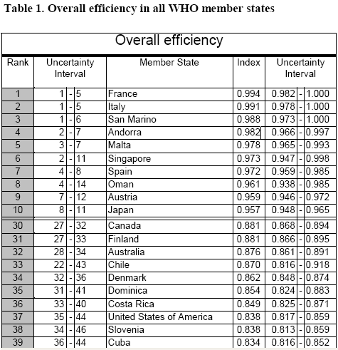
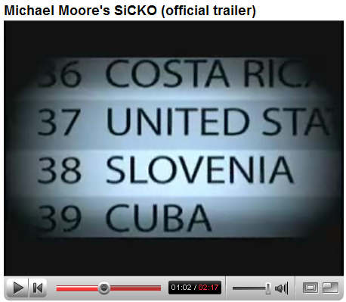
The US Ranked 37th!
Countries were ranked by overall efficiency

Slide 21
Linear Regression
Correlation (and vs. causality)
Examining correlation
  Descriptive: Relationship between variables
  Predictive: Use values of one variable to predict another.
  Control: Should a firm increase R&D?
  Understanding: What is the elasticity of demand for our product? (Should we raise our price?)
The regression relationship

Slide 22
Positive Correlation and Regression
Expected Number of Real Estate Cases
Given Number of Financial Cases
2.4 -
2.3 -
2.2 -
2.1 -
2.0 -
1.9 -
The “regression of R on F”
0 1 2
Financial Cases

Slide 23
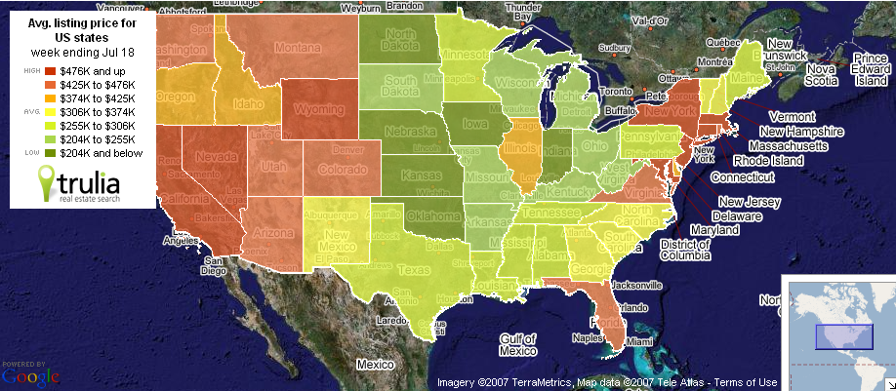
Correlation of Home Prices with Other Factors
What explains the pattern? Is the distribution of average listing prices random?

Slide 24
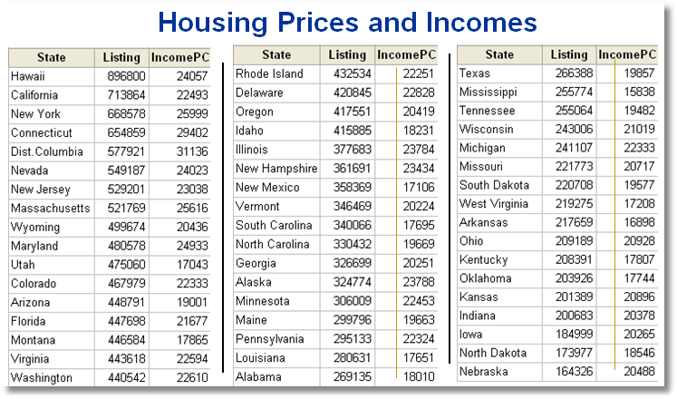

Slide 25
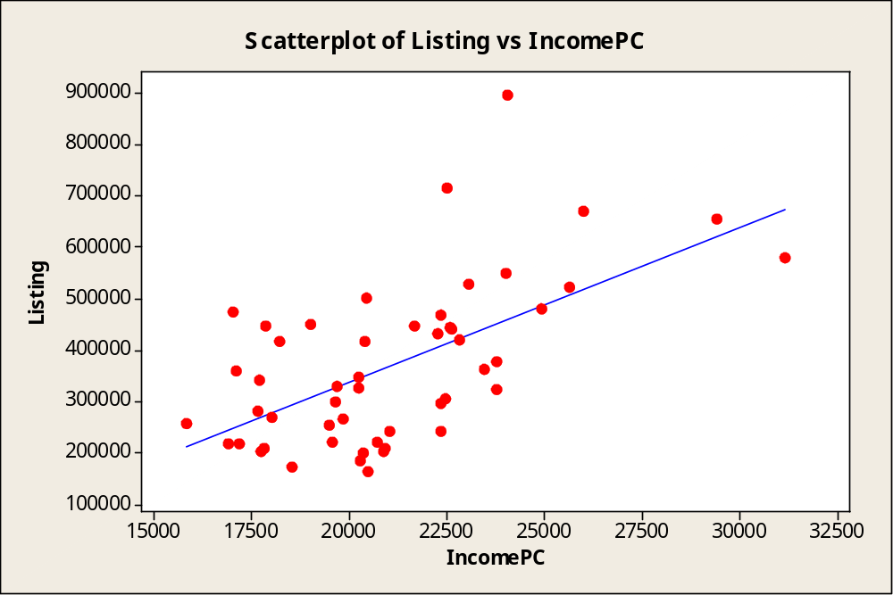

Slide 26
Regression
Modeling and understanding correlation
“Change in y” is associated with “change in x”
  How do we know this?
  What can we infer from the observation?
  Causality and correlation
http://en.wikipedia.org/wiki/Causality
and see, esp. “Probabilistic Causation” about halfway down the article.

Slide 27
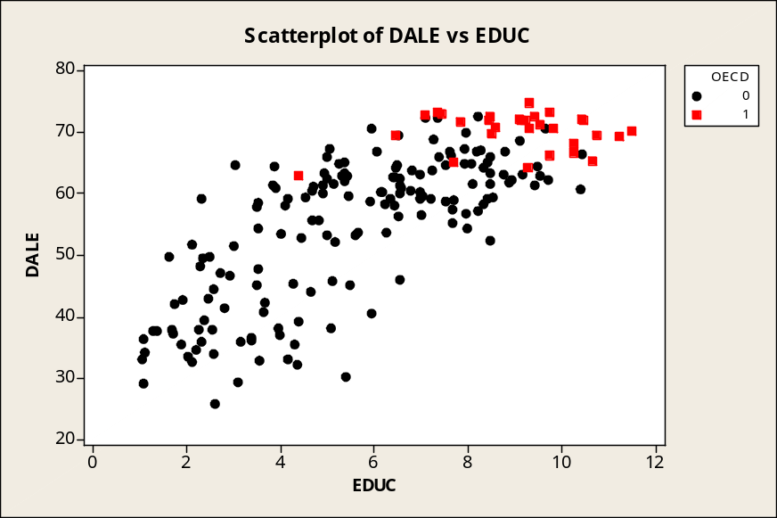
Correlation – Education and Life Expectancy
Graph → Scatterplots → With Groups/ Categorical variable is OECD.
Causality? Correlation? Does more education make people live longer? A hidden driver of both? (GDPC)

Slide 28
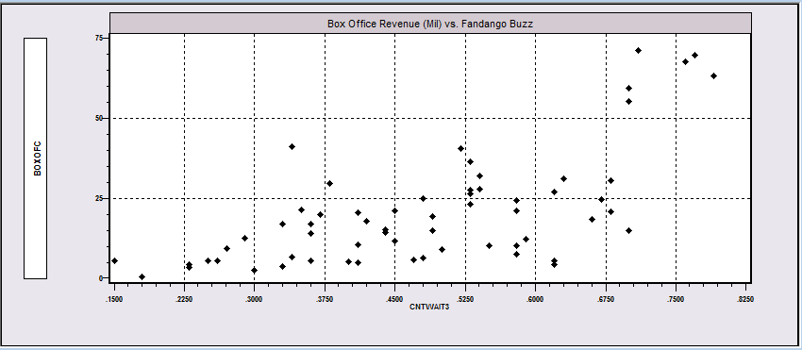
Useful Description(?)
Scatter plot of box office revenues vs. number of “Can’t Wait To See It” votes on Fandango for 62 movies. What do we learn from the figure? Is the “relationship” convincing? Valid? (Real?)

Slide 29
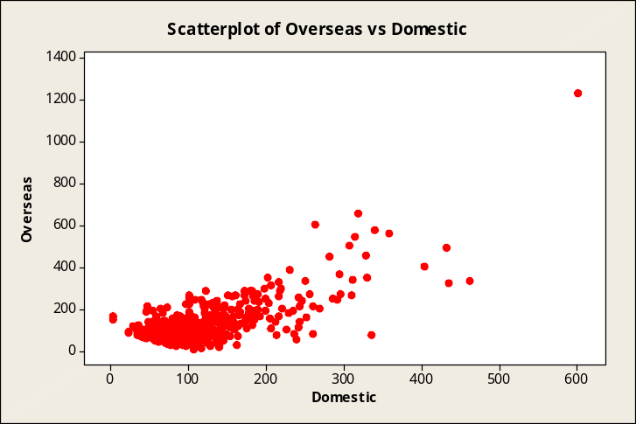
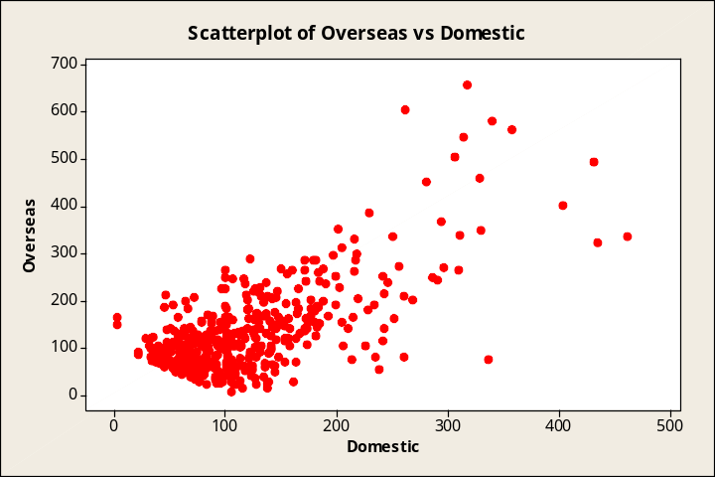

More Movie Madness
Did domestic box office success help to predict foreign box office success?
Movies.mtp
Note the influence of an outlier.
500 biggest movies up to 2003
499 biggest movies up to 2003

Slide 30
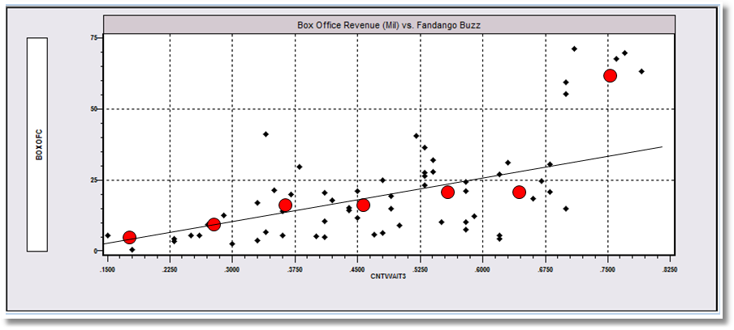
Average Box Office by
Internet Buzz Index
= Average Box Office for Buzz in Interval

Slide 31
Correlation
Is there a conditional expectation?
The data suggest that the average of Box Office increases as Buzz increases.
Average Box Office = f(Buzz) is the “Regression of Box Office on Buzz”

Slide 32
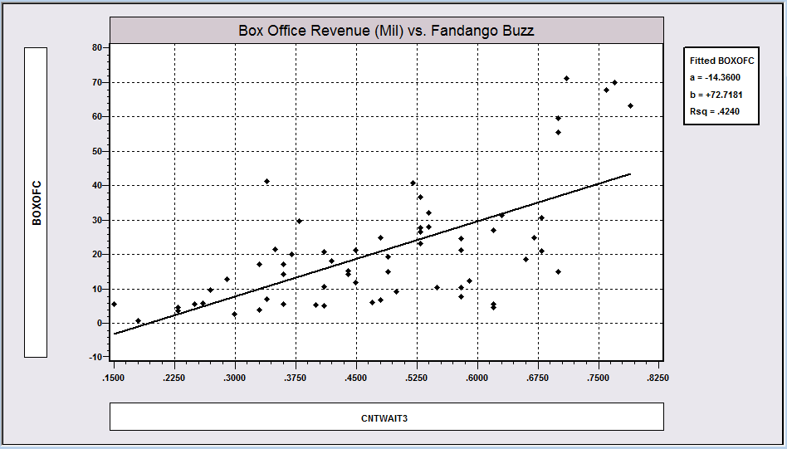
Is There Really a Relationship?
BoxOffice is obviously not equal to f(Buzz) for some function. But, they do appear to be “related,” perhaps statistically – that is, stochastically. There is a correlation. The linear regression summarizes it.
A predictor would be Box Office = a + b Buzz.
Is b really > 0? What would be implied by b > 0?

Slide 33
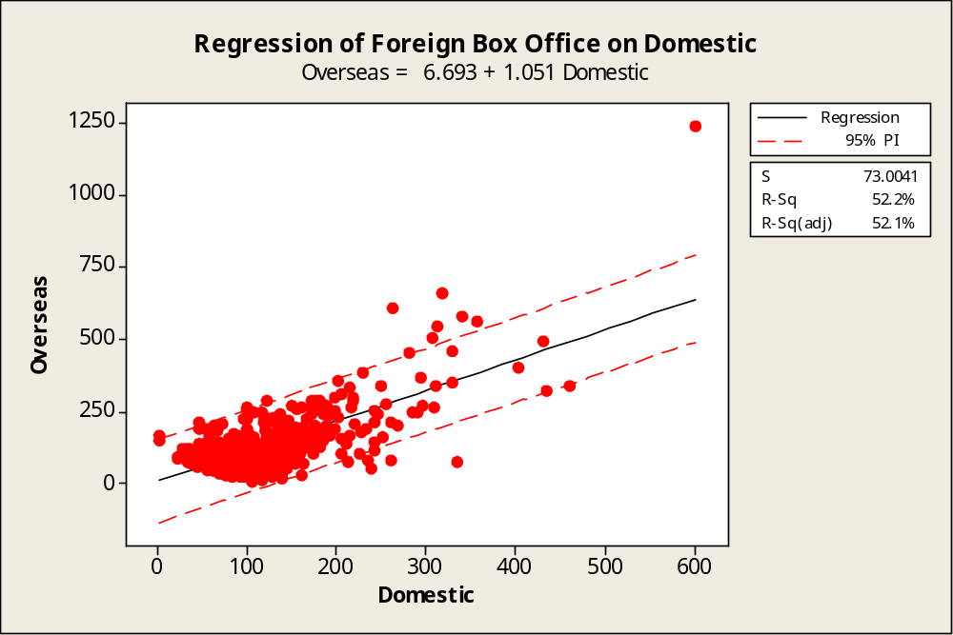

Using Regression to Predict
Stat → Regression → Fitted Line Plot
Options: Display Prediction Interval
The equation would not predict Titanic.
Predictor: Overseas = a + b Domestic.
The prediction will not be perfect. We construct a range of “uncertainty.”

Slide 34
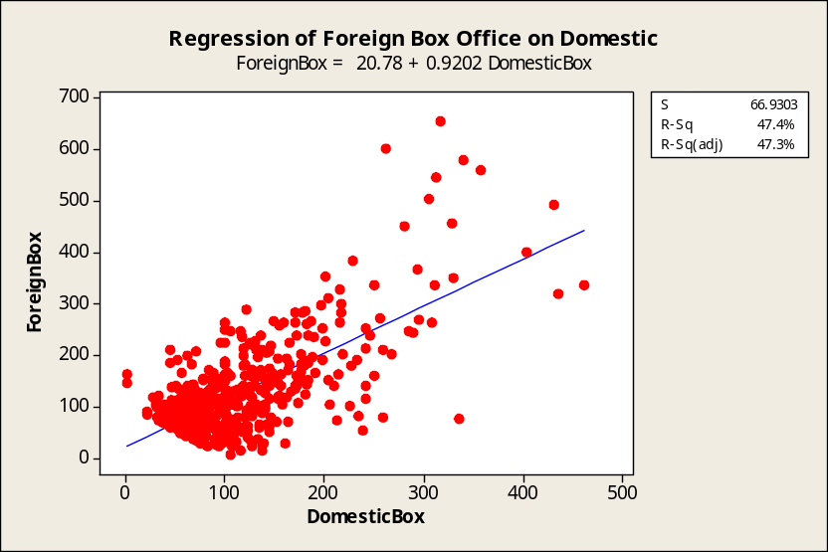
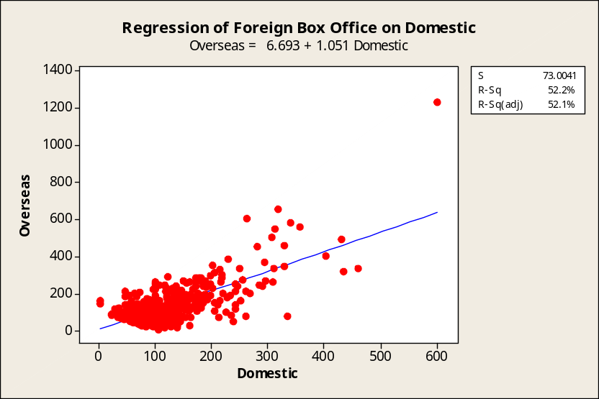
Effect of an Outlier is to
Twist the Regression Line
With Titanic, slope = 1.051
Without Titanic, slope = 0.9202

Slide 35
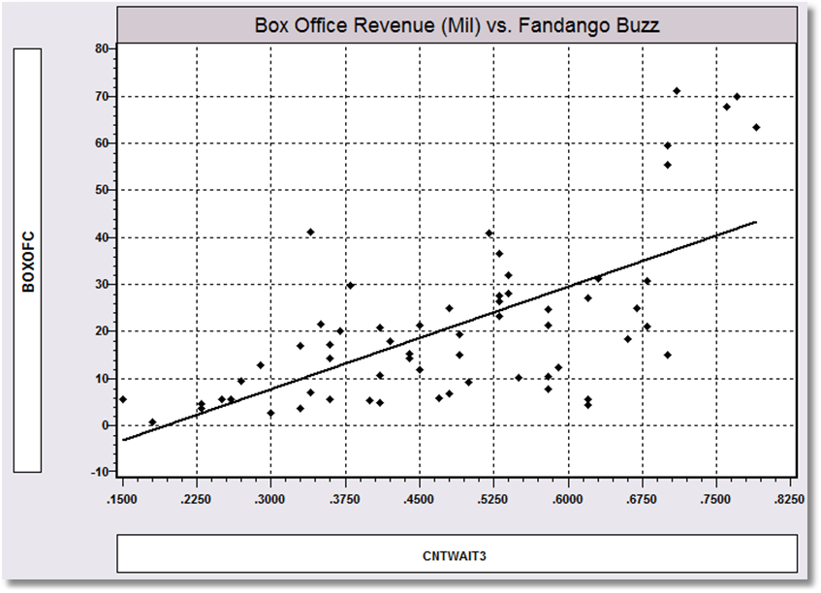
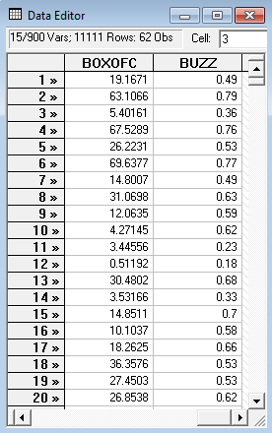
Least Squares Regression

Slide 36
How to compute the y intercept, a, and the slope, b, in y = a + bx.
b
a

Slide 37
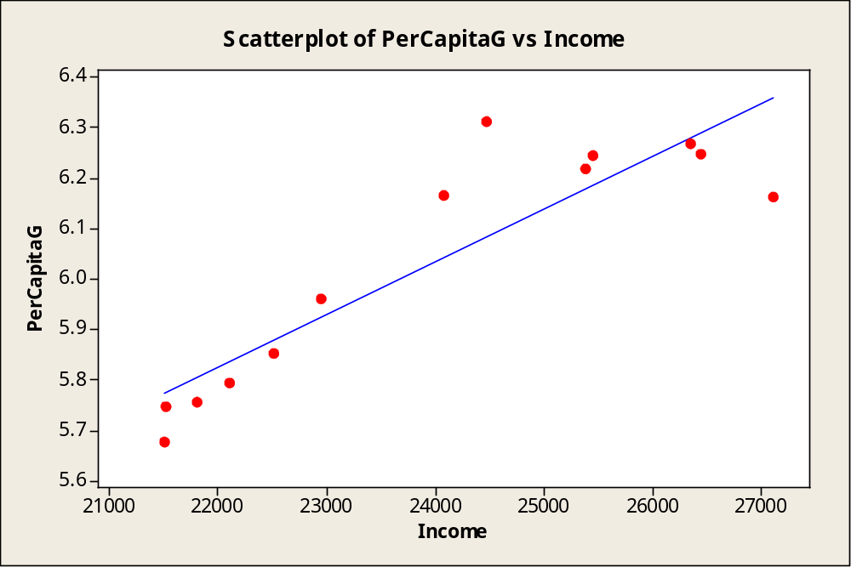


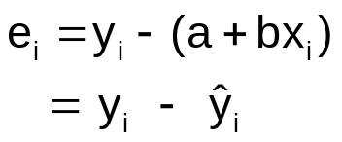
Fitting a Line to a Set of Points
Y_{i}
Gauss’s method
of least squares.
Residuals
Choose a and b to
minimize the sum of squared residuals
Predictions
a + bx_{i}
X_{i}

Slide 38
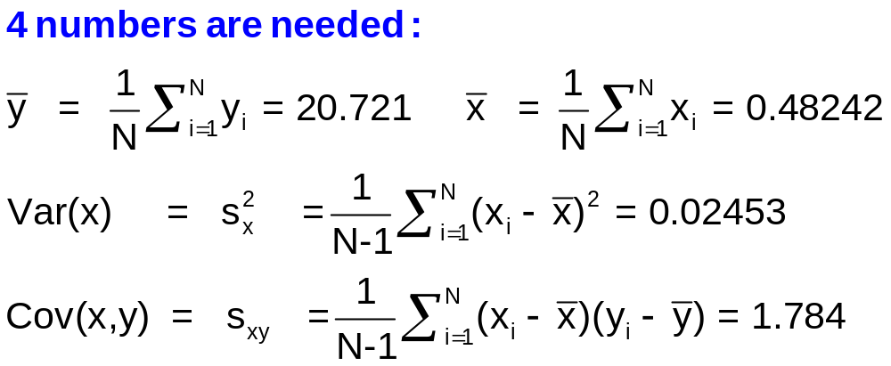
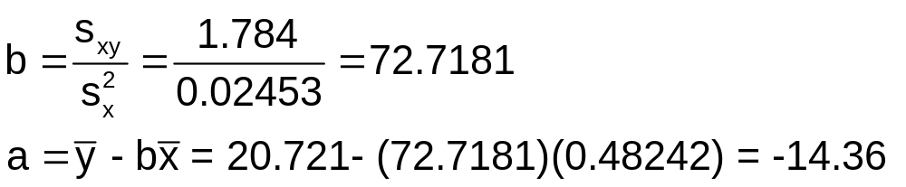
Computing the Least Squares Parameters a and b

Slide 39


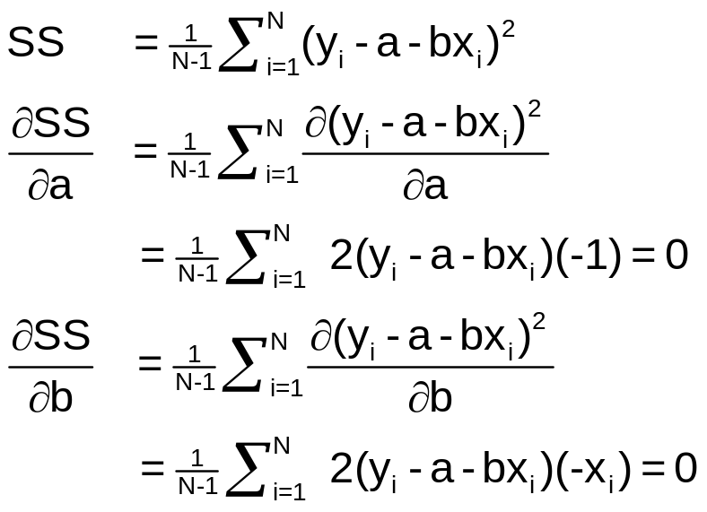
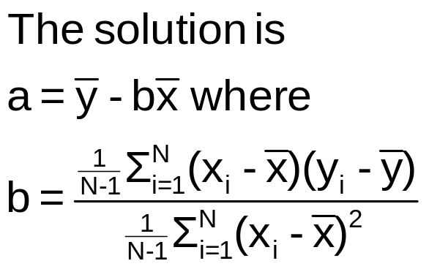

Least Squares Uses Calculus

Slide 40
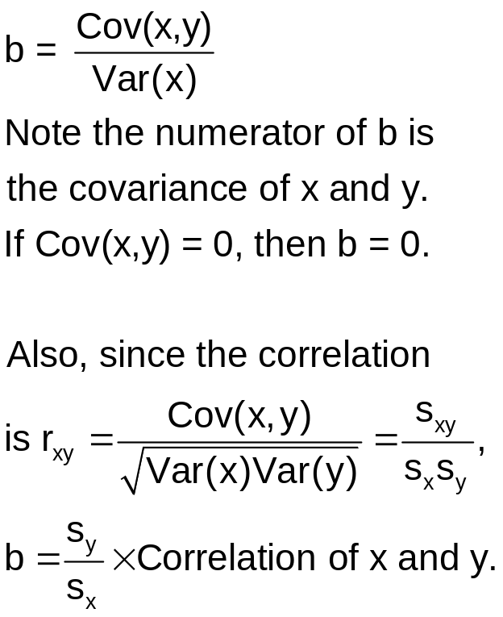
b Measures Covariation b is related to the correlation of x and y.
Predictor Box Office = a + b Buzz.

Slide 41
Is There Really a Statistically Valid Relationship?
We reframe the question.
If b = 0, then there is no (linear) relationship. How can we find out if the regression relationship is just a fluke due to a particular observed set of points? To be studied later in the course.
BoxOffice = a + b Cntwait3. Is b really > 0?

Slide 42
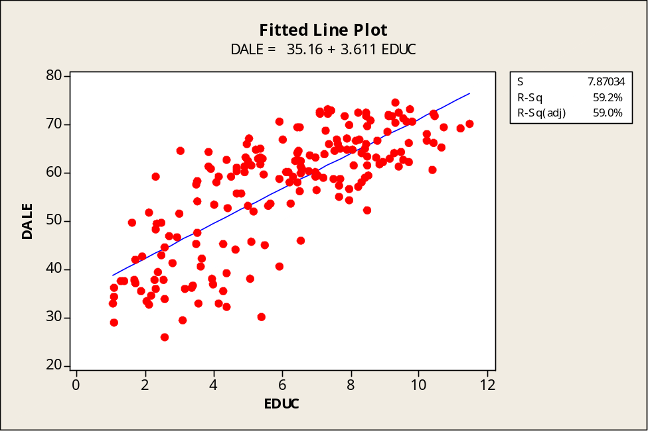
Interpreting the Function
a = the life expectancy
associated with 0 years of
education. No country has 0
average years of education.
The regression only applies
in the range of experience.
b = the increase in life
expectancy associated with
each additional year of
average education.
b
a
The range of experience (education)

Slide 43
Correlation and Causality
Does more education make you live longer (on average)?

Slide 44
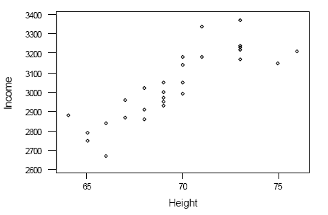
Causality?
Correlation = 0.84 (!)
Height (inches) and Income
($/mo.) in first post-MBA
Job (men). WSJ, 12/30/86.
Ht. Inc. Ht. Inc. Ht. Inc.
70 2990 68 2910 75 3150
67 2870 66 2840 68 2860
69 2950 71 3180 69 2930
70 3140 68 3020 76 3210
65 2790 73 3220 71 3180
73 3230 73 3370 66 2670
64 2880 70 3180 69 3050
70 3140 71 3340 65 2750
69 3000 69 2970 67 2960
73 3170 73 3240 70 3050
Estimated Income = -451 + 50.2 Height

Slide 45
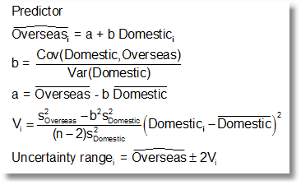
Using Regression to Predict

Slide 46
Summary
Using scatter plots to examine data
The linear regression
  Description
  Predict
  Control
  Understand
Linear regression computation
  Computation of slope and constant term
  Prediction
  Covariation vs. Causality
Interpretation of the regression line as a conditional expectation

