Slide 1
Statistics and Data Analysis
Professor William Greene
Stern School of Business
IOMS Department
Department of Economics

Slide 2
Statistics and Data Analysis
Part 15 – Hypothesis
Tests: Part 3

Slide 3
A Test of Independence
In the credit card example, are Own/Rent and Accept/Reject independent?
Hypothesis: Prob(Ownership) and Prob(Acceptance) are independent
Formal hypothesis, based only on the laws of probability:
Prob(Own,Accept) = Prob(Own)Prob(Accept)
(and likewise for the other three possibilities.
Rejection region: Joint frequencies that do not look like the products of the marginal frequencies.

Slide 4
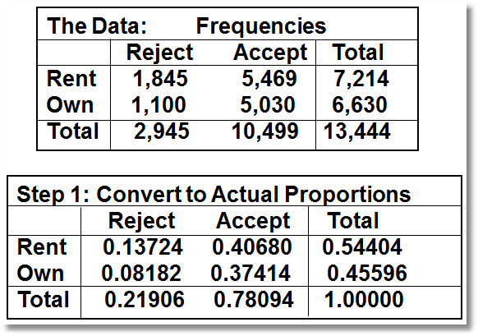
A Contingency Table Analysis

Slide 5
Independence Test
Step 2: Expected proportions assuming independence: If the factors are independent, then the joint proportions should equal the product of the marginal proportions.
Hypothetical (Actual)
[Rent,Reject] 0.54404 x 0.21906 = 0.11918 (.13724)
[Rent,Accept] 0.54404 x 0.78094 = 0.42486 (.40680)
[Own,Reject] 0.45596 x 0.21906 = 0.09988 (.08182)
[Own,Accept] 0.45596 x 0.78094 = 0.35606 (.37414)

Slide 6
Comparing Actual to Expected

Slide 7
When is Chi Squared Large?
For a 2x2 table, the critical chi squared value for α = 0.05 is 3.84.
(Not a coincidence, 3.84 = 1.96²)
Our 103.33 is large, so the hypothesis of independence between the acceptance decision and the own/rent status is rejected.

Slide 8
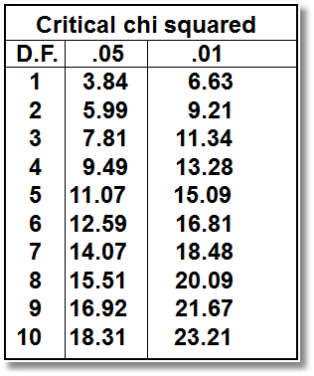
Computing the Critical Value
For an R by C Table, D.F. = (R-1)(C-1)
Calc→Probability Distributions → Chi-square
The value reported is 3.84146.

Slide 9
Analyzing Default
Do renters default more often (at a different rate) than owners?
To investigate, we study the cardholders (only)
We have the raw observations in the data set.
DEFAULT
OWNRENT 0 1 All
0 4854 615 5469
46.23 5.86 52.09
1 4649 381 5030
44.28 3.63 47.91
All 9503 996 10499
90.51 9.49 100.00

Slide 10
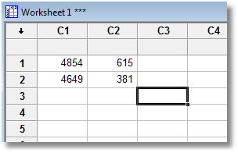
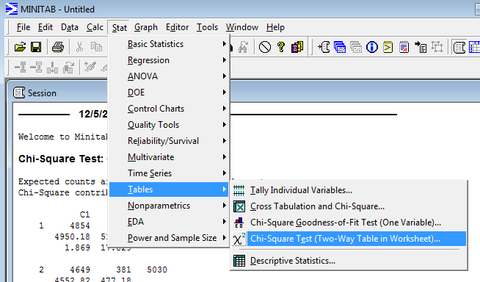

Slide 11
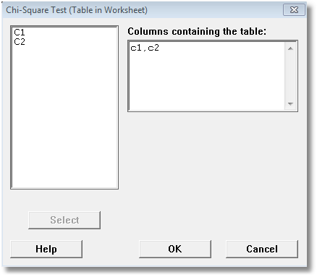

Slide 13
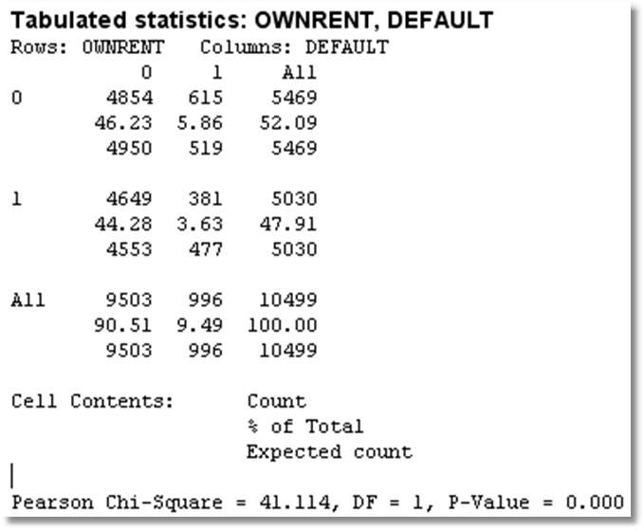
Hypothesis Test

Slide 14

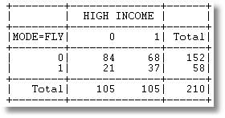
In my sample of 210 travelers between Sydney and Melbourne, it appears that there is a relationship between income and the decision whether to fly or not. Do the data suggest that the mode choice and income are independent?

Slide 15
Treatment Effects in Clinical Trials
Does Phenogyrabluthefentanoel (Zorgrab) work?
Investigate: Carry out a clinical trial.
  N+0 = “The placebo effect”
  N+T – N+0 = “The treatment effect”
  Is N+T > N+0 (significantly)?
Placebo Drug Treatment
No Effect N00 N0T
Positive Effect N+0 N+T

Slide 16


Slide 17
Confounding Effects

Slide 18
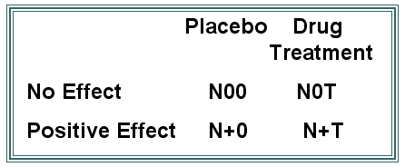
What About Confounding Effects?
Normal Weight Obese
Nonsmoker
Smoker
Age and Sex are usually relevant as well. How can all these factors be accounted for at the same time?

