Slide 1
Statistics and Data Analysis
Professor William Greene
Stern School of Business
IOMS Department
Department of Economics

Slide 2
Statistics and Data Analysis
Part 14 – Statistical
Tests: 2

Slide 3
Statistical Testing Applications
Methodology
Analyzing Means
Analyzing Proportions

Slide 4
Classical Testing Methodology
Formulate the hypothesis.
Determine the appropriate test
Decide upon the α level. (How confident do we want to be in the results?) The worldwide standard is 0.05.
Formulate the decision rule (reject vs. not reject) – define the rejection region
Obtain the data
Apply the test and make the decision.

Slide 5
Comparing Two Populations
These are data on the number of calls cleared by the operators at two call centers on the same day. Call center 1 employs a different set of procedures for directing calls to operators than call center 2.
Do the data suggest that the populations are different?
Call Center 1 (28 observations)
797 794 817 813 817 793 762 719 804 811 747 804 790 796 807 801 805 811 835 787 800 771 794 805 797 724 820 701
Call Center 2 (32 observations)
817 801 798 797 788 802 821 779 803 807 789 799 794 792 826 808 808 844 790 814 784 839 805 817 804 807 800 785 796 789 842 829

Slide 6
Application 1: Equal Means
Application: Mean calls cleared at the two call centers are the same
H₀: μ₁ = μ₂
H₁: μ₁ ≠ μ₂
Rejection region: Sample means from centers 1 and 2 are very different.
Complication: What to use for the variance(s) for the difference?

Slide 7
Standard Approach
H₀: μ₁ = μ₂
H₁: μ₁ ≠ μ₂
Equivalent: H₀: μ₁ – μ₂ = 0
Test is based on the two means:
  Reject the null hypothesis if
  is very different from zero (in either direction.
  Rejection region is large positive or negative values of

Slide 8
Rejection Region for Two Means

Slide 9
Easiest Approach: Large Samples
Assume relatively large samples, so we can use the central limit theorem.
It won’t make much difference whether the variances are assumed (actually are) the same or not.

Slide 10
Variance Estimator

Slide 11
Test of Means
H₀: μ_{Call Center 1} – μ_{Call Center 2} = 0
H₁: μ_{Call Center 1} – μ_{Call Center 2} ≠ 0
Use α = 0.05
Rejection region:

Slide 12
Basic Comparisons
Descriptive Statistics: Center1, Center2
Variable N Mean SE Mean StDev Min. Med. Max.
Center1 28 790.07 6.05 32.00 701.00 798.50 835.00
Center2 32 805.44 2.98 16.87 779.00 802.50 844.00
Means look different
Standard deviations (variances) look quite different.

Slide 13
Test for the Difference
Note minus 0 because that is the hypothesized value. It could have been some other value. For example, suppose we were investigating a claim that a test prep course would raise scores by 50 points.
Stat → Basic Statistics → 2 sample t (do not check equal variances box)
This can also be done by providing just the sample sizes, means and standard deviations.

Slide 14
Application: Paired Samples
Example: Do-overs on SAT tests
  Hypothesis: Scores on the second test are no better than scores on the first.
  (Hmmm… one sided test…)
  Hypothesis: Scores on the second test are the same as on the first.
  Rejection region: Mean of a sample of second scores is very different from the mean of a sample of first scores.
Subsidiary question: Is the observed difference (to the extent there is one) explained by the test prep courses? How would we test this?
Interesting question: Suppose the samples were not paired – just two samples.

Slide 15
Paired Samples
No new theory is needed
Compute differences for each observation
Treat the differences as a single sample from a population with a hypothesized mean of zero.

Slide 16
Testing Application 2: Proportion
Investigate: Proportion = a value
Quality control: The rate of defectives produced by a machine has changed.
H₀: θ = θ ⁰
(θ ⁰ = the value we thought it was)
H₁: θ ≠ θ ⁰
Rejection region: A sample of rates produces a proportion that is far from θ⁰

Slide 17
Procedure for Testing a Proportion
Use the central limit theorem:
  The sample proportion, p, is a sample mean. Treat this as normally distributed.
  The sample variance is p(1-p).
  The estimator of the variance of the mean is p(1-p)/N.

Slide 18
Testing a Proportion
H₀: θ = θ ₀
H₁: θ ≠ θ ₀
As usual, set α = .05
Treat this as a test of a mean.
Rejection region = sample proportions that are far from θ₀.
Note, assuming θ=θ₀ implies we are assuming that the variance is θ₀(1- θ₀)

Slide 19
Default Rate
Investigation: Of the 13,444 card applications, 10,499 were accepted.
The default rate for those 10,499 was 996/10,499 = 0.09487.
I am fairly sure that this number is higher than was really appropriate for cardholders at this time. I think the right number is closer to 6%.
Do the data support my hypothesis?

Slide 20
Testing the Default Rate
Sample data: p = 0.09487
Hypothesis: θ₀ = 0.06
As usual, use α = 5%.

Slide 21
Application 3: Comparing Proportions
Investigate: Owners and Renters have the same credit card acceptance rate
H₀: θ_{RENTERS} = θ_{OWNERS}
H₁: θ_{RENTERS} ≠ θ_{OWNERS}
Rejection region: Acceptance rates
for sample of the two types of applicants are very different.

Slide 22
Comparing Proportions
Note, here we are not assuming a specific θ_{O} or θ_{R} so we use the sample variance.

Slide 23
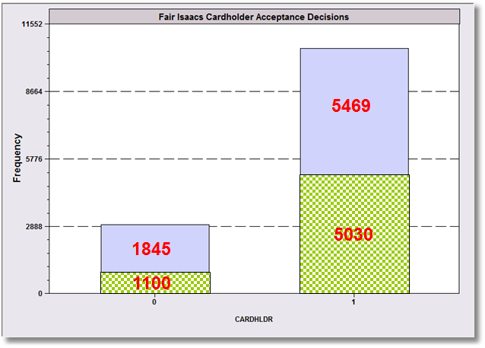
The Evidence
= Homeowners

Slide 24
Analysis of Acceptance Rates

Slide 25
Followup Analysis of Default
DEFAULT
OWNRENT 0 1 All
0 4854 615 5469
46.23 5.86 52.09
1 4649 381 5030
44.28 3.63 47.91
All 9503 996 10499
90.51 9.49 100.00
Are the default rates the same for owners and renters? The data for the 10,499 applicants who were accepted are in the table above. Test the hypothesis that the two default rates are the same.

