Slide 1
Statistics and Data Analysis
Professor William Greene
Stern School of Business
IOMS Department
Department of Economics

Slide 2
Statistics and Data Analysis
Part 13 – Statistical
Tests: 1

Slide 3
Statistical Testing
Methodology: Statistical testing
Classical hypothesis testing
  Setting up the test
  Test of a hypothesis about a mean
  Other kinds of statistical tests
Mechanics of hypothesis testing
Applications

Slide 4
Classical Hypothesis Testing
The scientific method applied to statistical hypothesis testing
Hypothesis: The world works according to my hypothesis
Testing or supporting the hypothesis
  Data gathering
  Rejection of the hypothesis if the data are inconsistent with it
  Retention and exposure to further investigation if the data are consistent with the hypothesis
Failure to reject is not equivalent to acceptance.

Slide 5
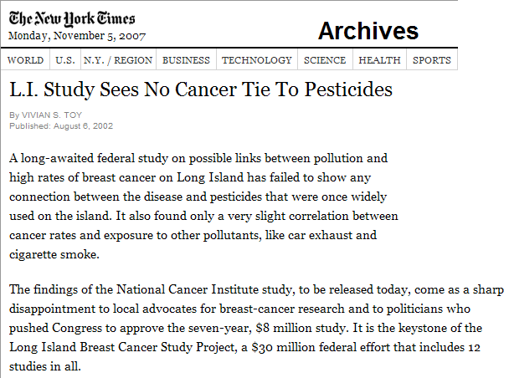
http://query.nytimes.com/gst/fullpage.html?res=9C00E4DF113BF935A3575BC0A9649C8B63

Slide 6
(Worldwide) Standard Methodology
“Statistical” testing
Methodology
  Formulate the “null” hypothesis
  Decide (in advance) what kinds of “evidence” (data) will lead to rejection of the null hypothesis. I.e., define the rejection region)
  Gather the data
  Carry out the test.

Slide 7
Formulating the Hypothesis
Stating the hypothesis: A belief about the “state of nature”
  A parameter takes a particular value
  There is a relationship between variables
  And so on…
The null vs. the alternative
  By induction: If we wish to find evidence of something, first assume it is not true.
  Look for evidence that leads to rejection of the assumed hypothesis.

Slide 8
Terms of Art
Null Hypothesis: The proposed state of nature
Alternative hypothesis: The state of nature that is believed to prevail if the null is rejected.

Slide 9
Errors in Testing
Hypothesis is Hypothesis is
True False
Correct Decision | Type II Error
Type I Error | Correct Decision
I Do Not Reject the Hypothesis
I Reject the Hypothesis
Business Decision Analysis:
Type I Error: Failing to take an action when one is warranted.
Type II Error: Taking an action when it was not needed.

Slide 10
Example: Credit Rule
Investigation: I believe that Fair Isaacs relies on home ownership in deciding whether to “accept” an application.
  Null hypothesis: There is no relationship
  Alternative hypothesis: They do use homeownership data.
What decision rule should I use?

Slide 11
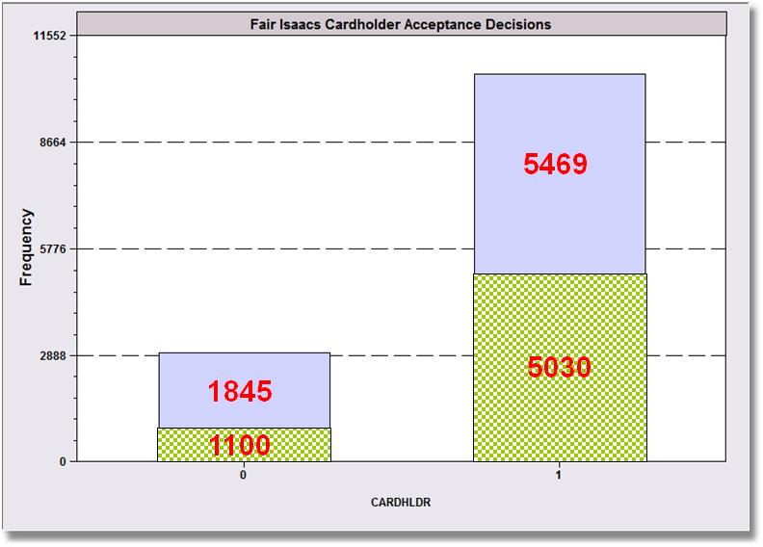
Some Evidence
= Homeowners
48% of acceptees are homeowners.
37% of rejectees are homeowners.
Rejected
Accepted

Slide 12
The Rejection Region
What is the “rejection region?”
Data (evidence) that are inconsistent with my hypothesis
Evidence is divided into two types:
  Data that are inconsistent with my hypothesis (the rejection region)
  Everything else

Slide 13
Application: Breast Cancer
On Long Island
Null Hypothesis: There is no link between the high cancer rate on LI and the use of pesticides and toxic chemicals in dry cleaning, farming, etc.
Procedure
  Examine the physical and statistical evidence
  If there is convincing covariation, reject the null hypothesis
  What is the rejection region?
The NCI study:
  Working hypothesis: There is a link: We will find the evidence.
  How do you reject this hypothesis?

Slide 14
Formulating the Testing Procedure
Usually: What kind of data will lead me to reject the hypothesis?
Thinking scientifically: If you want to “prove” a hypothesis is true (or you want to support one) begin by assuming your hypothesis is not true, and look for plausible evidence that contradicts the assumption.

Slide 15
Hypothesis Testing Strategy
Formulate the null hypothesis
Gather the evidence
Question: If my null hypothesis were true, how likely is it that I would have observed this evidence?
  Very unlikely: Reject the hypothesis
  Not unlikely: Do not reject. (Retain the hypothesis for continued scrutiny.)

Slide 16
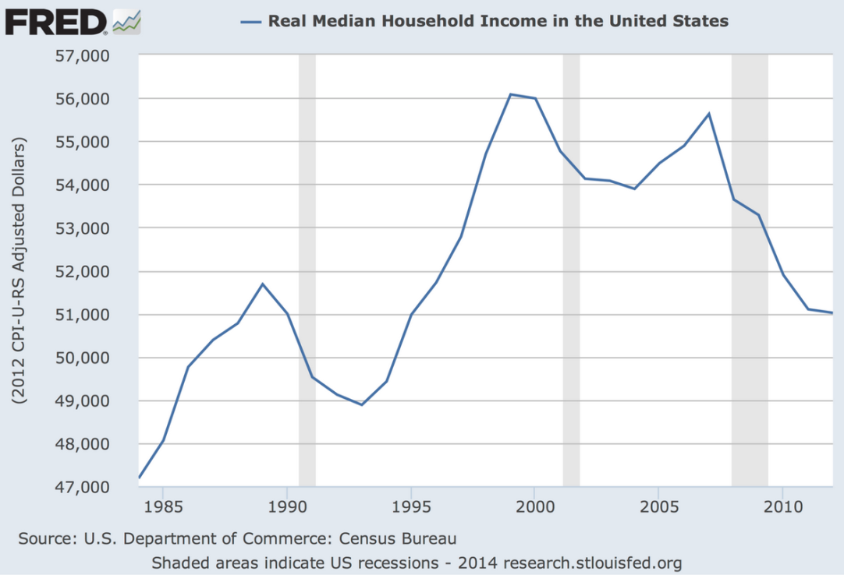
Hypothesis About a Mean
I believe that the average income of individuals in a population is (about) $30,000. (Numerical example. Not realistic for the U.S.)
  H₀ : μ = $30,000 (The null)
  H₁: μ ≠ $30,000 (The alternative)
I will draw the sample and examine the data.
The rejection region is data for which the sample mean is far from $30,000.
How far is far? That is the test.

Slide 17
Deciding on the Rejection Region
If the sample mean is far from $30,000, I will reject the hypothesis.
I choose, the region, for example, < 29,500 or > 30,500
The probability that the mean falls in the rejection region even though the hypothesis is true (should not be rejected) is the probability of a Type 1 error. Even if the true mean really is $30,000, the sample mean could fall in the rejection region.
Rejection
Rejection
29,500 30,000 30,500

Slide 18
Reduce the Probability of a Type I Error by Making the Rejection Region Smaller
Reduce the probability of a Type I error by moving the boundaries of the rejection region farther out.
Probability outside this interval is large.
28,500 29,500 30,000 30,500 31,500
Probability outside this interval is much smaller.
You can make a Type I error impossible by making the rejection region very far from the null. Then you would never make a Type I error because you would never reject H₀. This is not likely to be helpful.

Slide 19
Setting the α Level
“α” is the probability of a Type I error
Choose the width of the interval by choosing the desired probability of a Type I error, based on the t or normal distribution. (How confident do I want to be?)
Multiply the corresponding z or t value by the standard error of the mean.

Slide 20
Testing Procedure
The rejection region will be the range of values
greater than μ₀ + zσ/√N or
less than μ₀ - zσ/√N
Use z = 1.96 for 1 - α = 95% (wide)
Use z = 2.576 for 1 - α = 99% (wider)
(Use the t table if small sample and sampling from a normal distribution.)

Slide 21
Deciding on the Rejection Region
If the sample mean is far from $30,000, reject the hypothesis.
Choose, the region, say,
Rejection
Rejection
I am 95% certain that I will not commit a type I error (reject
the hypothesis in error). (I cannot be 100% certain.)

Slide 22

The Testing Procedure (For a Mean)

Slide 23
The Test Procedure
Choosing z = 1.96 makes the probability of a Type I error 0.05.
Choosing z = 2.576 would reduce the probability of a Type I error to 0.01.

Slide 24
Application

Slide 25
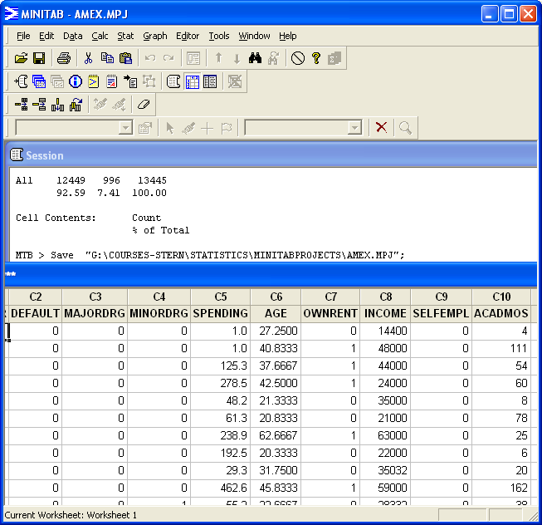

Slide 26
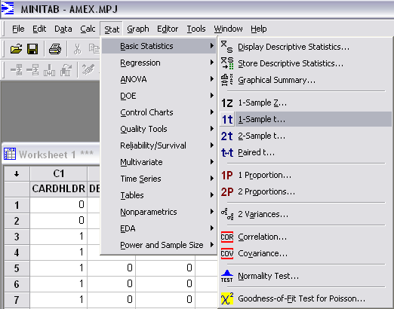
If you choose 1-Sample Z… to use the normal distribution, Minitab assumes you know σ and asks for the value.

Slide 27
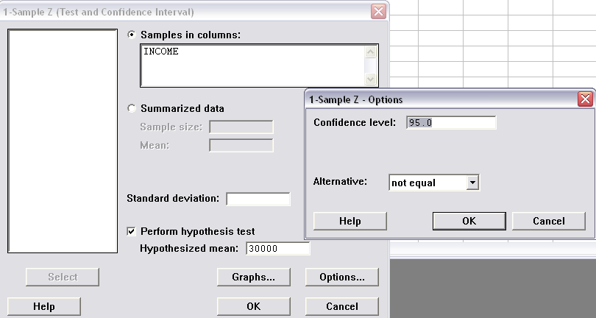
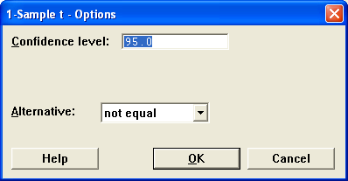
Specify the Hypothesis Test
Minitab assumes 95%. You can choose some other value.

Slide 28
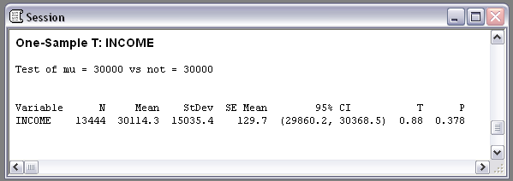
The Test Results (Are In)

Slide 29
An Intuitive Approach
Using the confidence interval
The confidence interval gives the range of plausible values.
If this range does not include the null hypothesis, reject the hypothesis.
If the confidence interval contains the hypothesized value, retain the hypothesis.
Includes $30,000.

Slide 30
Insignificant Results – P Value
The “P value” is the probability that you would have observed the evidence that you did observe if the null hypothesis were true.
If the P value is less than the Type I error probability (usually 0.05) you have chosen, you will reject the hypothesis.
This is 1 – α.
The test results are “significant” if the P value is less than α.
These test results are “insignificant” at the 5% level.

Slide 31
Application:
One sided test of a mean
Hypothesis: The mean is greater than some value
Academic Application: Do SAT Test Courses work?
  Null hypothesis: The mean grade on the second tests is less than the mean on the original test.
  Reject means the do-over appears to be better.
  Rejection supports the claim that the test prep courses work.

Slide 32
Summary
Methodological issues: Science and hypothesis tests
Standard methods:
  Formulating a testing procedure
  Determining the “rejection region”
Many different kinds of applications

