Slide 1
Statistics and Data Analysis
Professor William Greene
Stern School of Business
IOMS Department
Department of Economics

Slide 2
Statistics and Data Analysis
Part 11 – Two Normal
Approximations

Slide 3
Normal Approximations and Random Walks
Approximating the binomial distribution
Modeling sums
  Random walk model for stock prices
  Long run predictions

Slide 4

Binomial Probability
Best Buy sells 48 headphones for MP3 players per day (for $25 each)
The cashier offers an additional warranty (for $8)
The probability any individual customer will buy the warranty is 0.25. Customers are independent.
A customer (economist/statistician) standing nearby during one of these transactions guesses that from 8 to 15 headphone buyers will take the offer.
What is the probability that the guess is correct?

Slide 5
Exact Probability

Slide 6
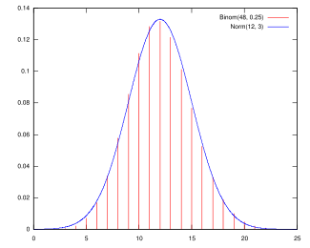
A Normal Approximation
The binomial density function has R=48, θ=.25, so
μ = 12 and σ = 3.
The normal density plotted has mean 12 and standard deviation 3. It gives a remarkably good fit to the binomial probabilities with R=8 and θ=.25.

Slide 7
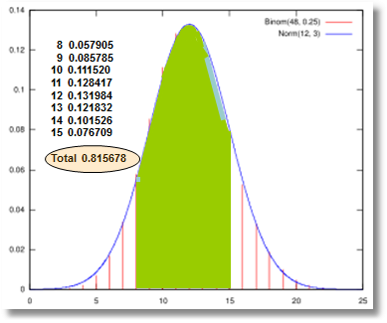
Exact Binomial Probability Looks Like a Normal Probability

Slide 8
A Continuity Correction (Theorem)
When using a continuous distribution (normal) to approximate a discrete probability (binomial) for a range of values, subtract .5 from the lowest value in the range and add .5 to the highest value in the range.
For the example, we will approximate Prob(8 < X < 15) by using a normal approximation to compute
Prob(7.5 < X < 15.5)

Slide 9
Normal Approximation
The binomial has R=48, θ=.25, so μ = 12 and σ = 3.
The normal distribution plotted has mean 12 and standard deviation 3.
We use this to approximate the binomial Prob(8 < X < 15) = 0.815678.
P[7.5 < x < 15.5] =
P[(7.5-12)/3 < z < (15.5-12)/3] =
P[-1.5 < z < 1.166] =
P[z < 1.166] – P[z < -1.5] =
0.878327 – 0.0668072 = 0.8115198 0.5% error

Slide 10
Application
A retailer sells 179 washing machines. With each sale, they offer the buyer a (wonderful) opportunity to purchase an extended warranty. The probability that any individual will buy the warranty is 0.38.
Find the probability that 70 or more will buy the warranty.

Slide 11
Warranty Purchases
The exact probability of 70 or more is
P[X > 70] = 1 – P[X < 69] = 1 – 0.592731 = 0.407269.
If we apply the normal approximation with the continuity correction,
μ = (179*0.38) = 68.02 and
σ = √(179(0.38)(0.62) = 6.494,
We find
P[X > 69.5] = P[Z > (69.5 – 68.02)/6.494]
= P[Z > 0.2279]
= 0.409862,
which is a pretty good approximation to .407269. The error is only 0.6%.

Slide 12
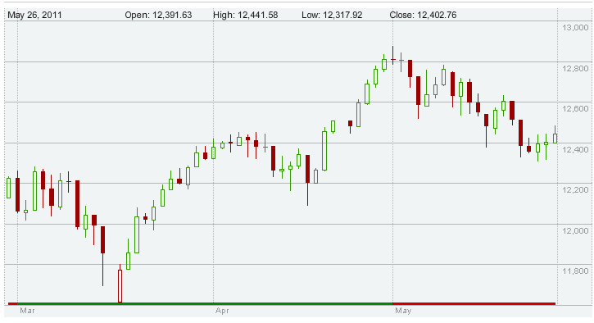
Random Walks and Stock Prices

Slide 13
Application of a Normal Model
Suppose P is sales of a store. The accounting period starts with total sales = 0
On any given day, sales are random, normally distributed with mean μ and standard deviation σ.
For example, mean $100,000 and
standard deviation $10,000
Sales on any given day, day t, are denoted Δ_{t}
  Δ₁ = sales on day 1,
  Δ₂ = sales on day 2,
Total sales after T days will be Δ₁+ Δ₂+…+ Δ_{T}
Each Δ_{t} is the change in the total that occurs on day t, starting at zero and beginning on day 1.

Slide 14
Behavior of the Total
Let P_{T} = Δ₁+ Δ₂+…+ Δ_{T}
be the total of the changes (variables) from times (observations) 1 to T.
The sequence is
  P₁ = Δ₁
  P₂ = Δ₁ + Δ₂
  P₃ = Δ₁ + Δ₂ + Δ₃
  And so on…
  P_{T} = Δ₁ + Δ₂ + Δ₃ + … + Δ_{T}

Slide 15
This Defines a Random Walk
The sequence is
  P₁ = Δ₁
  P₂ = Δ₁ + Δ₂
  P₃ = Δ₁ + Δ₂ + Δ₃
  And so on…
  P_{T} = Δ₁ + Δ₂ + Δ₃ + … + Δ_{T}
It follows that
  P₁ = 0 + Δ₁
  P₂ = P₁ + Δ₂
  P₃ = P₂ + Δ₃
  And so on…
  P_{T} = P_{T-1} + Δ_{T}
Interpret:
Total at end of today = Total at end of yesterday + effect of results today.

Slide 16
The sequence is
  P₁ = Δ₁
  P₂ = Δ₁ + Δ₂
  And so on…
  P_{T} = Δ₁ + Δ₂ + Δ₃ + … + Δ_{T}
The means are
  μ = 1μ
  μ + μ = 2μ
  And so on…
  μ + μ + μ + … + μ = Tμ
The variances and standard deviations are
  σ² = 1 σ² σ
  σ² + σ² = 2 σ² sqr(2)σ
  And so on…
  σ² + σ² + σ² + … + σ² = T σ² sqr(T)σ

Slide 17
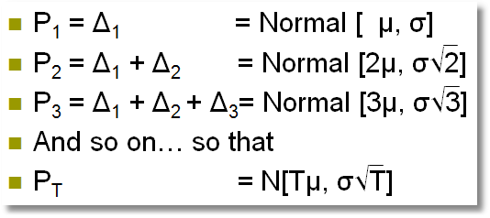
Summing
If the individual Δs are each normally distributed with mean μ and standard deviation σ, then
Note that the mean increases with t but the standard deviation increases only with sqr(t).

Slide 18
A Model for Stock Prices
Preliminary:
Consider a sequence of T random outcomes, independent from one to the next, Δ₁, Δ₂,…, Δ_{T}. (Δ is a standard symbol for “change” which will be appropriate for what we are doing here. And, we’ll use “t” instead of “i” to signify something to do with “time.”)
Δ_{t} comes from a normal distribution with mean μ and standard deviation σ.

Slide 19
A Model for Stock Prices
Random Walk Model: Today’s price = yesterday’s price + a change that is independent of all previous information.
(It’s a model, and a very controversial one at that.)
Start at some known P₀ so
P₁ = P₀ + Δ₁ and so on.
Assume μ = 0 (no systematic drift in the stock price).

Slide 20
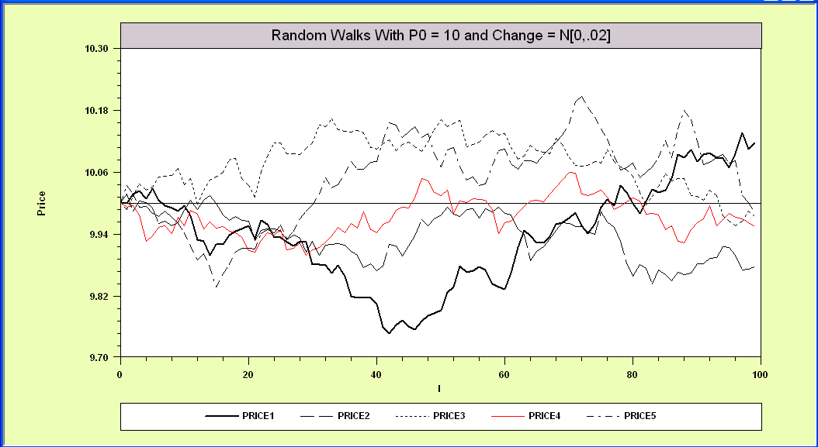
Random Walk Simulations
P_{t} = P_{t-1} + Δ_{t}, t = 1,2,…,100
Example: P₀= 10, Δ_{t} Normal with μ=0, σ=0.02

Slide 21
Random Walk?
Dow Jones March 27 to May 26, 2011.

Slide 22
Uncertainty and Prediction
Expected Price = E[P_{t}] = P₀+Tμ
We have used μ = 0 (no systematic upward or downward drift).
Standard deviation = σ√T reflects uncertainty or “risk.”
Looking forward from “now” = time t = 0, the uncertainty increases the farther out we look to the future.

Slide 23
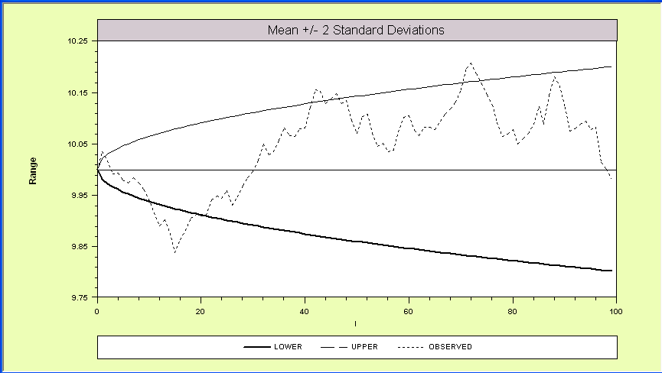
Using the Empirical Rule to
Formulate an Expected Range

Slide 24
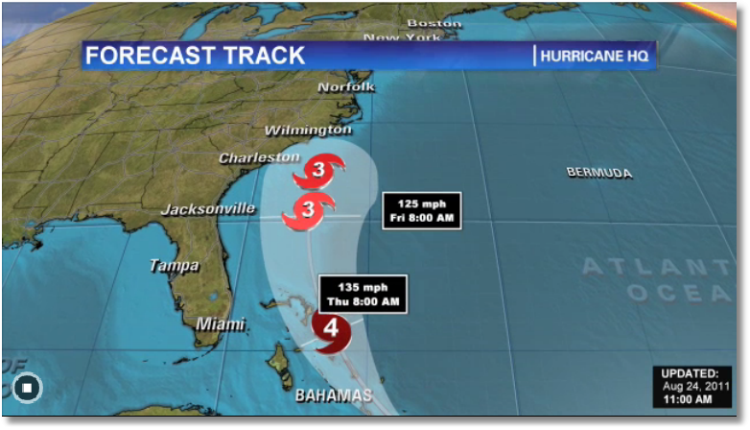
Hurricane Forecast Interval
The position of the center of the hurricane follows a random walk. The speed of movement is known reasonably accurately. The uncertainty is in the direction. Starting at time t, speed and direction, together, determine the position at time t+1. Two models are used to make the prediction, the ‘American’ model and the ‘European’ model.

Slide 25
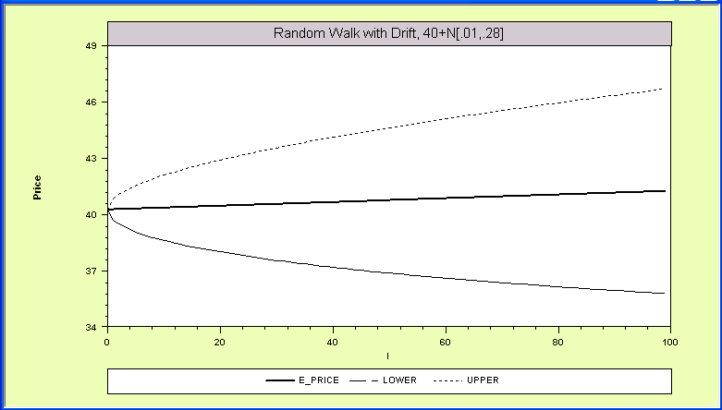
Prediction Interval
From the normal distribution,
P[μ_{t} - 1.96σ_{t} < X < μ_{t} + 1.96σ_{t}] = 95%
This range can provide a “prediction interval, where
μ_{t} = P₀ + tμ and σ_{t} = σ√t.

Slide 26
Application
Using the random walk model, with P₀ = $40, say μ =$0.01, σ=$0.28, what is the probability that the price will exceed $41 after 25 days?
E[P₂₅] = 40 + 25($.01) = $40.25. The standard deviation will be $0.28√25=$1.40.

Slide 27
Random Walk Model
Controversial – many assumptions
  Normality is inessential – we are summing, so after 30 periods or so, we can invoke the CLT.
  The assumption of period to period independence is at least debatable.
  The assumption of unchanging mean and variance is certainly debatable.
The additive model allows negative prices. (Ouch!)
The model when applied is usually based on logs and the lognormal model. [P_{t+1} = P_{t} x exp(δ_{t})], δ_{t} = ‘period return.’

Slide 28

Lognormal Random Walks
The lognormal model remedies some of the shortcomings of the linear (normal) model.
Somewhat more realistic.
Still controversial.

