Slide 1
Statistics and Data Analysis
Professor William Greene
Stern School of Business
IOMS Department
Department of Economics

Slide 2
Statistics and Data Analysis
Part 10 – The Law of
Large Numbers
and the Central
Limit Theorem

Slide 3
Sample Means and the Central Limit Theorem
Statistical Inference: Drawing Conclusions from Data
Sampling
  Random sampling
  Biases in sampling
  Sampling from a particular distribution
Sample statistics
Sampling distributions
  Distribution of the mean
  More general results on sampling distributions
Results for sampling and sample statistics
  The Law of Large Numbers
  The Central Limit Theorem

Slide 4
Overriding Principles in Statistical Inference
Characteristics of a random sample will mimic (resemble) those of the population
  Mean, Median, etc.
  Histogram
The sample is not a perfect picture of the population.
It gets better as the sample gets larger. (We will develop what we mean by ‘better.’)

Slide 5
Random Sampling
Population
The set of all possible observations that could be drawn in a sample
What makes a sample a random sample?
  Independent observations
  Same underlying process generates each observation made

Slide 6
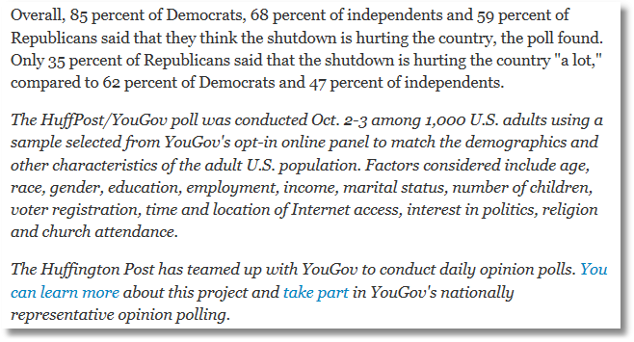
“Representative Opinion Polling” and Random Sampling

Slide 7
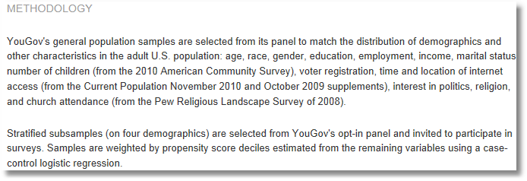
Selection on Observables Using Propensity Scores
This DOES NOT solve the problem of participation bias.

Slide 8
Sampling From a Specified Population
X₁ X₂ … X_{N} will denote a random sample. They are N random variables with the same distribution.
x₁, x₂ … x_{N} are the values taken by the random sample.
X_{i} is the ith random variable
x_{i} is the ith observation

Slide 9
Sampling from a Poisson Population
Operators clear all calls that reach them.
The number of calls that arrive at an operator’s station are Poisson distributed with a mean of 800 per day.
These are the assumptions that define the population
60 operators (stations) are observed on a given day.
x₁,x₂,…,x₆₀ =
797 794 817 813 817 793 762 719 804 811
837 804 790 796 807 801 805 811 835 787
800 771 794 805 797 724 820 601 817 801
798 797 788 802 792 779 803 807 789 787
794 792 786 808 808 844 790 763 784 739
805 817 804 807 800 785 796 789 842 829
This is a (random) sample of N = 60 observations from a Poisson process (population) with mean 800. Tomorrow, a different sample will be drawn.

Slide 10
Sample from a Normal Population
The population: The amount of cash demanded in a bank each day is normally distributed with mean $10M (million) and standard deviation $3.5M.
Random variables: X₁,X₂,…,X_{N} will equal the amount of cash demanded on a set of N days when they are observed.
Observed sample: x₁ ($12.178M), x₂ ($9.343M), …, x_{N} ($16.237M) are the values on N days after they are observed.
X₁,…,X_{N} are a random sample from a normal population with mean $10M and standard deviation $3.5M.

Slide 11

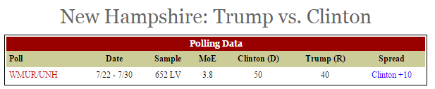
Sample from a Bernoulli Population
The population is “Likely Voters in New Hampshire in the time frame 7/22 to 7/30, 2015”
X = their vote, X = 1 if Clinton
X = 0 if Trump
The population proportion of voters who would vote for Clinton is θ. The 652 observations, X₁,…,X₆₅₂ are a random sample from a Bernoulli population with mean θ.
Aug.6, 2015. http://www.realclearpolitics.com/epolls/2016/president/nh/new_hampshire_trump_vs_clinton-5596.html

Slide 12
Sample Statistics
Statistic = a quantity that is computed from a random sample.
Ex. Sample sum:
Ex. Sample mean
Ex. Sample variance
Ex. Sample minimum x_{[1]}.
Ex. Proportion of observations less than 10
Ex. Median = the value M for which 50% of the
observations are less than M.

Slide 13
Sampling Distribution
The sample itself is random, since each member is random. (A second sample will differ randomly from the first one.)
Statistics computed from random samples will vary as well.

Slide 14
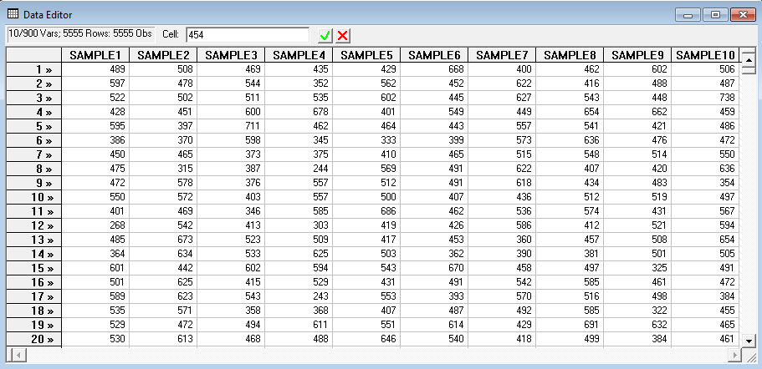
A Sample of Samples
Monthly credit card expenses are normally distributed with a mean of 500 and standard deviation of 100. We examine the pattern of expenses in 10 consecutive months by sampling 20 observations each month.
10 samples of 20 observations from normal with mean 500 and standard deviation 100; Normal[500,100²]. Note the samples vary from one to the next (of course).

Slide 15
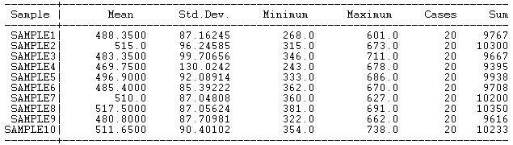
Variation of the Sample Mean
Implication: The sample sum and sample mean are random variables. Any random sample produces a different sum and mean.
When the analyst reports a mean as an estimate of something in the population, it must be understood that the value depends on the particular sample, and a different sample would produce a different value of the same mean. How do we quantify that fact and build it into the results that we report?

Slide 16
Sampling Distributions
The distribution of a statistic in “repeated sampling” is the sampling distribution.
The sampling distribution is the theoretical population that generates sample statistics.

Slide 17
The Sample Sum
Expected value of the sum:
E[X₁+X₂+…+X_{N}] = E[X₁]+E[X₂]+…+E[X_{N}] = Nμ
Variance of the sum. Because of independence,
Var[X₁+X₂+…+X_{N}] = Var[X₁]+…+Var[X_{N}] = Nσ²
Standard deviation of the sum = σ times √N

Slide 18
The Sample Mean
Note Var[(1/N)X_{i}] = (1/N²)Var[X_{i}] (product rule)
Expected value of the sample mean
E(1/N)[X₁+X₂+…+X_{N}] = (1/N){E[X₁]+E[X₂]+…+E[X_{N}]}
= (1/N)Nμ = μ
Variance of the sample mean
Var(1/N)[X₁+X₂+…+X_{N}] = (1/N²){Var[X1]+…+Var[X_{N}]}
= Nσ²/N² = σ²/N
Standard deviation of the sample mean = σ/√N

Slide 19
Sample Results vs. Population Values
The average of the 10 means is 495.87 The true mean is 500
The standard deviation of the 10 means is 16.72 . Sigma/sqr(N) is 100/sqr(20) = 22.361
The standard deviation of the sample of means is much smaller than the standard deviation of the population.

Slide 20
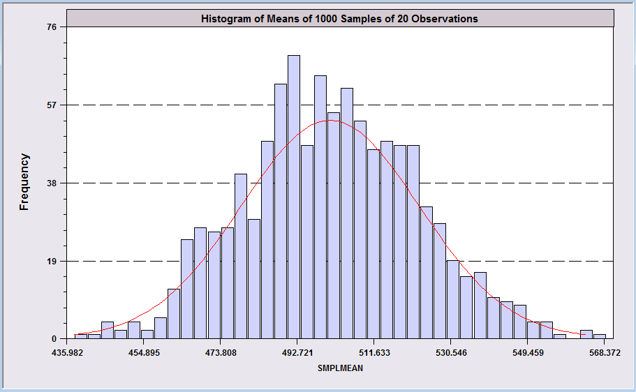
Sampling Distribution Experiment
1,000 samples of 20 from N[500,100²]
The sample mean has an expected value and a sampling variance.
The sample mean also has a probability distribution. Looks like a normal distribution.
This is a histogram for 1,000 means of samples of 20 observations from Normal[500,100²].

Slide 21
The Distribution of the Mean
Note the resemblance of the histogram to a normal distribution.
In random sampling from a normal population with mean μ and variance σ², the sample mean will also have a normal distribution with mean μ and variance σ²/N.
Does this work for other distributions, such as Poisson and Binomial? Yes.
  The mean is approximately normally distributed.

Slide 22
Implication 1 of the
Sampling Results

Slide 23
Implication 2 of the
Sampling Result

Slide 24
The % is a mean of Bernoulli variables, X_{i} = 1 if the respondent favors the candidate, 0 if not. The % equals 100[(1/652)Σ_{i}x_{i}].
(1) Why do they tell you N=652?
(2) What do they mean by
MoE = 3.8? (Can you show
how they computed it?)
Fundamental polling result:
Standard error = SE = sqr[p(1-p)/N]
MOE = ± 1.96 × SE
Aug.6, 2015. http://www.realclearpolitics.com/epolls/2016/president/nh/new_hampshire_trump_vs_clinton-5596.html

Slide 25
Two Major Theorems
Law of Large Numbers: As the sample size gets larger, sample statistics get ever closer to the population characteristics
Central Limit Theorem: Sample statistics computed from means (such as the means, themselves) are approximately normally distributed, regardless of the parent distribution.

Slide 26
The Law of Large Numbers

Slide 27
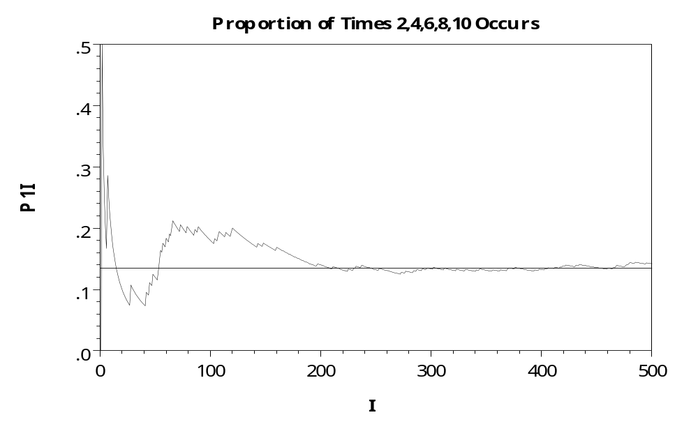
The LLN at Work – Roulette Wheel
Computer simulation of a roulette wheel – θ = 5/38 = 0.1316
P = the proportion of times (2,4,6,8,10) occurred.

Slide 28

Application of the LLN
The casino business is nothing more than a huge application of the law of large numbers. The insurance business is close to this as well.

Slide 29
Insurance Industry and the LLN
Insurance is a complicated business.
One simple theorem drives the entire industry
  Insurance is sold to the N members of a ‘pool’ of purchasers, any one of which may experience the ‘adverse event’ being insured against.
  P = ‘premium’ = the price of the insurance against the adverse event
  F = ‘payout’ = the amount that is paid if the adverse event occurs
  θ = the probability that a member of the pool will experience the adverse event.
  The expected profit to the insurance company is N[P - θF]
  Theory about θ and P. The company sets P based on θ. If P is set too high, the company will make lots of money, but competition will drive rates down. (Think Progressive advertisements.) If P is set to low, the company loses money.
How does the company learn what θ is?
What if θ changes over time. How does the company find out?
The Insurance company relies on (1) a large N and (2) the law of large numbers to answer these questions.

Slide 30
Insurance Industry Woes
Adverse selection: Price P is set for θ which is an average over the population – people have very different θs. But, when the insurance is actually offered, only people with high θ buy it. (We need young healthy people to sign up for insurance.)
Moral hazard: θ is ‘endogenous.’ Behavior changes because individuals have insurance. (That is the huge problem with fee for service reimbursement. There is an incentive to overuse the system.)

Slide 31
Implication of the Law of Large Numbers
If the sample is large enough, the difference between the sample mean and the true mean will be trivial.
This follows from the fact that the variance of the mean is σ²/N → 0.
An estimate of the population mean based on a large(er) sample is better than an estimate based on a small(er) one.

Slide 32

Implication of the LLN
Now, the problem of a “biased” sample: As the sample size grows, a biased sample produces a better and better estimator of the wrong quantity.
Drawing a bigger sample does not make the bias go away. That was the essential flaw of the Literary Digest poll (text, p. 313) and of the Hite Report.

Slide 33

3000 !!!!!
Or is it 100,000?

Slide 34
Central Limit Theorem
Theorem (loosely): Regardless of the underlying distribution of the sample observations, if the sample is sufficiently large (generally > 30), the sample mean will be approximately normally distributed with mean μ and standard deviation σ/√N.

Slide 35
Implication of the Central
Limit Theorem
Inferences about probabilities of events
based on the sample mean can use a
normal approximation even if the data
themselves are not drawn from a normal
population.

Slide 36
Poisson
Sample
797 794 817 813 817 793 762 719 804 811
837 804 790 796 807 801 805 811 835 787
800 771 794 805 797 724 820 601 817 801
798 797 788 802 792 779 803 807 789 787
794 792 786 808 808 844 790 763 784 739
805 817 804 807 800 785 796 789 842 829
The sample of 60 operators from text exercise 2.22 appears above. Suppose it is claimed that the population that generated these data is Poisson with mean 800 (as assumed earlier). How likely is it to have observed these data if the claim is true?
The sample mean is 793.23. The assumed population standard error of the mean, as we saw earlier, is sqr(800/60) = 3.65. If the mean really were 800 (and the standard deviation were 28.28), then the probability of observing a sample mean this low would be
P[z < (793.23 – 800)/3.65] = P[z < -1.855] = .0317981.
This is fairly small. (Less than the usual 5% considered reasonable.) This might cast some doubt on the claim that the true mean is still 800.

Slide 37
Applying the CLT

Slide 38
Overriding Principle in
Statistical Inference
(Remember) Characteristics of a random sample will mimic (resemble) those of the population
  Histogram
  Mean and standard deviation
  The distribution of the observations.

Slide 39
Using the Overall Result in This Session
A sample mean of the response times in 911 calls is computed from N events.
• How reliable is this estimate of the true
average response time?
• How can this reliability be measured?

Slide 40
Question on Midterm: 10 Points
The central principle of classical statistics (what we are studying in this course), is that the characteristics of a random sample resemble the characteristics of the population from which the sample is drawn. Explain this principle in a single, short, carefully worded paragraph. (Not more than 55 words. This question has exactly fifty five words.)

Slide 41
Summary
Random Sampling
Statistics
Sampling Distributions
Law of Large Numbers
Central Limit Theorem

