Slide 1
Statistics and Data Analysis
Professor William Greene
Stern School of Business
IOMS Department
Department of Economics

Slide 2
Statistics and Data Analysis
Introduction

Slide 3
Professor William Greene;
Economics and IOMS Departments
Office: KMEC, 7-90 (Economics Department)
Office phone: 212-998-0876
Office hours: TR 3-4PM (Other times, when the door is open. Or by appointment)
Email: wgreene@stern.nyu.edu
URL: http://people.stern.nyu.edu/wgreene
http://people.stern.nyu.edu/wgreene/Statistics/Outline.htm

Slide 4
Course Objectives
Basic Understanding
  Random outcomes and random information
  Statistical information as the measured outcomes of random processes
Technical Skills
  Analysis of statistical information
  Model building
  Presentation of statistical information

Slide 5
Your Technical Help Is Wanted
Our firm is looking for a [Ph.D.-level] statistician to assist us in analyzing a simple database of compensation levels. Our database includes 93 unique records for different institutions. We expect to analyze two dependent variables against 13 independent variables.
We need to perform multivariate regression analysis to determine which of the variables are statistically significant. We also need to calculate the t-statistics for each of the independent variables and adjusted r-squared values for the multivariate regression model developed. We expect that some of the variables may need to be transformed prior to creating the regression analysis. Additional statistical approaches and techniques may be required as appropriate.
Subsequent to the analysis of each of the variables, we will require a brief write-up detailing any relationships (or lack thereof) uncovered through the analysis. We anticipate that this write-up will be approximately 2-3 pages in length, excluding any supporting appendices. This write up should describe, in plain English, all relevant details regarding the analysis.

Slide 6
Course Prerequisites
Basic algebra. (Especially summation)
Geometry (straight lines)
Logs and exponents
NOTE: I (you) will use only base e (natural) logs, not base 10 (common) logs in this course.
A smattering of simple calculus. (I may use two or three derivatives during the semester.)

Slide 7
Course Grade
Midterm 30%
Quizzes 15%
Final 30%
Problems 15%
Project 10%
You may work in groups of up to four
students on homework sets and the project
and submit one report for the group.
Stern Policy mandates that no more
than 35% of final grades in core
courses may be A or A-

Slide 8
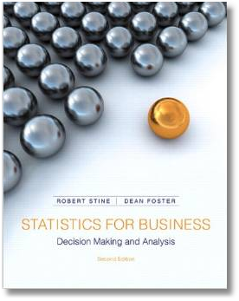
Course Materials
Notes: Distributed in first class
Text: Stine and Foster. Statistics for
Business: Decision Making and Analysis
On the course website:
  Miscellaneous notes and materials
  Class slide presentations
  Problem sets with data when needed
Software: Minitab 17
http://people.stern.nyu.edu/wgreene/Statistics/Outline.htm

Slide 9
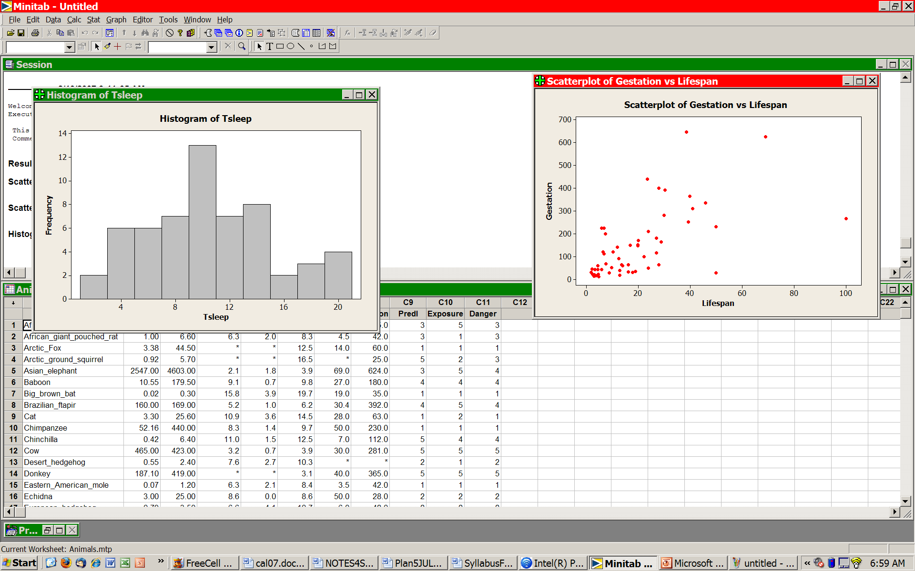
Course Software: Minitab
The Current Version: Minitab 17
Rent or buy: www.onthehub.com
$29.99 to rent for 6 months $99.99 to own.
Search: www.onthehub.com/minitab

Slide 10
Using SternApps
The first time, go to http://apps.stern.nyu.edu
  Download the client software (CitrixReceiver.exe)
  Install (takes 2 minutes). After completion, Continue
  Select ‘launch ica’ when it downloads
  When the license manager worries, select gonzo…
Now launch Minitab 17 from the apps menu
(This procedure has gotten easier over time.)

Slide 11
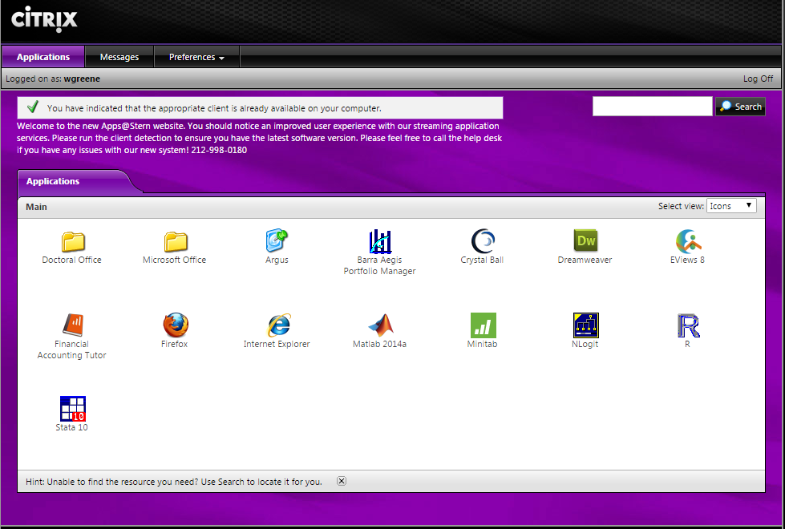

Slide 12
Course Outline and Overview
1. Presenting Data
Data
  Types
  Information content
Data Description
  Graphical devices: Plots, histograms
  Statistical: Summary statistics

Slide 13
Course Outline and Overview
2. Explaining How Random Data Arise
Probability: Understanding unpredictable outcomes
Precise mathematical principles of random outcomes e.g., gambling and games of chance
Models = descriptions of random outcomes that don’t have fixed mathematical laws
The Normal distribution
  THE fundamental model for outcomes involving behavior
  Model building for random outcomes using the normal distribution

Slide 14
Course Outline and Overview
3. Learning from Data
Statistical inference
  Hypothesis testing: (Is the correlation large? Can we be confident that it not actually zero?)
Hypothesis tests for specific applications
  Mean of a population: Is it a specific value?
  Applications in regression: Are the variables in the model really related?
  An application in marketing: Did the sales promotion work? How would you find out?
Model building – multiple regression analysis

