Slide 1
Two approaches to non-convex machine learning
Yuchen Zhang
Stanford University

Slide 2
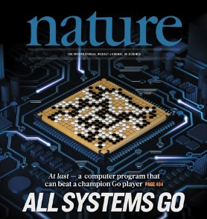

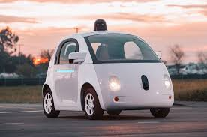
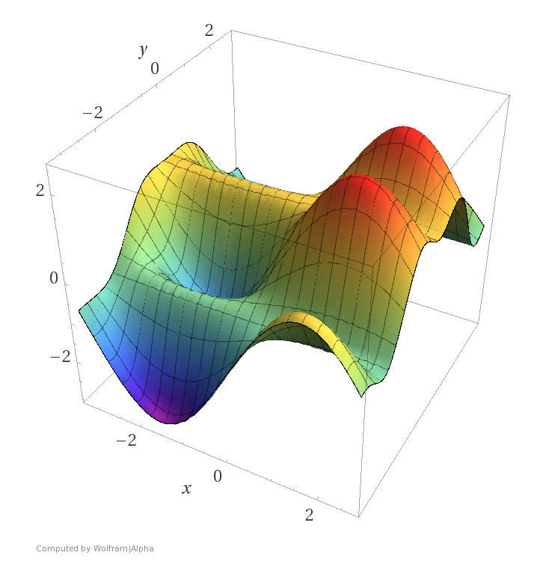
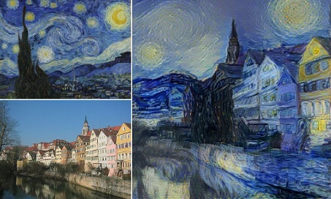

Non-convexity in modern machine learning
State-of-the-art AI models are learnt by minimizing (often non-convex) loss functions.
Traditional optimization algorithms only guarantee to find locally optimal solutions.

Slide 3
This talk
Two ideas to attack non-convexity and local minima:
Idea 1: Injecting large random noise to SGD.
  A Hitting Time Analysis of Stochastic Gradient Langevin Dyanmics
  Yuchen Zhang, Percy Liang, Moses Charikar (COLT’17)
Idea 2: Convex relaxation.
  Convexified Convolutional Neural Network
  Yuchen Zhang, Percy Liang, Martin Wainwright (ICML’17)

Slide 4
Part I
Injecting Large Random Noise to SGD

Slide 5
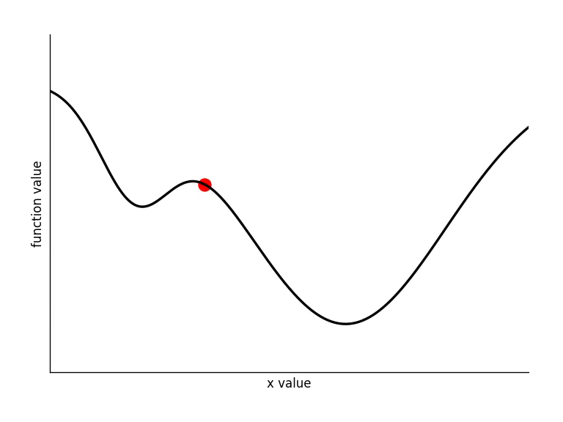
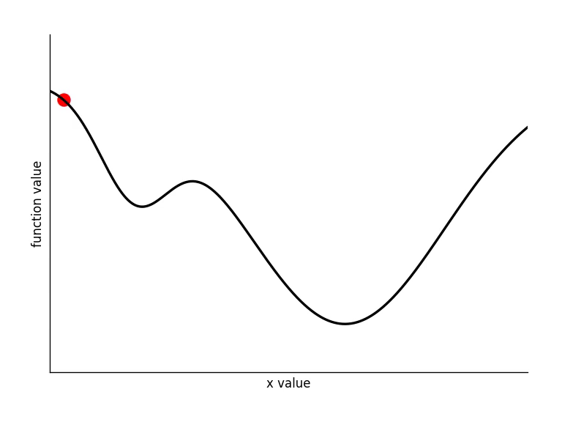
Gradient descent and local minima
Problem: $\min_{x∈K}f(x)$.
Gradient Descent: $x←x−η⋅∇f(x)$.
Running GD on a non-convex function may converge to a sub-optimal local minimum.
global minima
local minima

Slide 6
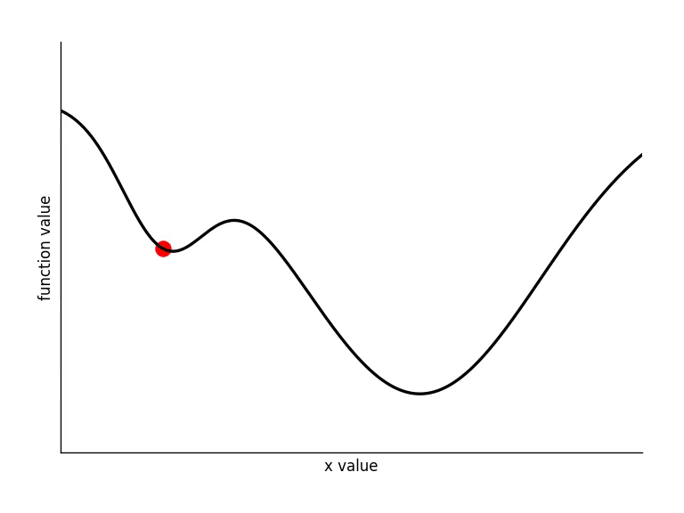
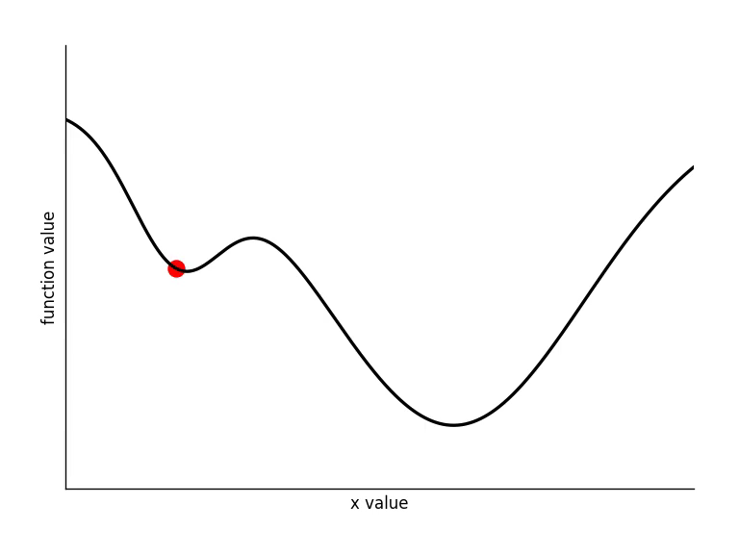
Adding noise to gradient descent
Draw a noise vector: $w∼N\left(0, I\right)$
Update: $x←x−η⋅(∇f\left(x\right)+σ⋅w)$
Noise will be vacuous when $η→0$.
$$η=0.05$$
$$η=0.01$$

Slide 7
Langevin Monte Carlo (LMC) (Roberts and Tweedie 1996)
Imitate Langevin Diffusion in physics
Choose temperature $T>0$ and stepsize $η>0$.
Iteratively update:
$$x←x−η⋅(∇f\left(x\right)+\sqrt{1/η}⋅\sqrt{2/T}⋅w) where w∼N(0,I)$$
Noise will dominate gradient when $η→0$.
LMC escapes local minima with small step sizes.

Slide 8
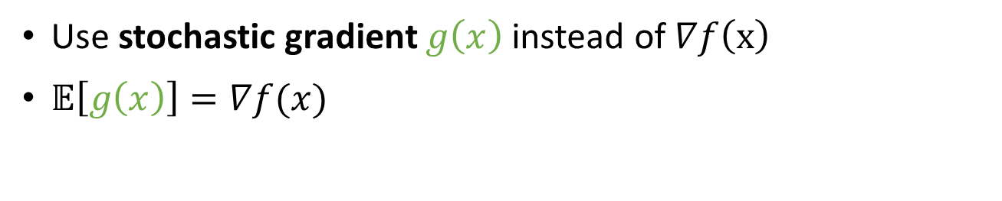
Stochastic Gradient Langevin Dynamics
(SGLD) (Welling and Teh 2011)
Use stochastic gradient $g\left(x\right)$ instead of $∇f\left(x\right)$
$𝔼\left[g\left(x\right)\right]=∇f(x)$
Iteratively update:
$$x←x−η⋅(g\left(x\right)+\sqrt{1/η}⋅\sqrt{2/T}⋅w) where w∼N(0,I)$$

Slide 9
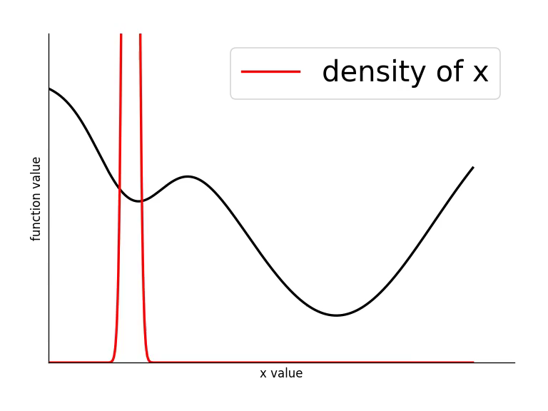

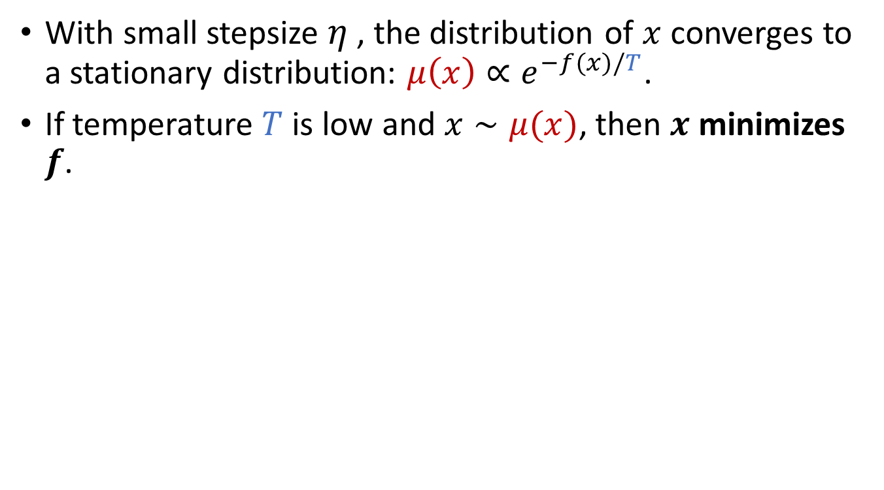
Stationary distribution
With small stepsize $η$, the distribution of $x$ converges to a stationary distribution: $μ\left(x\right)∝e^{−f(x)/T}$.
If temperature $T$ is low and $x∼μ(x)$, then $x$ minimizes $f$.
$$x←x−η⋅(g\left(x\right)+\sqrt{1/η}⋅\sqrt{2/T}⋅w)$$

Slide 10
SGLD in practice
SGLD outperforms SGD on several modern applications:
Prevent over-fitting (Welling and Teh 2011)
  Logistic regression
  Independent Components Analysis
Learn deep neural networks
  Neural programmer (Neelakantan et al. 2015)
  Neural random-access machines (Kurach et al. 2015)
  Neural GPUs (Kaiser and Sutskever 2015)
  Deep bidirectional LSTM (Zeyer et al. 2016)

Slide 11
Mixing time (time for converging to $μ$)
For smooth functions and small enough stepsize: SGLD asymptotically converge to $μ\left(x\right)∝e^{−f(x)/T}$. (Roberts and Tweedie 1996, Teh et al. 2016)
For convex $f$: the LMC mixing time is polynomial. (Bubeck et al. 2015, Dalalyan 2016)
For non-convex $f$: the SGLD mixing time was rigorously characterized (Raginsky et al 2017). However, it can be exponential in $d$ and $1/T$.

Slide 12
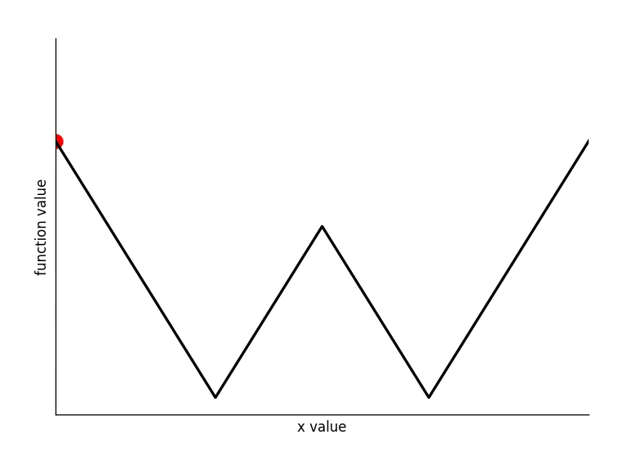
Mixing time is too pessimistic?
SGLD can hit a good solution much earlier than it converges to the stationary distribution.
Example: W-shaped function.

Slide 13

Our analysis
SGLD’s hitting time to an arbitrary target set.
Polynomial upper bounds on hitting time.
Application: non-convex empirical risk minimization.
target set

Slide 14
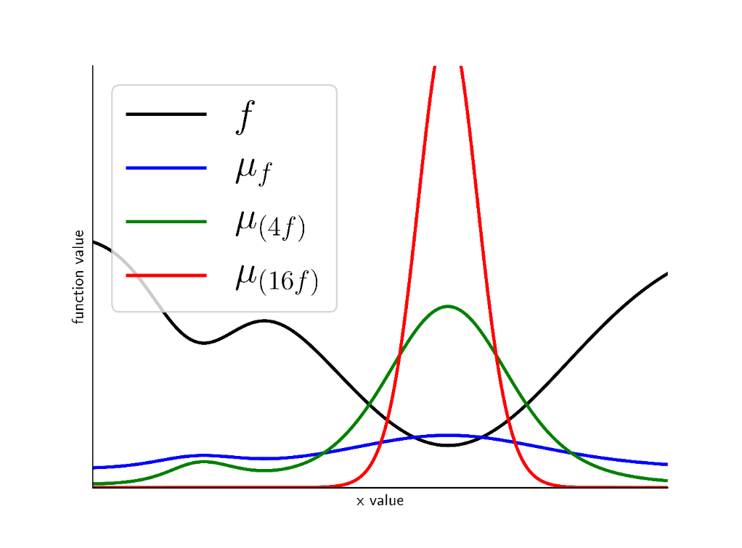
Preliminaries (I)
For any $f:K→ℝ$, define a probability measure:
$$μ_{f}\left(x\right)≝\frac{e^{−f\left(x\right)}}{\int_{K}{e^{−f\left(x\right)}}dx}∝e^{−f\left(x\right)}$$

Slide 15
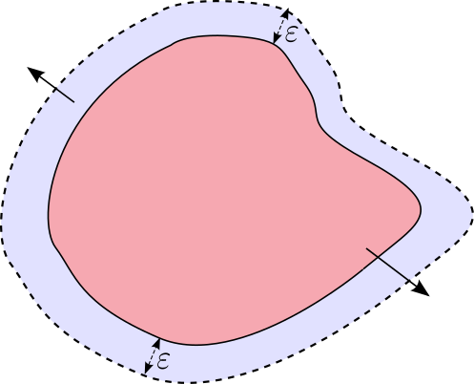
Preliminaries (II)
Given function $f$, for any set $A⊂K$, define its boundary measure (informally, surface area):
$$μ_{f}\left(∂A\right)≝\lim_{ε→0}{\frac{μ_{f}(shell of A)}{ε}}$$
shell
$$A$$

Slide 16
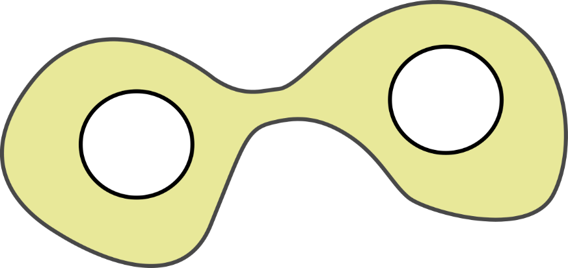
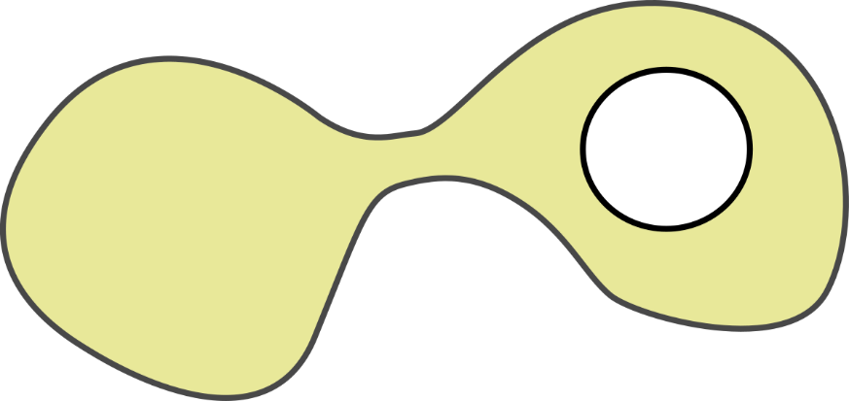
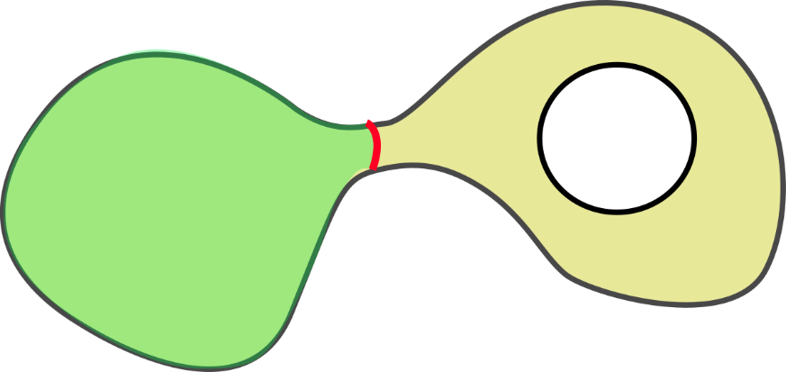
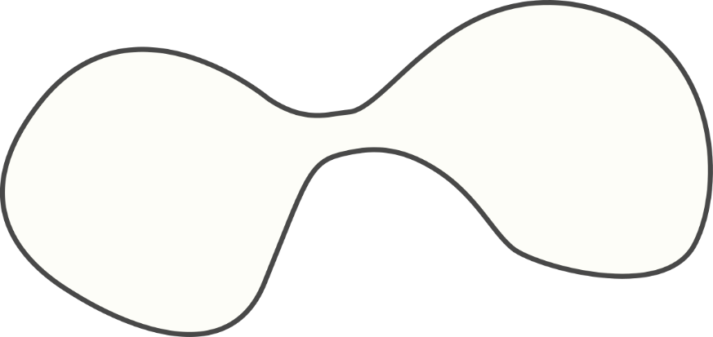
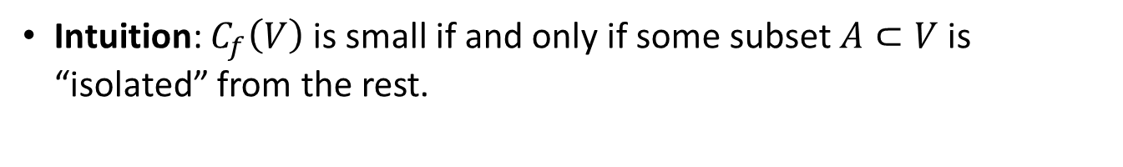
Restricted Cheeger Constant
Given $f$ and set $V⊂K$, define Restricted Cheeger Constant:
$$C_{f}\left(V\right)≝\inf_{A⊂V}\frac{μ_{f}(∂A)}{μ_{f}(A)}$$
surface area
volume
Intuition: $C_{f}\left(V\right)$ is small if and only if some subset $A⊂V$ is “isolated” from the rest.
$$K$$
$$∂A$$
$$V$$
$$V$$
$$A$$
$A$ is isolated, $C_{f}\left(V\right)$ is small
All subsets are well-connected, $C_{f}(V)$ is large
Claim: $C_{f/T}\left(V\right)$ measures the efficiency of SGLD (defined on $f$ and $T$) to escape the set $V$.

Slide 17
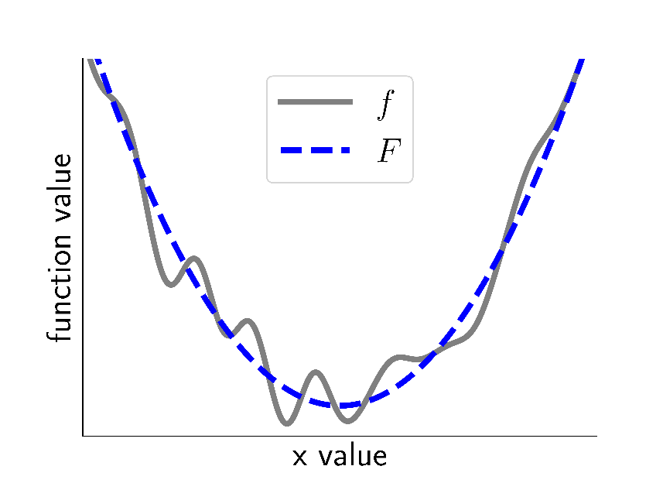
Stability property
If two functions are pointwise close, then their Restricted Cheeger Constants are close.
Lemma If $\sup_{x∈K}{|f\left(x\right)−F(x)|}≤T$, then:
  $\max\left\{\frac{C_{f/T}\left(V\right)}{C_{F/T}\left(V\right)},\frac{C_{F/T}\left(V\right)}{C_{f/T}\left(V\right)}\right\}=O(1)$
If $f≈F$, the efficiency of SGLD on $f$ and $F$ are almost equivalent.
Our strategy: Run SGLD on $f$, but analyze its efficiency on $F$
Example: $f=$ empirical risk, $F=$ population risk

Slide 18
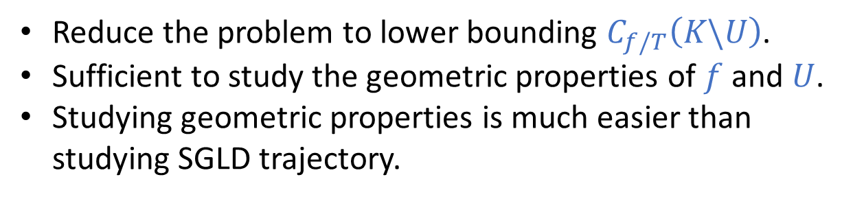
General theorem
Theorem For arbitrary $f$ and target set $U⊂K$, SGLD’s hitting time to $U$ satisfies (with high probability) :
$$hitting time≤\frac{poly(d)}{{\left(C_{f/T}\left(K\backslash U\right)\right)}^{2}}$$
Reduce the problem to lower bounding $C_{f/T}\left(K\backslash U\right)$.
Sufficient to study the geometric properties of $f$ and $U$.
Studying geometric properties is much easier than studying SGLD trajectory.

Slide 19
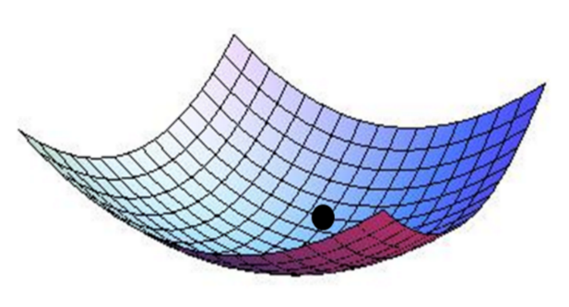
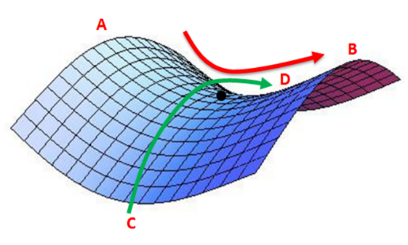
Lower bounds on Restricted Cheeger Constant
For arbitrary smooth function $f$:
Lemma Under following conditions:
$U$ = {$ε$-approximate local minimum}, and
$T≤O\left(\frac{ε^{2}}{poly\left(smoothness params of f \right)}\right)$
We have lower bound: $C_{f/T}\left(K\backslash U\right)=Ω\left(\sqrt{ε}\right)$.
local minima $x∈U$
saddle point $x∉U$

Slide 20
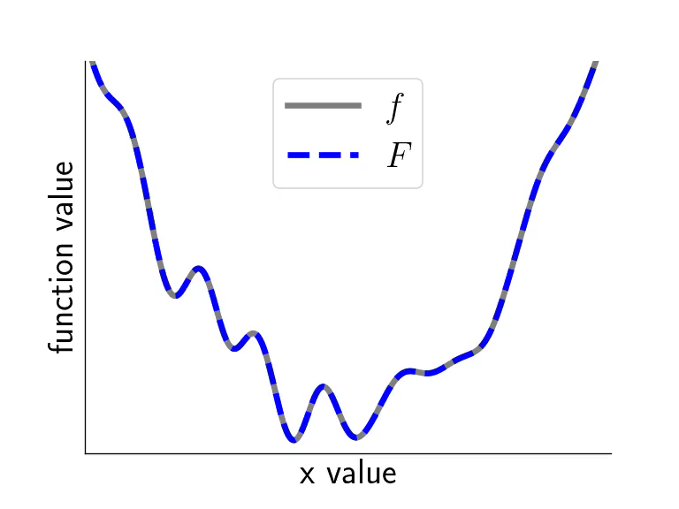
Lower bound + General theorem + Stability property
Theorem Run SGLD on $f$. For proxy function $F≈f$ satisfying:
$F$ is smooth, and
${\left\|f−F\right\|}_{∞}=O\left(\frac{ε^{2}}{poly\left(smoothness params of F \right)}\right)$
SGLD hits an $ε$-approximate local minimum of $F$ in poly-time.
Function $F$: a perturbation of $f$ that eliminates as many local minima as possible.
SGLD efficiently escapes all local minima that don’t exist in $F$.

Slide 21
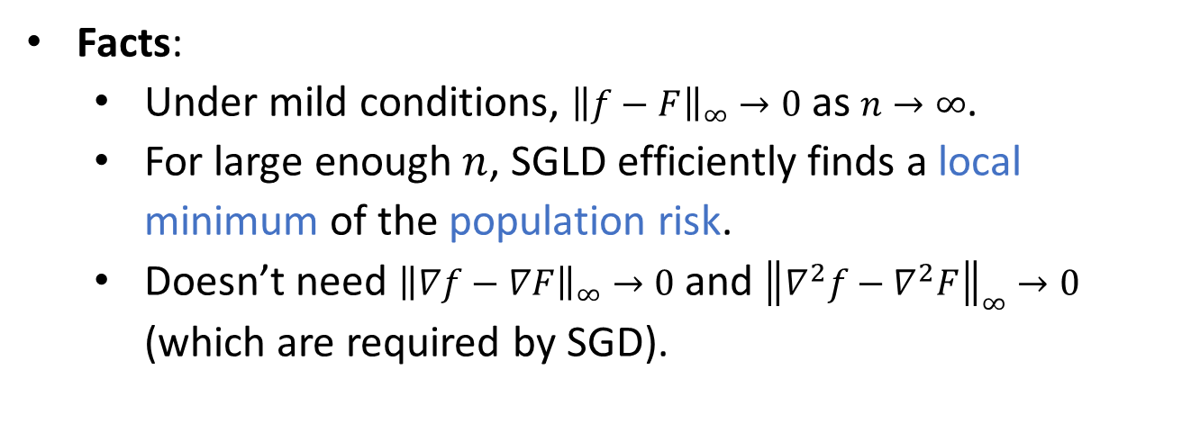
SGLD for empirical risk minimization
Empirical risk minimization:
  Empirical risk $f\left(x\right)=\frac{1}{n}\sum_{i=1}^{n}{ℓ(x;a_{i})}$ for $a_{1},…,a_{n}∼ℙ$.
  Population risk $F\left(x\right)=𝔼_{a∼ℙ}\left[ℓ\left(x;a\right)\right]$
Facts:
  Under mild conditions, ${\left\|f−F\right\|}_{∞}→0$ as $n→∞$.
  For large enough $n$, SGLD efficiently finds a local minimum of the population risk.
  Doesn’t need ${\left\|∇f−∇F\right\|}_{∞}→0$ and ${\left\|∇^{2}f−∇^{2}F\right\|}_{∞}→0$ (which are required by SGD).

Slide 22
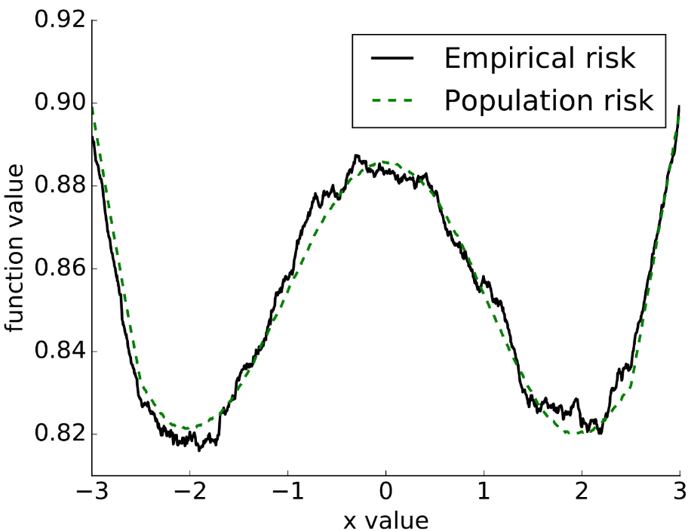
Learning linear classifier with 0-1 loss
Assumption: Labels corrupted by Massart noise ($1/2−β$).
(Awasthi et al 2016): Learns in $d^{exp⁡(poly(1/β))}$ time.
SGLD: Learns in $poly(d,1/β)$ time.
One dimensional 0-1 loss, sample size $n=5,000$

Slide 23
Summary
SGLD is asymptotically optimal for non-convex optimization; But its mixing time can be exponentially long.
The hitting time inversely depends on the Restricted Cheeger Constant.
Under certain conditions, the hitting time can be polynomial.
If $f≈F$, then running SGLD on $f$ hits optimal points of $F$.
SGLD is more robust than SGD for empirical risk minimization.

Slide 24
Part II
Convexified Convolutional Neural Networks

Slide 25
Why convexify CNN?
CNN uses “convolutional filters” to extract local features.
Generalizes better than fully-connected NNs.
Requires non-convex optimization.
What if I want a globally optimal solution?
ScatNet (Bruna and Mallat 2013)
PCANet (Chan et al. 2014)
Convolutional kernel networks (Mairal et al. 2014)
CNN with random filters (Daniely et al. 2016)
However, none of them is guaranteed to be as good as the classical CNN.
Notes:
The first question to ask is why to we want to convexify convolutional neural networks.
In many applications, CNN has better empirical performance than fully-conntected NN.
Essentially, this is because that CNN has the so-called convolutional filters. These filters able to extracts local features from the image.
They reduce the number of parameters and enables CNNs to generalize better than fully-connected neural networks.
As we all know, CNN are learnt by non-convex optimization, which only guarantees local optimality.
But if you want global optimality, there are several variants of CNN globally optimal parameters can be computed.
But unfortunately, none of these models are guaranteed to be as good as the classical CNN model in terms of classification accuracy.

Slide 26
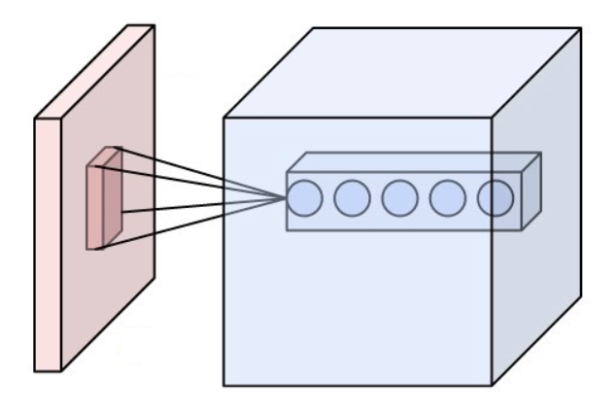
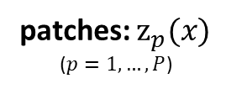
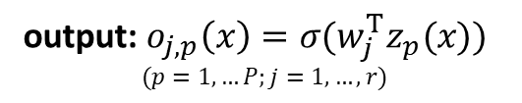

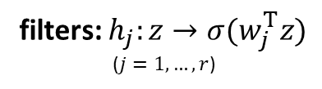
CNN: convolutional layer
A convolutional layer applies non-linear filters to a sliding window of patches.
filters: $h_{j}:z→σ(w_{j}^{T}z)$
($j=1,…,r$)
input: $x$
output: $o_{j,p}\left(x\right)=σ(w_{j}^{T}z_{p}(x))$
$$(p=1,…P;j=1,…,r)$$
patches: $z_{p}(x)$
($p=1,…,P$)
A convolutional layer

Slide 27
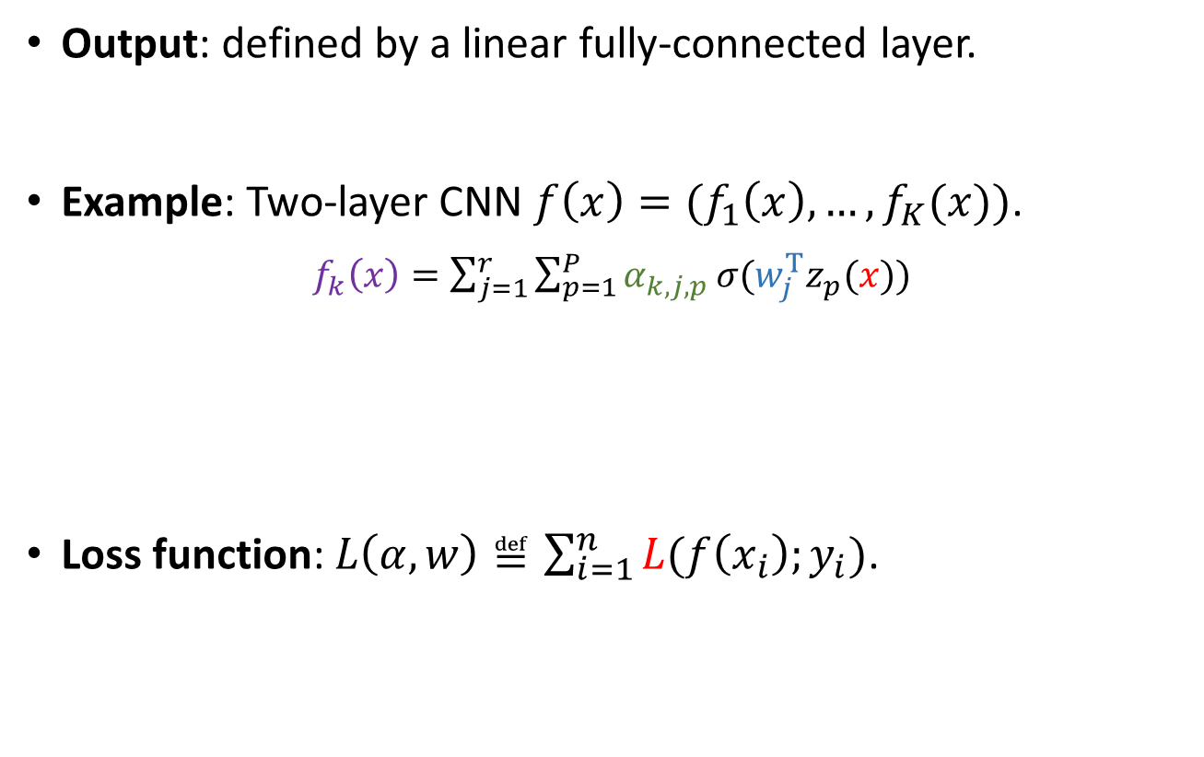
CNN: output and loss function
Output: defined by a linear fully-connected layer.
Example: Two-layer CNN $f\left(x\right)=(f_{1}\left(x\right),…,f_{K}(x))$.
$f_{k}\left(x\right)=\sum_{j=1}^{r}{\sum_{p=1}^{P}{α_{k,j,p}}σ(w_{j}^{T}z_{p}(x))}$
Loss function: $L\left(α,w\right)≝\sum_{i=1}^{n}{L(f\left(x_{i}\right);y_{i})}$.
image
output
output
parameters
filter
parameters
cross-entropy loss / hinge loss / squared loss …

Slide 28
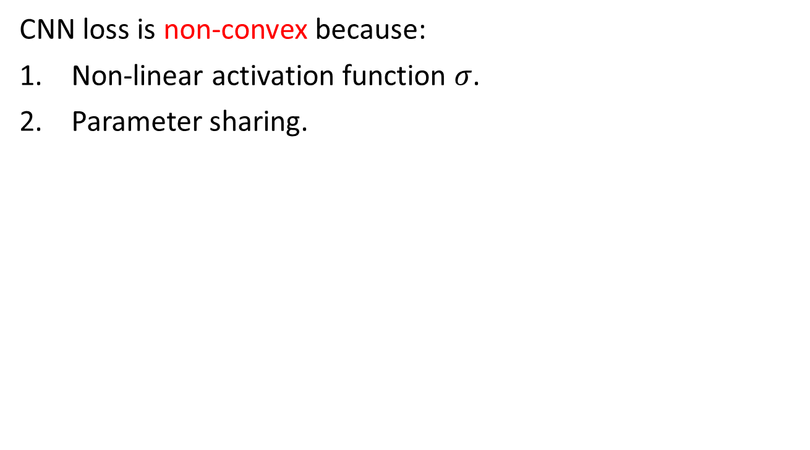
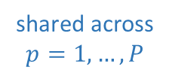
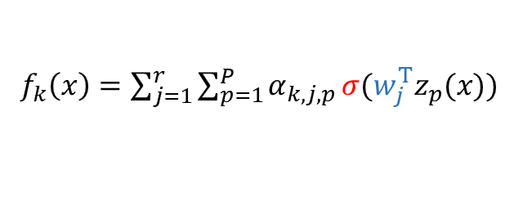
Challenges
CNN loss is non-convex because:
Non-linear activation function $σ$.
Parameter sharing.
$f_{k}\left(x\right)=\sum_{j=1}^{r}{\sum_{p=1}^{P}{α_{k,j,p}}σ(w_{j}^{T}z_{p}(x))}$
non-linear
shared across
$$p=1,…,P$$
Question: How to train CNN by convex optimization
but preserving non-linear filters and parameter sharing?

Slide 29

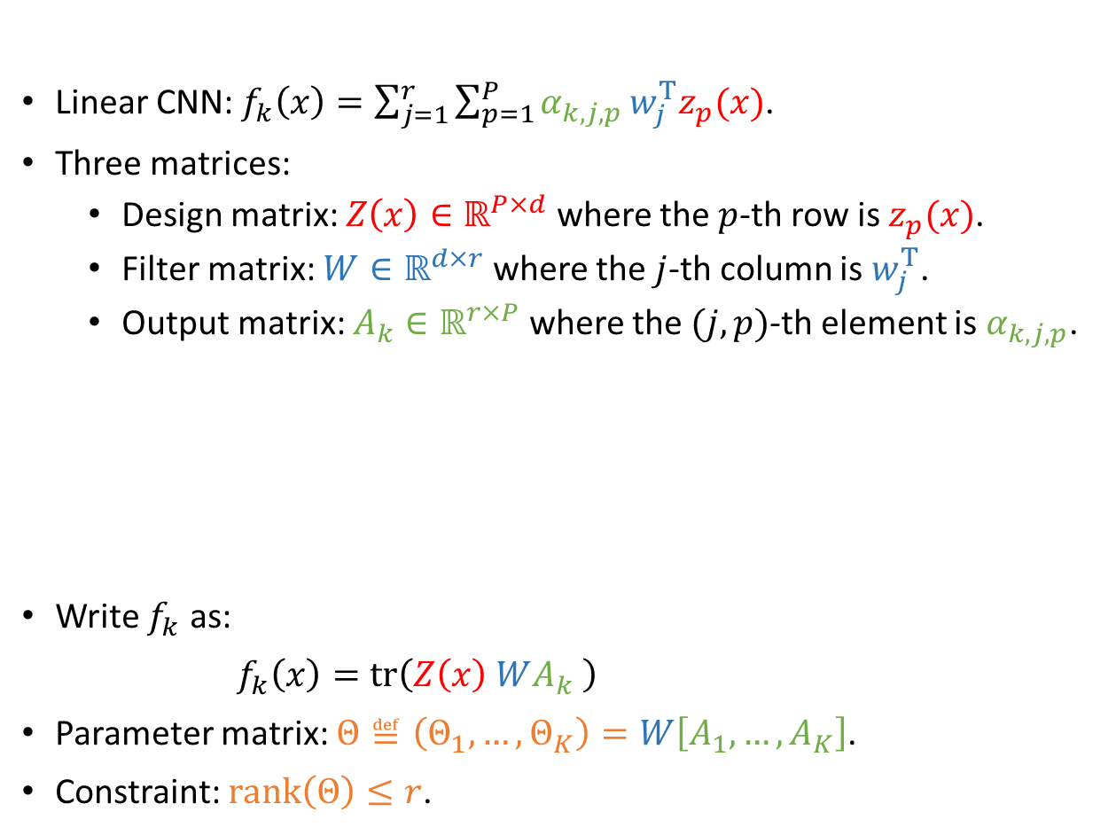



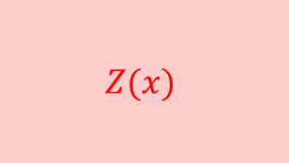


Convexifying linear two-layer CNNs (I)
Linear CNN: $f_{k}\left(x\right)=\sum_{j=1}^{r}{\sum_{p=1}^{P}{α_{k,j,p}}w_{j}^{T}z_{p}(x)}$.
Three matrices:
  Design matrix: $Z\left(x\right)∈ℝ^{P×d}$ where the $p$-th row is $z_{p}(x)$.
  Filter matrix: $W∈ℝ^{d×r}$ where the $j$-th column is $w_{j}^{T}$.
  Output matrix: $A_{k}∈ℝ^{r×P}$ where the $(j,p)$-th element is $α_{k,j,p}$.
Write $f_{k}$ as:
${ f}_{k}\left(x\right)=tr\left(Z\left(x\right) WA_{k} \right)$
Parameter matrix: $Θ≝\left(Θ_{1},…,Θ_{K}\right)=W\left[A_{1},…,A_{K}\right]$.
Constraint: $rank\left(Θ\right)≤r$.
$$W$$
$$Z(x)$$
$$f_{k}\left(x\right)=tr$$
$$×$$
$$×$$
$$A_{k}$$
filter outputs
$$=tr\left(Z\left(x\right) Θ_{k} \right)$$

Slide 30


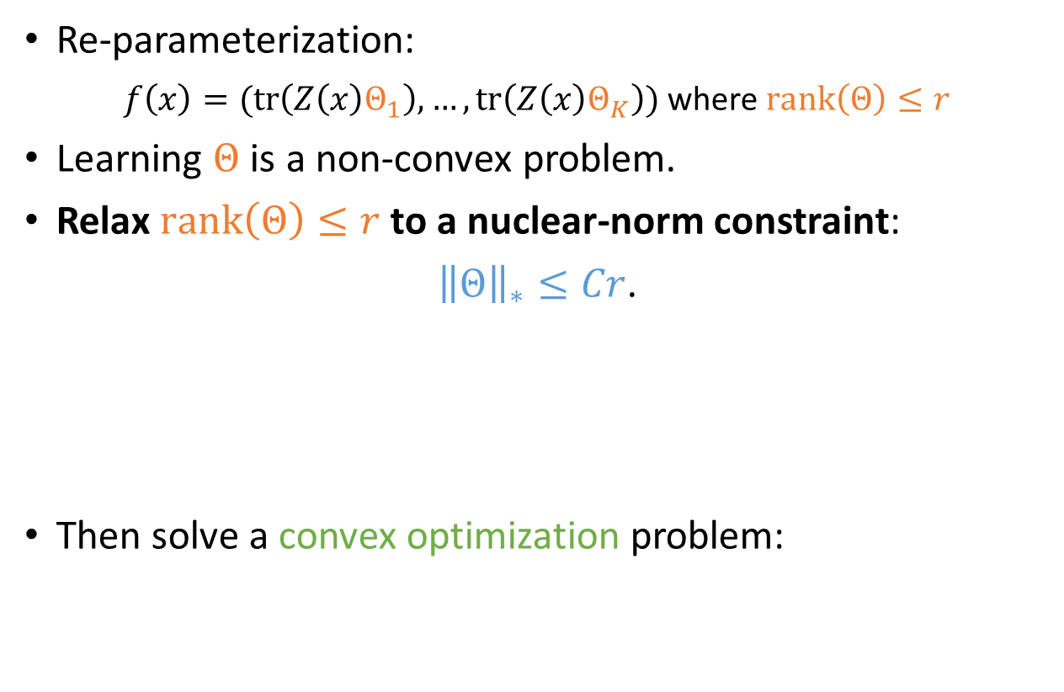
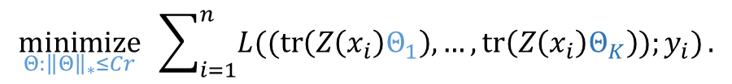
Convexifying linear two-layer CNNs (II)
Re-parameterization:
$f\left(x\right)=(tr\left(Z\left(x\right)Θ_{1}\right),…,tr\left(Z\left(x\right)Θ_{K}\right))$ where $rank\left(Θ\right)≤r$
Learning $Θ$ is a non-convex problem.
Relax $rank\left(Θ\right)≤r$ to a nuclear-norm constraint:
${\left\|Θ\right\|}_{∗}≤Cr$.
Then solve a convex optimization problem:
Relax to a convex constraint
$$\underset{Θ:{\left\|Θ\right\|}_{∗}≤Cr}{minimize}{ \sum_{i=1}^{n}{L((tr\left(Z\left(x_{i}\right)Θ_{1}\right),…,tr\left(Z\left(x_{i}\right)Θ_{K}\right));y_{i})}}.$$

Slide 31
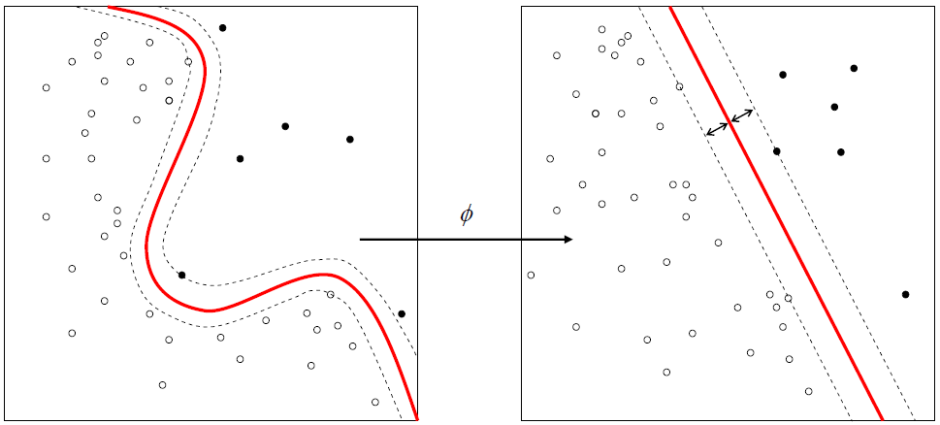
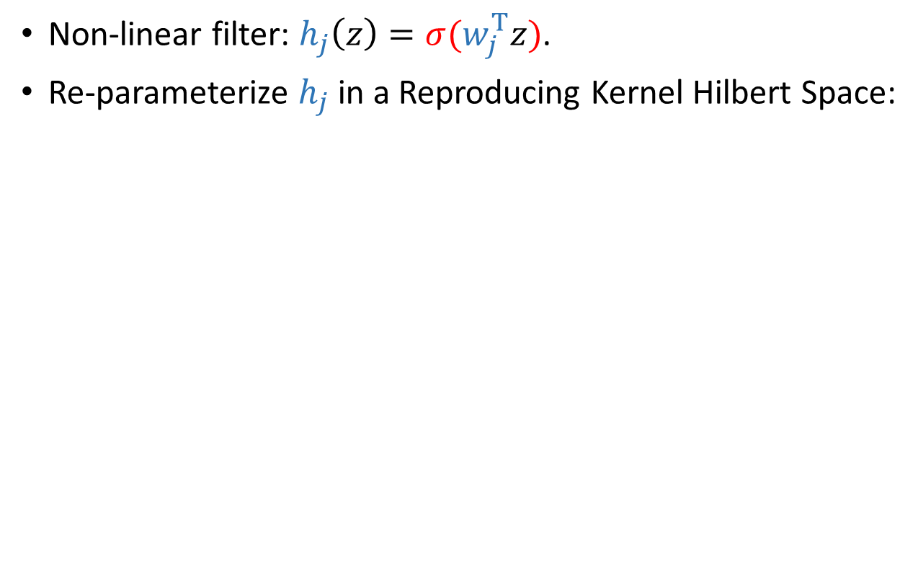

Convexifying non-linear two-layer CNNs (I)
Non-linear filter: $h_{j}\left(z\right)=σ(w_{j}^{T}z)$.
Re-parameterize $h_{j}$ in a Reproducing Kernel Hilbert Space:
$h_{j}\left(z\right)=〈β_{j},φ\left(z\right)〉$ where $〈φ\left(z^{′}\right),φ\left(z^{′′}\right)〉=k(z^{′},z′′)$
non-linear mapping
kernel function
non-linear CNN filter $⇒$ linear RKHS filter
Notes:
What if the activation function is non-linear
For non-linear filters, our general idea is to reparameterize it in order to convert it to be a linear filter.
In order to do this, we introduce Reproducing Kernel Hilbert Space
A RKHS is a function space that is induced by some kernel function k
Every valid kernel function can be factorized in the following form: it is equal to the inner product of two non-linear mappings.
On the other hand, if h_j belongs to the RKHS, then it can be expressed has an inner product of some vector beta_j, and the non-linear mapping phi(z)
In this way, we have converted a non-linear filter into a linear filter, by pushing the non-linearlity from outside of the inner product to inside of the inner product.
This trick has been widely used by kernel methods. It shows that by mapping to a higher dimensional space, a non-linear function can be transformed into a linear function.

Slide 32
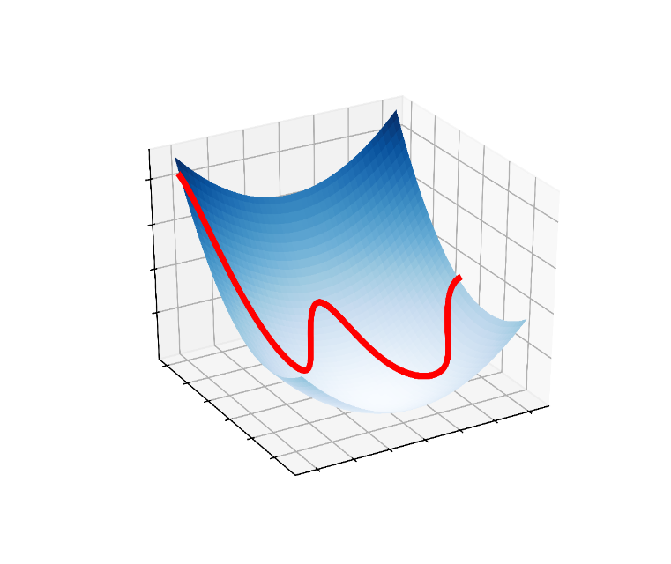
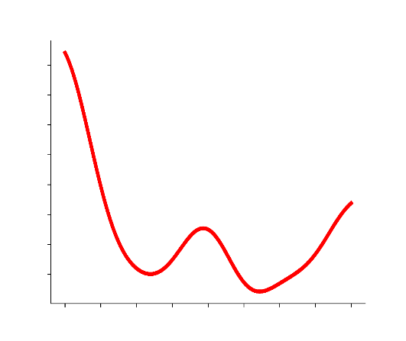
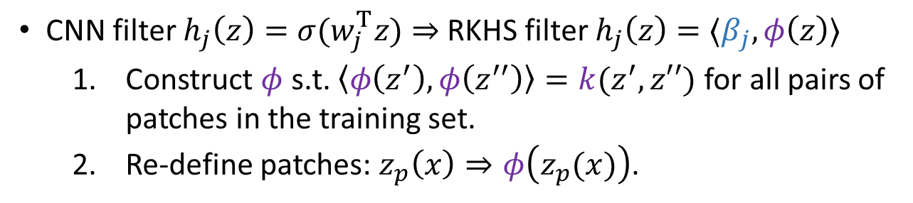



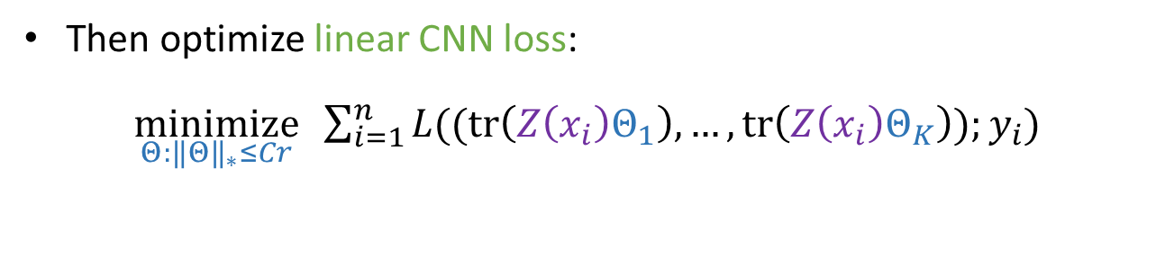
Convexifying non-linear two-layer CNNs (II)
CNN filter $h_{j}\left(z\right)=σ(w_{j}^{T}z)$ $⇒$ RKHS filter $h_{j}\left(z\right)=〈β_{j},φ\left(z\right)〉$
  Construct $φ$ s.t. $〈φ\left(z^{′}\right),φ\left(z^{′′}\right)〉=k(z^{′},z′′)$ for all pairs of patches in the training set.
  Re-define patches: $z_{p}\left(x\right)⇒φ\left(z_{p}(x)\right)$.
re-parameterization defines a convex loss
$$β_{1}$$
$$w$$
$$β_{2}$$
Then optimize linear CNN loss:
$\underset{Θ:{\left\|Θ\right\|}_{∗}≤Cr}{minimize}{ \sum_{i=1}^{n}{L((tr\left(Z\left(x_{i}\right)Θ_{1}\right),…,tr\left(Z\left(x_{i}\right)Θ_{K}\right));y_{i})}}$
Notes:
Having obtained a linear filter, everything reduces to the case of linear CNN.
We solve the same convex optimization problem. The only difference is that the design matrix Z(x) needs to be re-defined, because a non-linear mapping has been applied to every patch.
Precisely, we construct the design matrix as following. First, a kernel function is chosen. Then, we construct a mapping phi which satisfies this property for all patches in the dataset. This step can be done in polynomial time.
Finally, we apply the mapping to every patch to re-define the design matrix.
After we learn the parameter matrix \Theta, we follow the same steps as in the linear CNN case, to plug it to the CNN output function, then we are able to make predictions.

Slide 33
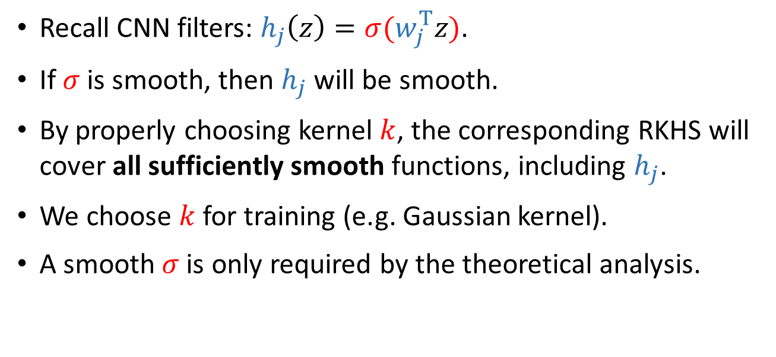
What filters can be re-parameterized?
Recall CNN filters: $h_{j}\left(z\right)=σ(w_{j}^{T}z)$.
If $σ$ is smooth, then $h_{j}$ will be smooth.
By properly choosing kernel $k$, the corresponding RKHS will cover all sufficiently smooth functions, including $h_{j}$.
We choose $k$ for training (e.g. Gaussian kernel).
A smooth $σ$ is only required by the theoretical analysis.
Notes:
There is one remaining problem: why can we re-parameterize non-linear filters in a RKHS, and what are the assumptions on these filters.
We are going to answer this question on this slide.
Recall that the filter is a linear transformation followed by a non-linear activation.
If the activation function is smooth, then the filter will be smooth.
On the other hand, we know that certain RKHSs contains all sufficiently smooth functions. As a result, they will contain the filter if the activation function is smooth enough.
The first example is the Gaussian kernel, we are able to show that the corresponding RKHS contains filters that are activated by the following sigma: it can be any polynomial function, or the sine function. Both have been used in practice to activate neural networks.
If we choose another kernel called the inverse-polynomial kernel, then it supports not only the above two activations, but two more activations. They are the ERF function that approximates the sigmoid function, and a smooth hinge that approximates the ReLU function.
So we see that by properly choosing a kernel function, we are able to re-parametrize filters that are activated by a broad class of activations function, which people use in practice.

Slide 34
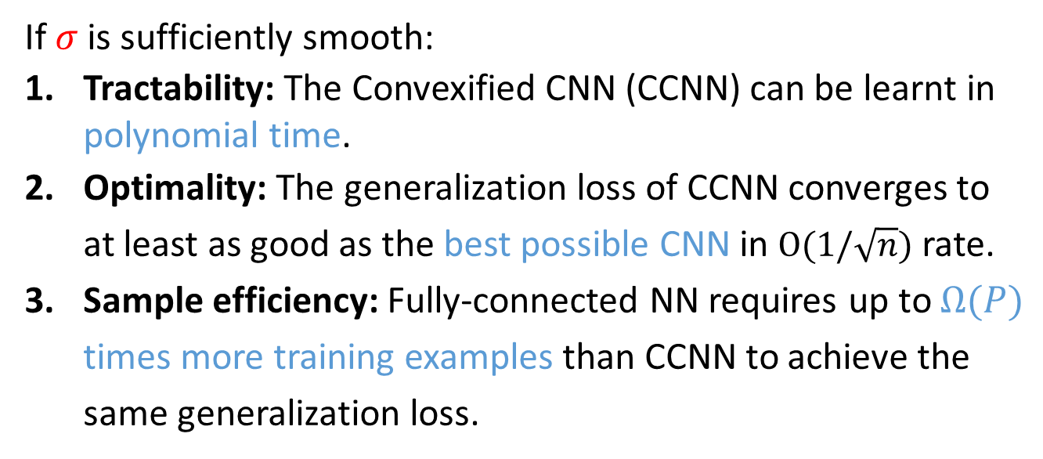
Theoretical results for convexifying two-layer CNN
If $σ$is sufficiently smooth:
Tractability: The Convexified CNN (CCNN) can be learnt in polynomial time.
Optimality: The generalization loss of CCNN converges to at least as good as the best possible CNN in $O(1/\sqrt{n})$ rate.
Sample efficiency: Fully-connected NN requires up to $Ω(P)$ times more training examples than CCNN to achieve the same generalization loss.

Slide 35
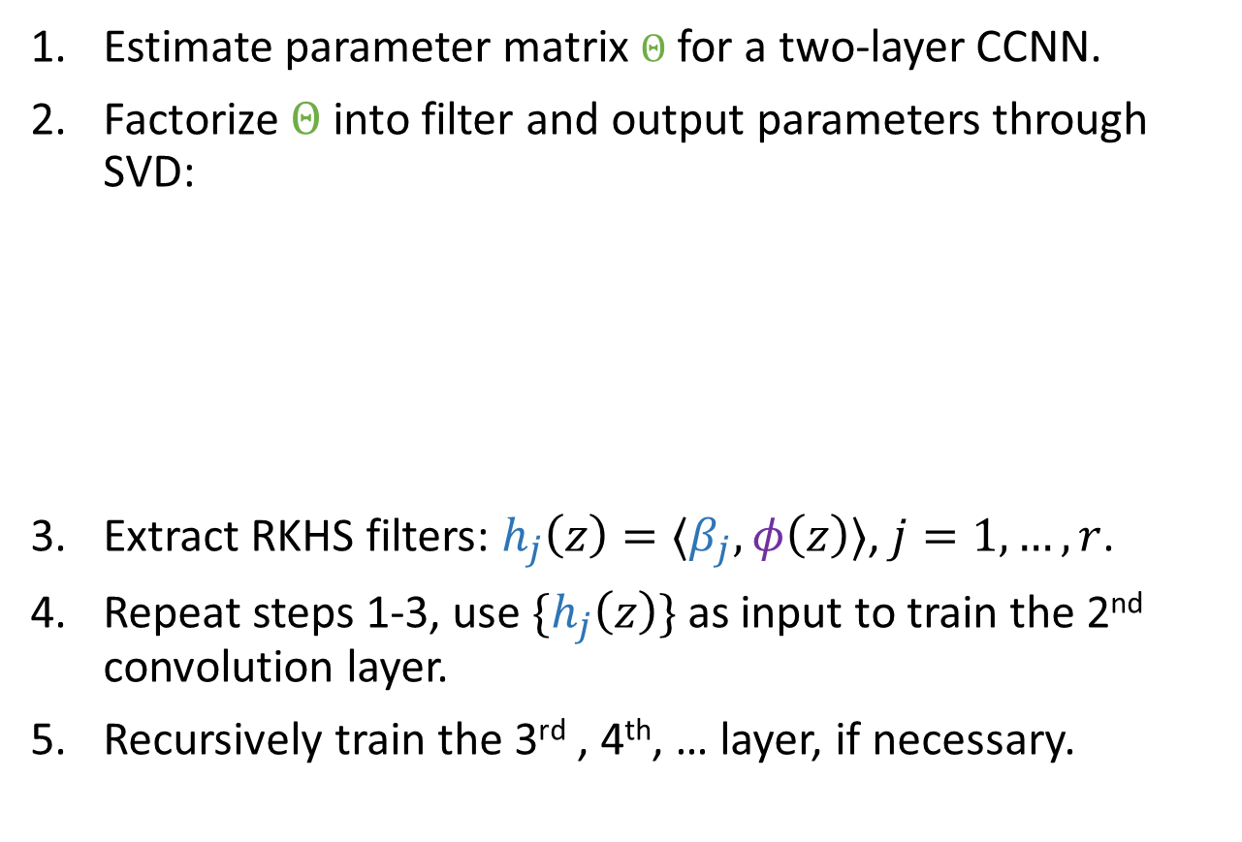
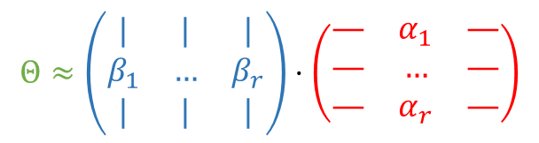
Multi-layer CCNN
Estimate parameter matrix $Θ$ for a two-layer CCNN.
Factorize $Θ$ into filter and output parameters through SVD:
Extract RKHS filters: $h_{j}\left(z\right)=〈β_{j},φ\left(z\right)〉$, $j=1,…,r$.
Repeat steps 1-3, use $\{h_{j}\left(z\right)\}$ as input to train the 2nd convolution layer.
Recursively train the 3rd , 4th, … layer, if necessary.
$$Θ≈\left(\begin{matrix}| & | & | \\ β_{1} & … & β_{r} \\ | & | & |\end{matrix}\right)⋅\left(\begin{matrix}— & α_{1} & — \\ — & … & — \\ — & α_{r} & —\end{matrix}\right)$$
filter
parameters
output
parameters
Notes:
Unfortunately, for training the second convolution layer, there is no theoretical guarantee like we had for training a single convolution layer.
This is because that the algorithm is greedy, so it is not guaranteed to be optimal
However, we have done experiments to show that training deeper convexified CNNs helps to improve the performance quite a lot, and these convexifiec versions are comparable to the canonical CNNs of the same depth, even when the model contains multiple layers of convolution.

Slide 36
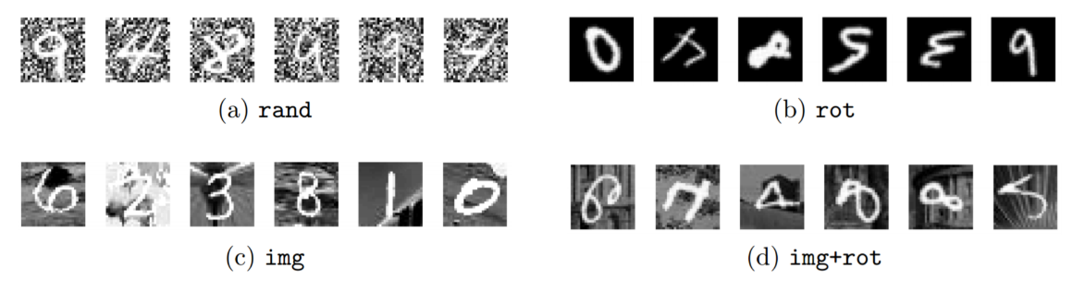
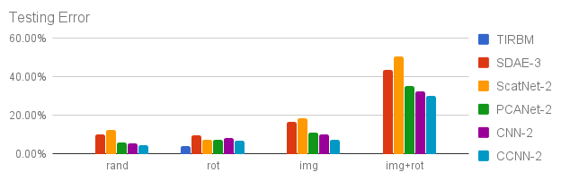
Empirical results on multi-layer CCNN
MNIST variations (random noise, image background, random rotation…).
10k/2k/50k examples for training/validation/testing:
(CCNN outperforms state-of-the-art results on rand, img and img+rot)

Slide 37

Summary
Two challenges of convexifying CNN: non-linear activation and parameter sharing.
CCNN is a combination of two ideas:
  CNN filters $⇒$ RKHS filters.
  Parameter sharing $⇒$ nuclear-norm constraint.
Two-layer CCNN: strong optimality guarantee.
Deeper CCNN: convexification improves empirical results.

Slide 38

Final summary of this talk
Non-convex optimization is hard, but we don’t always need to solve non-convex optimization.
  Optimization $⇒$ Diffusion process: SGD $⇒$ SGLD.
  Non-linear / Low-rank $⇒$ RKHS / nuclear-norm: CNN $⇒$ CCNN.
High-level open question: is there a better abstraction for machine learning?

